Slide 1
Charz Character Recognition Using Neural network
-19it007 Rohan Bangoriya
-19it018 Rut Butani

Slide 2
Content
Introduction.
Required Frameworks.
CNN.

Slide 3
What is character recognition
Character recognition is a process which allows computer to recognize hand written or printed characters such as numbers or letters and to change them into a form that the computer can use.
It is a optical process used to detect the shape of individual characters printed or written on paper.

Slide 4
The Optical Character Recognition (OCR) takes an optical images of character as input and produces the corresponding character as output. It has a wide range of applications including traffic surveillance, robotics, digitization of printed articles, etc. The OCR can be implemented by using Convolutional Neural Network (CNN), which is a popular deep neural network architecture.

Slide 5
Required frameworks
NumPy
cv2 (OpenCV)
Keras
TensorFlow (Keras uses TensorFlow in backend and for some image pre-processing)
Matplotlib
Pandas

Slide 6
CNN- Convolution neural network
Convolutional neural networks (CNN) are one of the most popular models used today. This neural network computational model uses a variation of multilayer perceptron and contains one or more convolutional layers that can be either entirely connected or pooled.
These convolutional layers create feature maps that record a region of image which is ultimately broken into rectangles and sent out for nonlinear processing.
CNN is primarily used in object recognition by taking images as input and then classifying them in a certain category.

Slide 7
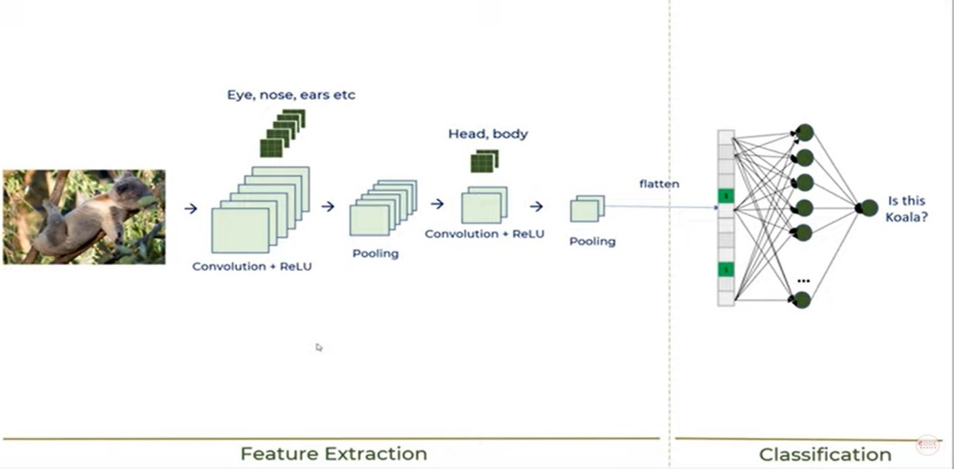
Workflow of CNN

Slide 8
Convolution (Feature filter):
Convolutional layer detects the features of character or image.
ReLu:
Introduces non-linearity.
Speeds Up training, faster to compute.
Pooling Layer:
Pooling layer reduces the size of image of character.
Reduces dimensions and computation.

Slide 9
Advantages of CNN
Very high accuracy in image recognition problems.
Automatically detects the important features without any human supervision.
Weight sharing.
disadvantages of CNN
CNN don’t encode the position and orientation of object.
Lack of ability to be spatially invariant to the input data.
Lots of training data is required.

Slide 10
Thank You

