Slide 1
Software Group Project
-Rohan Bangoriya(19IT007)
-Rut Butani(19IT018)

Slide 2
Ringer : Android Application
Music plays an very important role in one’s life.
Music elevates mood and helps relieve feelings of anxiety and depression.
It simulates memories.
It manages the pain on a person.
It reduces stress.

Slide 3
Ringer : Android Application
It is an Android based mobile application.
First thing First so user has to create account on it and has to login in it.
There are two login option:-
- by using email id.
- by using OTP.

Slide 4
Ringer : Android Application
Prerequisite:-
- we will use Android Studio as an IDE.
- JAVA as an backhand language.
-XML for designing purpose.

Slide 5
Ringer : Android Application
Functionality:-
-we will use the concept of:-
- Login Identification
-Internet connectivity
-Database(Google Firebase)
- and some more…

Slide 6
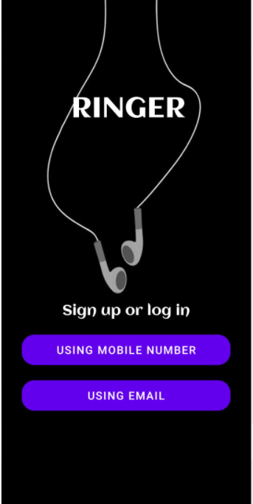
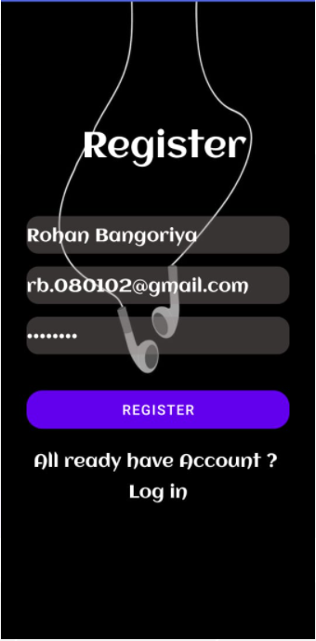


Slide 7
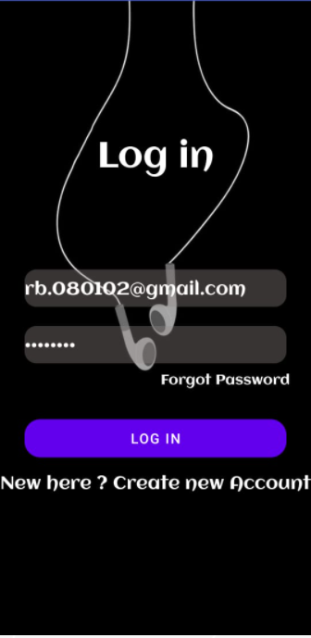
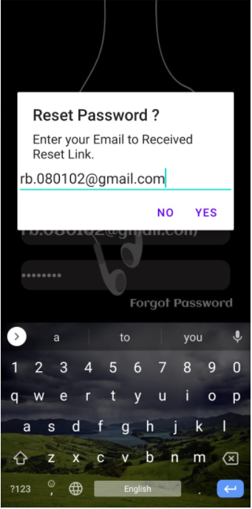
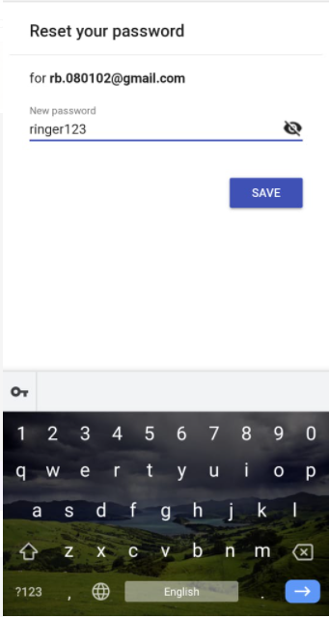

Slide 8
