Slide 1
INTERNSHIP REPORT PRESENTATION
Python Developer Internship
PY
Codec Technologies
1-Month Internship • Python Development
Rohan Patil
IILM University Greater Noida B.Tech CSE
July - August 2026

Slide 2
ABOUT THE STUDENT
Candidate Profile
•
Roll Number
25SCS1003005701
[YOUR NAME]
•
Institute
IILM University Greater Noida
[B.Tech / BCA / MCA] Computer Science
•
Programme
B.Tech CSE
•
Internship Domain
Python Development
•
Duration
1 Month
Python Developer Internship • Internship Report
02

Slide 3
ABOUT THE INTERNSHIP
Codec Technologies — Python Developer Internship
The one-month internship is structured around practical Python development, moving from fundamentals and data structures to advanced Python, web development, data handling, APIs, debugging and a final project.
01
Python Foundations
02
Advanced Development
03
Data, APIs & Project
Syntax, variables, data types, control flow, functions, exceptions and core data structures.
OOP, modules, packages, file handling, decorators, generators and Flask web development.
Pandas, data cleaning, visualization, REST APIs, requests, debugging and a final project.
Python Developer Internship • Internship Report
03

Slide 4
PROBLEM STATEMENT
Bridging Theory and Practical Python Development
Academic learning often introduces programming concepts separately. The internship provided a structured path to connect those concepts into practical development workflows.
01
LEARN
02
BUILD
03
INTEGRATE
04
APPLY
Understand Python concepts
→
Write and structure programs
→
Work with files, web & APIs
→
Develop a practical project
Python Developer Internship • Internship Report
04

Slide 5
INTERNSHIP OBJECTIVES
What the Internship Set Out to Achieve
PY
Python Fundamentals
DS
Data Structures
OP
Advanced Python
Build a strong foundation in Python syntax, control flow, functions and exceptions.
Work confidently with lists, tuples, sets, dictionaries and comprehensions.
Understand OOP, modules, packages, files and selected advanced concepts.
FL
Web Development
API
Data & APIs
PR
Practical Project
Learn Flask basics, routes, requests and templates.
Use Pandas and integrate REST APIs with HTTP requests.
Apply the learned concepts to a simple internship project.
Python Developer Internship • Internship Report
05

Slide 6
TECHNOLOGIES & TOOLS
The Toolkit Behind the Internship
•
Python
•
VS Code / IDE
•
Flask
•
Pandas
Core programming language
Development and execution environment
Web application framework
Data analysis and manipulation
•
Requests
•
CSV / JSON
•
Git / Version Control
•
Project Tools
HTTP and API integration
Structured data and file handling
Use if applicable to your work
Add any tools actually used
Python Developer Internship • Internship Report
06

Slide 7
PROJECT ARCHITECTURE
From Input to Working Application
Use this as the high-level workflow for the internship project. Replace labels with your exact project flow if needed.
1
INPUT
2
PYTHON LOGIC
3
DATA LAYER
4
WEB / API
5
OUTPUT
User / File / API data
→
Processing & business rules
→
CSV / JSON / Pandas
→
Flask routes & requests
→
Result / report / application
Python Developer Internship • Internship Report
07

Slide 8
METHODOLOGY
The 4-Week Learning Journey
1
WEEK 1
2
WEEK 2
3
WEEK 3
4
WEEK 4
Python Fundamentals
Advanced Python
Data & APIs
Final Project
Syntax, control flow, functions and data structures
OOP, modules, files and Flask fundamentals
Pandas, visualization, REST APIs and debugging
Apply concepts in a practical Python project
Python Developer Internship • Internship Report
08

Slide 9
INTERNSHIP PROJECT
API Performance Monitor
Project description: A Python-based web application that monitors API performance by measuring response time, tracking HTTP status codes, recording successful and failed requests, and displaying performance metrics through a Flask dashboard.
01
Objective
02
Technologies
03
Key Features
• API endpoint testing • Response-time measurement • HTTP status monitoring • Success/failure tracking • SQLite logging • Performance metrics dashboard
To develop a monitoring system that helps analyze API reliability and response performance.
Python • Flask • Requests • SQLite • HTML/CSS
Python Developer Internship • Internship Report
09

Slide 10
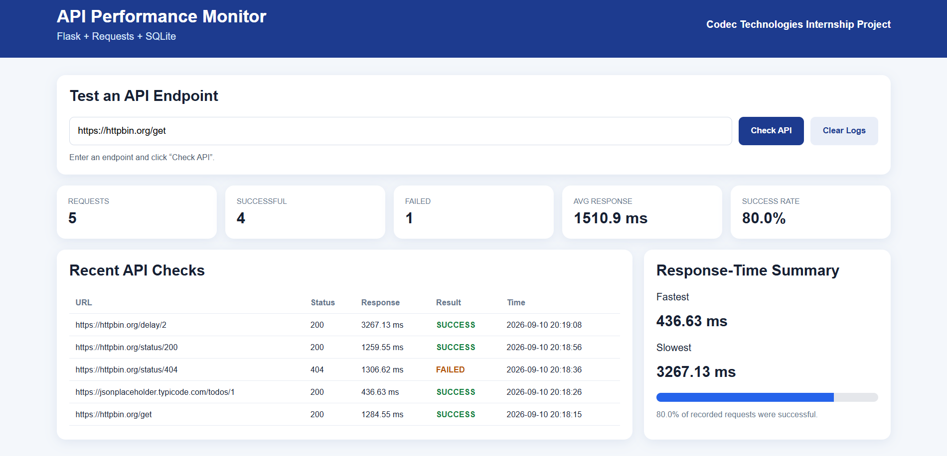

Slide 11
EXPECTED / ACHIEVED OUTCOMES
Skills & Capabilities Gained
• Stronger understanding of Python programming fundamentals
• Practical use of data structures, functions and OOP
• Experience with file handling and structured data
• Exposure to Flask and basic web application development
• Understanding of Pandas for data handling
• Experience consuming and processing REST API data
• Improved debugging and problem-solving ability
• Ability to apply concepts in a practical project
Python Developer Internship • Internship Report
10

Slide 12
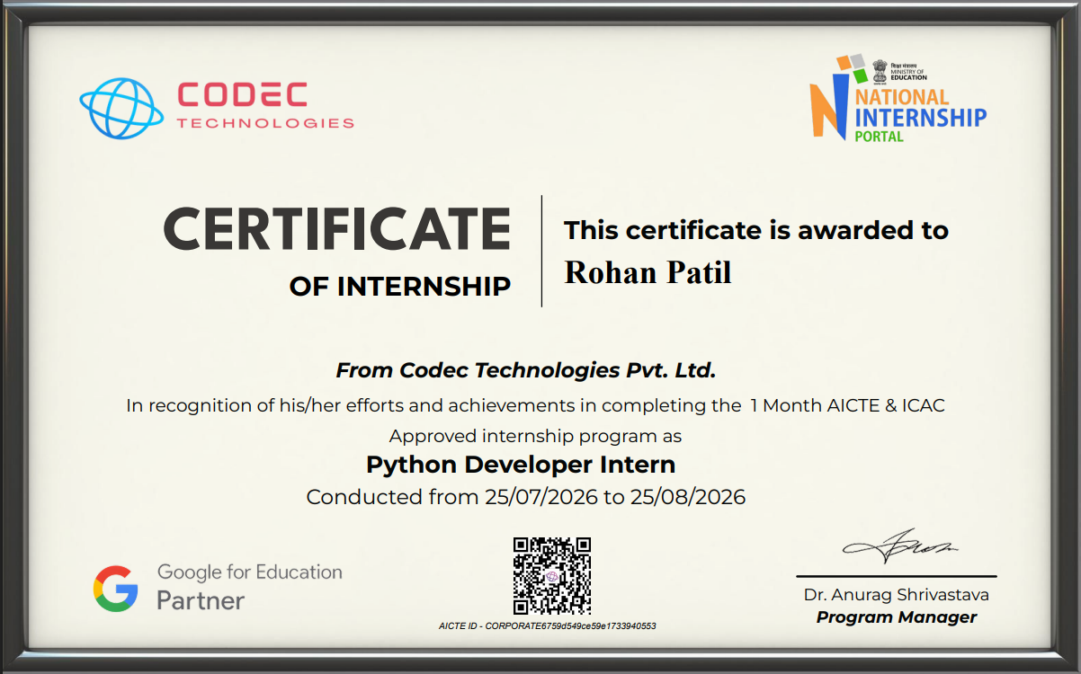
COMPLETION
COMPLETION
Successfully Completed
Python Developer Internship
CERTIFICATE
Organization
Codec Technologies
Duration
1 Month
Certificate / ID
CORPORATE6759d549ce59e1733940553
Thank You

