Slide 1
Analysis of U-Net Architecture for
Nuclei Cell Segmentation
Bachelor of Technology
in
Information Technology
by
Rohan Thapa (1754077)
IT 4th Year
Under the supervision
of
Prof. Uttam Kumar Das

Slide 2
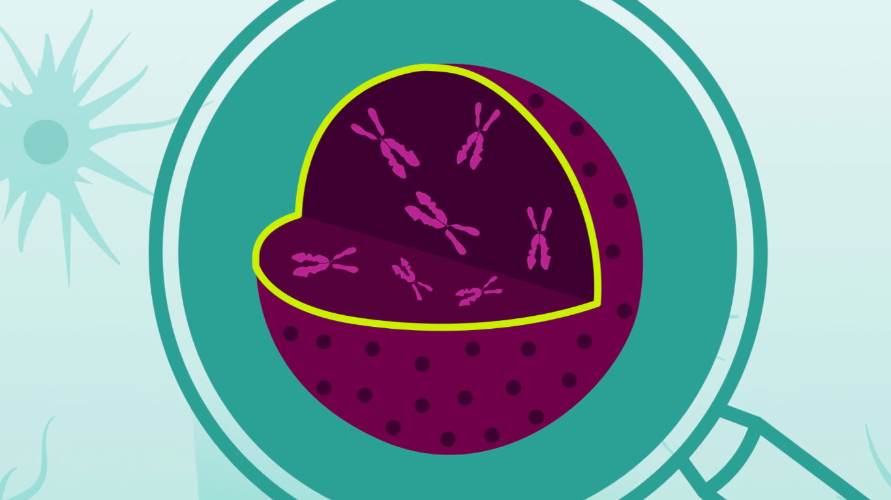
Nucle Cell detection Needs
Identifying the cells’ nuclei is the starting point for most analyses because most of the
human body’s 30
trillion cells contain a nucleus
full of DNA, the genetic code that
programs each cell. Identifying nuclei
allows researchers to identify
each individual cell in a sample,
and by measuring how cells react to
Various treatments, the researcher can understand the underlying biological processes at work.

Slide 3

We choosed the U-Net Architecture
Overview: The U-Net model
addresses a mainstream CNN
design for taking care of biomedical
issues (for example sectioning various
types of cells and identifying limits
between thick cell structures) and other
image interpretation assignments. The primary
benefit of this model is its capacity to take in
generally precise models from (exceptionally)
little datasets, which is a typical issue for information scant vision undertakings, including nuclei segmentation.

Slide 4
Objective and Proposed Outcome
Detect (Segment) all Nuclei cells present in the Nuclear medicine imaging images.Much of the time, the impeded nuclei region would extraordinarily impact the general precision of nuclei cell division calculations. Past investigations have shown that the blunder created in the nuclei division step is communicated into all after periods of the nuclei acknowledgment, so nuclei limit assessment is as yet a vital pre-handling stage for accomplishing the high precision of the system

Slide 5
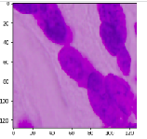
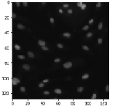
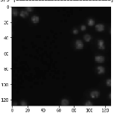
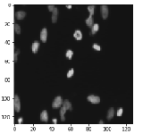
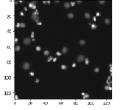
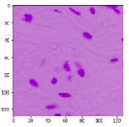
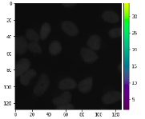
Nuclei Cell Segmentation through U-Net
Sample Data set:

Slide 6
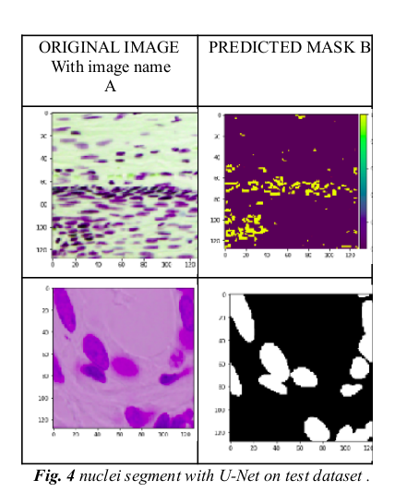
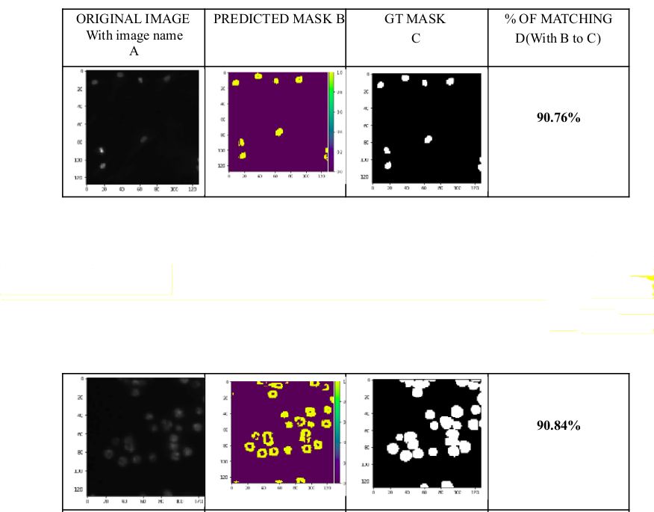
Nuclei Cell Segmentation through U-Net
Sample Outpus:

Slide 7
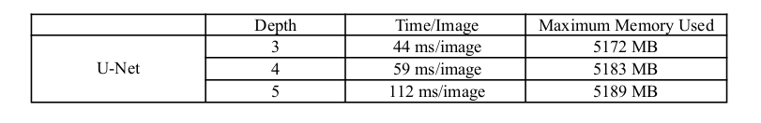
Time and space efficiency
We utilize a work area PC for the investigations running an Intel I7-7600k processor with 8 GB of RAM and a Nvidia GTX-1060 6 GB GPU. All models are tried on the GPU with the utilization of CUDA. Utilizing this equipment design we evaluate the speed of each model by taking care of them the test pictures in a circle each in turn. During this test we likewise measure the use of the GPU's assets. The outcomes are appeared in Table. The distinction being the time it took for each model to portion the example pictures. The time expectedly expanded with profundity. During testing we likewise checked the GPU utilization. All models came to a 100% GPU utilization.

Slide 8
Conclusion & Future Work
We have introduced a U-Net based methodology for Nuclei segmentation on Nuclear medicine imaging . The CNN-based architechture model ends up helpfull to medical image segmentation, while likewise outflanking all thought about gauge techniques. Taking everything into account, the utilization of profound learning strategies in nuclei cell detection may give an expansion in execution in a space of biomedical image segmentation contrasted techniques. For improving Nuclei detection remaking by upgrading the nature of pictures.
We foster the U-Net design by utilizing convolution bits and changing the number of layers. The outcomes demonstrate that our proposed strategy could improve the Nuclei designs in the forefront region and decrease the effect of commotion behind the region of the scene.

Slide 9
References we taken:
[1] Esteva, A., Chou, K., Yeung, S., Naik, N., Madani, A., Mottaghi, A., Liu, Y., Topol, E., Dean, J. and Socher, R., 2021. Deep learning-enabled medical computer vision. NPJ digital medicine, 4(1), pp.1-9.
[2] Zhang, Y., Sun, X., Dong, J., Chen, C. and Lv, Q., 2021. GPNet: Gated pyramid network for semantic segmentation. Pattern Recognition, 115, p.107940.
[3] Massey, Z.B., Brockenberry, L.O. and Harrell, P.T., 2021. Vaping, smartphones, and social media use among young adults: Snapchat is the platform of choice for young adult vapers. Addictive Behaviors, 112, p.106576.
[4] Zhang, Y., 2021. Backtracking search algorithm with specular reflection learning for global optimization. Knowledge-Based Systems, 212, p.106546.
[5] Yu, S. and Lakshminarayanan, V., 2021. Fractal Dimension and Retinal Pathology: A Meta-Analysis. Applied Sciences, 11(5), p.2376
[6] Tan, W., Liu, P., Li, X., Liu, Y., Zhou, Q., Chen, C., Gong, Z., Yin, X., and Zhang, Y., 2021. Classification of COVID-19 pneumonia from chest CT images based on reconstructed
[7] super-resolutionimages and Science and Systems, 9(1), pp.1-12. VGG neural network. Health Information

Slide 10
Thank You Sir.

