Slide 1
SPRING BOOT
TUTORIAL
Presented By: Rohit

Slide 2
Definitions
Spring Boot
It is a Spring framework module which provides RAD (Rapid Application Development) feature to the Spring framework. It is highly dependent on the starter templates feature which is very powerful and works flawlessly.
Microservices
Developing a single application as a suite of small services each running in its own process and communicating with lightweight mechanisms, often an HTTP resource API. These services are built around business capabilities and independently deployable by fully automated deployment machinery. There is a bare minimum of centralized management of these services, which may be written in different programming languages and use different data storage technologies

Slide 3
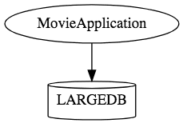
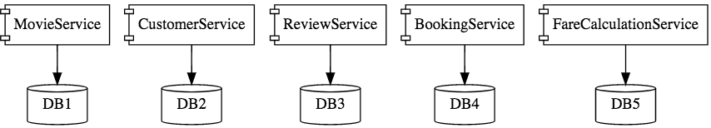
This is how a monolith would look like. One application for everything.
This is how the same application would look like when developed using Microservices Architecture.

Slide 4
Spring boot advantages
It helps to create stand-alone Spring applications
Embed Tomcat, Jetty or Undertow directly (no need to deploy WAR files)
It provide opinionated ‘starter’ POMs to simplify your Maven configuration
Automatically configure Spring whenever possible
It provide production-ready features such as metrics, health checks and externalized configuration
Absolutely no code generation and no requirement for XML configuration
Spring Boot Features
Web Development
Spring Application
Application events and listeners
Admin features
Externalized Configuration
Properties Files
YAML Support
Type-safe Configuration
Logging
Security

Slide 5
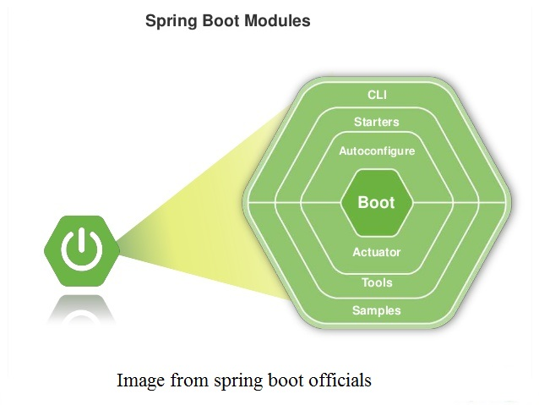
Spring boot architecture diagram

Slide 6
Spring Boot Starters: Main concept behind spring boot starters is to reduce the dependencies definitions and to simplify the project build dependencies. For example : if we are creating spring application than we have to define following dependencies in pom.xml file –
Spring core Jar file
Spring Web Jar file
Spring Web MVC Jar file
Servlet Jar file
Spring Boot Starters provides the facility to add only one jar file spring-boot-starter-web instead of adding 4 jar files.
Spring Boot AutoConfigurator: Main concept behind Spring Boot AutoConfigurator is to minimizing the programmer’s effort to define lots of XML configuration. It will take care of all these XML configurations and annotations.
Spring Boot CLI: It is Spring Boot software which is used to run and test Spring Boot applications from command prompt. CLI refers to command line arguments. To execute a spring application, spring boot CLI uses Spring Boot Starter and Spring Boot AutoConfigurate components to resolve all dependencies.
Spring Boot Actuator: Spring boot actuator is a tool which provides HTTP endpoints. We can manage our production application using these HTTP endpoints.

Slide 7
Ways to Create Spring Boot Project
Spring Maven Project
Spring Starter Project Wizard
Spring Initializr
Spring Boot CLI
we can use STS (Spring Toll Suite) eclipse plugin to create project.

Slide 8
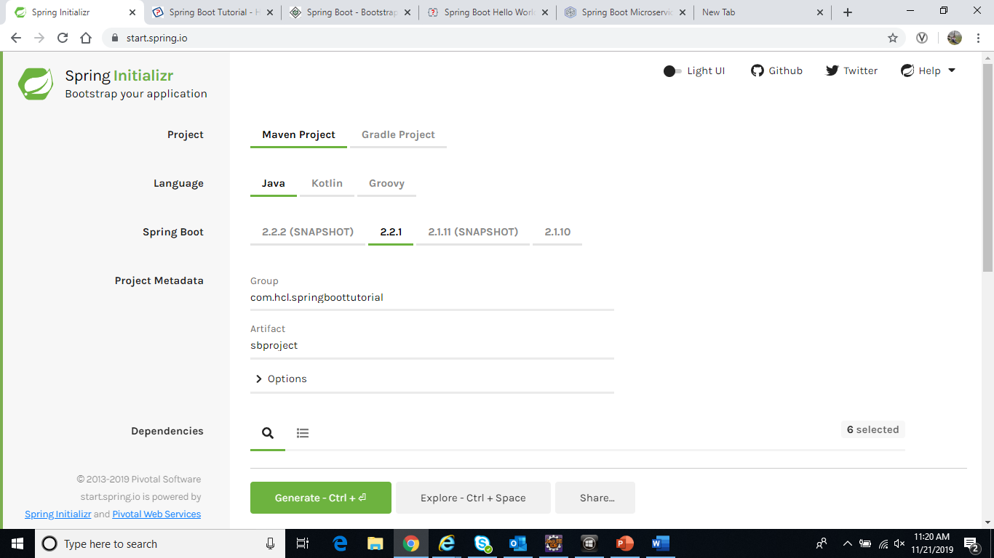

Slide 9
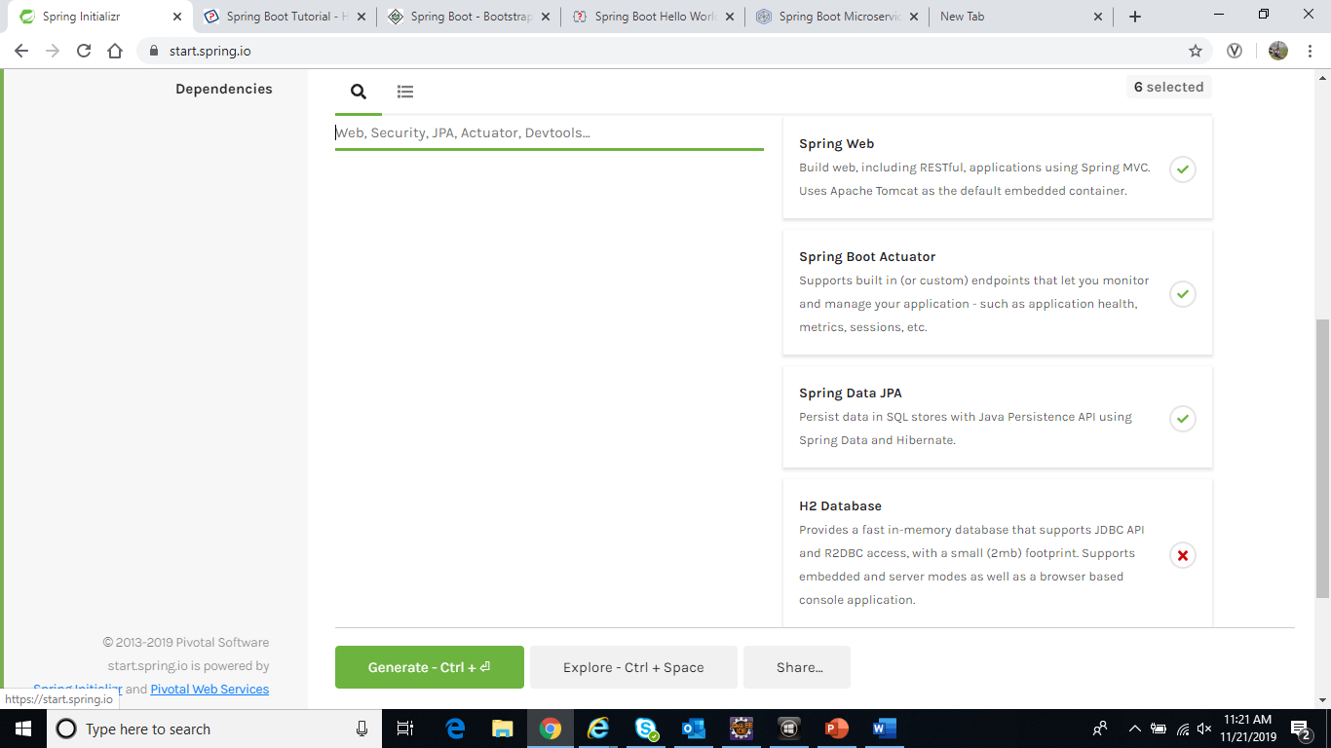

Slide 10
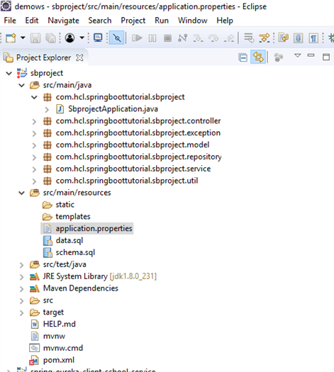
Project Structure-:

Slide 11
Core Spring Framework Annotations
@Bean - indicates that a method produces a bean to be managed by Spring.
@Autowired - marks a constructor, field, or setter method to be autowired by Spring dependency injection.
@Value - indicates a default value expression for the field or parameter to initialize the property.
@Service - indicates that an annotated class is a service class.
@Repository - indicates that an annotated class is a repository, which is an abstraction of data access and storage.
Spring Boot Annotations
@SpringBootApplication - enables Spring Boot autoconfiguration and component scanning.
@SpringBootApplication = @Configuration + @EnableAutoConfiguration + @ComponentScan
Spring Framework DataAccess Annotations
@Transactional - This annotation is placed before an interface definition, a method on an interface, a class definition, or a public method on a class. The mere presence of @Transactional is not enough to activate the transactional behaviour. The @Transactional is simply a metadata that can be consumed by some runtime infrastructure.

Slide 12
Spring MVC and REST Annotations
@RequestMapping - maps HTTP request with a path to a controller method.
Composed @RequestMapping Variants
@GetMapping - This annotation is used for mapping HTTP GET requests onto specific handler methods.
@PostMapping - This annotation is used for mapping HTTP POST requests onto specific handler methods.
@PutMapping - This annotation is used for mapping HTTP PUT requests onto specific handler methods.
@PatchMapping - This annotation is used for mapping HTTP PATCH requests onto specific handler methods.
@DeleteMapping - This annotation is used for mapping HTTP DELETE requests onto specific handler methods.
@ExceptionHandler - This annotation is used at method levels to handle exception at the controller level.
@PathVariable - This annotation is used to annotate request handler method arguments.
@RequestAttribute - This annotation is used to bind the request attribute to a handler method parameter
@RestController - This annotation is used at the class level. The @RestController annotation marks the class as a controller where every method returns a domain object instead of a view. By annotating a class with this annotation you no longer need to add @ResponseBody to all the RequestMapping method
@RequestBody - This annotation is used to annotate request handler method arguments.
@RequestHeader - This annotation is used to annotate request handler method arguments.
@RequestParam - This annotation is used to annotate request handler method arguments. Sometimes you get the parameters in the request URL, mostly in GET requests. In that case, along with the @RequestMapping annotation you can use the @RequestParam
@ResponseStatus - This annotation is used on methods and exception classes. @ResponseStatus marks a method or exception class with a status code and a reason that must be returned.

Slide 13
Spring Cloud Annotations
@EnableConfigServer - This annotation is used at the class level. When developing a project with a number of services, you need to have a centralized and straightforward manner to configure and retrieve the configurations about all the services that you are going to develop. One advantage of using a centralized config server is that you don’t need to carry the burden of remembering where each configuration is distributed across multiple and distributed components.
@EnableEurekaServer -This annotation is applied to Java classes. One problem that you may encounter while decomposing your application into microservices is that, it becomes difficult for every service to know the address of every other service it depends on. There comes the discovery service which is responsible for tracking the locations of all other microservices. Netflix’s Eureka is an implementation of a discovery server and integration is provided by Spring Boot
@EnableDiscoveryClient - This annotation is applied to Java classes. In order to tell any application to register itself with Eureka you just need to add the @EnableDiscoveryClient annotation to the application entry point. The application that’s now registered with Eureka uses the Spring Cloud Discovery Client abstraction to interrogate the registry for its own host and port.
@EnableCircuitBreaker - This annotation is applied on Java classes that can act as the circuit breaker. The circuit breaker pattern can allow a micro service continue working when a related service fails, preventing the failure from cascading. This also gives the failed service a time to recover.

Slide 14
Spring Boot - Application Properties
Spring Boot provides various properties which can be specified inside our project's application.properties file. These properties have default values and you can set that inside the properties file. The application.properties file is located in the src/main/resources directory.
// application.properties
server.port=2017
spring.application.name=SpringBootTest
// TestController.java
@Value("${spring.application.name}")
private String appName;
Spring Boot – Profiles In properties
Spring Boot supports different properties based on the Spring active profile. By default, application. properties will be used to run the Spring Boot application. If you want to use profile-based properties, we can keep separate properties file for each profile as shown below:
//application-dev.properties
server.port = 9090
spring.application.name = demoservice // application.properties
spring.profiles.active=dev
//application-prod.properties
server.port = 4431
spring.application.name = demoservice

Slide 15
Spring Boot Profiles In Java Code
// application.properties
spring.profiles.active=dev
// SbprojectApplication.java
@Profile("dev")
@Bean
public String devBean() {
return "I will be available in profile dev";
}
@Profile("prod")
@Bean
public String prodBean() {
return "I will be available in profile prod";
}

Slide 16
Spring Boot – DataSource configuration
//pom.xml
<dependency>
<groupId>org.springframework.boot</groupId>
<artifactId>spring-boot-starter-data-jpa</artifactId>
</dependency>
<dependency>
<groupId>com.h2database</groupId>
<artifactId>h2</artifactId>
<version>2.4.1</version>
<scope>runtime</scope>
</dependency>
// application.properties
# H2 DB
spring.datasource.url=jdbc:h2:file:C:/temp/test
spring.datasource.username=sa
spring.datasource.password=
spring.datasource.driverClassName=org.h2.Driver
spring.jpa.database-platform=org.hibernate.dialect.H2Dialect

Slide 17
Spring Boot Logging
In Spring Boot, Logback is the default logging framework, just add spring-boot-starter-web, it will pull in the logback dependencies.
// application.properties
# logging level
logging.level.org.springframework=ERROR
logging.level.com.hcl=DEBUG
# output to a file (Log files will rotate when they reach 10 Mb)
logging.file=app.log
logging.pattern.file=%d %p %c{1.} [%t] %m%n
logging.pattern.console=%d{HH:mm:ss.SSS} [%t] %-5level %logger{36} - %msg%n
For production, we need more logging features like file rolling:
logback.xml
//TestController.java
private static final Logger logger = LoggerFactory.getLogger(TestController.class);
logger.debug("Hello from Logback");

Slide 18
Default Logging Format in Spring Boot
Date and Time: Millisecond precision and easily sort able.
Log Level: ERROR, WARN, INFO, DEBUG or TRACE.
Process ID.
— Separator to distinguish the start of actual log messages.
Thread name: Enclosed in square brackets (may be truncated for console output).
Logger name: This is usually the source class name (often abbreviated).
Ex: 2019-12-05 22:09:54.946 INFO 8344 --- [nio-8761-exec-2] c.h.s.s.controller.EmployeeController : Entry: getAllEmployees

Slide 19
Spring Boot Actuator
Spring boot actuator is a tool which provides HTTP endpoints. We can manage our production application using these HTTP endpoints.
Id | Description
actuator | It provides a hypermedia-based "discovery page" for the other endpoints. It requires Spring HATEOAS to be on the classpath.
auditevents | It exposes audit events information for the current application.
autoconfig | It is used to display an auto-configuration report showing all auto-configuration candidates and the reason why they 'were' or 'were not' applied.
beans | It is used to display a complete list of all the Spring beans in your application.
configprops | It is used to display a collated list of all @ConfigurationProperties.
dump | It is used to perform a thread dump.
env | It is used to expose properties from Spring's ConfigurableEnvironment.
flyway | It is used to show any Flyway database migrations that have been applied.
health | It is used to show application health information.
info | It is used to display arbitrary application info.
loggers | It is used to show and modify the configuration of loggers in the application.
liquibase | It is used to show any Liquibase database migrations that have been applied.
Metrics | It is used to show metrics information for the current application.
mappings | It is used to display a collated list of all @RequestMapping paths.
shutdown | It is used to allow the application to be gracefully shutdown.
trace | It is used to display trace information.

Slide 20
Spring boot exception handling
@ControllerAdvice
This is an annotation, to handle the exceptions globally.
@ExceptionHandler
This is an annotation used to handle the specific exceptions and sending the custom responses to the client.
@ResponseStatus(value = HttpStatus.NOT_FOUND)
public class RecordNotFoundException extends Exception {
public RecordNotFoundException(String message) {
super(message);
}
}

Slide 21
Spring Boot With Swagger
Swagger is widely used for visualizing APIs, and with Swagger UI it provides online sandbox for frontend developers. It enables documentation to be updated at the same pace as the server. When properly defined via Swagger, a consumer can understand and interact with the remote service with a minimal amount of implementation logic.
//pom.xml
<dependency>
<groupId>io.springfox</groupId>
<artifactId>springfox-swagger2</artifactId>
<version>2.4.0</version>
</dependency>
<dependency>
<groupId>io.springfox</groupId>
<artifactId>springfox-swagger-ui</artifactId>
<version>2.4.0</version>
</dependency>

Slide 22
//SbprojectApplication.java
@Bean
public Docket employeeApi() {
return new Docket(DocumentationType.SWAGGER_2).groupName("public-api")
.apiInfo(apiInfo()).select().build();
}
private ApiInfo apiInfo() {
return new ApiInfoBuilder().title("Employee API")
.description("Employee API reference for developers")
.termsOfServiceUrl("http://hcl.com")
.contact("sbtutorial@gmail.com").license("Employee License")
.licenseUrl("sbtutorial@gmail.com").version("1.0").build();
}

Slide 23
THANK YOU

