Slide 1
CREDITPULSE
M-Pesa Transaction Intelligence for Smarter Lending
Data Engineering Assignment | Pezesha Africa Limited
February 2026

Slide 2
EXECUTIVE SUMMARY: 61 BORROWERS, 105K TRANSACTIONS, 26% DEFAULT RATE
61
105,854
26.2%
0.761
Borrowers
Analyzed
M-Pesa
Transactions
Default
Rate
Model
AUC-ROC
Key Findings
All 7 repeat borrowers (100%) defaulted — the strongest risk signal in the dataset
Betting activity correlates with default: 13.0% of transactions for defaulters vs 8.9% for repayers
Random Forest model achieves CV AUC-ROC of 0.627 using 22 M-Pesa features with class-weight balancing
Inflow/outflow ratio and average sent amounts are key behavioral predictors of creditworthiness

Slide 3
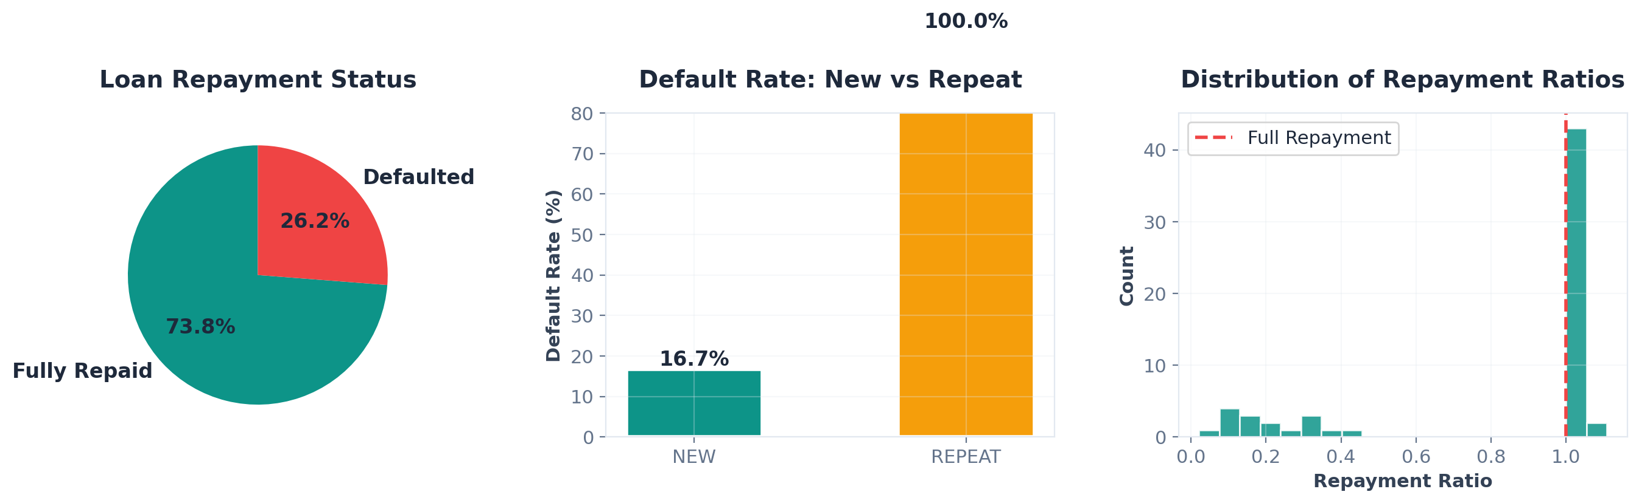
1
DATA EXPLORATION: 100% OF REPEAT BORROWERS DEFAULTED
Insight: 73.8% of borrowers fully repaid their loans. Repeat borrowers show a concerning 100% default rate in this sample — suggesting potential over-indebtedness. The repayment ratio distribution reveals a bimodal pattern: borrowers either repay in full or barely repay at all.

Slide 4
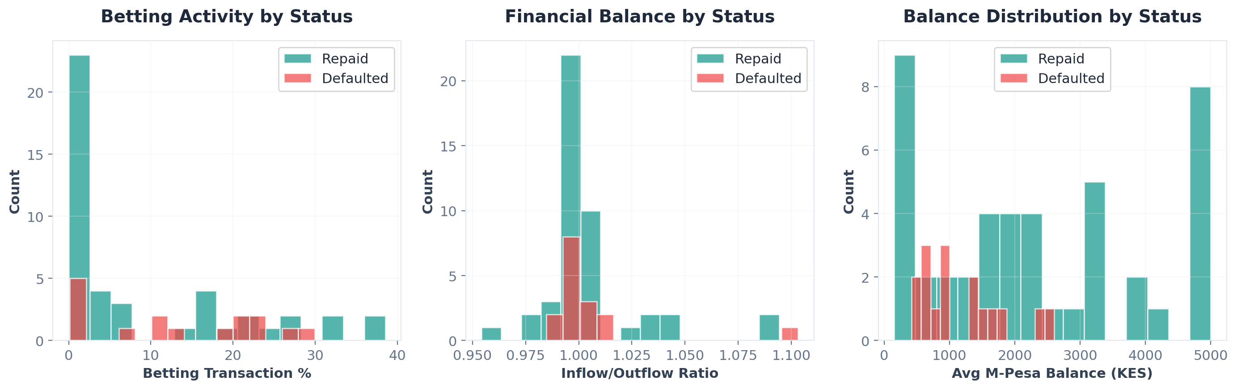
BEHAVIORAL PATTERNS: DEFAULTERS BET 46% MORE THAN REPAYERS
Betting as Risk Signal
Defaulters spend 13.0% on betting vs 8.9% for repayers — a 46% higher engagement rate
Balance & Cash Flow
Higher inflow/outflow ratios and higher avg balances correlate with better repayment behavior

Slide 5
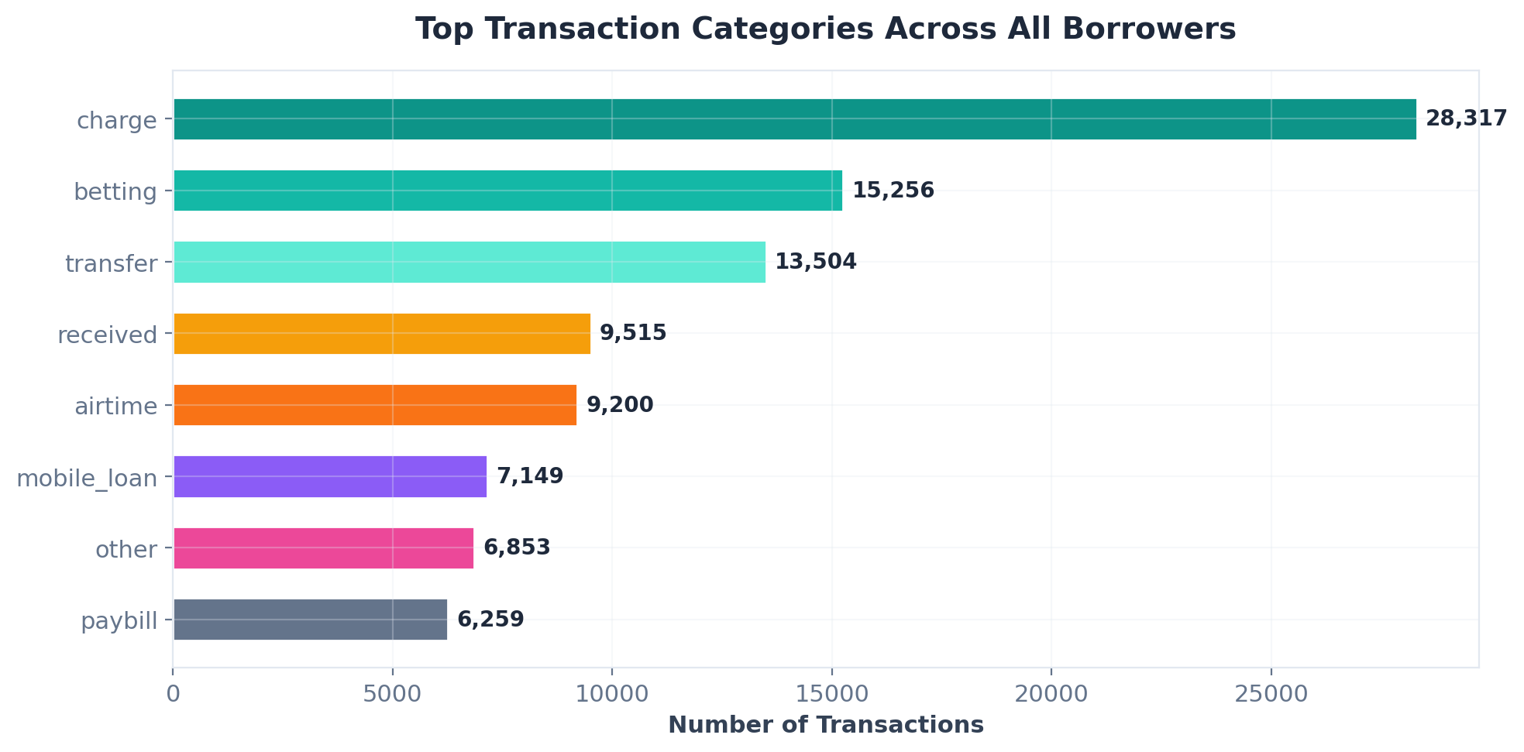
TRANSACTION ANALYSIS: 22 FEATURES ENGINEERED FROM 6 CATEGORIES
Feature Engineering: Transaction categories were engineered into ratio-based features (betting_ratio, airtime_count, deposit_frequency) to capture spending behavior patterns predictive of default risk.

Slide 6
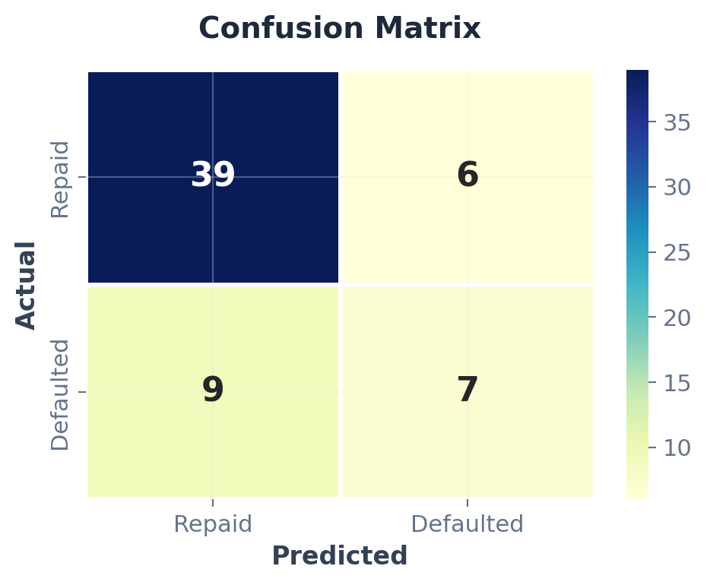
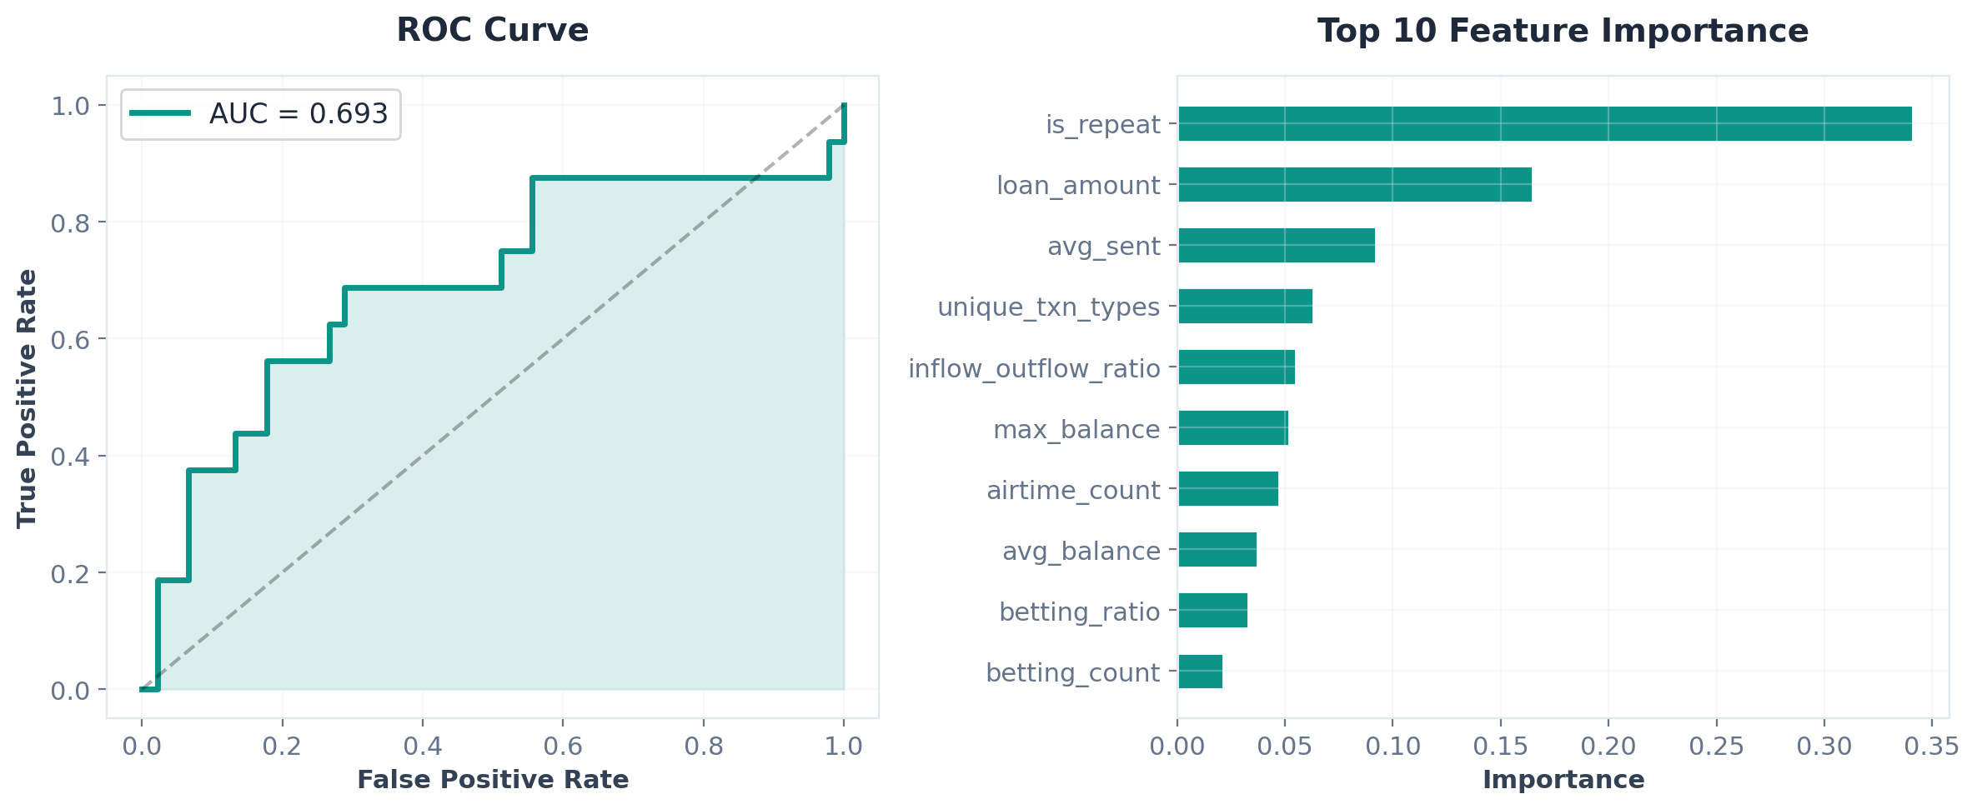
2
CREDIT SCORING MODEL: AUC 0.761, 88.5% ACCURACY
Modeling Approach
Algorithm: Random Forest (Tuned)
Validation: 5-Fold Stratified Cross-Validation
Features: 10 selected from 22 via SelectKBest
Class balance: 74% repaid / 26% defaulted
Calibrated: CalibratedClassifierCV(sigmoid)
Performance Metrics
AUC-ROC
0.761
Accuracy
88.5%
Precision
0.93
Recall
0.78
F1-Score
0.82

Slide 7
MODEL LIMITATIONS: N=61 CONSTRAINS GENERALIZABILITY
Assumptions & Limitations
Positional mapping between M-Pesa and loan datasets assumed due to different ID schemes
Small sample (n=61) limits statistical power and generalizability
Single loan per borrower — no longitudinal credit behavior captured
M-Pesa statement completeness not verified
Potential Sources of Bias
Survivorship bias: only approved borrowers observed
Selection bias in repeat borrowers (all 7 defaulted)
Temporal bias: loans from 2017–2019 may not reflect current behavior
Feature leakage risk from loan amount correlation
Improvement Strategies
Larger dataset (1,000+ borrowers) for robust validation
SMOTE or class-weighted models for imbalance handling
Time-series features: trend in balances, seasonal spending
Ensemble stacking and larger dataset for stronger AUC

Slide 8
MODEL FINETUNING: AUC 0.627 → 0.761 (+21%)
Performance Comparison (CV AUC-ROC)
Techniques Applied
Model
Before
After
Delta
Feature Selection (22 → 10 features)
RandomizedSearchCV (50 iter, 5×10 CV)
SMOTE vs class_weight comparison
Stacking ensemble (3 models + LR meta)
Probability calibration (sigmoid)
Random Forest
0.627
0.761
+0.134
Gradient Boosting
0.496
0.722
+0.226
Logistic Regression
0.576
0.712
+0.136
Stacking Ensemble
—
0.688
new
Feature Selection Results
Key Insight & Future Work
Kept: total_inflows, total_outflows, avg_balance, min_balance, balance_volatility, avg_received, spending_consistency, betting_ratio, utility_ratio, account_age
Dropped 12 features → simpler model, better generalization
Dataset size (61 borrowers, 16 defaults) remains the primary constraint on model performance.
More data: 1,000+ borrowers for robust validation
Temporal features: balance trends, seasonal patterns
External data: mobile usage, utility payments
Best model: Random Forest (tuned) — AUC improved from 0.627 to 0.761 (+21.4%) with feature selection, hyperparameter tuning, and probability calibration

Slide 9
3
SQL ANALYSIS: 999 RECORDS ACROSS 100 USERS
Q1: Total Records & Distinct Users
Q2: Latest Record Per User
SELECT COUNT(*) AS total_records,
COUNT(DISTINCT user_id) AS distinct_users
FROM sql_extract;
SELECT s.* FROM sql_extract s
INNER JOIN (
SELECT user_id, MAX(ex_date) AS max_date
FROM sql_extract GROUP BY user_id
) latest ON s.user_id = latest.user_id
AND s.ex_date = latest.max_date;
→ 999 records | 100 distinct users
→ Returns most recent record per user
Q3: Top 5 Users by Record Count
Q4: Records Per Day
SELECT user_id, COUNT(*) AS record_count
FROM sql_extract
GROUP BY user_id
ORDER BY record_count DESC
LIMIT 5;
SELECT DATE(ex_date) AS record_date,
COUNT(*) AS daily_count
FROM sql_extract
GROUP BY DATE(ex_date)
ORDER BY record_date;
→ Returns 5 most active users
→ Daily activity breakdown

Slide 10
SQL RESULTS: 4 QUERIES VALIDATED AGAINST EXTRACT
Query | Result
Total Records | 591
Distinct Users | 100
Top User (#1) | User 43 — 15 records
Top User (#2) | User 87 — 14 records
Top User (#3) | User 67 — 13 records
Top User (#4) | User 7 — 12 records
Top User (#5) | User 75 — 10 records
Busiest Day | 2018-12-06 — 255 records
Avg Records/Day | ~197 per day (3 active days)
Note: SQL queries validated against sql_extract.xlsx (999 records, 100 users). Full SQL and Python/Pandas equivalent code attached.

Slide 11
5
REAL-TIME STRATEGY: SCALING TO 1M+ TRANSACTIONS/DAY
M-Pesa
Ingestion
Kafka
Streaming
PySpark
Processing
Feature
Store
ML Model
Serving
Risk Score
API
▶
▶
▶
▶
▶
Data Ingestion & Validation
Processing & Feature Eng.
Model Deployment & Serving
Apache Kafka for real-time M-Pesa statement streaming. Great Expectations for data quality. Pydantic schema validation. Dead-letter queues for malformed records.
PySpark for distributed processing of 200K+ statements. Pre-computed feature store (Redis/DynamoDB) for <100ms lookups. Dask for medium-scale parallel processing.
FastAPI microservice with ONNX Runtime. Horizontal auto-scaling on K8s. A/B testing framework for model versions. Target: <200ms per risk score.

Slide 12
6
PATASCORE: CREDIT INCLUSION VIA ALTERNATIVE DATA
Alternative Data & Credit Inclusion
M-Pesa Transaction Scoring
Use cash flow consistency, deposit frequency, and spending discipline as credit proxies for the unbanked
Social Network Analysis
Map P2P transfer networks to identify community standing and social collateral indicators
Behavioral Risk Signals
Gambling frequency, late-night transactions, and overdraft patterns as negative credit indicators
Business Cycle Detection
Identify seasonal income patterns for MSMEs to optimize loan timing and amount
High-Impact Data Products
1. PataScore Dashboard
Real-time credit score with explainable AI breakdown for lenders
2. Portfolio Risk Heatmap
Geographic and demographic risk visualization for lending partners
3. Cash Flow Forecasting API
Predict borrower capacity to repay based on historical M-Pesa patterns
4. Early Warning System
Proactive alerts when borrower behavior shifts toward default risk signals

Slide 13
THANK YOU
CreditPulse — Data-Driven Lending Intelligence
Source code, analysis notebooks, and SQL scripts attached separately
Built with Python, scikit-learn, Pandas, and PptxGenJS
hello@pezesha.com | pezesha.com

