Slide 1

Client- Solkawind
“US State Wind Energy Facts 2018”
Presented by:
Group-5

Slide 2
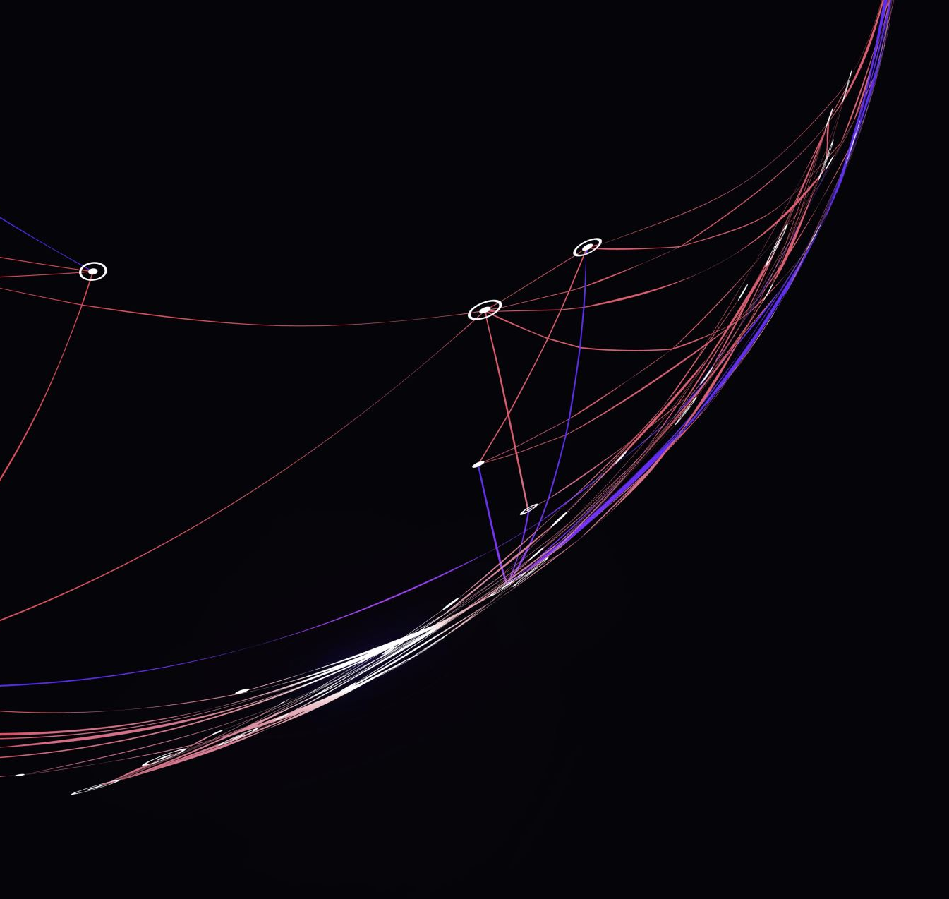
Problem statement:
Problem Statement: Despite significant investment in wind turbine infrastructure, Solkawind is experiencing a decline in revenue by a significant percentage in the coming year.

Slide 3
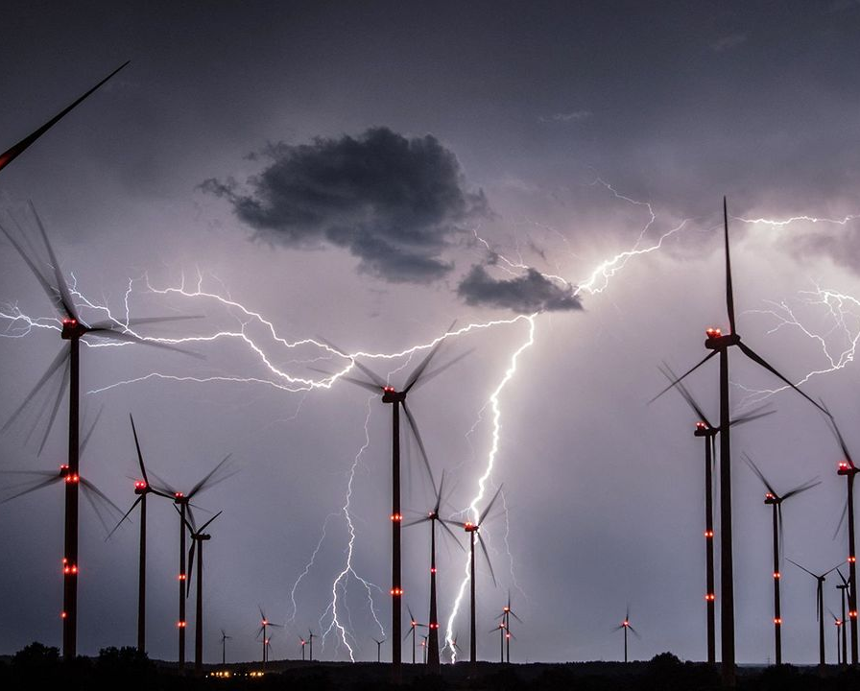
Solutions
Solkawind revenue decreased by a certain percentage due to discrepancies in wind turbine deployment across states. Some states have more turbines but low Equivalent Homes Powered metrics, indicating inefficient resource allocation and investment.
PURPOSED SOLUTIONS:
Strategic Resource Reallocation
Optimization of Installed Capacity
Community Engagement
Investment in Innovation
Regulatory Compliance
Market diversification

Slide 4
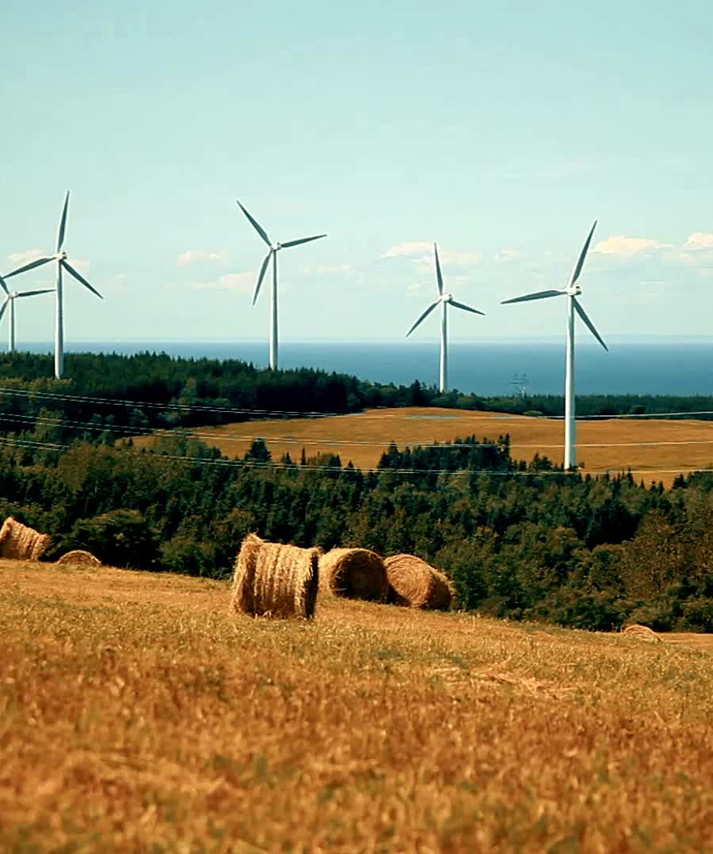
Objectives
Identify Underperforming Projects
Optimize Resource Allocation
Maximize Revenue Generation
Develop Regional Strategies

Slide 5
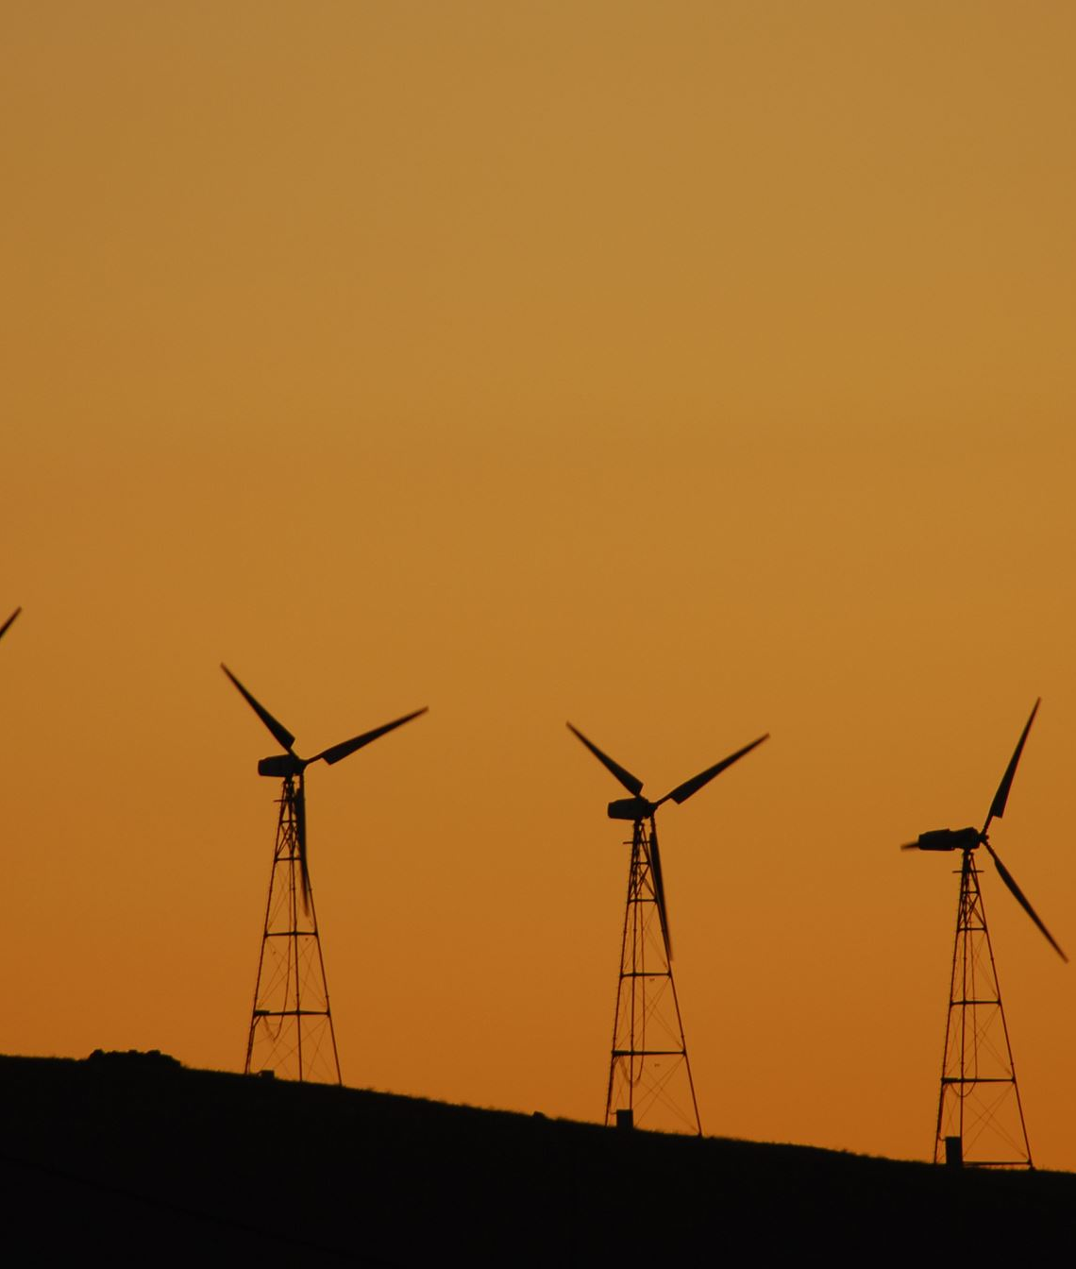
Key Performance Indicators (KPIs)
Energy Production per Turbine
Capacity Utilization Rate
Revenue per Megawatt-hour (MWh) by State
Transmission and Distribution Losses
Evaluation of Average Wind Speed by State

Slide 6

MUSKAN BISHT 500124992
PIYUSH SHAHI 500123343
ROHIT KOTHARI 500117908R
SIDDHANT SWARUP 500122305
SIDHARTHA BISWAL 500124991
VAIBHAV CHAUHAN 500124352
SAURAV KANT 500125635
VRINDA KULSHRESHTHA 500117945

