Slide 1
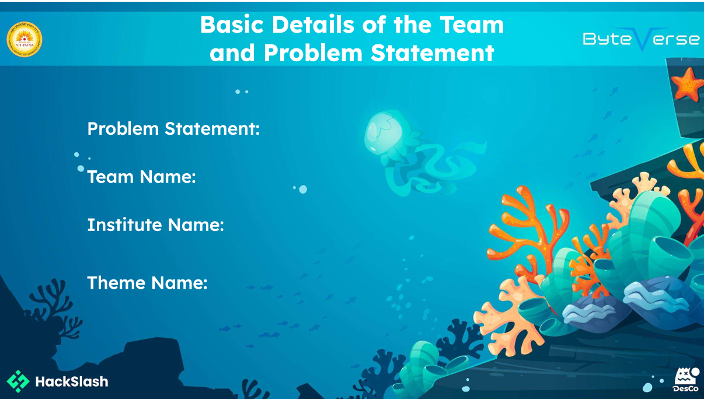
Identifying Food For your Healthy Life
Current Crusher
NIT Patna
Food Quality And Hunger

Slide 2
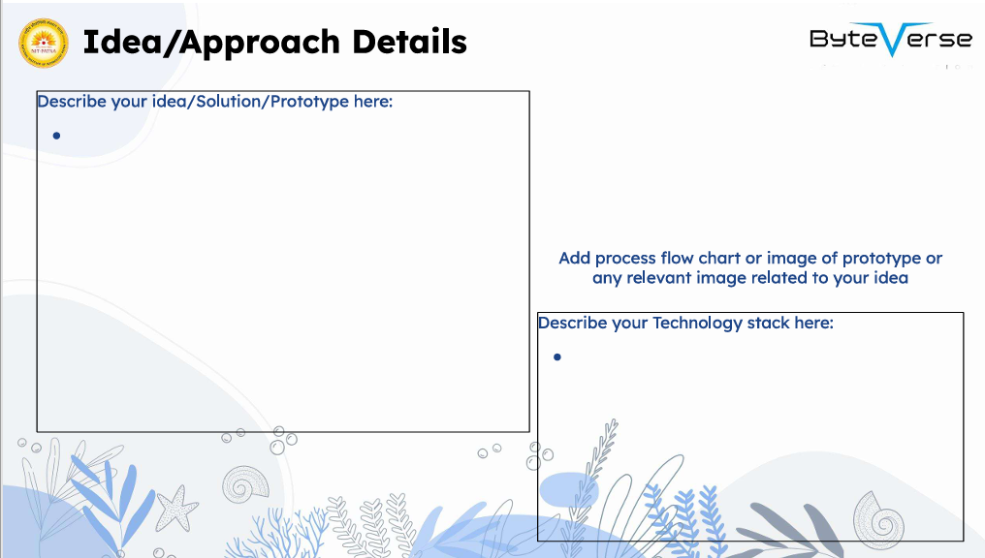
We are creating a smart website that helps users check how healthy a food item is by simply uploading a photo or entering the name of the food.
The website will analyze the image or text, and provide detailed information such as calories, nutritional value, and an overall health rating. This platform will make it easy for people to understand what they’re eating and make healthier food choices based on real-time analysis.
Frontend
HTML ,CSS, JavaScript
Backend
Node.js,Express.js
Image & Text Processing (AI/ML):
Python, Pre-trained ML Models
Nutrition Data APIs:

Slide 3
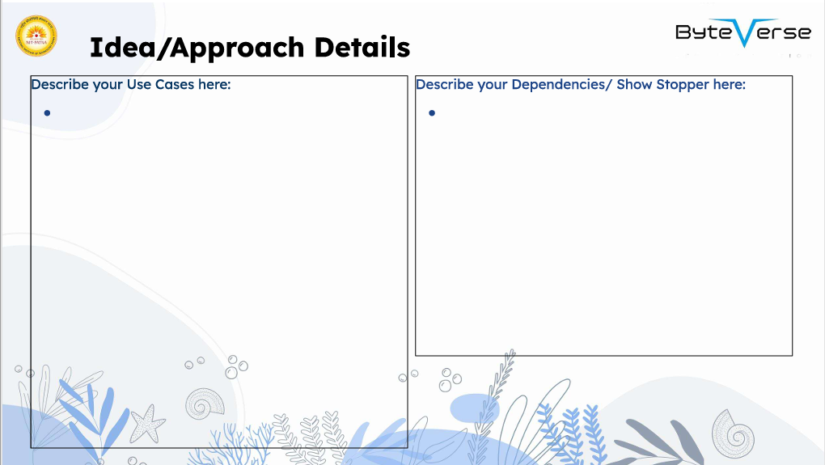
User Input
Photo upload
Manual entry
2. Food Identification
By Photo Recognition
By Name Matching
3. Nutritional Information Retrieval
Nutritional Score/Healthiness Index
Health Assessment and Feedback
Health Status
Detailed Feedback
Personalized Health Goals and Advice
Food Recommendations and Substitutions
Tracking and Progress Monitoring
Community and Social Sharing
Dependencies
Image Recognition & AI Models
Food & Nutrition Databases
Backend and API Layer
Frontend Framework
Authentication and User Management
Image Preprocessing Tools
Data Privacy & Compliance
Showstopper
Inaccurate or Unreliable Image Recognition
Lack of Detailed or Accurate Food Nutrition Data
API Limitations or Cost

Slide 4


Team Leader Name : Aryan Raj
Btech Electrical Engineering year(II)
Team member 1 Name: Aryan Raj
Btech Electrical Engineering year(II)
Team member 2 Name: Ratnesh Ranjan
Btech Electrical Engineering year(II)
Team member 3 Name: Sudhanshu Kumar
Btech Electrical Engineering year(II)
Team member 4 Name: Rohit Kumar
Btech Electrical Engineering year(II)

