Slide 1

SDM COLLEGE OF ENGINEERING AND TECHNOLOGY, DHARWAD - 580002
(An autonomous Institution affiliated to Visvesvaraya Technological University, Belagavi – 590018)
Department of Electrical and Electronics Engineering
Major Project -2 review
“Wide Bandgap Gallium Nitride (GaN) Based DC-DC Converter model for Electric Vehicle Application ”
Project Members: USN
RADHIKA PATIL 2SD22EE032
ROHINI SHALAVADI 2SD22EE034
SAHANA GOUDAR 2SD22EE035
SAMPRITA R S 2SD22EE037
Under the guidance of
Prof.KAVYA K

Slide 2
CONTENTS:
Introduction
Problem Statement Objectives
Literature Review
Methodology
Advantages Disadvantages Output
References

Slide 3
INTRODUCTION:
Electric Vehicles require efficient power conversion from the high-voltage battery (≈400 V) to the low-voltage systems (12 V).
Wide Bandgap Gallium Nitride (GaN) devices offer higher switching speed, higher efficiency, and reduced size compared to traditional silicon MOSFETs.
This project focuses on designing and simulating a GaN-based 400 V → 12 V, 500 W DC–DC converter using LTspice.

Slide 4
PROBLEM STATEMENT:
Design and develop a high-efficiency, compact, and reliable Wide Bandgap Gallium Nitride (GaN) based converter model for electric vehicle (EV) applications, addressing the challenges of high power density, fast switching speeds, and thermal management, while ensuring efficient and reliable operation, and meeting the stringent requirements of the automotive industry.

Slide 5
OBJECTIVES:
  To study about GaN Based transistor and LTSpice software.
  To Design the GaN-based converter topology, including the selection of GaN devices, DC-link capacitor, and output filter.
  To Simulate the GaN-based converter model under various operating conditions, including different temperatures, loads, and input voltages.
  To Compare the performance of the GaN-based converter with traditional silicon-based inverters.

Slide 6
LITERATURE SURVEY:
  Gallium Nitride MOSFET Properties Nexperia Semiconductor (2024) provides datasheet specifications for GaN MOSFETs
  Wide Bandgap Semiconductor Technologies Millán et al. (2024), in their influential survey published in IEEE Transactions on Power Electronics

Slide 7
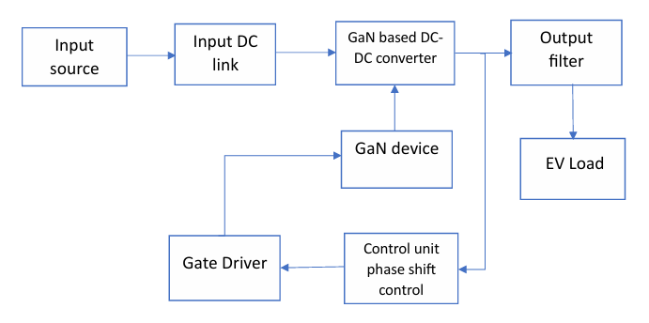
METHODOLOGY:
Fig.1 Block Diagram

Slide 8
ADVANTAGES:
Higher Efficiency
High Switching Frequency Capability
Smaller Size & Weight
Better Power Density
Thermal Performance
(Lower losses reduce heating smaller heatsinks)

Slide 9
DISADVANTAGES:
Higher Cost
Complex Gate Driving Requirements
Layout Sensitivity

Slide 10
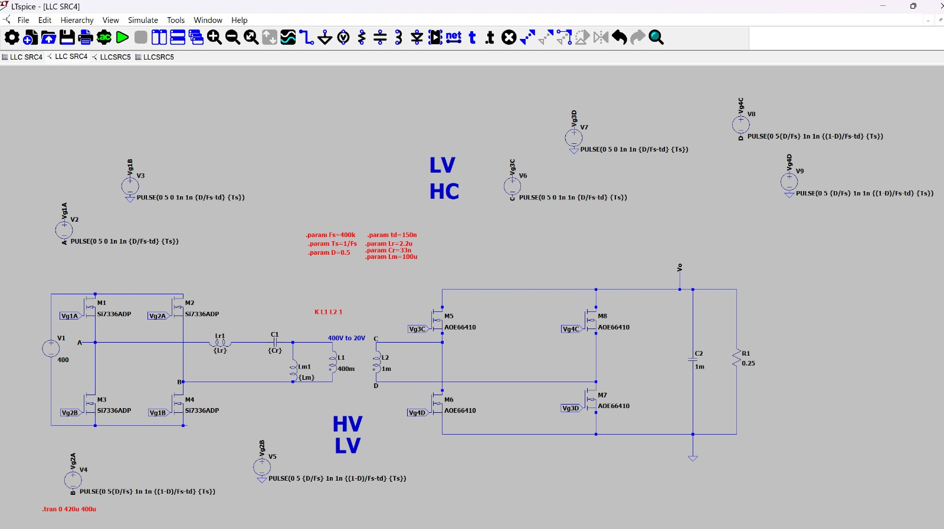
Fig. LTspice simulation circuit of Si based DC-DC converter
Fig.5.4 Datasheet of 12v lead acid battery

Slide 11
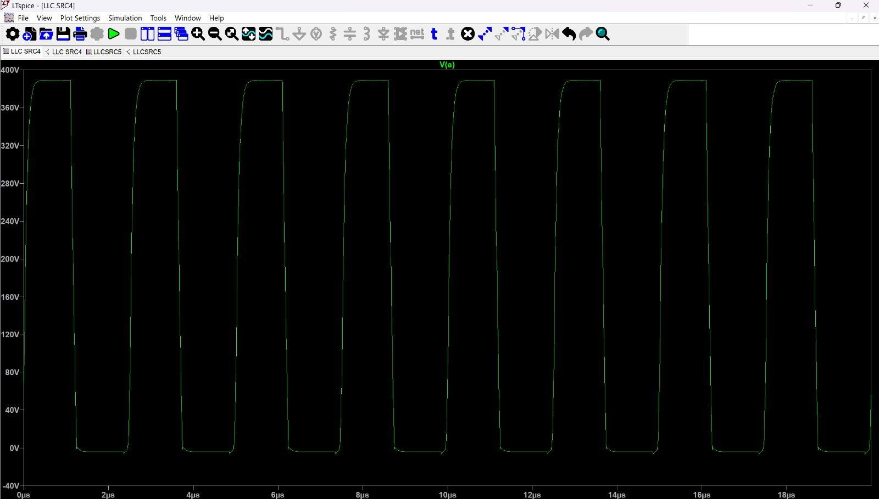
OUTPUT:

Slide 12
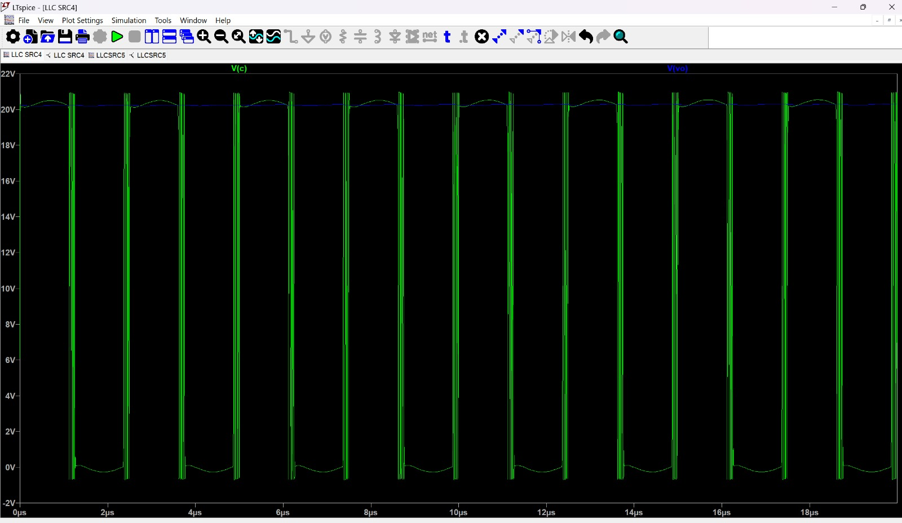

Slide 13
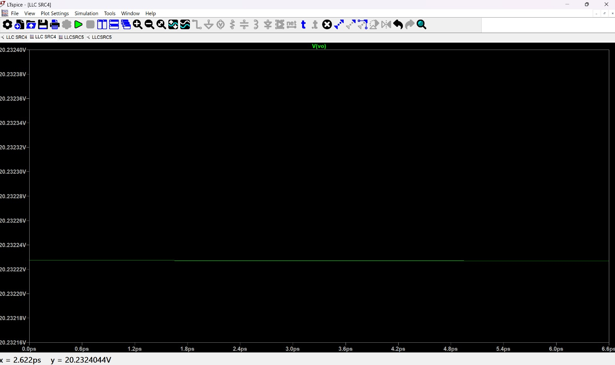

Slide 14
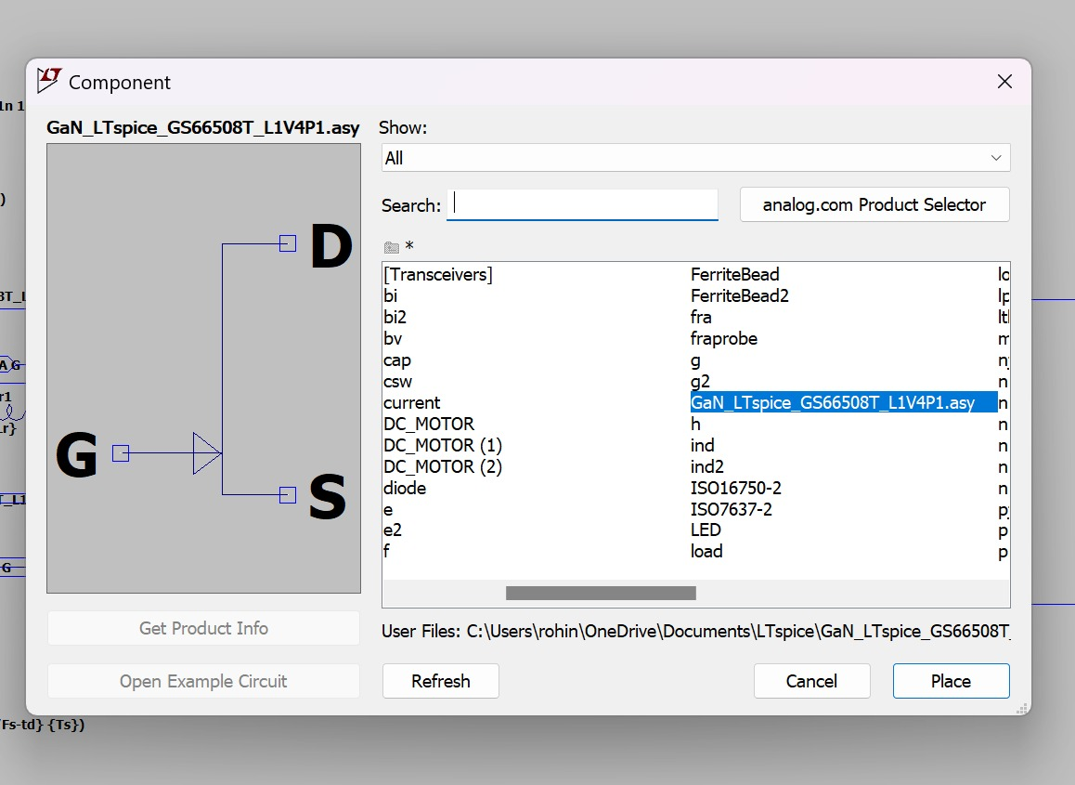

Slide 15
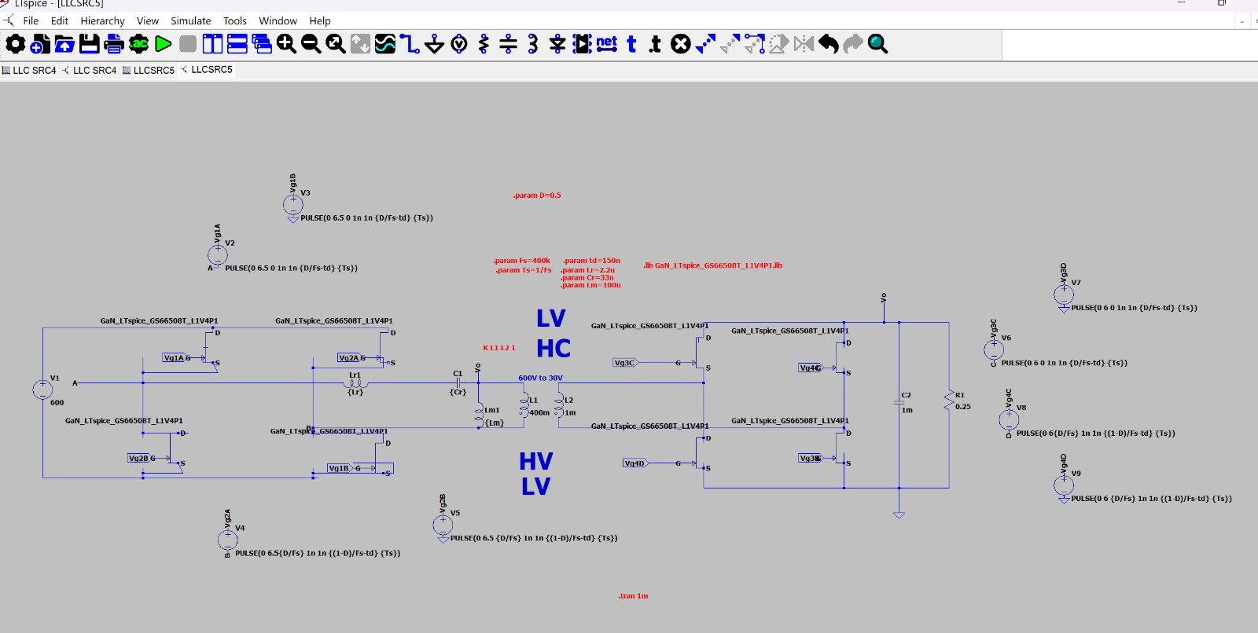
Fig. LTspice simulation circuit of GaN based DC-DC converter

Slide 16
REFERENCES:
[1] | Nieuwenhuis, P., Cipcigan, L., & Sonder, H. B. (2024). “The Electric Vehicle Revolution.” Future Energy: Improved, Sustainable and Clean Options for Our Planet, 227–243. doi: 10.1016/B978-0-08-102886-5.00011.
[2] | J. Millán, P. Godignon, X. Perpiñà, A. Pérez-Tomás and J. Rebollo, (2024) “A Survey of Wide Bandgap Power Semiconductor Devices,” in IEEE Transactions on Power Electronics, vol. 29, no. 5, pp. 2155-2163, doi: 10.1109/TPEL.2013.2268900.
[3] | Kumar, K., Bertoluzzo, M., Buja, G., & Ortenzi, F. (2023). Quantitative Analysis of Efficiency Improvement of a Propulsion Drive by Using SiC Devices: A Case of Study. Advances in Power Electronics, 2017, doi: 10.1155/2017/9149472.
[4] | Wide Bandgap Semiconductor Technologies Millán et al. (2024), in their influential survey published in IEEE Transactions on Power Electronics,

Slide 17
THANK YOU

