Slide 1

Cyber Bullying Detection and Prevention in Web Chat Application using Support Vector Machine
Group No. : 14
B190138518:- Siddhi Damale
B190138528:- Apurva Hyalij
B190138529:- Rohini Jadhav
B190138536:- Pooja Khalkar
B.E. Information Technology, KKWIEER, Nashik
Guide: Prof. Y. H. Khairnar

Slide 2

Problem Definition
Cyberbullying is intentional actions performed by an individual or a group of people via digital communication methods such as sending messages and posting comments against a victim. The System will detect cyberbullying in web chat application by using a Support Vector machine.

Slide 3
Scope and Objectives
Scope:
The System only focuses on English language.
The system can recognize only proper and formal text.
Objectives:
The system will detect and prevent the cyber bullying event to be deteriorated.
Web chat application will be used by peoples for safer and secure communication with their friends and followers
Cyber bullying leads to increase of stress and anger in a person, Being a victim of cyber bullying also affected students' grades and hence if peoples uses our system they will live a healthy social life.

Slide 4
METHODOLOGY
1. User Interaction:
• The user can interact with the system using a Graphical User Interface (GUI).
• The user is required to enter their Username and the name of the chatroom they wish to join.
2. Entering the Chatroom:
• After entering the valid details, the user gains access to the specified chatroom.
• The user can engage in conversations with other members present in the chatroom.
3. Toxicity Detection:
• The system incorporates a machine learning model to detect the toxicity of messages within the chatroom.
• The system analyzes each message to determine if it contains any elements of cyberbullying. If a message is identified as cyberbullying, the system alerts the user and provides information about the type of cyberbullying involved.

Slide 5
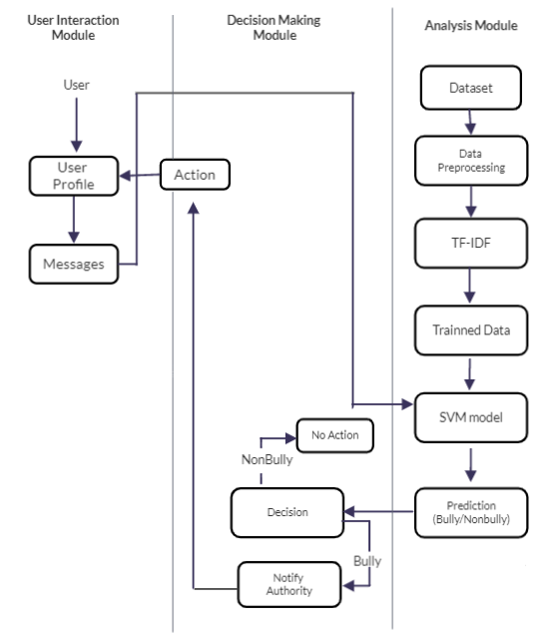
Detailed Design :
Block Diagram
Cyber Bullying Detection and Prevention in Web Chat Application

Slide 6
Specific Requirements :
Hardware Requirements:
Computer System with RAM: 4GB or 8GB
Software Requirements:
Visual Studio Code
Jupyter Notebook
Tools and Technologies Used:
Python Programming Language
Django Web Framework
Support Vector Machine (SVM)
HTML, CSS, and JavaScript
Dataset:
Cyberbullying Classification Dataset

Slide 7
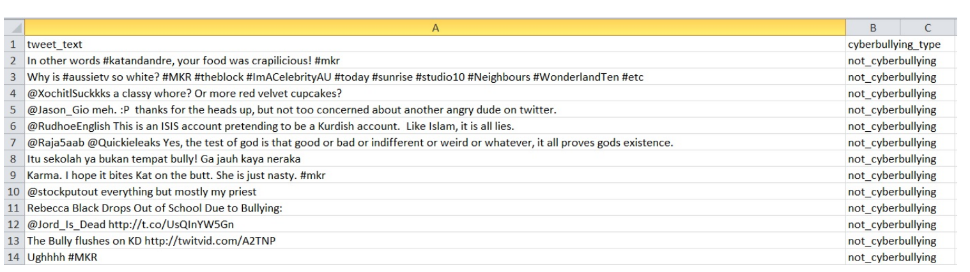
Dataset:
Cyberbullying Classification Dataset
The dataset used for this project consists of more than 47,000 tweets that have been labeled according to the class of cyberbullying. It provides valuable insights into the prevalence and impact of cyberbullying in the context of social media usage. The dataset includes information related to various categories, such as age, ethnicity, gender, religion, and other types of cyberbullying.

Slide 8
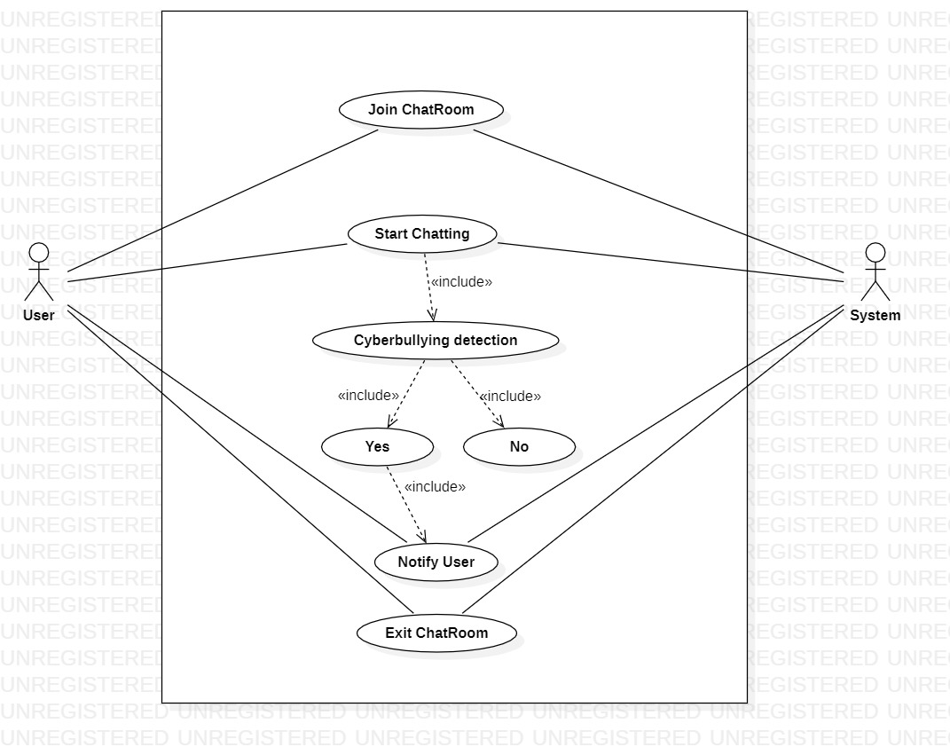
Detailed Design / UML Diagrams
1. Use Case Diagram
Cyber Bullying Detection and Prevention in Web Chat Application

Slide 9

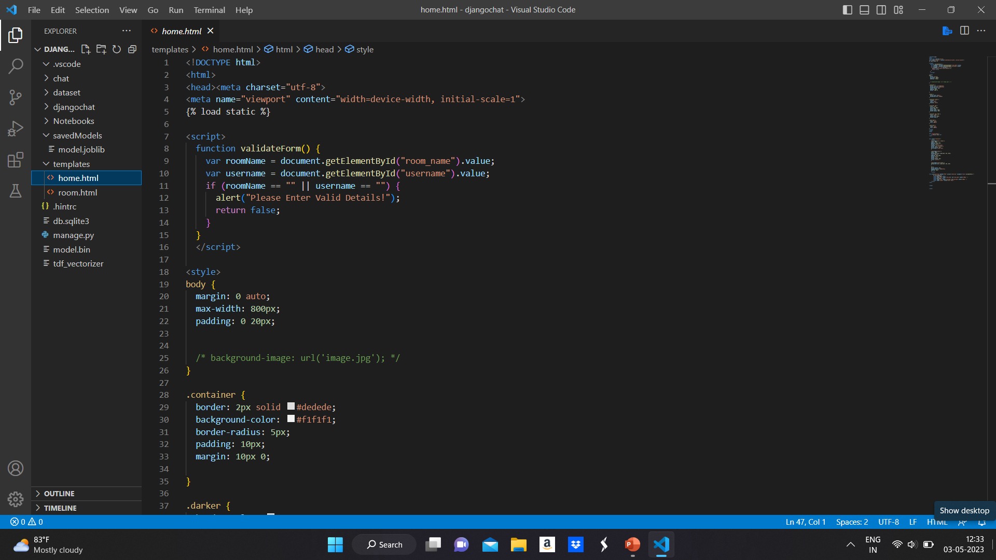
Implementation:
Cyber Bullying Detection and Prevention in Web Chat Application

Slide 10

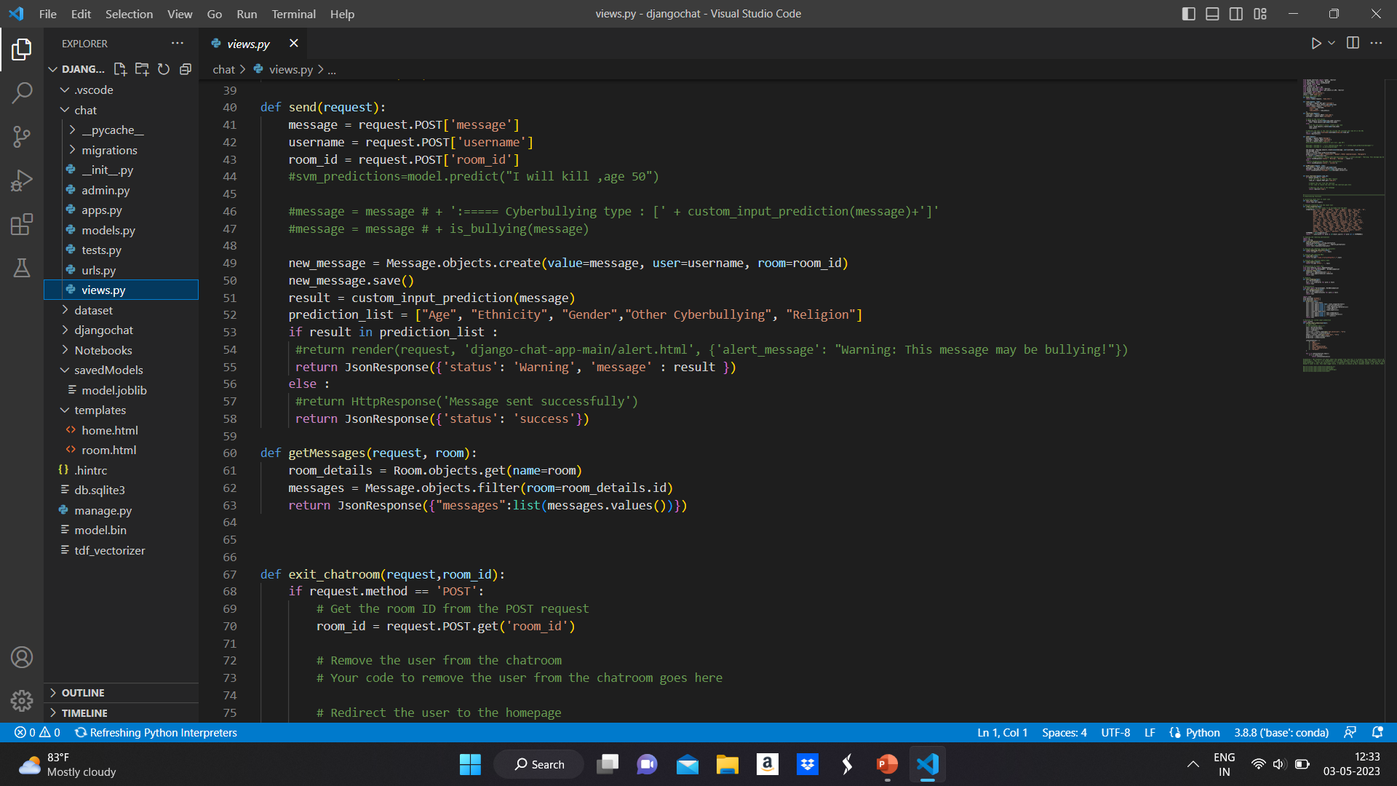
Cyber Bullying Detection and Prevention in Web Chat Application

Slide 11

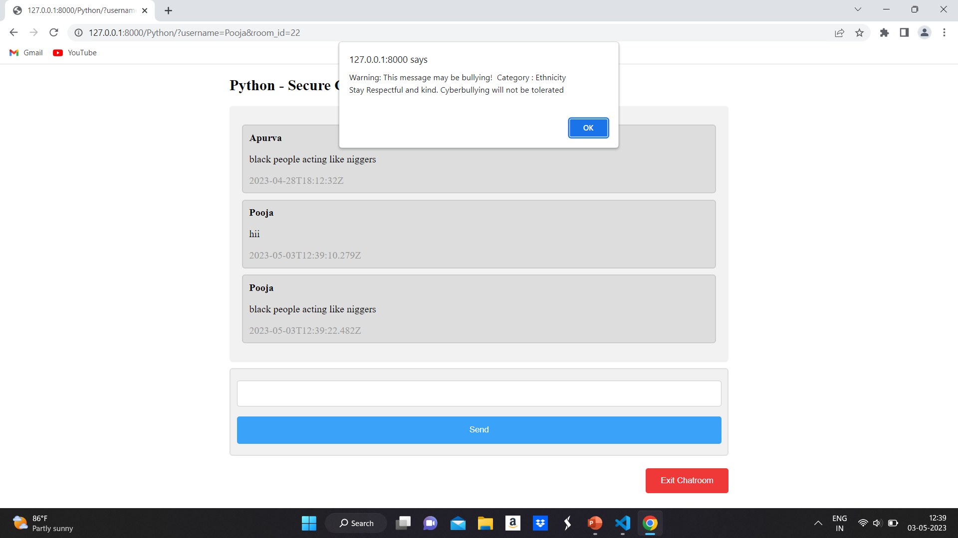
Result:
Cyber Bullying Detection and Prevention in Web Chat Application

Slide 12

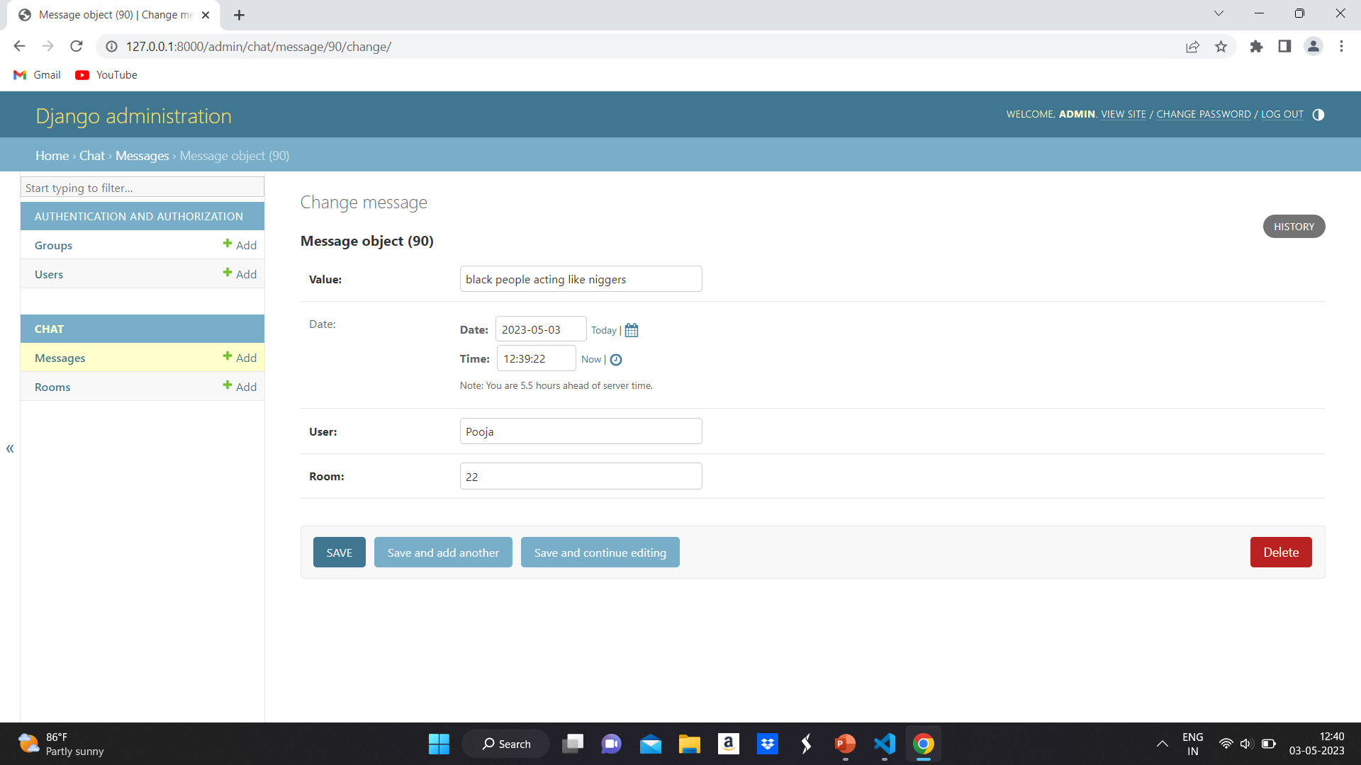
Cyber Bullying Detection and Prevention in Web Chat Application

Slide 13
Conclusion
The web chat application provides a safe and secure platform for users to connect with people. The machine learning model integrated with the chat application detects the toxicity of a chat. If the message is bulled, then the system sends an alert to the user with the type of cyberbullying of the message. Hence users will be able to live and maintain their healthy social life.

Slide 14
THANK YOU !!

