Slide 1
Employee Salary Analysis
STUDENT NAME: ROHINI V
REGISTER NO: 312204613, 915ED92FC9E7632871B46549DE5C10C0
DEPARTMENT: Commerce
COLLEGE: K.C.S Kasi Nadar College of Arts and Science

Slide 2
PROJECT TITLE
Employee Salary Analysis

Slide 3
AGENDA
Problem Statement
Project Overview
End Users
Our Solution and Proposition
Dataset Description
Modelling Approach
Results and Discussion
Conclusion
3/21/2024 Annual Review

Slide 4
PROBLEM STATEMENT
The Employee Salary Analysis project aims to evaluate salary distribution, identify disparities, and provide recommendations for fair compensation.
Average salary, Age of employee According to their
Department, gender and role.
Compare the organization's salary structure with industry standards and competitors

Slide 5
PROJECT OVERVIEW
The project will involve collecting and analyzing salary data across various departments and roles.
Key objectives include understanding pay equity, evaluating compensation competitiveness, and providing recommendations for adjustments
1. Tables
2. Slicer
3. Pivot Chart(Line Chart, Pie Chart, Bar Chart)
4.By inserting formula to make interactive dashboard

Slide 6

WHO ARE THE END USERS?
Specialist
IT and Data Management Team
HR Department
Finance Department
Compensation and benefit
Operational manager

Slide 7
OUR SOLUTION AND ITS VALUE PROPOSITION
Advanced Analytical tools
Formulas and function
Pivot tables
Visual representation
Charts and graphics
Scenario analysis
Used to analyses different situation
User friendly interface
Accessibility
Ease of use
5. Comprehensive data management
Data organization
Data integration

Slide 8
Dataset Description
Data Overview
The data for the Employee Salary Analysis includes employee salary records, job titles, departments, years of experience, performance ratings, and demographic information.
2. Data fields
Id
Name
Surname
Age
Tenure
Gender
Region
Department
Manager
Hours
Salary band
FTE Salary
Salary
Performance

Slide 9
MODELLING
Data cleaning.
Creating table
Creating pivot chart.
Creating dashboard.
Inserting pivot chart in dashboard.
Inserting formulas in dash board to make interaction
.Creating interactive dashboard by putting all together elements
9

Slide 10
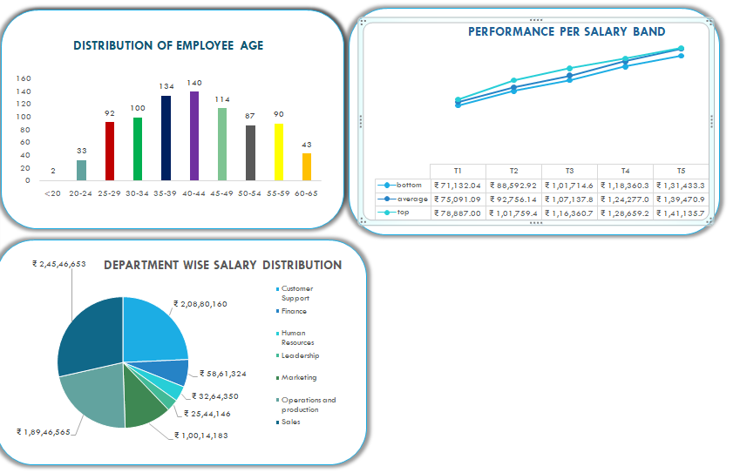
RESULTS
10

Slide 11
conclusion
With out the compensation or compensation Administration a company can't use its full resources because the people of the organization need motivation to do the work so by compensation any organization can use its full resources to earn maximum profit.
The major challenges what manager face today is retention of the man power and the major cause of it is that they are paid better in the other organization
Wages and salary adminiztaration must fix the wages in that way which enough for employee to fulfill his basic needs and organization are able to pay that wage.

