Slide 1
Prog Found Data Science & AI (DSA-5100-0)
An Intelligent Intrusion Detection System Using the CIC-IDS-2017 Dataset
Under the guidance of
Prof. Meongsu Lee, Ph.D
Rohini Muniganti 700762192

Slide 2
Problem Statement
Building a Simple & Accurate Network Intrusion Detection System
Cyberattacks are exploding → millions of incidents every day
Traditional firewalls & signature-based tools fail against new/zero-day attacks
Real-world example:
DDoS, Port Scanning, Web Attacks, Botnets, SQL Injection, Heartbleed still common in 2025
Many attacks hide inside normal-looking traffic
Current commercial systems are slow, expensive, or miss rare but dangerous attacks
We need a system that:
→ Detects both common and super-rare attacks
→ Runs fast on normal computers
→ Uses simple, explainable models (not black-box deep learning)
→ Achieves near-perfect accuracy
Project Goal:
Build a lightweight, accurate, and practical ML-based IDS using the famous CIC-IDS-2017 dataset that can detect 15 different attack types — including the rarest ones — in real network traffic.

Slide 3
Solution
Dataset: CIC-IDS-2017 (real + simulated traffic from Canadian Institute for Cybersecurity)
Dataset: CIC-IDS-2017 (8 CSV files → ~2.8M flows)
Cleaned & merged into one DataFrame
Fixed imbalance → balanced dataset (~190k flows, max 20k per class)
Tested 8 fast ML models with default settings
Trained on 80%, tested on 20% (stratified)
Goal: Highest accuracy + fastest training
Simple, fast, fully runs in Colab → practical IDS ready to deploy!

Slide 4
Dataset & Data Exploration
CIC-IDS-2017 Dataset
5 days of traffic → 8 CSV files → ~2.8 million flows
79 features (flow duration, packet sizes, etc.)
15 classes: BENIGN + 14 attack types (DDoS, PortScan, Web Attack, Heartbleed, etc.)
Originally very imbalanced (80% BENIGN)
After balancing (max 20,000 per class):
All attacks visible and fairly represented
Rare attacks (Heartbleed, Web Attack) fully kept
Final dataset: ~190,000 flows → fast to train

Slide 5
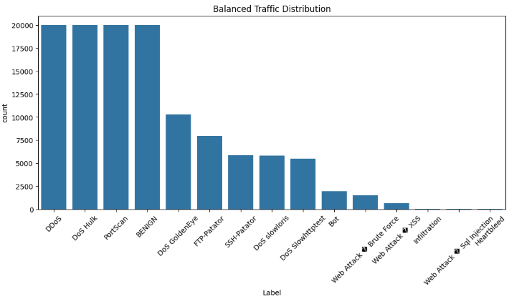
Dataset & Data Exploration

Slide 6
Machine Learning Models
Models We Tested (All Simple & Fast)
Random Forest
Extra Trees
Decision Tree
Neural Network (MLP)
K-Nearest Neighbors
Logistic Regression
Naive Bayes
All trained with default settings for fair comparison
Goal: Find the most accurate + efficient model

Slide 7
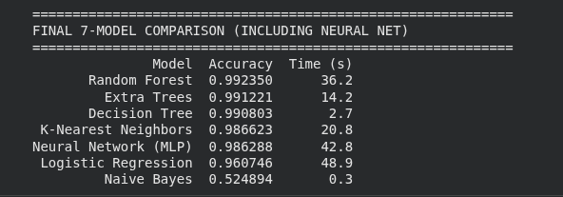
Results
Results
Tree-based models win easily (>99% accuracy)
Random Forest is the best: highest accuracy + reliable on rare attacks
No need for complex neural networks — simple models are faster and better here
Even Heartbleed (only 11 samples) was detected correctly

Slide 8
Conclusion
Successfully built a real-world-ready intrusion detection system using CIC-IDS-2017
Cleaned & merged 8 daily CSV files → created a balanced ~190k dataset
Compared 8 simple ML models with default settings
Tree-based models dominated: all top-3 achieved >99% accuracy
Random Forest is the clear winner: 99.24% accuracy, trains in ~44 seconds
Detected all attack types, even rare ones (Heartbleed, Web Attack – Sql Injection, Infiltration)
Simple classical models beat neural networks in both accuracy and speed

