Slide 1

Department of Electronics and Telecommunication
“IoT Based Onions Preservation”
Paper ID : 33
Vinay Sidawadkar (16EX329 )
Dipak Gavhale (16EX314 )
Rohini Ahire (16EX301)
Shankaranand Lohare (16EX320 )
Project Guide:
Dr.P.P.Vast

Slide 2
Contents
Introduction
Literature Review
Literature Survey
Need of Project
Problem Statement
Objectives
System Specifications
Block Diagram
T002/ Version 1.0

Slide 3

Hardware and software used
Simulation
Result
Future Scope
Application
Conclusion
References

Slide 4
Introduction
IoT Based Onions Preservation
Introducing IoT based onion preservation system.
Able to control and monitor the preservation process.
Owners will get notifications about recent market trends.

Slide 5
Literature Review
Sr.no | Authors | Paper Title | Year (Chronological Order | Publication | Method adopted/Solution Provided
1. | Mokshi Vyas (Student, IT Dept, JSPM College, Pune, India) | Post harvesting Onion Storage Methodology Using IOT | May 2019 | International Journal of Advanced Research in Computer and Communication Engineering | By integrating gas,moisture,temperature & humidity with arduino. GSM module to send notification to user
2. | D. Jude Hemanth | An Intelligent IoT-Based Food Quality Monitoring Approach Using Low-Cost Sensors | January 2017 | Symmetry Magzines | By integrating gas,moisture,temperature & humidity with arduino. GSM module to send notification to user
T002/ Version 1.0

Slide 6
Literature Review
Sr.no | Authors | Paper Title | Year (Chronological Order | Publication | Method adopted/Solution Provided
3. | S.A.Pawar, P.V.Shinde, V.G Wagh | Cost Effective Long-Time Preservation & Reporting of ‘Onion Rotting & Onion Decay’ with Online Feedback | January 2017 | International Journal of Advanced Research in Electrical, Electronics and Instrumentation Engineering | This system consist of sensors, actuators, microcontroller and router(for online wireless feedback).
4. | Walter E. Matson (Extension agricultural engineer, Oregon State University) | Onion Storage Guidelines for Commercial Growers | May 1985 | A Pacific Northwest Extension | Guideline for onion storage & preservation peripherals

Slide 7
Literature Survey
Nowadays farmers uses traditional method for onion preservation.
Existing electronic system gives only alert after onion decay.
The available system is not efficient.
Cost of cold storage is high.
T002/ Version 1.0

Slide 8
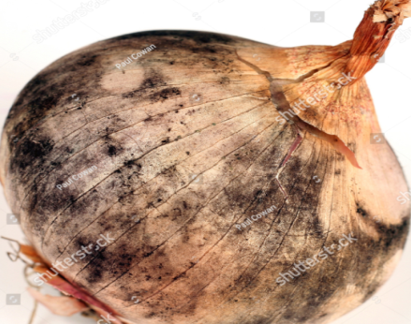
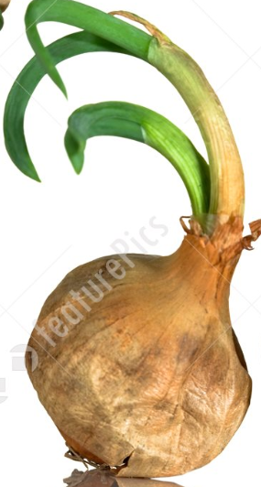
Need of project
India ranks second in onion production in the world.
Onion is extremely important not only as a vegetable but also a foreign exchange earner among the fruits and vegetables.
Onion is having high level of water content.
Due to the continuous change in indian climate onions can rot or decay. Therefore onions should be preserved by maintaining the temperature given by the National Onion Association.

Slide 9
Problem statement
Develop a system which monitors and control the onion preservation process and give acknowledgement to user on mobile phones.
T002/ Version 1.0

Slide 10
Objectives
To study the different onion preservation techniques.
To study the Peltier effect.
To design the proposed system.
To monitor onion conditions under the proposed system.
T002/ Version 1.0

Slide 11

System Specifications
Electrical specifications :
- Input voltage : 12V
- Input current : 2A
- Output temperature range : -18℃ to 50℃
- Power : 72 to 90W
- Cooling time : 1hr30min(2ft x1ft box)
Mechanical specification:
- Dimension: 3ft x 4ft

Slide 12
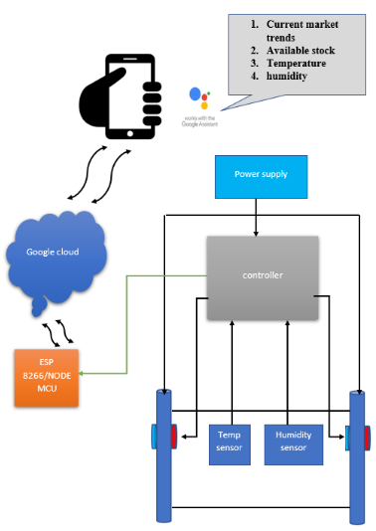
Block Diagram

Slide 13

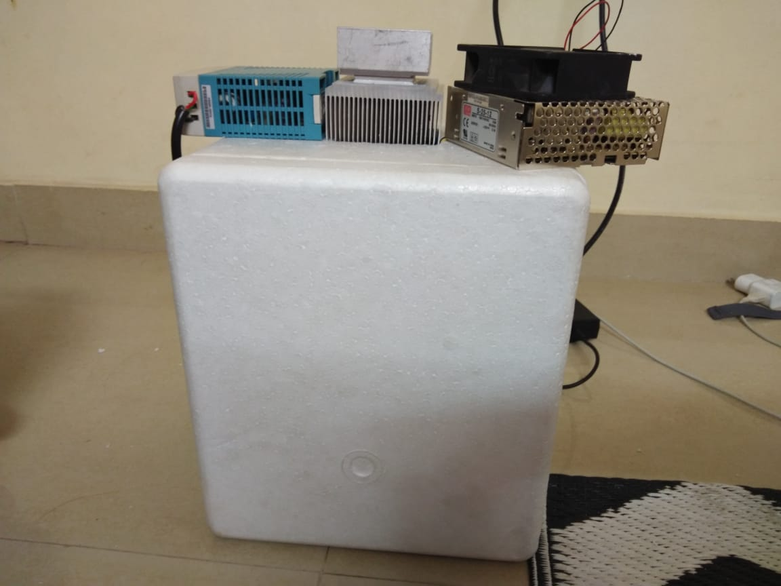
Hardware :-
ATMega328P
LM35
Peltier tile (TE12706)
Wifi Module
Power Supply
Heat Sink
Cooling Fans

Slide 14
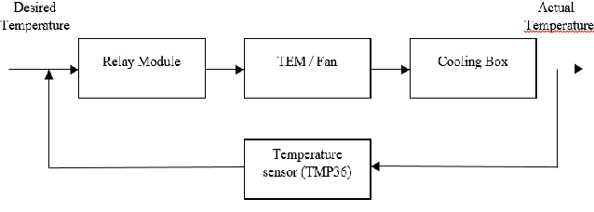
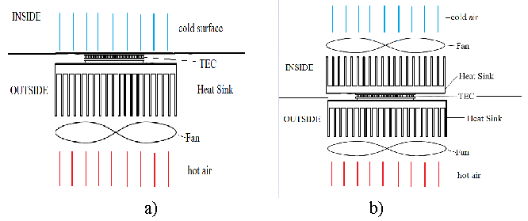

Slide 15
Software :-
Proteus Software
Flowcode Software

Slide 16

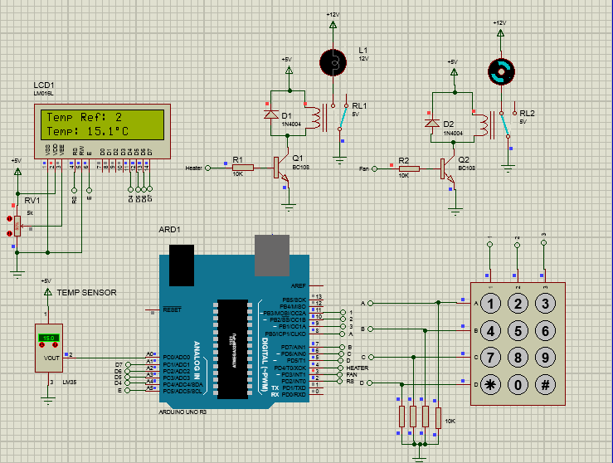

Slide 17
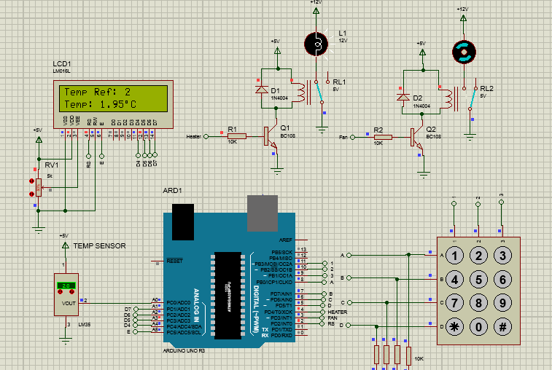

Slide 18

According to our design
For given set temperature the cooling and heating system is operated.
For disscipation of heat we design heat sink.

Slide 19

This system can be used for other vegetables and fruits.
Used to preserved flower.
As quantity increase we also increase size of system accordingly.

Slide 20
Application
Preservation of onions for long duration.
Used to stored and transport decoration flowers for long time.
Notifications for recent market trends for onion.

Slide 21

We proposed the conception and implementation of a system for preserving onion based on IoT .
This system is able to control the temperature inside the cell required for the onion preservation by monitoring outside temperature.
Also studied the Peltier effect for cooling and heating.

Slide 22
References
[1] Mokshi Vyas, Rutuja Gore, Manali Misal, Sneha Jagtap, Prof. S.V. Todkari
“Post harvesting Onion Storage Methodology Using IOT” IJARCCE Vol. 8, Issue 5, May 2019
[2] D. Jude Hemanth etal “An Intelligent IoT-Based Food Quality Monitoring
Approach Using Low-Cost Sensors” Symmetry 13 March 2019
[3] S.A.Pawar, P.V.Shinde, V.G Wagh “Cost Effective Long-Time Preservation and
Reporting of ‘Onion Rottening and Onion Decay’ with Online Feedback” International Journal of Advanced Research in Electrical,
Electronics and Instrumentation Engineering Vol. 6, Issue 1, January 2017
[4] Walter E. Matson “Onion Storage Guidelines for Commercial Growers” A Pacific Northwest Extension Publication May 1985
T002/ Version 1.0

Slide 23
THANK YOU!!!!!!!!

