Slide 1
DBA COURSE PROJECT
Team-1
Roll Number | Name | USN
517 | Madhura Nagaraj Nayak | 01FE19BCS285
520 | Soumya N Jakkali | 01FE19BCS288
523 | Rohini K Katti | 01FE19BCS291
539 | Apeksha P Gaonkar | 01FE19BCS309

Slide 2
Problem Statement: Flower Bouquet Management System
This projects aims to design and implement the data base which helps the floral shop to maintain the records of every operations taking place and manage the shop effectively.

Slide 3
Problem Description
Floral shop management is a comprehensive system that coordinates various operations of the shop.
The distributor meets the demand of the shop based on the requirements.
Manager hold the record of all the customers and employees.
Customer places order. The employee delivers the order based on the orderline of the product which is with respect to a particular occasion once.
The payment is made by the customer either through cash or credit card.

Slide 4
Data Requirement
A distributor is identified by a distributor id, name, address and phone number.
The Shop is identified by shop id, name, address and phone number.
Owner is identified by uid , name ,address, phone number ,gender.
A customer is identified by customer id, name , address ,phone number, age and gender.
An employee is identified by employee id, name, address, phone number, start date, age,gender and salary.
Order contains order number and order date.
Orderline contains orderlinenumber and quantity.
Flower item has Flower item code, name, price, occasion code, occasion name.
Payment has payment id, amount to be paid and payment method(cash or credit card)

Slide 5
Functionalities
Many distributor distributes flower to different shops. So cardinality is M:N
A shop can have more than one employees. So cardinality is 1:N
A shop is managed by an employee (manager). So cardinality is 1:1
A customer places many orders. So cardinality is 1:N
Many order can have a orderline. So cardinality is N:1
An employee delivers many orders. So cardinality is 1:N
Many orderlines have single flower item. So cardinality is N:1
A owner can have many shops .So cardinality is N:1.
A customer makes payment only once. So cardinality is 1:1

Slide 6
IDENTIFIED ENTITY
Distributor: Attributes: Distributor id, name, address(street,city,state,pincode), phone number.
Shop: Attributes: Shop id, name, address( street ,city , state, pincode), phone number(multivalued).
Employee: Attributes: Employee id, name(first,middle,last) address (street,city,state,pincode), phone number, age(derived),gender,start date,salary.
Customer: Attributes: Customer id, name, address(street number,house number,city,state,pincode), phone number,age,gender.

Slide 7
IDENTIFIED ENTITY
5. Order: Attributes: Order number, order date.
Orderline: Attributes: Orderlines number(secondary key), quantity.
Owner: Attributes: UID, name,gender,phone number,address((street,city,state,pincode).
Flower item: Attributes: Flower item code, name, price,occasion(code,name).
Payment: Attributes: Payment id, amount, payment method.

Slide 8
Functional Requirements
Inserting and deleting the flower items
Inserting and deleting the employee details
Details of all the customers who placed orders.
Viewing the bill with respect to the customer .
Viewing purchased records.
Details of the flower items based on their demand and sales.
Viewing the discount rate given to the customer as per his purchases.
Viewing daily purchases.

Slide 9
Relationships Identified
Distributor distributes flower to shop.
Shop has a owner.
Shop has employees.
Shop is managed by Employee(Manager).
Customer places order.
Employee delivers order.
Order has orderlines.
Orderlines has flower item.
Customer makes payment.

Slide 10
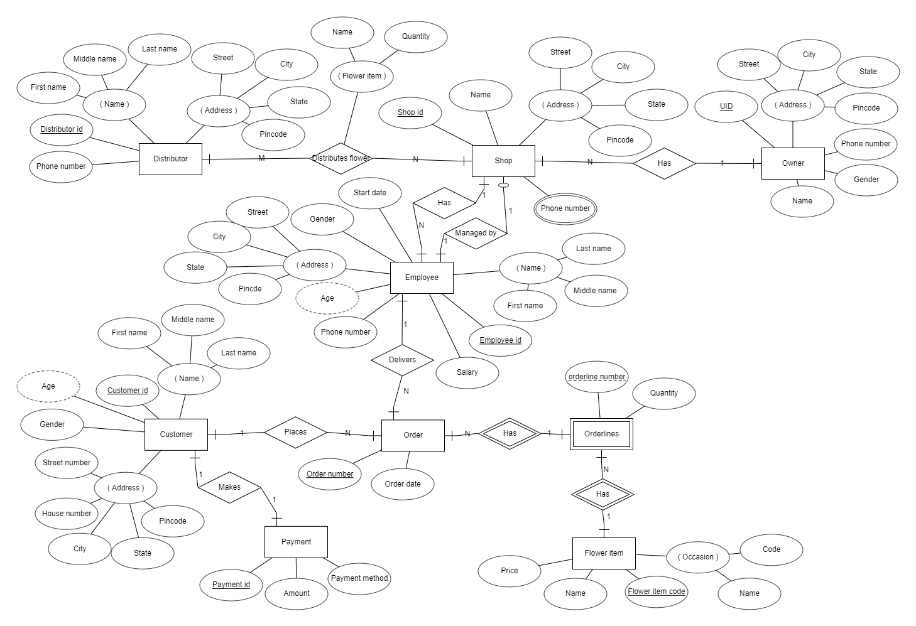
ER Diagram

Slide 11
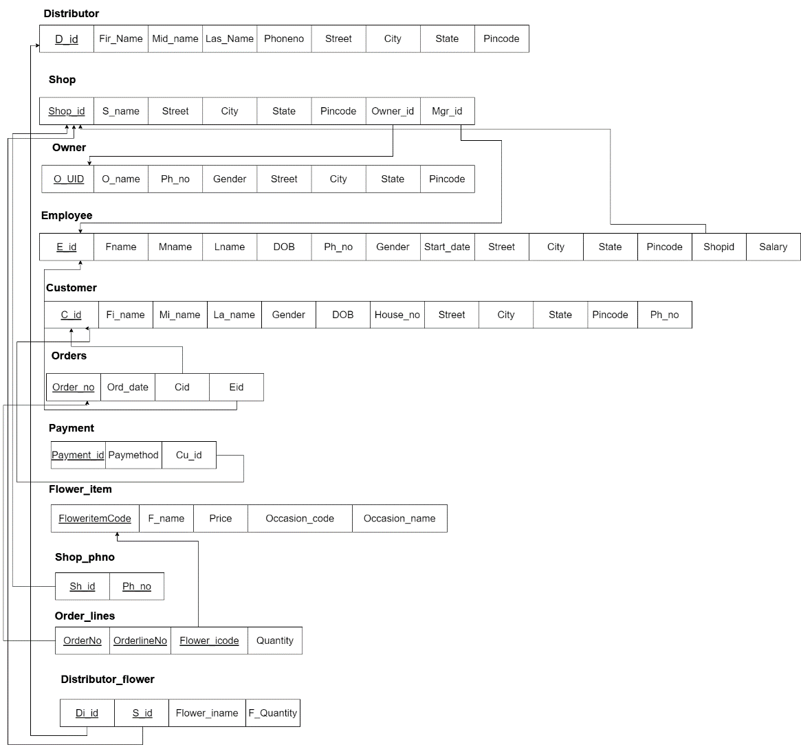
Relational Model

Slide 12
Normalization
Distributor(D_id,Fir_name,Mid_name,Las_name,Street,City,State,Pincode, Phone number) 1.The relation is in 1NF as it has atomic valued attributes. 2.The relation is in 2NF since, every attribute is fully functionally dependent on the key. 3.There is no transitivity in functional dependencies for this relation. Hence the relation is in 3NF.
Shop(Shop_id, S_name, Street, City, State, Pincode, Owner_id,Mgr_id) 1.The relation is in 1NF as it has atomic valued attributes. 2.The relation is in 2NF since, every attribute is fully functionally dependent on the key. 3.There is no transitivity in functional dependencies for this relation. Hence the relation is in 3NF.

Slide 13
Normalization
Owner(O_UID,O_name, Gender, Ph_no, Street, City, State, Pincode) 1.The relation is in 1NF as it has atomic valued attributes. 2.The relation is in 2NF since, every attribute is fully functionally dependent on the key. 3.There is no transitivity in functional dependencies for this relation. Hence the relation is in 3NF.
Employee(E_id, Fname, Mname, Lname, Gender, Ph_no,DOB,Street, City, State,Pincode,Shopid,Startdate,Salary) 1.The relation is in 1NF as it has atomic valued attributes. 2.The relation is in 2NF since, every attribute is fully functionally dependent on the key. 3.There is no transitivity in functional dependencies for this relation. Hence the relation is in 3NF.

Slide 14
Normalization
Customer(C_id, Fi_name, Mi_name, La_name, Gender, DOB, House_no, Street, City, State, Pincode,Ph_no) 1.The relation is in 1NF as it has atomic valued attributes. 2.The relation is in 2NF since, every attribute is fully functionally dependent on the key. 3.There is no transitivity in functional dependencies for this relation. Hence the relation is in 3NF.
Order(Order_no, ord_date,Cid,Eid) 1.The relation is in 1NF as it has atomic valued attributes. 2.The relation is in 2NF since, every attribute is fully functionally dependent on the key. 3.There is no transitivity in functional dependencies for this relation. Hence the relation is in 3NF.

Slide 15
Normalization
Payment(Payment_id, Paymethod, Cu_id) 1.The relation is in 1NF as it has atomic valued attributes. 2.The relation is in 2NF since, every attribute is fully functionally dependent on the key. 3.There is no transitivity in functional dependencies for this relation. Hence the relation is in 3NF.
Flower_item(Floweritemcode, F_name, Price, Occasion_code, Occasion_name) 1.The relation is in 1NF as it has atomic valued attributes. 2.The relation is in 2NF since, every attribute is fully functionally dependent on the key. 3.There is no transitivity in functional dependencies for this relation. Hence the relation is in 3NF.

Slide 16
Normalization
Shop_phno(Sh_id,Ph_no) 1.The relation is in 1NF as it has atomic valued attributes. 2.The relation is in 2NF since, every attribute is fully functionally dependent on the key. 3.There is no transitivity in functional dependencies for this relation. Hence the relation is in 3NF.
Orderlines(OrderNo,OrderlineNo, Flower_icode,Quantity) 1.The relation is in 1NF as it has atomic valued attributes. 2.The relation is in 2NF since, every attribute is fully functionally dependent on the key. 3.There is no transitivity in functional dependencies for this relation. Hence the relation is in 3NF.

Slide 17
Normalization
Distributor_Shop(Di_id, S_id, Flower_iname,F_Quantity) 1.The relation is in 1NF as it has atomic valued attributes. 2.The relation is in 2NF since, every attribute is fully functionally dependent on the key. 3.There is no transitivity in functional dependencies for this relation. Hence the relation is in 3NF.

Slide 18
Front End
Qt Designer was used for designing the front end.
For programming purpose we used Pycharm and Visual studio.
Sqlite is the database which we used for developing the front end.
In the Front end user can perform inserting new entry, deleting data , searching based on Id and displaying details of information related to management of shop.

Slide 19
THANK YOU

