Slide 1


Hotel Booking Analysis
File created on: 11/29/2020 2:06:25 PM
ROHINI KANUNGO

Slide 2

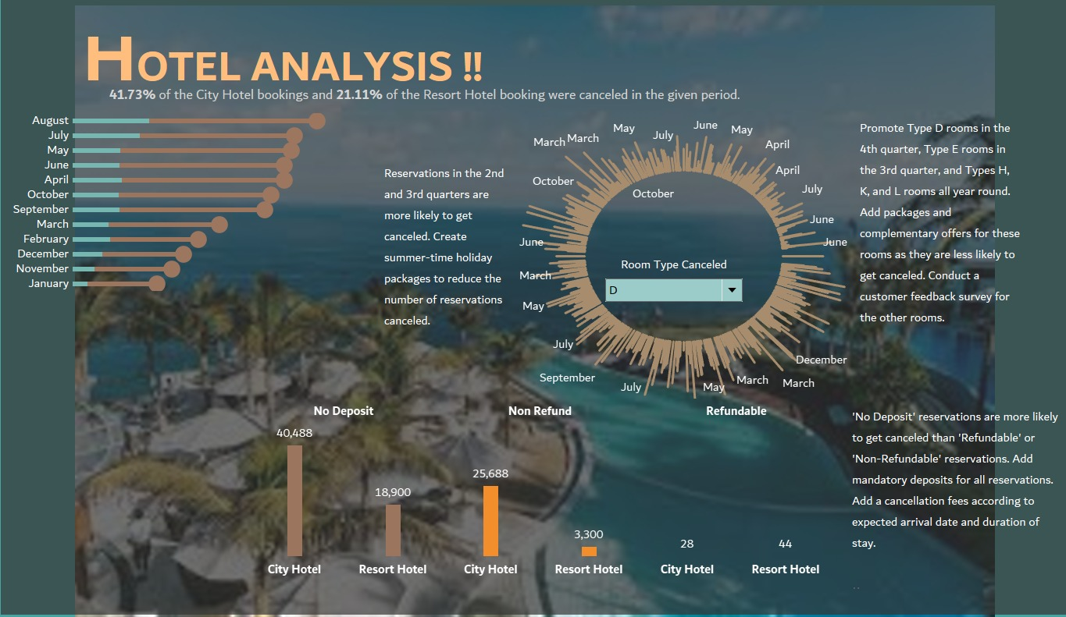




Slide 3
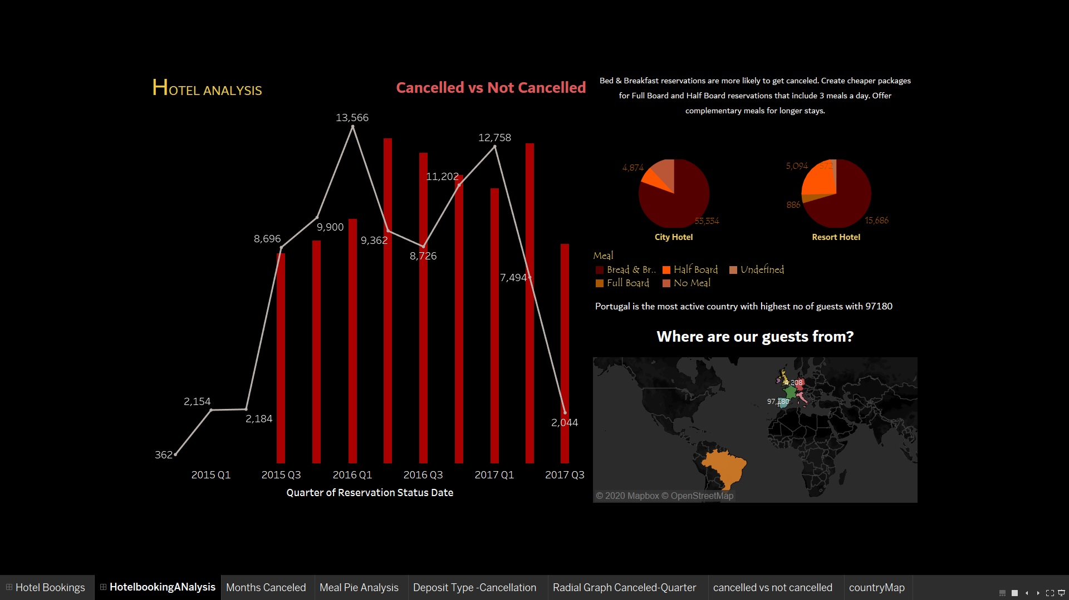

Slide 4
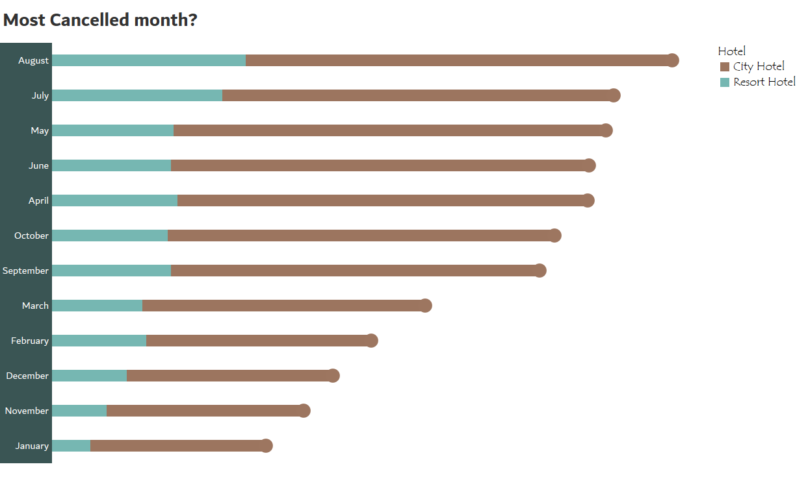

Slide 5
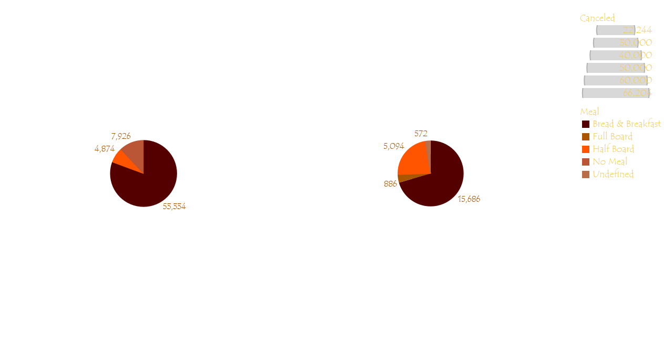

Slide 6
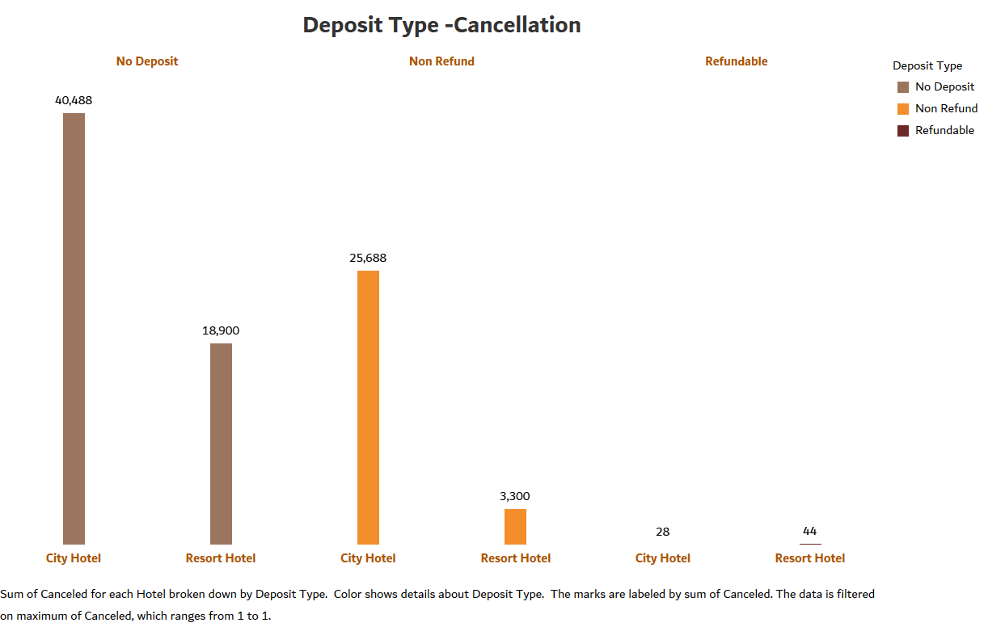

Slide 7
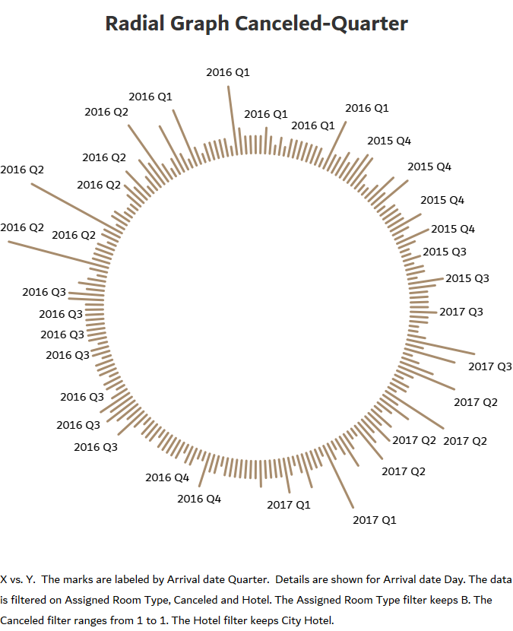

Slide 8
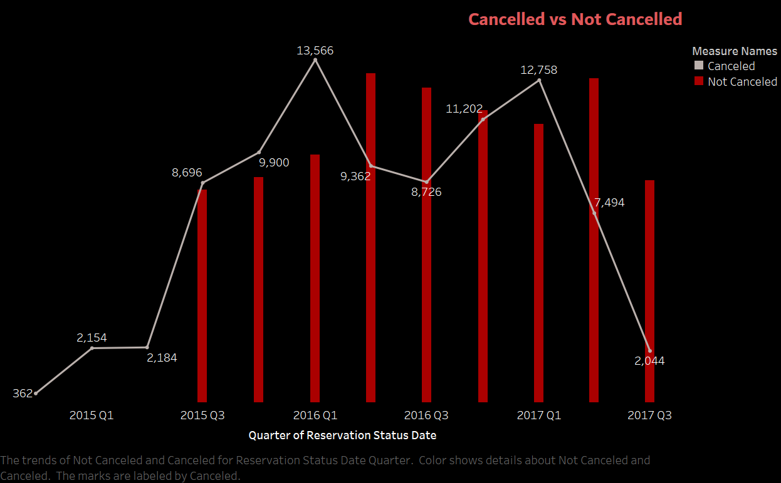

Slide 9
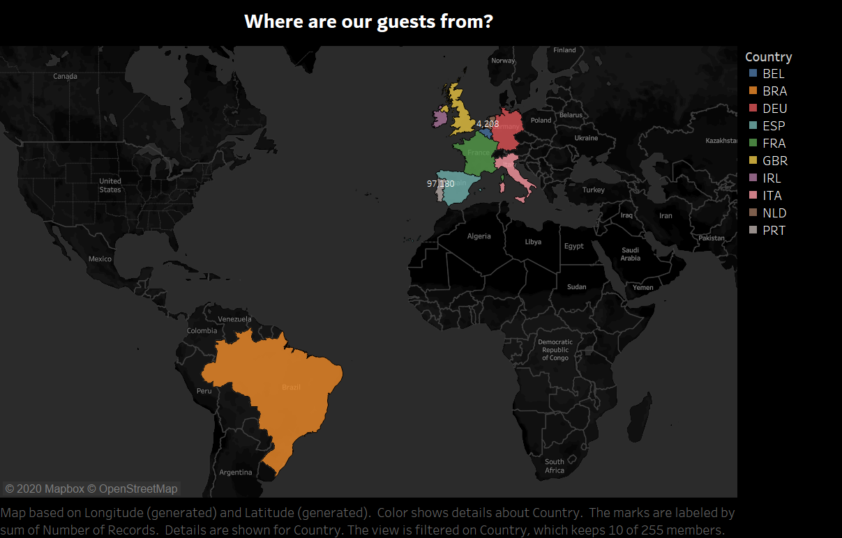

Slide 10


Slide 11
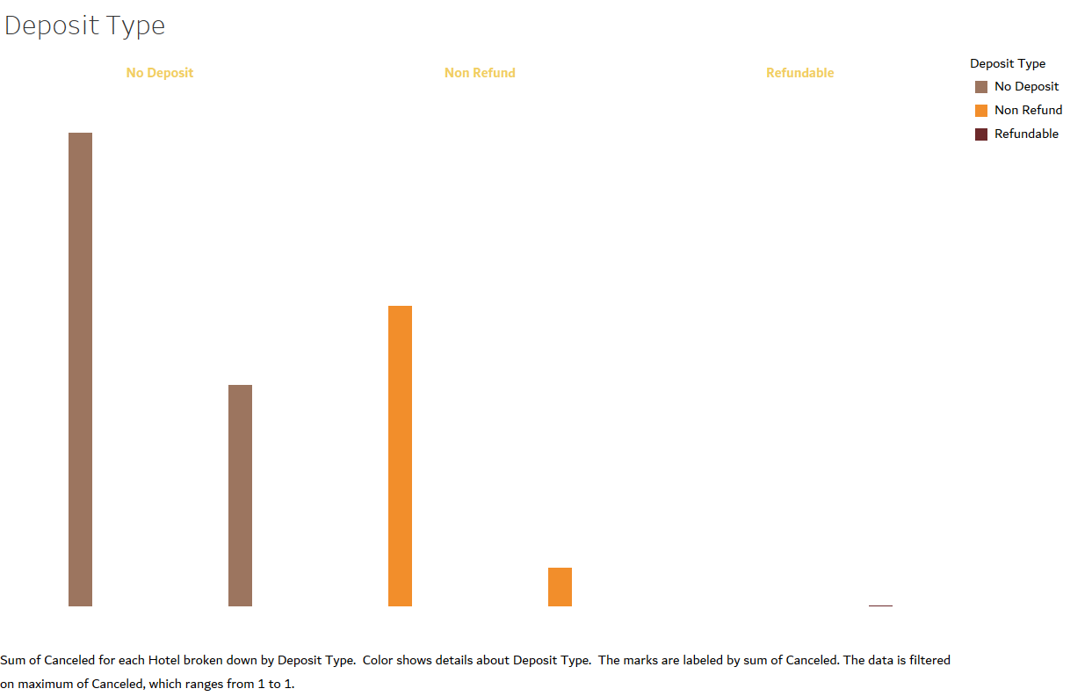

Slide 12
CONCLUSION:This is the visualization shows about cancellation of hotels and its analysis, the secret of powerful decision making is to create an insightful visualization , my visualization will help hotel management in knowing the most cancelled month, the room type cancelled and also on the reservations based on payment and much more.
I have analyzed and also recommended appropriate suggestions for hotel management to take required steps to increase revenue.

