Slide 1

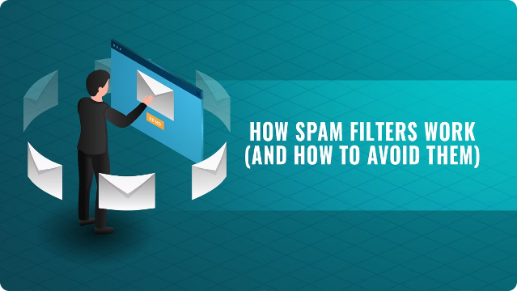
Introduction to Spam Classification
Spam classification is the process of identifying and filtering unwanted or unsolicited emails, also known as spam. These emails can range from advertisements and promotional materials to phishing attempts and malware distribution. Spam classification is essential for protecting users from harmful content and improving email communication efficiency.

Slide 2
Computational Complexity Theory
Time Complexity
Space Complexity
Spam filters need to process a large volume of emails quickly, so efficient algorithms are crucial. Time complexity measures the time taken by an algorithm to complete a task based on the input size.
Spam filters often store training data and models. Space complexity measures the amount of memory required by an algorithm during execution, including the storage of data structures and variables.

Slide 3


Algorithms for Spam Classification
1
Naive Bayes
This probabilistic classifier calculates the probability of an email being spam based on the presence of certain words or features.
2
Support Vector Machines (SVMs)
SVMs are supervised learning models that find optimal hyperplanes to separate data into classes. They are effective for high-dimensional data and can be used for spam classification.
3
Neural Networks
Deep learning models, such as recurrent neural networks (RNNs), can learn complex patterns and relationships in email content. These models have shown promising results in spam detection.

Slide 4





Challenges and Limitations
Evolving Spam Tactics
Spammers are constantly adapting their techniques, making it challenging for traditional filters to stay ahead.
False Positives
Spam filters may incorrectly flag legitimate emails as spam, leading to lost communication and user frustration.
Language and Cultural Differences
Spam filters may struggle to identify spam in languages they are not trained on, making it difficult to protect users globally.

Slide 5

Conclusion and Future Directions
Hybrid Approaches
Combining multiple algorithms and techniques can improve accuracy and resilience against evolving spam tactics.
User Feedback
Integrating user feedback into spam detection systems can provide valuable information about the effectiveness of filters and help improve their accuracy.
Real-time Analysis
Developing real-time spam detection systems can provide faster and more effective protection against evolving spam threats.

