Slide 1

Virtualization Strategy for Distributed Enterprises
Done by : Rohinth.R (192225115)

Slide 2

Virtualization Strategy for Distributed Enterprises
This presentation outlines a comprehensive virtualization strategy designed for medium-sized enterprises with geographically distributed offices. The strategy focuses on optimizing resource utilization, ensuring high availability, and streamlining management across multiple locations.

Slide 3

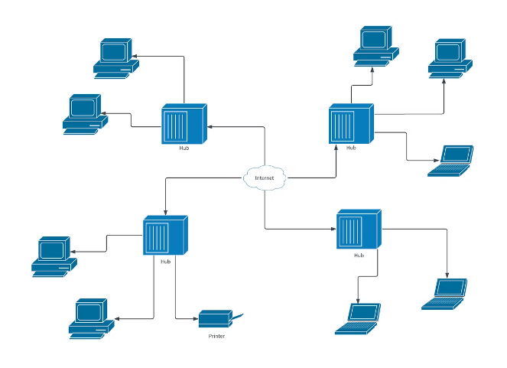
Aim, Scope, & Problem Statement
The aim of this virtualization strategy is to enhance efficiency and cost-effectiveness within the IT infrastructure of distributed enterprises. The scope encompasses all aspects of virtualization, from infrastructure design to application deployment. The primary problem addressed is the challenge of managing and optimizing resources across geographically dispersed locations.
Increased Resource Utilization
Virtualization enables consolidation of physical servers, reducing hardware costs and energy consumption.
Enhanced High Availability
Virtualized environments provide redundancy, ensuring continuous operation even in case of hardware failures.
Streamlined Management
Centralized management of virtualized resources simplifies administration across multiple locations.

Slide 4
Proposed Architecture Design
The proposed architecture design leverages industry-standard virtualization technologies and best practices. This approach ensures scalability, resilience, and optimal resource utilization.
Key Components
Functionality
Architectural Design
Hypervisor
Server Consolidation
The architecture will utilize a hypervisor-based approach with centralized management. Virtual machines will be deployed across multiple physical servers in each location, with a shared storage network ensuring data availability. Network virtualization will enable seamless communication between virtual machines.
Virtual Machines
Application Isolation
Storage Area Network (SAN)
High Availability Clusters
Network Virtualization
Disaster Recovery
Management Console
Centralized Management

Slide 5
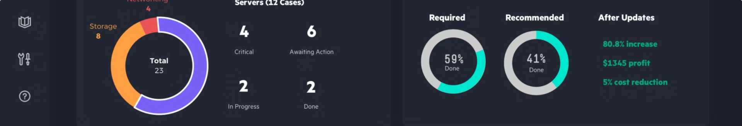
GUI Design
The GUI design prioritizes user-friendliness and intuitive navigation. The interface provides a clear overview of the virtualized environment and facilitates easy management of resources.
1
Clear Layout
2
User-Friendly Features
3
Color Selection
The interface will utilize a well-structured layout with intuitive icons and labels, making it easy for administrators to navigate and understand.
The color scheme will be carefully selected to provide visual clarity and minimize eye strain. High-contrast colors will be used for important information and alerts.
The GUI will include features such as drag-and-drop functionality, search capabilities, and customizable dashboards to enhance user experience.

Slide 6

Implementation
The implementation process involves connecting the various components of the virtualization platform and deploying it in a cloud environment.
Connecting the Components
This step involves integrating the hypervisor, virtual machines, storage network, and management console to create a cohesive virtualization platform.
Project Testing
Thorough testing will be conducted throughout the implementation process to ensure the platform meets all requirements and operates as expected.
1
2
3
Cloud Deployment
The platform will be deployed in a cloud environment, leveraging the scalability and flexibility offered by cloud infrastructure.

Slide 7


Conclusion
This virtualization strategy provides a comprehensive approach to optimize resource utilization, ensure high availability, and streamline management across geographically distributed enterprises. By implementing this strategy, organizations can enhance efficiency, reduce costs, and improve overall IT performance.

