Slide 1

Hosting a Static website on S3
A Summer Internship Report submitted in partial fulfilment of the requirements for the award of degree of
BACHELOR OF TECHNOLOGY
In
CSE (Artificial Intelligence
and machine learning)
Submitted by:
D.Rohit Sai Anjan
22MH1A42F7
Department Of CSE (Artificial Intelligence and machine learning)
ADITYA COLLEGE OF ENGINEERING
Approved by AICTE, Permanently affiliated to JNTUK & Accredited by NAAC with ‘A’ Grade Recognized by UGC under the sections 2(f) and 12(B)of the UGC act 1956 Aditya Nagar, ADB Road –Surampalem 533437, E.G. Dist., A.P., 2022-2023

Slide 2

OUTLINES:
Abstract
What is Amazon S3?
Benefits of Hosting on S3
Setting Up an AWS Account and S3 Bucket
Configuring S3 Bucket Properties
Setting Bucket Policies and Permissions
Uploading and Managing Website Files
Enabling Static Website Hosting
Testing and Optimizing the Website
Conclusion

Slide 3
Abstract
This project demonstrates the implementation of hosting a static website using Amazon S3. We configured an S3 bucket to serve as the hosting platform, enabling static content delivery with high availability and scalability. By setting appropriate bucket policies and permissions, we ensured secure public access to website files while maintaining compliance with best practices. Additionally, we integrated custom domain support and enabled website redirection to enhance user experience. This architecture highlights the simplicity and efficiency of deploying static websites on AWS, providing a cost-effective solution for hosting web applications.

Slide 4

What is Amazon S3?
Amazon Simple Storage Service (S3) is a highly scalable, secure, and durable cloud storage service offered by AWS.
Key Features:
Object Storage: Stores data as objects with metadata in buckets.
Scalable: Seamlessly scales to handle any amount of data.
Secure: Offers encryption, access controls, and bucket policies.
High Availability: Built with redundancy for uninterrupted access.
Use Cases:
Hosting static websites.
Storing backups and archives.
Serving media files for applications.
Big data analytics and processing.
S3 is cost-effective and ideal for use cases ranging from simple file storage to complex cloud-native applications.

Slide 5

Benefits of Hosting on S3?
Cost-Effective:
Pay only for storage and data transfer, making it ideal for small-scale websites.
Scalability:
Automatically scales to handle any traffic volume without manual intervention.
High Availability:
Offers built-in redundancy and ensures the website is always accessible.
Ease of Use:
Simplified setup process with minimal maintenance requirements.

Slide 6
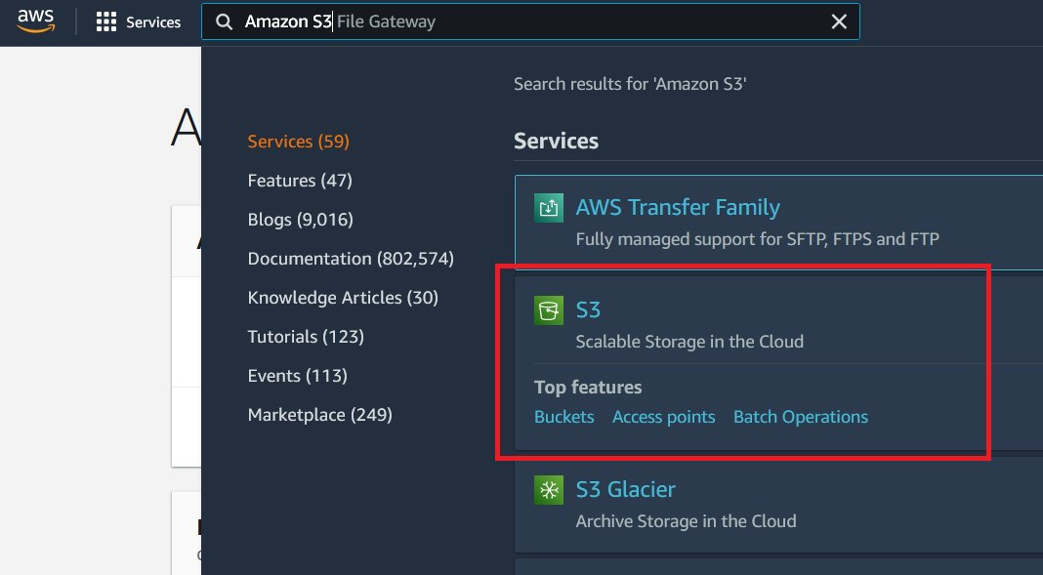
Setting Up AWS Account and S3 Bucket
Create an AWS Account:
Sign up for an AWS free-tier account to get started.
Access the S3 Console:
Navigate to the S3 service in the AWS Management Console.
Create a Bucket:
Choose a globally unique name for your bucket.
Select the appropriate AWS region for hosting.

Slide 7

Configuring S3 Bucket Properties
Public Access Settings:
Adjust public access settings in the Permissions tab to allow or restrict access.
Versioning:
Enable versioning to keep multiple versions of an object in the same bucket.
Useful for recovering accidentally deleted or overwritten files.
Bucket Encryption:
Enable server-side encryption to protect data at rest.
Choose from AWS-managed keys (SSE-S3) or customer-managed keys (SSE-KMS).
Enable compliance or governance mode for long-term data retention.
Logging and Monitoring:
Activate server access logging to track requests made to the bucket.
Use Amazon CloudWatch to monitor usage metrics and performance.

Slide 8
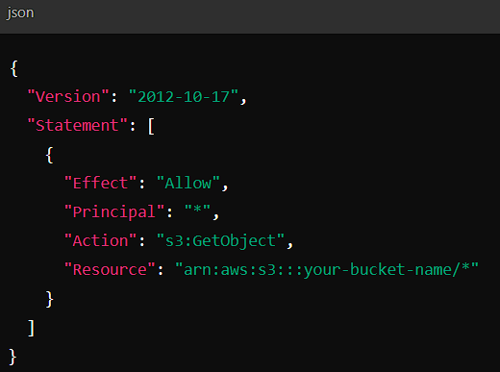
Setting Bucket Policies and Permissions
Public Access Policy:
Add a bucket policy to allow read-only access to website files for all users.
Example JSON Policy: Ensure only necessary access is granted.
IAM Roles and Permissions: Assign roles to control administrative access to the bucket.
Steps to Add a Policy:
Go to the bucket’s Permissions tab.
Edit the bucket policy by pasting a JSON policy.
Best Practices:
Avoid granting unnecessary permissions to prevent unauthorized access.
Regularly review and audit bucket permissions to maintain security.

Slide 9
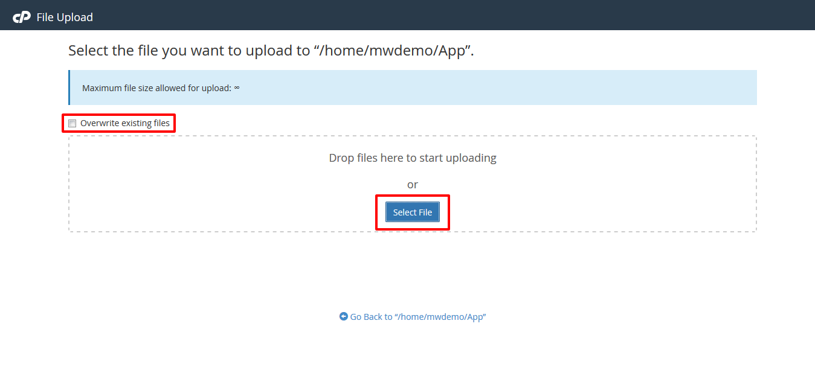
Uploading and Managing Website Files
Upload Website Content:
Use the AWS Management Console or CLI to upload HTML, CSS, JS, and media files.
Organize Folder Structure:
Arrange files into folders like /css, /js, and /images for better management.
Object Properties:
Set cache control for improved website performance.
Manage Updates:
Replace outdated files by uploading new versions.
Enable versioning to keep old versions for rollback.
Custom Error Page:
Include a 404.html file for handling missing pages gracefully.

Slide 10

Enabling Static Website Hosting
Activate Website Hosting:
In the S3 bucket settings, enable the static website hosting option.
Specify the index (e.g., index.html) and error document (e.g., error.html).
Custom Domain Setup:
Link a custom domain using Route 53 or an external DNS provider.
Configure CNAME or Alias records for domain redirection.

Slide 11
Testing and Optimizing the Website
1
Test the Website:
Access the website using the provided S3 bucket endpoint or custom domain.
2
Optimize Performance:
Use CloudFront for content delivery to enhance speed and reduce latency.
3
Monitor and Maintain:
Use AWS monitoring tools to analyze website traffic and performance.

Slide 12
Conclusion
In conclusion, hosting a static website using Amazon S3 is a simple, cost-effective, and efficient solution that leverages the power of cloud technology. By utilizing S3’s scalability, high availability, and security features, developers can deliver reliable and globally accessible web experiences with minimal effort. This process demonstrates how AWS empowers users to deploy static websites effortlessly, making it an ideal choice for modern, lightweight web applications and content delivery.

Slide 13


Slide 14
Thank You

