Slide 1

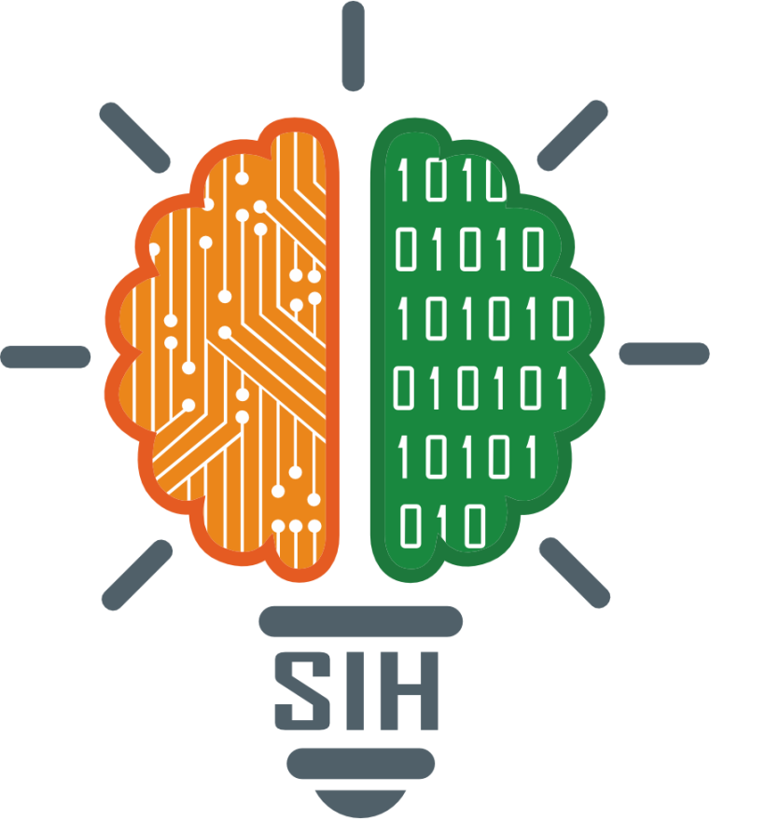
SMART INDIA HACKATHON 2025
TITLE PAGE
Problem Statement ID – SIH25024
Problem Statement Title - Comprehensive Cloud-Based Practice Management & Nutrient Analysis Software for Ayurvedic Dietitians, Tailored for Ayurveda-Focused Diet Plans
Theme - MedTech / BioTech / HealthTech
PS Category- Software
Team ID- CIH25ID29
Team Name - SynerSix

Slide 2
AyurDiet: Intelligent Ayurvedic Nutrition Platform
SynerSix
PROPOSED SOLUTION :
We propose an AI-powered Ayurvedic Diet Management Software that digitizes the process of creating and managing patient diet charts in hospitals. The platform integrates modern nutritional science with core Ayurvedic dietary principles to provide personalized, accurate, and holistic diet recommendations.
A dynamic food database (100+ items) enriched with both nutrient data (calories, protein, fat, carbs) and Ayurvedic properties (Rasa – taste, Guna – qualities, Virya – potency, Vipaka – post-digestive effect, Dosha impact, digestibility).
Automated diet chart generator that considers patient profile (age, gender, digestion, bowel habits, lifestyle, health conditions) and generates Ayurveda-compliant balanced diet plans.
Mobile + Web support for use by both practitioners and patients, with printable diet charts and reports.
PROBLEM ADDRESSING:
Digitization of manual processes, Integration of Ayurveda with modern nutrition, Time & accuracy benefits for doctors, Clarity for patients
INNOVATION AND UNIQUENESS:
AI Knowledge Base for Patients – Patients can input symptoms (e.g., acidity, fatigue, constipation) and get preliminary Ayurvedic food guidance.
Traditional Ayurvedic wisdom + modern data + AI - Existing nutrition software focuses on calories and macros, making it globally relevant but India-first.
Diverse Food Database – A rich dataset combining North Indian, South Indian, and international cuisines ensures cultural inclusivity and global adaptability.
Symptom-to-Diet Mapping – AI recommends foods and recipes aligned with Ayurvedic treatment principles while simultaneously cross-checking modern nutrition

Slide 3
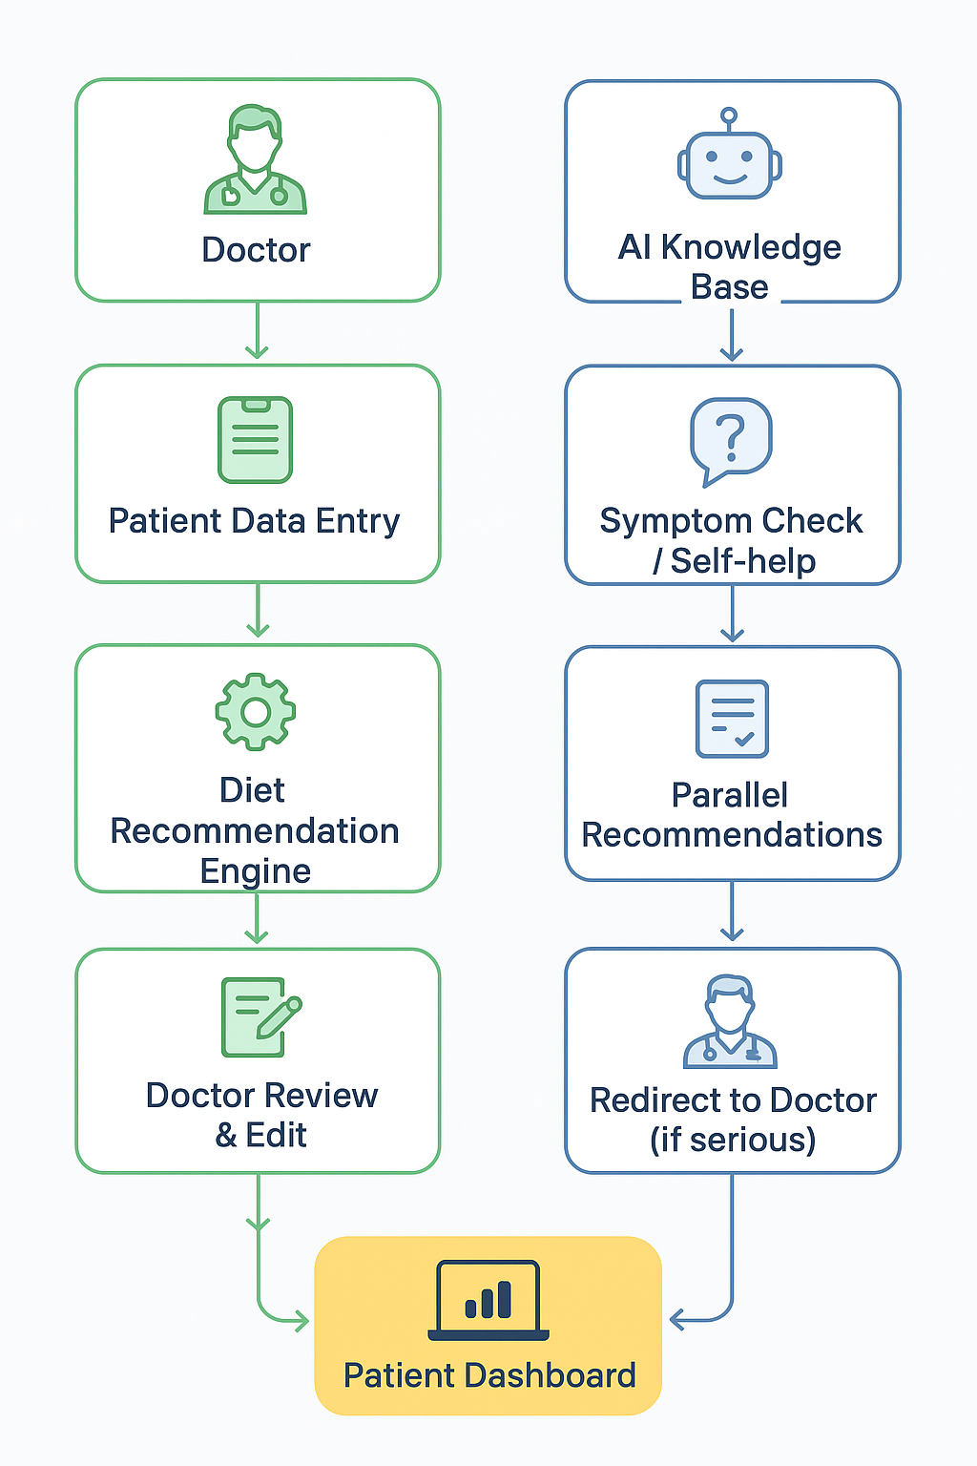
TECHNICAL APPROACH
SynerSix
TECHNOLOGY STACK:
Frontend: HTML, CSS, JavaScript, React.js
Backend: Python (Flask)
Database: MySQL for structured storage
AI/ML: Python, Gemini API Key
Deployment: Google Cloud Platform
The AI Knowledge Base takes patient inputs such as symptoms and disease details and analyzes them using a curated Ayurvedic dataset. It identifies the possible root causes based on doshas (Vata, Pitta, Kapha) and Ayurvedic principles.
Using Gemini AI, it then provides personalized recommendations, including diet plans, herbal remedies, and lifestyle changes, offering a holistic, natural approach to managing health conditions.

Slide 4
FEASIBILITY AND VIABILITY
SynerSix
FEASIBILITY ANALYSIS:
Technical: Built using Flask, MySQL, and a responsive dashboard; cloud deployment ensures scalability across multiple hospitals.
Operational: Converts handwritten diet charts into structured, digital records; simplifies storage, retrieval, and patient tracking.
Market: Unique Ayurveda-driven approach; high adoption potential in hospitals, wellness centers, and telemedicine.
CHALLENGES & RISKS:
Data Standardization: Ayurvedic principles (Rasa, Guna, Dosha) vary across regions.
Accuracy & Validation: Incorrect recommendations could affect patient trust or outcomes.
Adoption Resistance: Doctors/patients may prefer traditional methods over digital workflow.
Regulatory Compliance: Must follow AYUSH guidelines and healthcare data laws.
STRATEGIES:
Standardization: Expert-reviewed food-condition database for consistency.
Phased AI Integration: Start rule-based; gradually enhance with AI/ML for personalized recommendations.
User-Centric Design: Doctor-friendly interface with editing options, printable reports, and minimal workflow disruption.
Security & Compliance: Role-based access, encryption, and regular audits.

Slide 5
IMPACT AND BENEFITS
SynerSix
Potential Impact on Target Audience
Patients: Get personalized Ayurvedic diet plans → improved health outcomes, reduced dependency on trial-and-error treatments.
Doctors: Save time with automated charting, better accuracy in diet recommendations, and focus more on critical patients.
Hospitals/Healthcare: Improved efficiency, reduced manual errors, and streamlined patient care.
Benefits
Social: Increases accessibility of Ayurvedic nutrition for all (urban + rural), empowers patients with self-help tools
Economic: Reduces hospital re-visits, saves the cost of repetitive consultations/tests, scalable AI reduces doctor workload.
Environmental: Encourages plant-based, seasonal, and regionally-sourced diets → lower carbon footprint, supports sustainable food habits.
Technological: Integrates AI + Ayurveda, first-of-its-kind in India with potential for global adoption.

Slide 6
RESEARCH AND REFERENCES
SynerSix
Research
Current Scenario: Ayurvedic diet charts in hospitals are mostly handwritten → risk of errors, difficult to store & retrieve, time-consuming.
Existing Tools:
Ntuitive, NutriAdmin → Excellent nutrient analysis, but lack Ayurveda dosha/rasa integration.
AyurEHR, VaidyaManager → Ayurveda-specific EMR systems, but limited nutrient breakdown or AI-based diet suggestions.
Gap Identified : No single platform that combines modern nutrient science + Ayurvedic dietetics + AI-powered personalization.
Feasibility: Cloud + AI solution can serve multiple hospitals/clinics, support tele-consultation & remote diet tracking.
Reference link
Ministry of Ayush :The official government portal for Ayurveda and other traditional Indian medicine systems in India.
https://ayush.gov.in/#!/
Technology Documentation:
Python / Flask Docs: https://flask.palletsprojects.com
TensorFlow AI Docs: https://www.tensorflow.org
Research Papers / Journals
IEEE Xplore: https://ieeexplore.ieee.org
Springer Link: https://link.springer.com
Scientific Review – Ayurveda & Food
https://pmc.ncbi.nlm.nih.gov/articles/PMC4815005/

