Slide 1
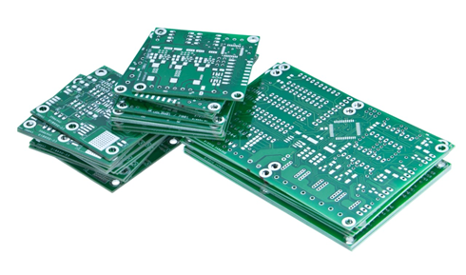
Project Based Learning
Holistic Development :Outcome Based Education
for A. Y.2020-21
PBL Activity
DATE: 09/04/21

Slide 2
Guidelines for Students
State /Identify the Problem for the implementation in consultation with your faculty member
Generate the idea to solve the problem with technical solution
Identify the Learning issues related to it
Emphasis on Self directed Learning through literature survey
Suggest the technical / Practical Implementable feasible Solution
Identify the team members and Build the team
Evaluate the theoretical results and surveys if any
Identify the Design ,Synthesis and application
Present the results
Emphasis on Reflection of results, development experience, challenges and feedback in informative way and documentation.
Co relate the overall learning experience and future scope
GA6
GA5
GA3
GA1
GA10
GA8
GA11
GA7
GA2
GA9
GA12

Slide 3
Contents
Title of the Project
Social Problem Identification (Need of the project in Society )
Technical Solution (your solution in the form of your Project )
Abstract (Description of your Project)
Proposed Methodology/ Algorithm
Future Lens: To understand the future opportunities and challenges (Future Scope)
User Lens : Identification the key people/points , group and organization that have direct influence of your project.
Result

Slide 4
Title of the Project-Problem Statement –GA6 (5mks)
ONLINE EDUCATIONAL GAME DESIGN : COMPOSITE FFT
E&TC-A Group NO:- 17
Jagdish Lohar (36)
Rohit Pal (46)
Vimlesh Pathak (53)

Slide 5
Social Problem Identification –GA1 (5mks)
Students often find difficulty in understanding a particular topic or concept in particular a subject because the topic is not engaging or intuitive enough .
Games help us tap into positive emotions, like curiosity, optimism, creativity. You enjoy it just for the sake of enjoying.
These emotions stay up hours after we play. Playing games bring people together, it is the competition among peers that adds adrenaline.
After a success in a game, we are more likely to set an ambitious goal for ourselves, even outside of gaming.

Slide 6
Technical Solution-GA2 (5mks) (your solution in the form of your Project )
Composite FFT is a difficult topic. Many students skip the topic.
To help students in learning Composite FFT very easily, we have applied gamification in the learning of FFT.
As it is proved, students learn faster & get engaged in learning when the are having fun.
We have tried to make Composite FFT more fun by using the snake & Ladders game in which objective questions will be asked based on the topic.

Slide 7
Application of your project -GA3 (5mks)
This project has application in making students learn composite FFT faster and in intuitive way with the help of games.
Also the questions are objective, student need not to memorise any topic. It will make him think on the question as explanation is also provided for the incorrect answers.

Slide 8
Abstract (Description of your Project) (5mks)
In snake and ladder board game, we find that the minimum number of dice throws required to reach the destination or last cell from source or 1st cell.
If the player reaches a cell which is base of a ladder, the player has to climb up that ladder.
If reaches a cell is mouth of the snake,then a question will appear and if answered correctly the player stays there else drops down.

Slide 9
Proposed Methodology/ Algorithm-GA4 (5mks)
Playing Snakes & Ladder
If player got bitten by snake, a question will appear.
If player answers correct then he will stays there else he will move to tail of snake.
The Game continues…

Slide 10
Development Experience –GA7 (5mks)
The development experience was quite good. while making a project we also learn different concept of python e.g about Tkinter library.
We also learnt about the ghaphics using python. The understanding that experience provides about the Project and that developes technologies interface with each other.
It give us a huge advantage in making sure our project are completed effectively and efficiently.

Slide 11
Identify the Learning issue faced by your team-GA8 (5mks)
During project development, we came across major issue which slow down the development. Initially there was problem with the position of the player. It was solved by working more on the methods.
There was also a problem when the players answer wrong then also it was at the same position. This was solved by changing the colors of the position.

Slide 12
User Lens : Identification the key people, group and organization that have direct influence of your project : Build the team and team efforts –GA9 (5mks)
This project will have impact on students who might have find composit FFT less interesting . This project will help them to make learning composite FFT fun and intuitive.
Also educational institutions such as engineering colleges can use this project to engage students in learning/testing this topic very easily.

Slide 13
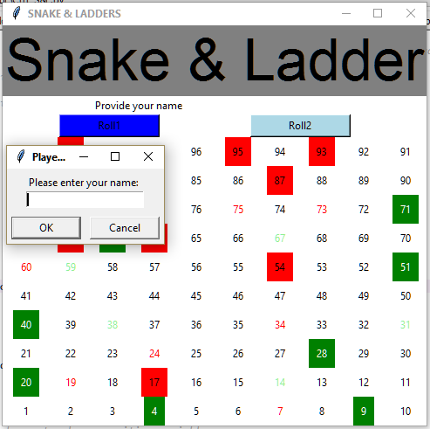
Result Presentation –GA10 (5mks)
Build the team and team efforts

Slide 14
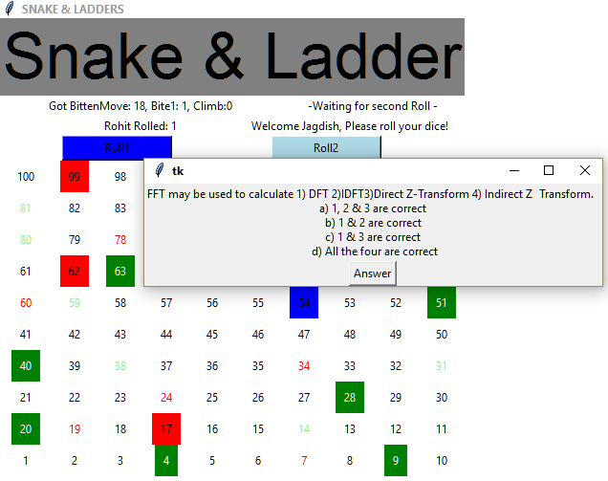
Result Presentation –GA10 (5mks)
Build the team and team efforts

Slide 15

Result Presentation –GA10 (5mks)

Slide 16
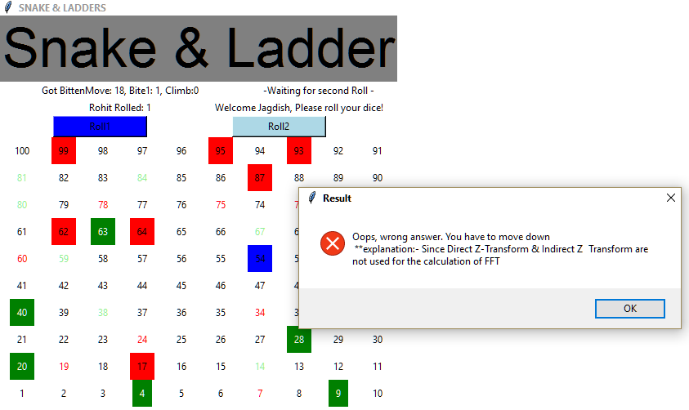
Result Presentation –GA10 (5mks)
Build the team and team efforts

Slide 17
Learning From the Project –GA11 (5mks)
Python is one of the most popular programming languages currently we have learned Python in 4th semester. Using those concept which we have study and studying new concept we have implemented a Snake and Ladder game.
Like Tkinter Library which provides a fast and easy way to create GUI applications. Tkinter provides a powerful object-oriented interface to the Tk GUI toolkit and counter in python.
The best things is we learnt about how theoretical knowledge is applied and many other things are required for implementing any project.

Slide 18
Future Lens: To understand the future opportunities and challenges (Future Scope)-GA12 (5mks)
It can be made with very high quality graphics.
We can add more options like Player Profile, top scores(player winning in least time).
We can add multiplayer option. More topics of various subjects can be added to increase its scope.

Slide 19
THANK YOU!
Any questions?

