Slide 1

A Pseudo Live Project
Project Code Module
Micro Service

Slide 2
Team Members :
1 | Krishna Mohan Verma
2 | Rohit Aditya Sahoo
3 | Piyush Kumar Pathak
4 | Shivendra Singh
5 | Mounika A
6 | Nishant Kumar Singh
7 | Amarendra Singh

Slide 3
Table of Contents
Sl No | List of Topics
1 | Introduction
2 | Add Project Details
3 | Validations
4 | Modify a project
5 | Search a project based on its project code
6 | Modify a project based on its project code

Slide 4
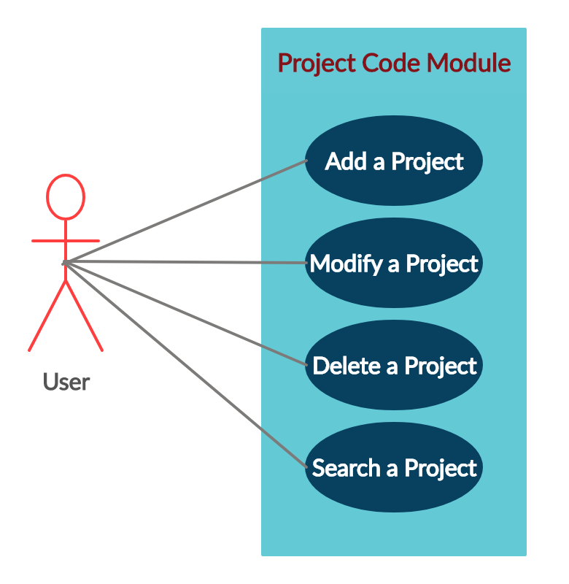
1: Introduction
The project aims at developing an Expense Management System as integration of all independent micro services.
In this project, there are four independent micro services. We were assigned with the task of project code module micro service.
Following is a list of functionalities of the system. There is a user who can perform the following functions using this micro service .
Add project details
Modify project details
Delete a project details based on its project code
Search a project based on its project code

Slide 5
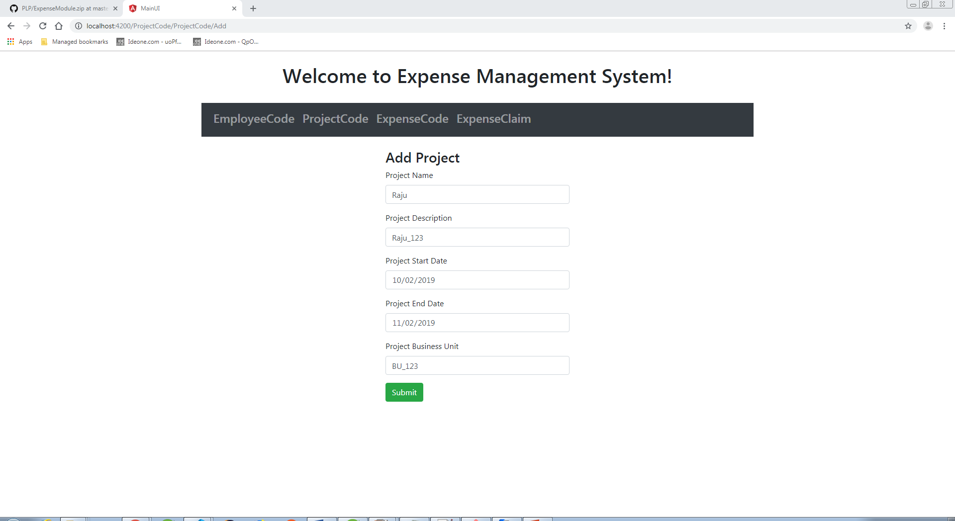
2: Add project details
The required fields to add a
project into the database
were as follows

Slide 6
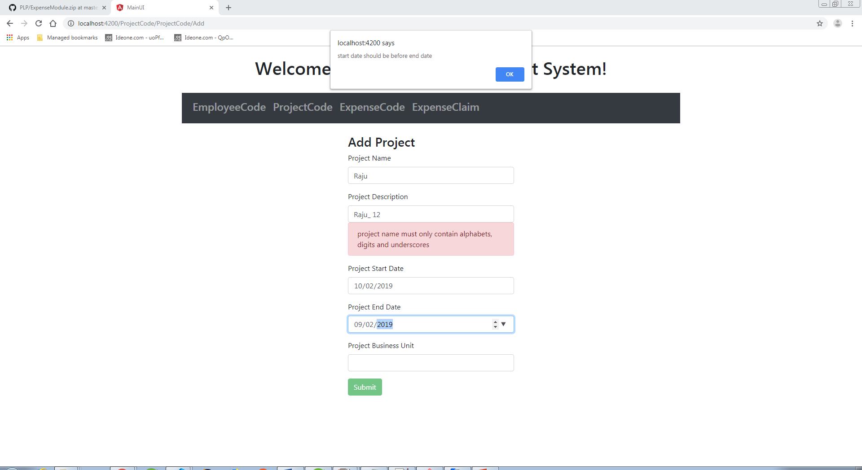
3: Validations :

Slide 7
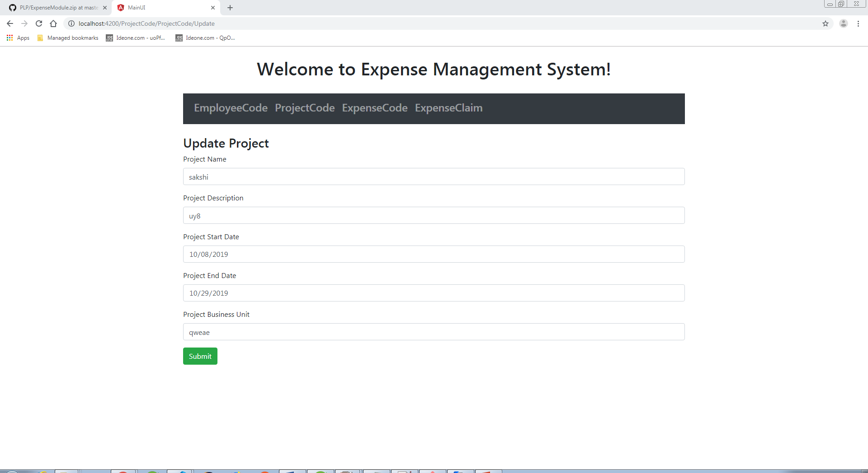
4: Modify a project

Slide 8
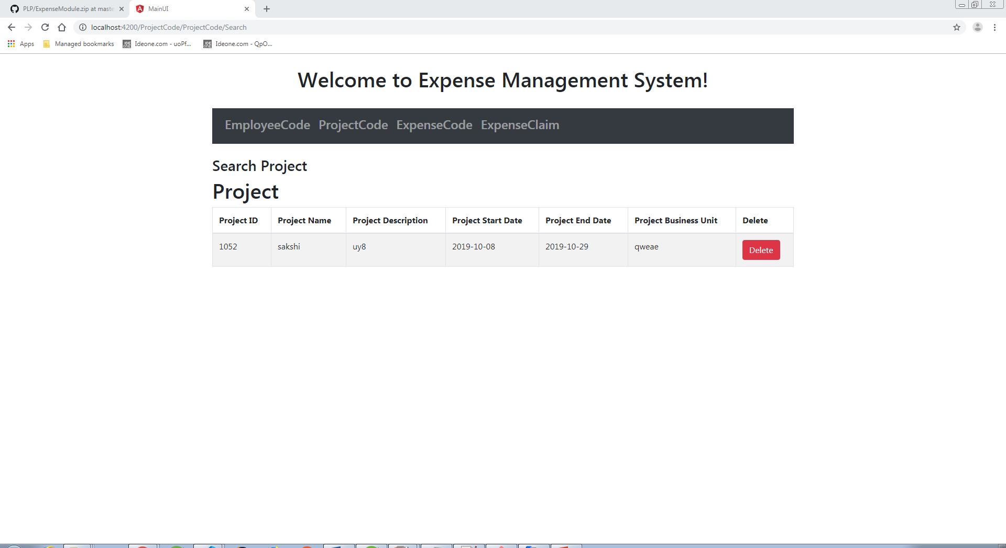
5: Search a project based on its project Id

Slide 9
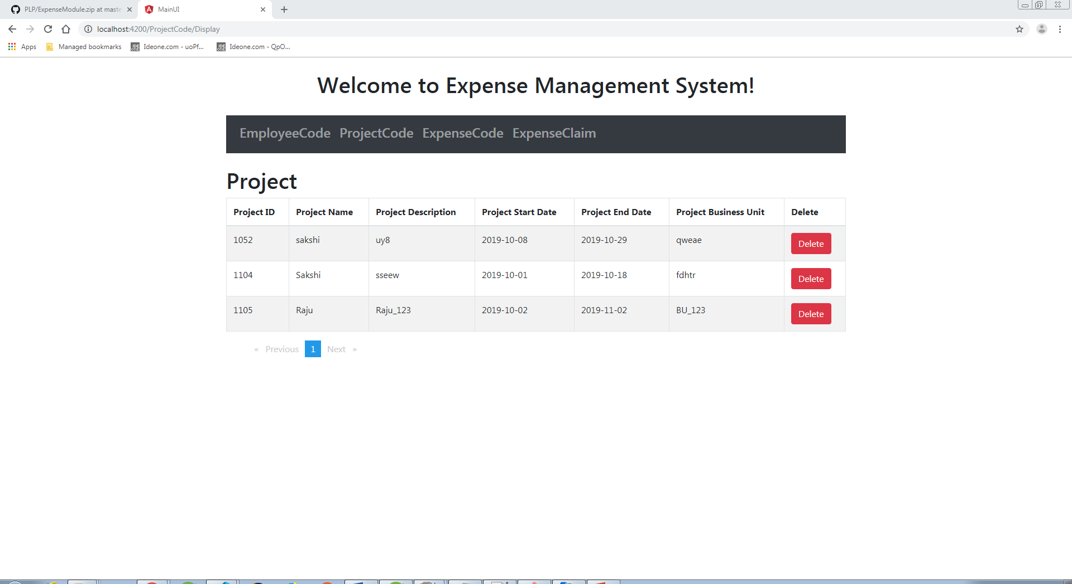
6: Delete a Project
We can delete a project either by directly clicking on the delete button in the ProjectCode page or by searching the project based on its id .

Slide 10
6: Class Diagram

Slide 11
Thank You

