Slide 1

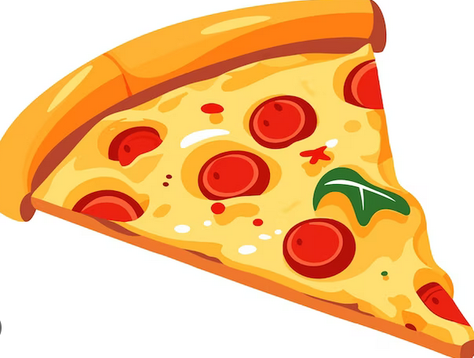
PIZZA SALES ANALYSIS WITH MS SQL SERVER
TASK 2
Project By: Rohit Ashok
Batch –MIP-DA-12

Slide 2
Agenda
Introduction
Objective
Queries Used
Final tips & takeaways

Slide 3
Introduction
In today's competitive market, understanding customer preferences and sales trends is crucial for any business to thrive. The project focuses on analyzing pizza sales data to uncover valuable insights into customer behavior, popular pizza types, and overall sales performance for a popular Pizza outlet.
By leveraging MS SQL, we will extract, analyze, and interpret data from our pizza sales database to provide a comprehensive understanding of the business operations. The insights gained from the analysis will help in making informed decisions by the directors of the outlet to enhance customer satisfaction and further drive business growth.

Slide 4
Objective
The objective of this project includes-
Identify Sales Trends by the pizza outlet over a period of year 2015.
Determine the most popular pizza types, sizes, and categories so as to align the outlet’s offerings with customer preferences.
Calculate the total revenue generated from pizza sales and identify the top-performing pizzas based on revenue as well as categories.
Examine the distribution of orders by time of day to optimize operational efficiency.
Evaluate the performance of different pizza categories and their contribution to overall sales.
Provide key performance metrics such as average number of pizzas ordered per day and cumulative revenue over time.

Slide 5
Tables Used
order_details_pizza
orders_pizza
pizza_types
pizzas

Slide 6
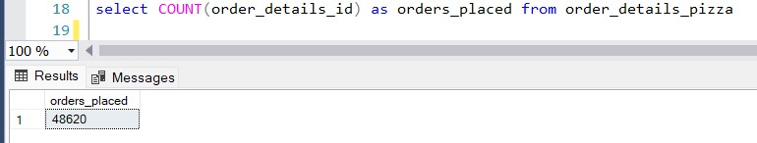
The total number of order placed

Slide 7
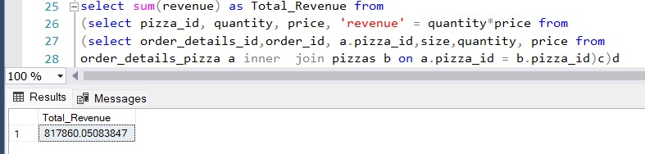
The total revenue generated from pizza sales

Slide 8
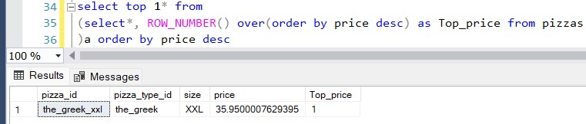
The highest priced pizza

Slide 9
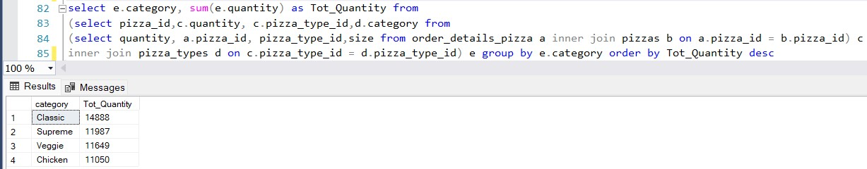
The quantity of each pizza categories ordered

Slide 10
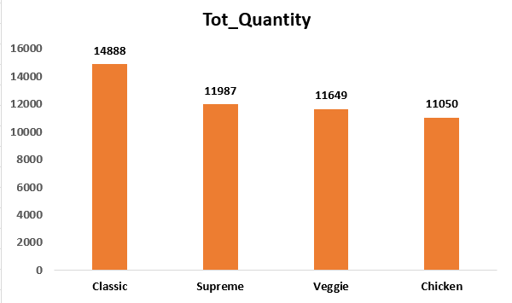
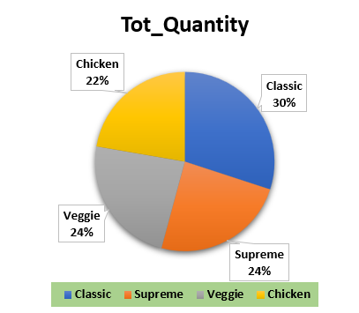
The quantity of each pizza categories ordered

Slide 11
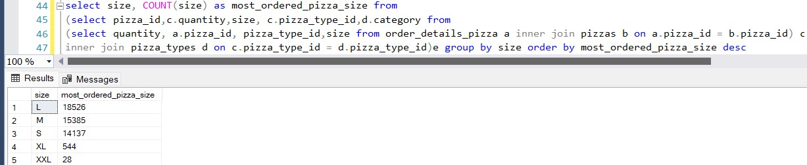
The most common pizza size ordered

Slide 12
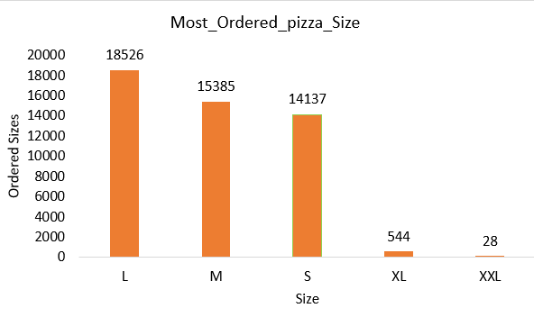
The most common pizza size ordered

Slide 13
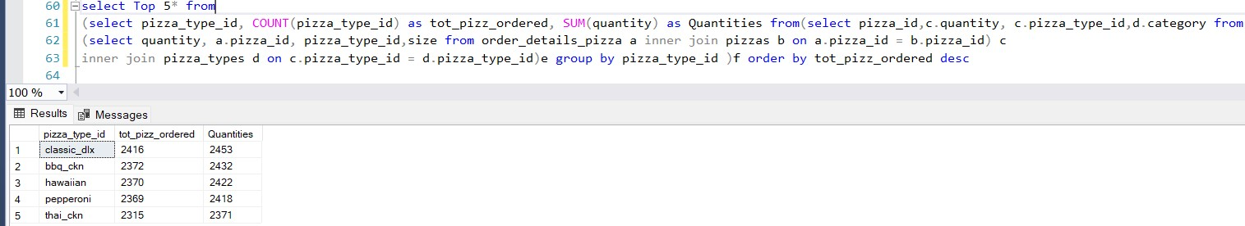
The top 5 most ordered pizza types along their quantities

Slide 14
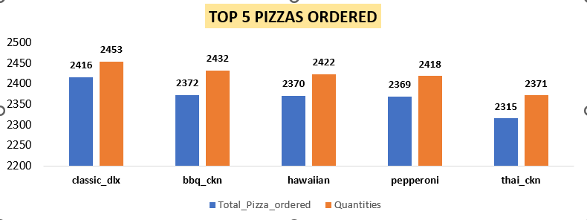
The top 5 most ordered pizza types along their quantities

Slide 15
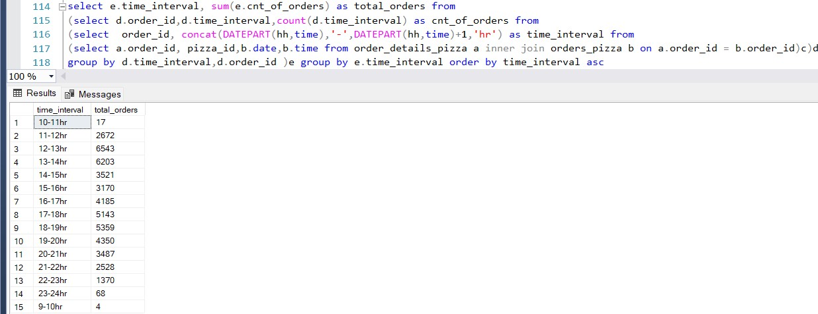
The distribution of orders by hours of the day

Slide 16
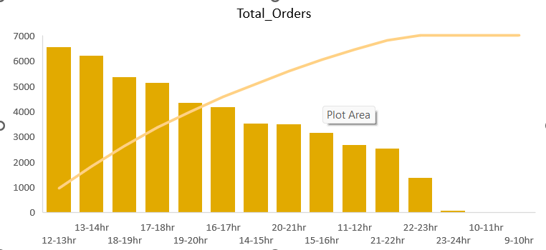
The distribution of orders by hours of the day

Slide 17
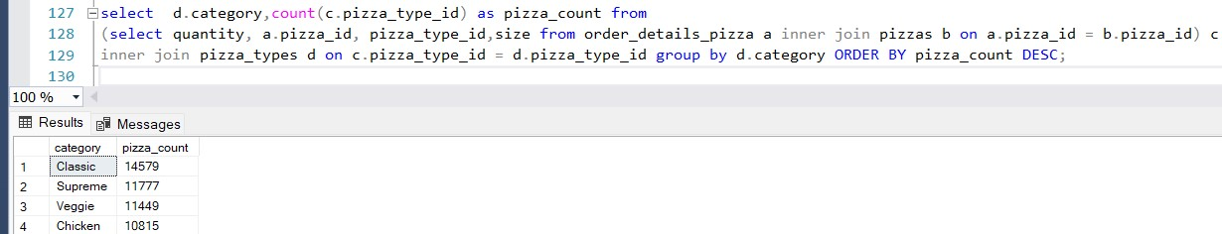
The category-wise distribution of pizzas

Slide 18
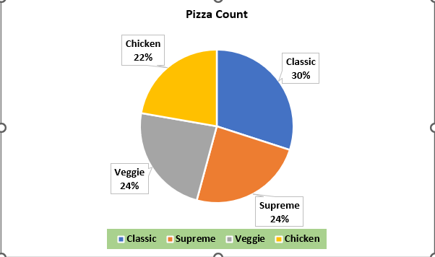
The category-wise distribution of pizzas

Slide 19
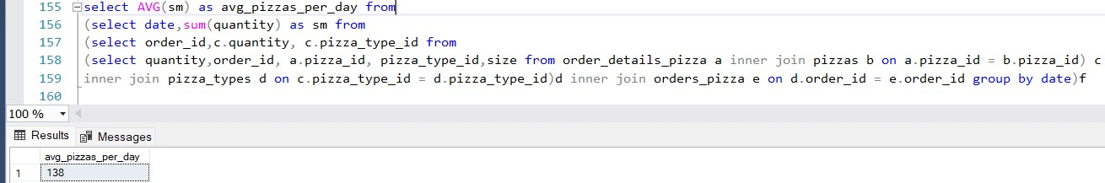
The average number of pizzas ordered per day

Slide 20
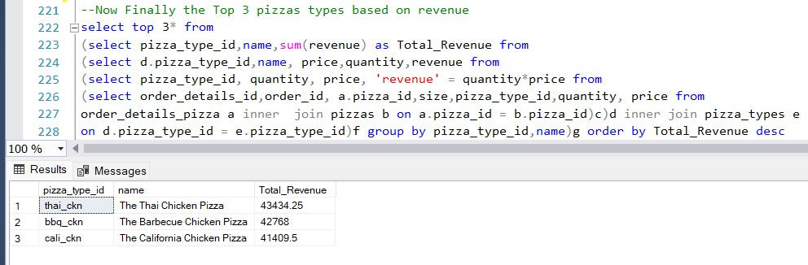
Top 3 most ordered pizza type base on revenue

Slide 21
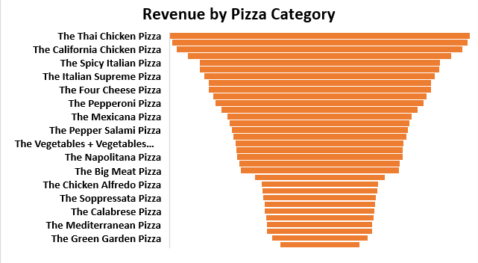
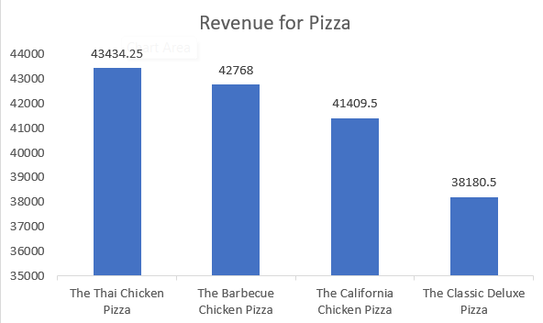
Top 3 most ordered pizza type base on revenue

Slide 22
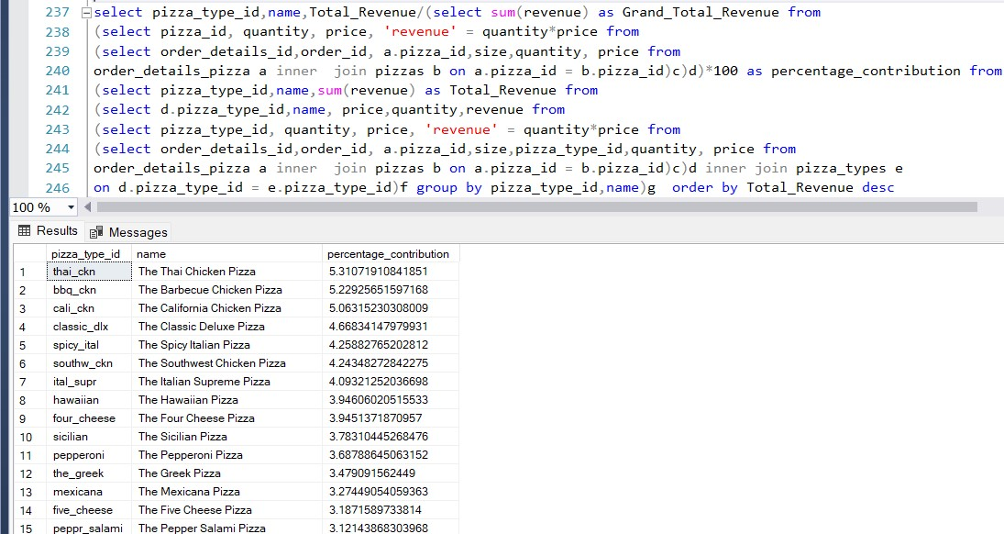
The percentage contribution of each pizza type to revenue

Slide 23
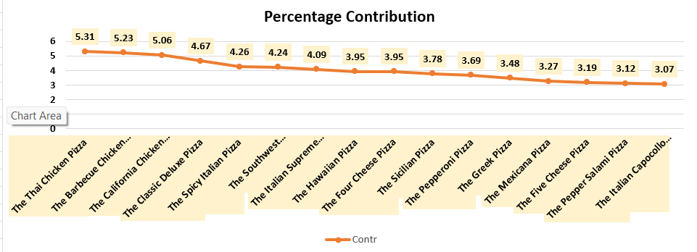
The percentage contribution of each pizza type to revenue

Slide 24
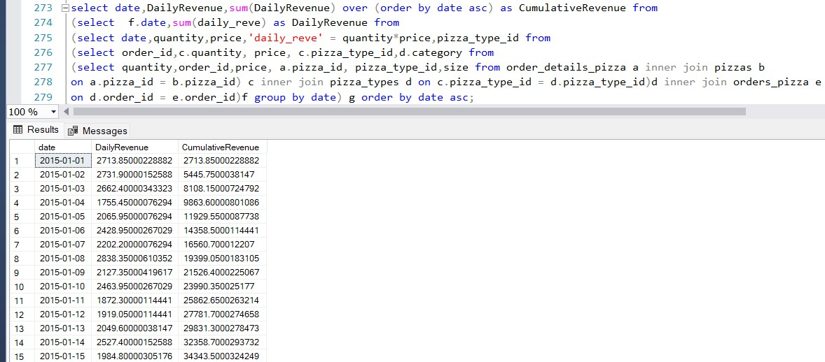
The cumulative revenue generated over time

Slide 25
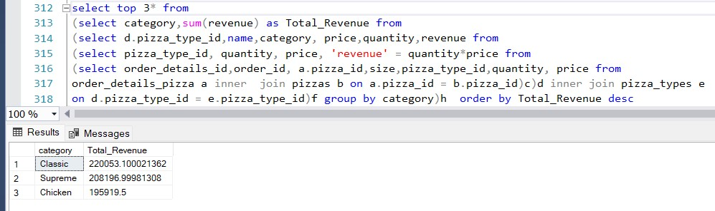
The top 3 most ordered pizza type based on revenue for each pizza category

Slide 26
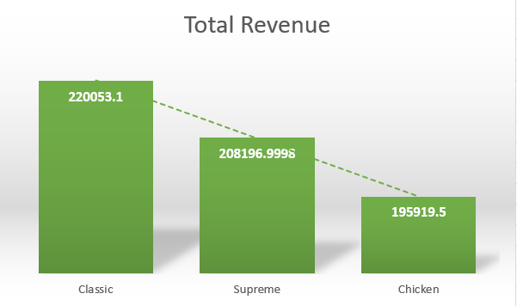
The top 3 most ordered pizza type based on revenue for each pizza category

Slide 27
Final Insights
The Thai Chicken Pizza, the Barbeque Chicken Pizza, and the California Pizza are the highest revenue generating pizzas.
On an average 1378 pizzas are ordered per day.
The best selling category of pizza is the Classic pizza with a value of quantity sold standing at 14888 followed by Supreme, veggie, and Chicken.
Additionally, as is evident, the Thai Chicken Pizza, the Barbeque Chicken Pizza, and the California Pizza are the major contributors in revenue generation
The Classic Pizza followed by the Supreme Pizza, and Chicken Pizzas are the most ordered pizzas based on revenue.
The Total number of order placed stands at 48620
Total Revenue generated from Pizza Sales is 817860 for the year 2015
The highest priced pizza is the Greek xxl pizza with a price of 35.950
The most common pizza size ordered is “Large” sized pizza with an order size of 18526.
The Top 5 most ordered pizza types in decreasing order are CLASSIC DLX followed by BBQ_CKN, HAWAIIAN, PEPPERONI AND THAI_CKN WITH QUANTITIES 2453, 2432, 2422, 2418, and 2371 respectively.

Slide 28
Some suggestions
To further enhance the business growth the company may put prime focus on the Classic Pizza category as it is the most ordered pizzas.
The company may further offer some bonus points to it’s regular customers.
The company may offer coupons to encourage customers in purchasing pizzas other than the top selling pizzas.
Some special offers or Discounts could be provided during the non-peak Hours of purchasing.
Additionally, a small price cut could be granted on the top selling pizzas during the non peak hours.

Slide 29
Thank you for your precious time
Email- engrrohitatwork16@gmail.com
9718816835

