Slide 1


TASK 3
IPL DATA ANALYSIS
Project By: Rohit Ashok
Batch –MIP-DA-12

Slide 2
Agenda
Introduction
OBJECTIVE
DATA SOURCES
TEAM ANALYSIS REPORT
KEY INSIHTS
SUGGESTIONS

Slide 3
Introduction
The Indian Premier League (IPL) is a professional Twenty20 cricket league in India, founded in 2008 by the Board of Control for Cricket in India (BCCI). Known for its exhilarating matches and star-studded line-ups, the IPL is one of the most popular and lucrative cricket leagues globally. Featuring various franchise teams representing different cities of India, the tournament showcases a blend of domestic and international cricket talent. The IPL's unique format and entertainment value have revolutionized cricket, making it a global sporting phenomenon with a massive fan following and significant commercial success.

Slide 4
OBJECTIVE
The objective of the IPL Data Analysis project is to leverage Power BI to analyze comprehensive cricket data from the Indian Premier League (IPL). This analysis aims to gain in-depth insights into team and player performance, match outcomes, and various key metrics related to both batting and bowling. By utilizing data from multiple related tables, the project will provide a holistic view of the tournament's dynamics, enabling a better understanding of trends and patterns within the IPL.

Slide 5
DATA SOURCES
Fact Bowling Summary
Fact Batting Summary
Dim Player Summary, and
Dim Match Summary

Slide 6
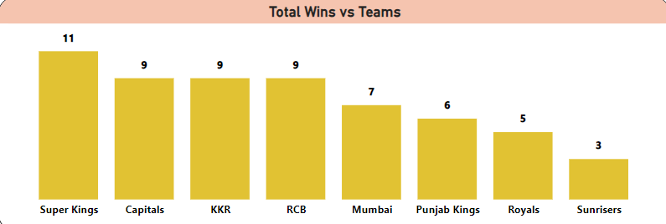
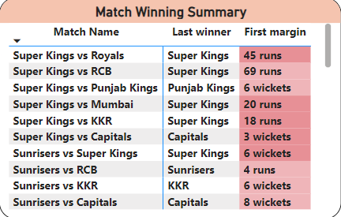
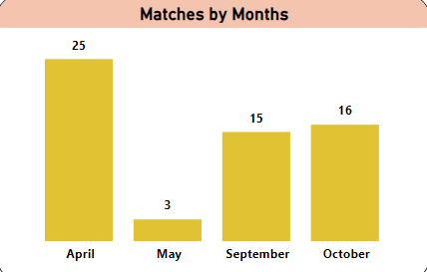
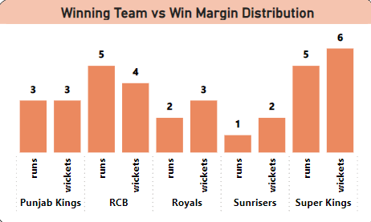
MATCH SUMMARY
The Match Summary gives us the brief summary of the matches by the various teams using various Bar charts and Matrix visuals.
The visuals here provide us with a brief summary of the IPL Season 2021, with the Bar chart (Wins vs Teams) detailing the maximum matches won by any team for the season IPL 21.
Another BAR chart (Matches by Months) details the time duration and matches held in the various months for the IPL 21.
The Bar chart for Winning Team vs Win Margin Distribution provides us with details of the win margin distribution of each teams for the season. As we can see, for the season 2021, the winning team have majorly won by margin of wickets than the runs maintained.
Further, the matrix chart displays the Match winning summary that gives us the details of all the matches played with their result outcome(i.e. winning Team) and their respective victory margins.

Slide 7
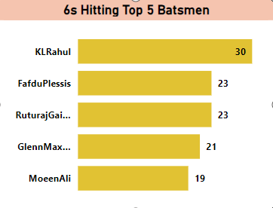
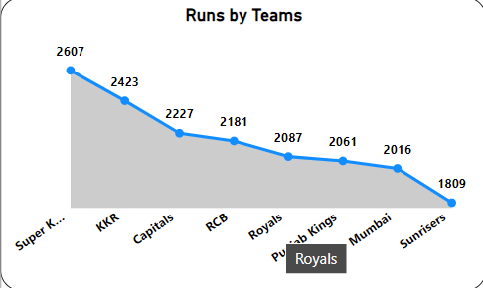
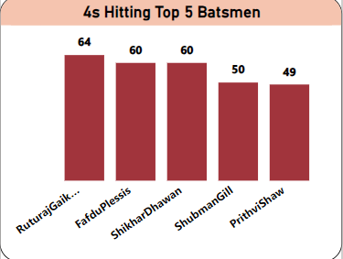
Batting SUMMARY
The Batting Summary provides us with batting details of all the players and the teams for IPL Season 2021.
The Bar Chart (6 hitting batsmen) details the top 5 6’s hitting batsman, which is KL Rahul for the IPL 2021.
Another Bar chart details the top 5 4’s hitting batsman which is Ruturaj Gaikwad for the current Season.
A line chart displays the top runs scoring teams with Super Kings being the highest runs scorer for IPL2021, followed by KKR, and Capitals.

Slide 8
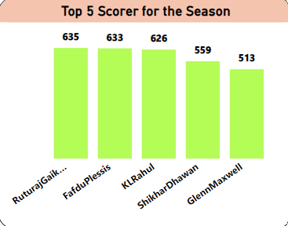
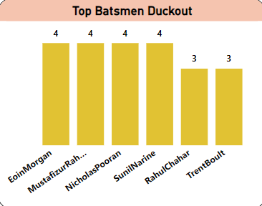
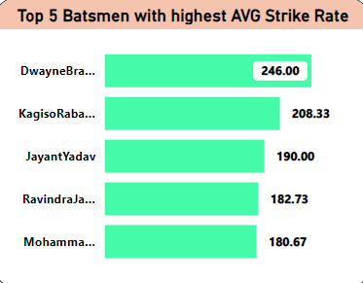
Batting SUMMARY
The 1st Bar chart details the top 5 scorers for the IPL Season 2021.
Another Bar chart ( top batsmen duckout) provides us with details of the batsmen Given maximum number of Out at Zero Score.
Further, another Bar chart (top 5 avg strike rate) provides us with the details of the Top 5 batsmen with highest Average strike rate for the IPL Season 21.

Slide 9
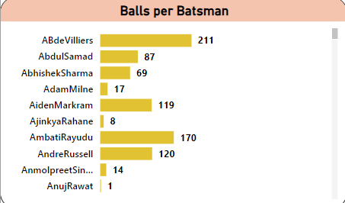
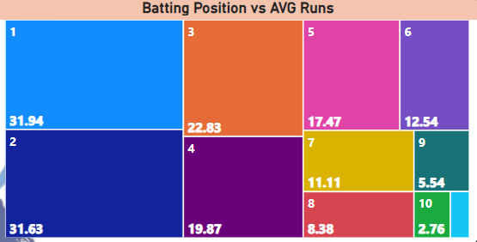
Batting SUMMARY
The Bar chart provides us with the details of the total balls faced by each batsmen for the IPL Season 21.
Next, the tree map here provides us with details of the batting position of the players and the average runs scored with respect to their positions.

Slide 10
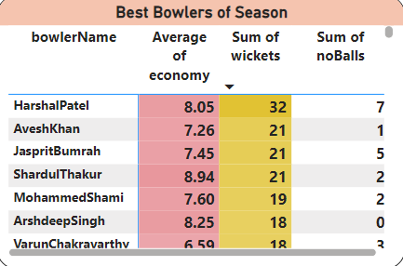
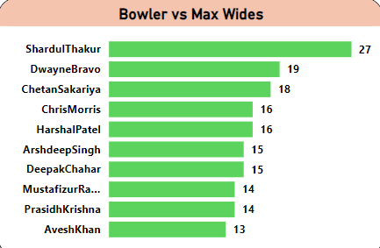
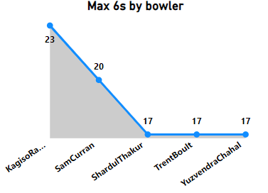
IPL BOWLING SUMMARY
The bowling summary provides us with the bowling details of the players of the teams of the particular IPL Seasons, which here is for IPL 21.
The matrix chart gives us the Best bowlers of the season which includes the list of bowlers with highest wickets while maintaining best average Economy rate.
The line chart (max 6 by bowlers) gives us the list of the Top 5 bowlers who have conceded the maximum number of 6s in the season.
The Bar chart (bowler vs max wides) gives us the list of the bowlers who have conceded the maximum number of wides for the season.

Slide 11
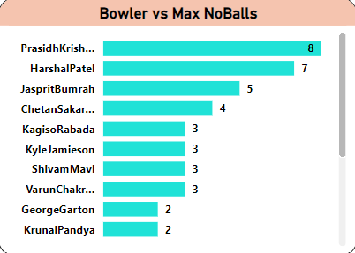
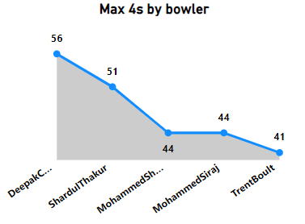
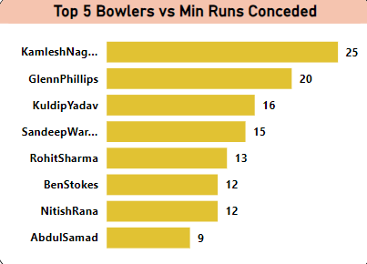
IPL BOWLING SUMMARY
The Bowler vs Max No-Balls bar chart clearly details the bowlers conceding maximum number of No-balls for the season IPL21.
The min runs conceded Bar Chart provides us with the bowlers who have conceded minimum runs against the batters for the current IPL season 21.
The line chart details top 5 players who conceded maximum number of 4s for the season.

Slide 12
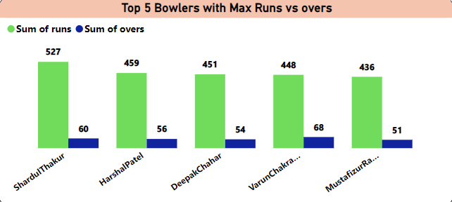
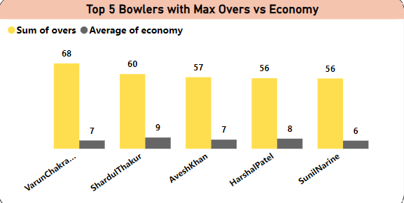
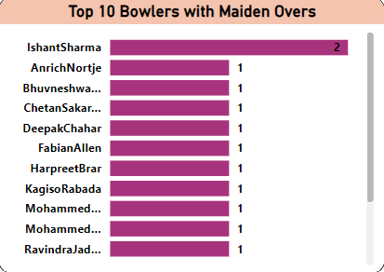
Bowling SUMMARY
The 1st clustered Bar Chart (max runs vs overs) details the Top 5 bowlers with their total runs and Overs Bowled.
The next clustered Bar Chart (max overs vs economy) details the Top 5 bowlers with their total overs for the season versus their average economy.
The Bar chart displays the list of top 10 bowlers having highest number of maiden overs for the season, where Ishant Sharma tops the list with two maiden overs for the IPL 21.

Slide 13
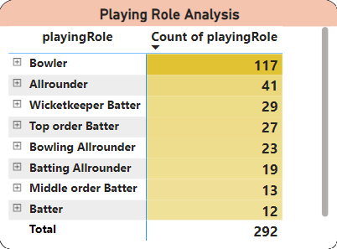
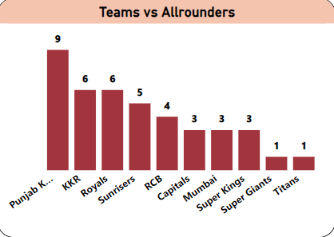
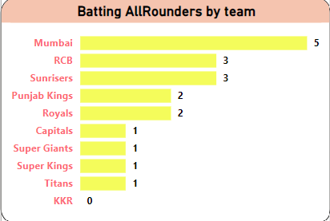
IPL Player SUMMARY
The Player summary provides with the details of all the players with respect to their teams for the seasons.
The matrix chart (playing role analysis) provides with the count of the players with their playing roles for the particular season.
The Bar chart (Teams vs all-rounders) the total count of All-Rounders per team for the season.
Another Bar chart (batting all-rounders) provides us with the Batting All-rounders per team for the respective season.

Slide 14
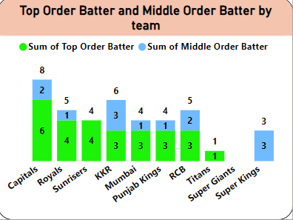
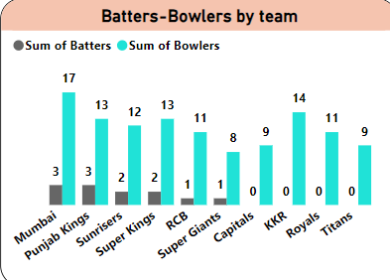
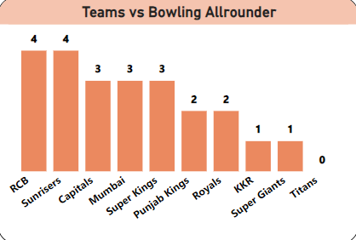
IPL Player SUMMARY
Here the first stacked column chart (Top & Middle order batter) shows the details of the Top order and the Middle order batsmen per team for the season.
Here the clustered column chart (Batters-Bowlers by Team) provides with the total count of Batsmen and the Bowlers included in each team.
Further, the Bar chart details the total Bowling Allrounders included in the respective team for the IPL Season.

Slide 15
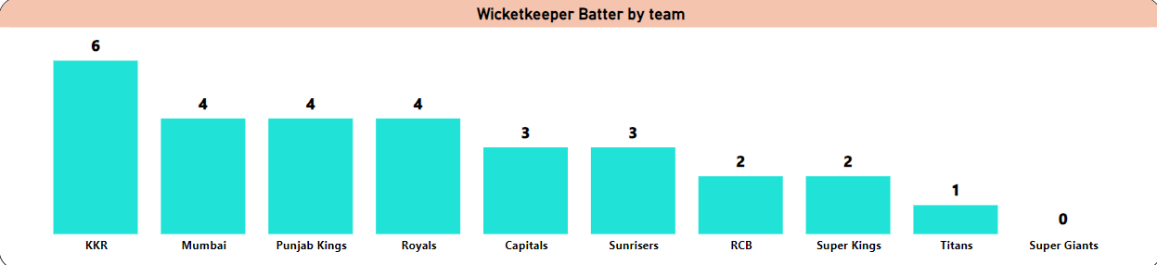
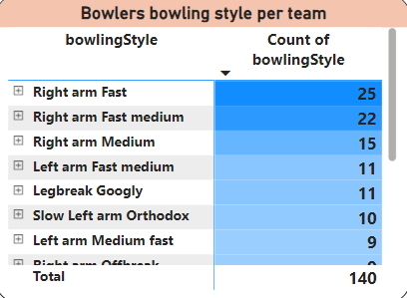
IPL Player SUMMARY
Here, the Bar chart (wicketkeeper batter by team) provides us with the total wicket keeper batsmen per team for the current IPL Season.
Further, the Matrix chart details the count of Bowlers of a particular bowling style for the respective season.

Slide 16
InsIGHTS
MATCHES-
The Winning Teams- For IPL Season 2021- Super Kings, for IPL 22- Titans, and for IPL23 – Titans.
Win Margin of the winning teams for respective IPL Seasons:
For IPL21-Super Kings won 6 times with wickets while 5 times with exceeding runs.
For IPL22-Titans won 8 times with wickets while 4 times with exceeding runs.
For IPL23-Titans won 6 times with wickets while 5 times with exceeding runs.
Majorly the matches are played in the months of April and May across the seasons.

Slide 17
InsIGHTS
BATTING-
Score distribution of the winning Teams across the seasons-
For IPL 2021- Super Kings scored- 2607 Runs with 115 6s, & 231 4s.
For IPL 2022- Titans scored- 2807 Runs with 137 6s, & 249 4s.
For IPL 2023- Titans scored- 2906 Runs with 124 6s, & 248 4s.
Highest Runs scorer across the seasons-
For IPL 2021- Ruturaj Gaikwad scored- 635 Runs.
For IPL 2022- Jos Butler scored- 863 Runs.
For IPL 2023- Shubman Gill scored- 890 Runs.
Top 6 Hitting Batsmen across the seasons-
For IPL2021: KL Rahul – 22
For IPL2022: Jos Butler– 30
For IPL2023: Faf Du Plessis– 36
Batsmen playing maximum number of balls across the seasons-
For IPL2021: AB De Villiers
For IPL2022: Abhishek Sharma & Aiden Markam
For IPL2023: Aiden Markam & Ajinkya Rahane

Slide 18
InsIGHTS
BOWLING:
Highest Wicket taking Bowlers with best average Economy-
For IPL 2021- Harshal Patel, Avesh Khan, Jasprit Bumrah, and Shardul Thakur.
For IPL 2022- Yuzvendra Chahal and Sam Curran
For IPL 2023- MD. Shami and Mohit Sharma
Bowlers Conceded Maximum 6s-
For IPL 2021- K. Rabadda (23) & Sam Curran(20)
For IPL 2022- MD. Siraj (31) and W. Hasranga (30)
For IPL 2023- Tushar Deshpande (28) and Rashid Khan (26)
Bowlers Conceded Maximum Wides-
For IPL 2021- Shardul Thakur(27) & Dwayne Bravo(19)
For IPL 2022- Prasidh Krishna(30) and Shardul Thakur (24)
For IPL 2023- M. Pathirana(29) and MD. Siraj (27).
Bowlers Conceded Maximum 6s-
For IPL 2021- P.Krishna (8) & Harshal Patel (7)
For IPL 2022- Umesh Yadav (5) and Anrich Mortje (4)
For IPL 2023- Akash Madhwal (5) and Harshal Patel (5)
Bowlers Conceded Maximum runs across the seasons-
For IPL 2021- Shardul Thakur : 527 runs for 60 overs.
For IPL 2022- Prasidh Krishna:551 runs for 66 overs
For IPL 2023- Tushar Deshpande: 552 runs for 56 overs.

Slide 19
InsIGHTS
PLAYER:
From all the players, the Playing teams majorly consists of Bowlers which counts to 117 followed by All-Rounders 41 While Wicket Keeper Batsmen at 29.
The count of Bowlers far exceeds the count of batsmen across the teams. This clearly proves that the bowlers are the major factor for successful performances of top IPL Teams as was very much evident with the results that demonstrated that majority of teams won with best Wickets margin.
Overall the teams from 292 players includes-
Right hands batsmen – 210
Left hands batsmen - 82

Slide 20
SOME SUGGESTIONS
Across the seasons, Teams Super Kings and Titans have performed consistently.
Across the seasons the Top 5 teams have won the matches with winning margin of wickets. Thus bowlers should be selected by minutely observing their performing aspects.
Rutraj Gaikwad, KL Rahul, Faf du Plessis, Dwayne Warmer, Virat Kohli, Shubman Gill, Jos Buttler, and Yashaswi Jaiswal have the best batting performance across the seasons.
Dwayne Bravo, Rabadda, Prerak Mankad, Ripal Patel, Umran Malik, and K.Gowtham are the batsmen having highest average strike rate. Hence, when in team, they should be played at top 5 batting positions.
Avesh Khan, Anuj Rawat, Akash Deep are the players with least average strike rate. Hence, should be played accordingly.
Harshal Patel, Avesh Khan, Jasprit Bumrah, Shardul Thakur, MD. Shami, Yuzvendra Chahal, K. Rabadda, Kuldeep Yadav, and Rashid Khan are among the best bowlers across the seasons and hence should be among the prime playing 11.
Shardul Thakur, D. Bravo, Prasidh Krishna, Y. Chahal, M. Pathirana, and MD. Siraj are among the bowlers whose performances needs a little attention as they are the bowlers conceding maximum wides.
Looking at the performances, each team might not just depend upon just Bowlers and Batsmen, rather All-Rounders, Wicket Keeper – Batters, Bowling All-Rounders and Batting All-rounders.

Slide 21


THANK YOU FOR YOUR PRECIOUS TIME
Rohit Ashok
Email- engrrohitatwork16@gmail.com

