Slide 1
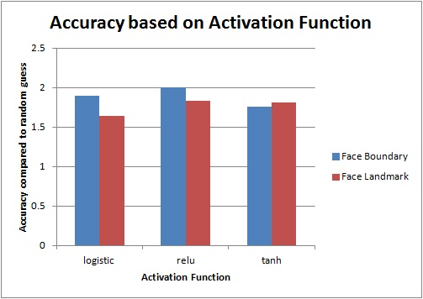
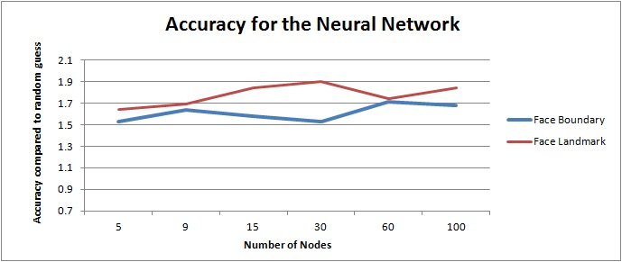
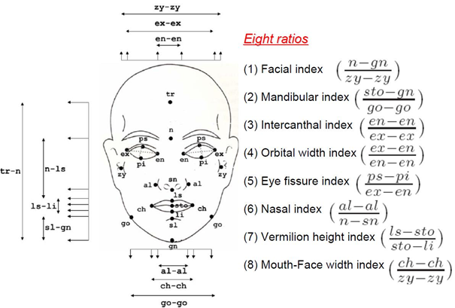
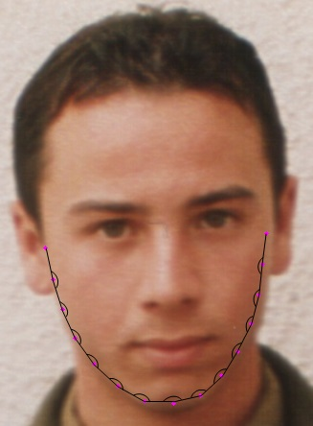
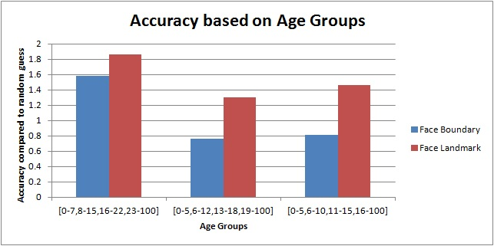
Age Estimation from Frontal Images of Faces
Rohit Nair, Srivatsan Iyer and Shashant Devadiga
School of Informatics and Computing, Indiana University Bloomington
ABSTRACT
METHODS
RESULTS
OBSERVATIONS
Humans have the ability to automatically look at the face of the person and estimate the age. For a computer to be able to do this automatically, we require algorithms that extract appropriate features from the faces and use them to learn how they map to ages. This poster summarizes the result of using anthropometric models with varying parameters.
We use the dlib library to automatically recognize faces in the given image. Additionally, the library also provides us with accurate location of various facial features such as a set of points that represent the boundary of eyes, eyebrows, lips, nose and jaw. These points allow us to calculate the ratios of various distances and use them in a classifier to predict the age groups.
We have used two models for this purpose. In one model, we extract the ratios as shown in Fig 2. In the other model, we proposed that the curvature of face also changes with age. We tried extracting a vector of angles as shown in Fig 3 for classification purpose. These ratios and the vector of angles made by the jaw boundary are later used for classification using neural networks.
The results that various parameters would have on the overall accuracy is summarized below.
From the experiments that we performed, we can note quite a few observations
Although the classifier gives a relatively good accuracy for more granular age groups, we found that the output is often unstable for higher ages. In other words, the classifier is able to distinguish better between kids and adults. However, it does not perform well when tasked with predicting more accurate ages.
The curvature of the faces can also be used to predict the age group of the person. However, it gives a lower accuracy as compared to the other model.
However, since the facial boundary can sometimes be similar for different people of different age, we feel that this could have lead to lower accuracy while running it against the test images.
INTRODUCTION
Humans can estimate information such as age, gender, expression etc. by simply looking at faces. Automated age estimation has several challenges such as variance among different ethnicities, facial deformities etc. Aging progress is uncontrollable depending on various factors such as lifestyle, climatic conditions, health etc. Hence, we can’t have an accurate estimation process for every possible case. We try to predict age groups of people by exploiting various biologically defined ratios in facial features and relations between them.
Detect Face
Detect points of interest
Calculate ratios
Calculate angles in face boundary
Classification
Classification
Chart 1. Comparison with different activation functions
Figure 1 Overall process
REFERENCES
“Automatic Facial Age Estimation” Xin Geng, Yun Fu, Kate Smith‐Miles http://www1.ece.neu.edu/~yunfu/papers/pricai10_t4.pdf
X. Geng, Z. H. Zhou and K. Smith-Miles, "Automatic Age Estimation Based on Facial Aging Patterns," in IEEE Transactions on Patte rn Analysis and Machine Intelligence, vol. 29, no. 12, pp. 2234-2240, Dec. 2007.
API design for machine learning software: experiences from the scikit-learn project, Buitinck et al., 2013.
Davis E. King. Dlib-ml: A Machine Learning Toolkit. Journal of Machine Learning Research 10, pp. 1755-1758, 2009
Chart 2. Comparison with different nodes in hidden layer
Figure 2 Anthropometric model of human face
Figure 3 Angles in jaw boundary
ACKNOWLEDGEMENT
We wish to thank Prof. David Crandall for his support and advice throughout the duration of the project. We wish to also thank Datatang aging database that we used to train and test our classifier.
Chart 3. Comparison of accuracy for different age groups.

