Slide 1



Consumer goods insights
Tools Used :

Slide 2

introduction
About Company:
AtliQ Hardwares is a company that sells computer hardware to customers worldwide.
Presentation Overview:
A comprehensive analysis of consumer goods performance was conducted to know:
Market Reach & Expansion
Products Insights
Customer & Channel Dynamics
Performance Metrics

Slide 3
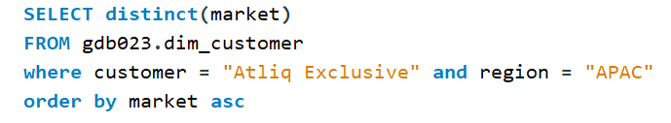
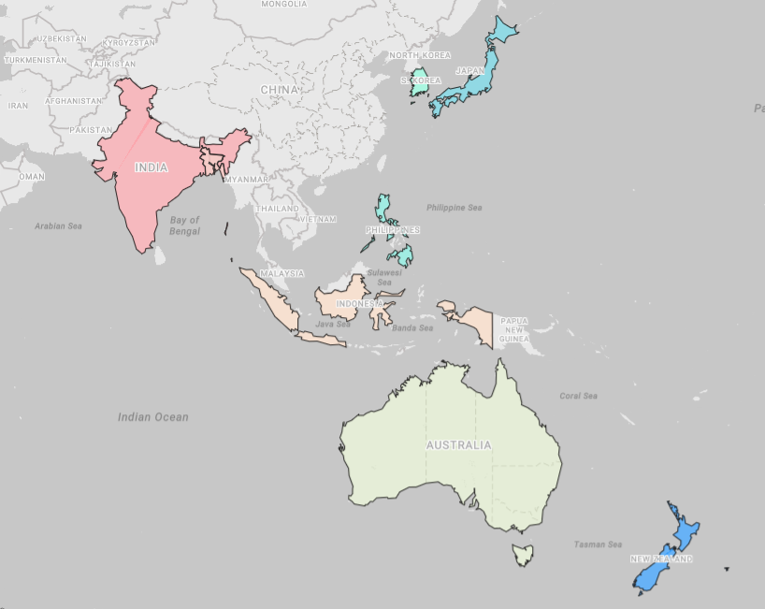

REQUEST :
Provide the list of markets in which customer "AtliQ Exclusive" operates its business in the APAC region.
QUERY :
VISUAL :
OUTPUT :
INSIGHTS :
AtliQ Hardwares serves customers in 27 countries across various regions.
One of its customers, AtliQ Exclusive, operates in 16 countries, with 8 of them located in the Asia-Pacific (APAC) region.

Slide 4
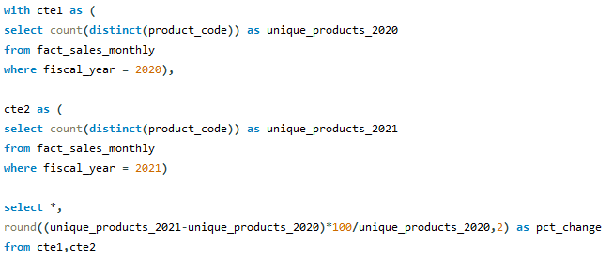
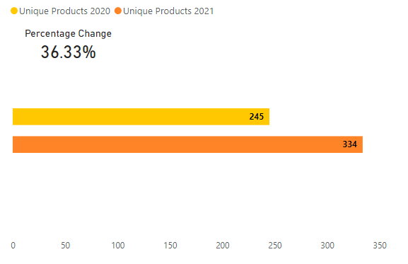

REQUEST :
What is the percentage of unique product increase in 2021 vs. 2020?
QUERY :
VISUAL :
OUTPUT :
INSIGHTS :
In 2021, 36% new products were sold as compared to the previous year.

Slide 5
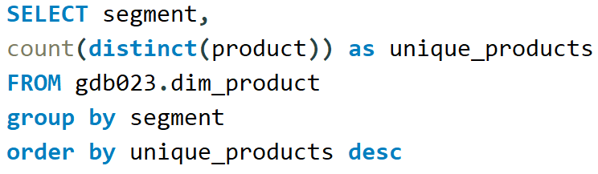
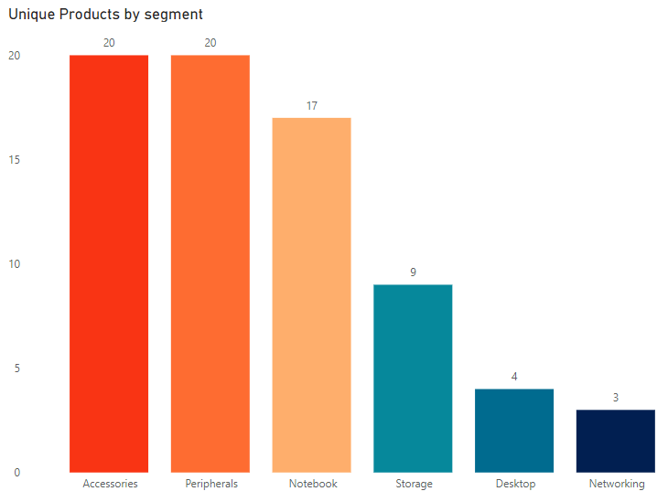
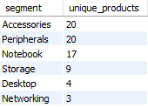
REQUEST :
Provide a report with all the unique product counts for each segment and sort them in descending order of product counts.
QUERY :
VISUAL :
OUTPUT :
INSIGHTS :
The Accessories & Peripherals segments comprise 54% of the total unique products.

Slide 6
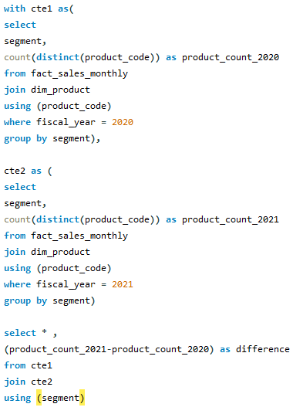
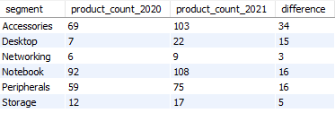
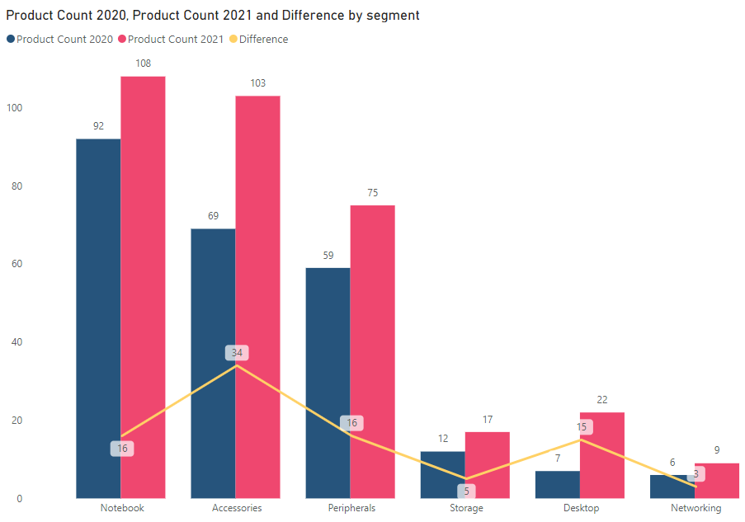
REQUEST :
Which segment had the most increase in unique products in 2021 vs 2020?
QUERY :
OUTPUT :
VISUAL :
INSIGHTS :
The Accessories segment experienced the largest growth in unique products, adding 34 new products in 2021.

Slide 7
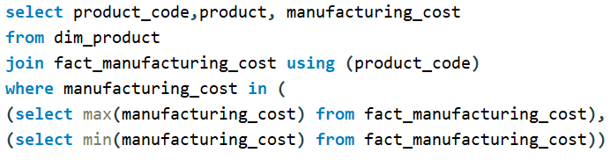
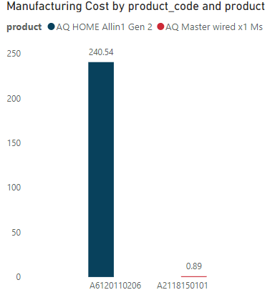

REQUEST :
Get the products that have the highest and lowest manufacturing costs.
QUERY :
VISUAL :
OUTPUT :
INSIGHTS :
Among all the products ‘Home Allin 1 Gen 2’ has highest whereas ‘Master wired x 1 MS’ has the lowest manufacturing cost.
The manufacturing cost of ‘Home Allin 1 Gen 2’ is 270 times higher than that of ‘Master wired x 1 MS’.

Slide 8
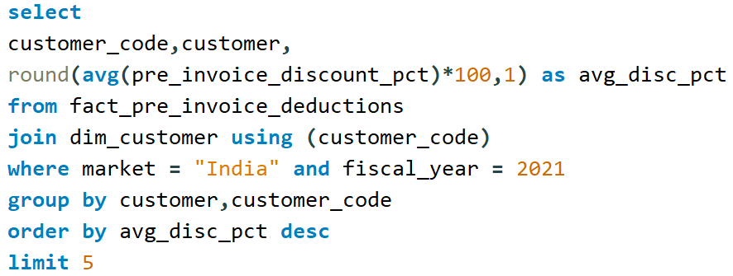
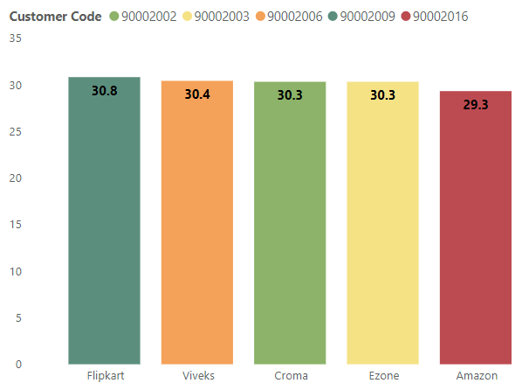
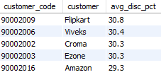
REQUEST :
Generate a report which contains the top 5 customers who received an average high pre-invoice discount pct for the fiscal year 2021 and in the Indian market.
QUERY :
VISUAL :
OUTPUT :
INSIGHTS :
In 2021 in the Indian market, Flipkart received the highest average pre-invoice discount, followed by Viveks, Croma, Ezone & Amazon.

Slide 9
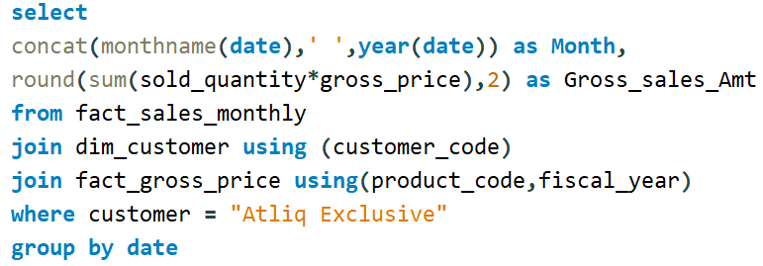
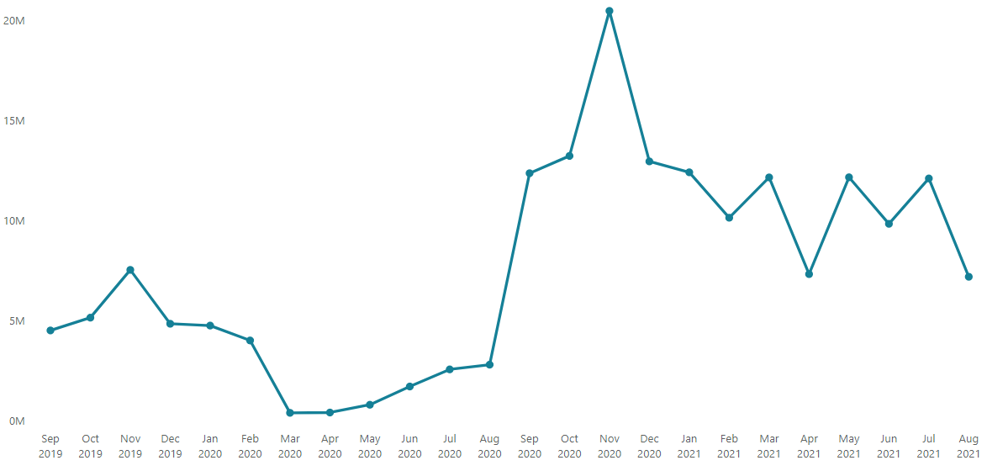
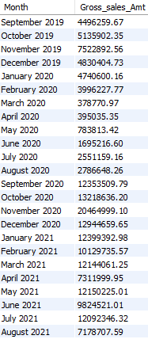
REQUEST :
Get the complete report of the Gross sales amount for the customer “Atliq Exclusive” for each month.
QUERY :
VISUAL :
OUTPUT :
INSIGHTS :
For Atliq Exclusive November 2020 recorded the highest Gross Sales Amount, reaching 20M.

Slide 10
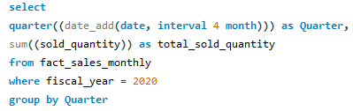
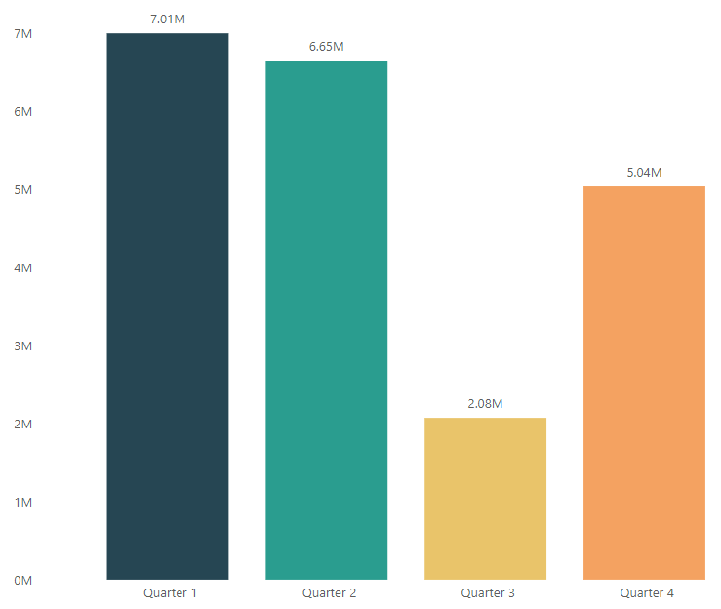

REQUEST :
In which quarter of 2020, got the maximum total sold quantity?
QUERY :
VISUAL :
OUTPUT :
INSIGHTS :
In FY 2020, Q1 achieved the highest sold quantity, exceeding 7 million units.
Sold quantities declined in Q2 and Q3 but rebounded in Q4, reaching 5.04 million units.

Slide 11
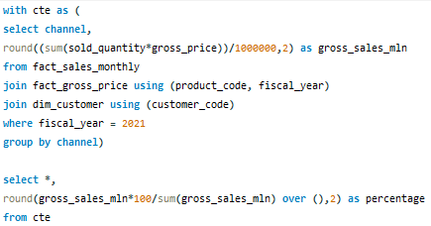
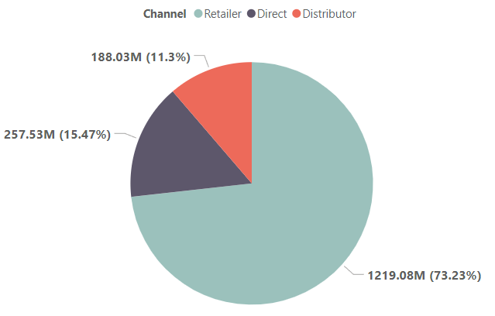

REQUEST :
Which channel helped to bring more gross sales in the fiscal year 2021 and the percentage of contribution?
QUERY :
VISUAL :
OUTPUT :
INSIGHTS :
The Retailer channel contributed 73% of the Gross sales.

Slide 12
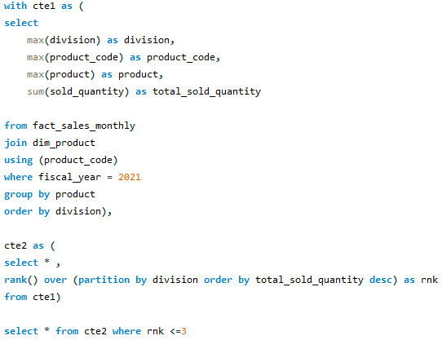
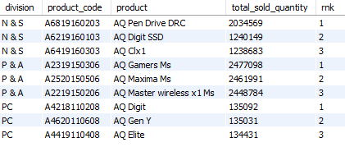
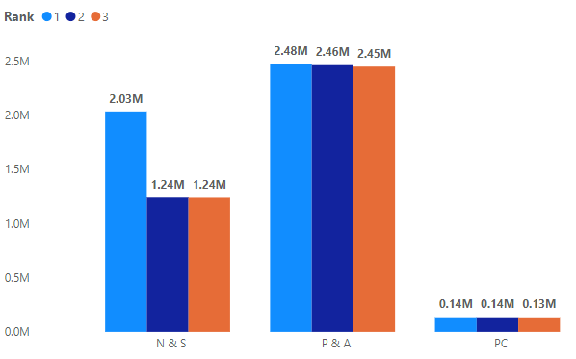
REQUEST :
Get the Top 3 products in each division that have a high total sold quantity in the fiscal year 2021?
QUERY :
OUTPUT :
VISUAL :
INSIGHTS :
The top 3 products from P&A division each surpassed 2.4M units in sold quantity.

Slide 13
End of presentation

