Slide 1
1 · DATA ENGINEERING & SEGMENTATION
Segmentation & data logic: from 6.6M events to visitor types
6.59M
745k
99.9%
359
GA4 events, loaded in 2 s (pyarrow)
visitors · 996k sessions (30-min rule)
purchases joined to transaction lines
products (356 from the data + 3 new) · 6 departments / 41 subcategories
Cleaning decisions that mattered
Engagement segments (rules) + 9 personas (K-Means, silhouette 0.29)
Gender/age vary row-to-row for one visitor (66% / 92% conflict) → per-visitor majority vote
income_group is missing on every row of every purchaser → label leak, excluded from all models
page_view product paths (ITEM377–500) never appear in transactions → only view_item / add_to_cart / purchase carry item signal
26 bots removed; channel grouped GA4-style (+ an AI-Assistant channel); state → census region → country hierarchy
Repeat / one-time purchasers · cart abandoners (8.3%) · frequent viewers · window shoppers (39%) · casual browsers · bouncers
Personas on depth, intent, value, 6-department mix, device, channel; auto-named: Direct Cart Hesitators, Womenswear Decisive Buyers, Search-Led Menswear Window Shoppers, Social-Discovered Mobile Quick Glancers…
Predicted for a brand-new visitor from first-touch context: 81% accuracy (9 classes, baseline 35%)
Catalog & merchandising engineered from the data
Categories for 120 never-sold items inferred by kNN vote on the session co-view graph · prices = transaction medians in ₹ · colour, material, sizes from name + photo · each item gets an audience (women / men / unisex) from its real viewer gender mix
Discounts are never typed in: 16 observed markdowns (recent price ≥ 7% below reference) + 44 data-driven clearance markdowns (high views, bottom-quartile add-to-cart rate → 20–50% off) → department "up to X% off" ranges
20 campaign creatives rendered from the catalog's own photos with targeting metadata (department, stage, season, channel, age) so the agent can select hero images
AURA · Hyper-Personalized Landing Page Generator Agent · NetElixir AIgnition 2.0 · K. Rohit & C. Namish · 1/5

Slide 2
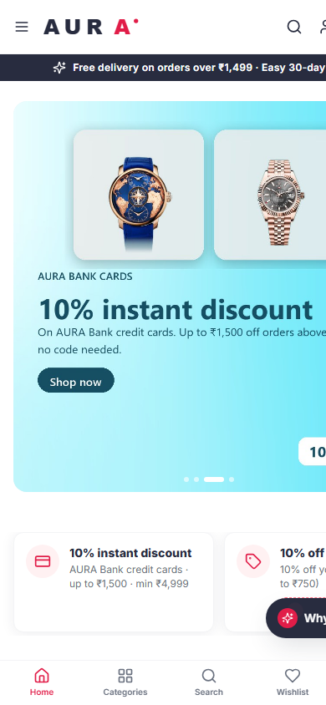
2 · LANDING PAGE AGENT
An agent that composes the page, not just a list
1
Perceive
2
Infer
Levels
UA → device · UTM/referrer → channel · timezone → state · hour → daypart & season · profile & history if signed in
hybrid scores for all 359 items · persona · department affinity · intent stage (discover / explore / buy now) from cart & purchase propensity (AUC 0.85 / 0.82)
L0 anonymous
L1 context
L2 declared (quiz / onboarding)
L3 in-session
L4 returning customer
3
Plan
4
Compose
layout template per stage & device; a Thompson-sampling bandit re-orders modules from live clicks (offline order = prior)
hero creatives scored by department, stage, season, channel, age · offer strip · category grid · Picked for you · For her/him · Trending in {state} · similar shoppers · bundles (co-purchase lift) · deals · stage CTA
Also
5
Explain
6
Learn
Clerk sign-in (email, Google, Apple)
coupons, bank offer, points
₹ checkout: UPI, cards, COD; orders & returns
optional Claude hero copy
every module has a reason & strategy, every product a why; the drawer shows level, context, persona, intent gauge, affinities, back-off path, timed trace
impressions/clicks → persisted log → 90/10 A/B (agent vs popularity control) + bandit; visible on /insights
Every element on the page is chosen for this visitor and can explain itself.
AURA · Hyper-Personalized Landing Page Generator Agent · NetElixir AIgnition 2.0 · K. Rohit & C. Namish · 2/5

Slide 3
3 · COLD-START SOLUTION
Cold start: back-off priors + similar visitors + LightGBM
Hybrid score = Σ w·component (weights tuned on a validation month)
Context back-off priors — P(item | cell) over 7 hierarchical chains (channel×device×state→region, pure location, time, landing, season, gender×age, gender×geo) with Dirichlet smoothing; sparse cells borrow from their parent. Location chain 0.61, gender×geo 1.0
kNN similar visitors — MI-weighted context, K=600 of 150k recent visitors, gender ×3 when declared (weight 0.79)
LightGBM (HP search, demographic dropout) — department, persona, cart & purchase propensity
Persona item mix · trend · popularity; in-session: co-view + next-item transitions (+144.6%)
Fallback ladder for a visitor we know nothing about
No UTM, no geo → global & time-decayed trends (L0)
Device / source / state / hour / landing page / season → priors + kNN + LightGBM (L1)
10-second style quiz or onboarding → declared gender, age, interest; hero leads with the declared department, hard-filtered “For her / For him” edit (L2)
First click → item graph takes over (L3); sign-in → own history & orders (L4)
+23.8%
−8.0%
vs popularity (95% CI 22.5–25.3)
NDCG if geography removed
5.1 / 10
+5.9%
top items change when the region changes
NDCG for women once gender is declared
AURA · Hyper-Personalized Landing Page Generator Agent · NetElixir AIgnition 2.0 · K. Rohit & C. Namish · 3/5

Slide 4
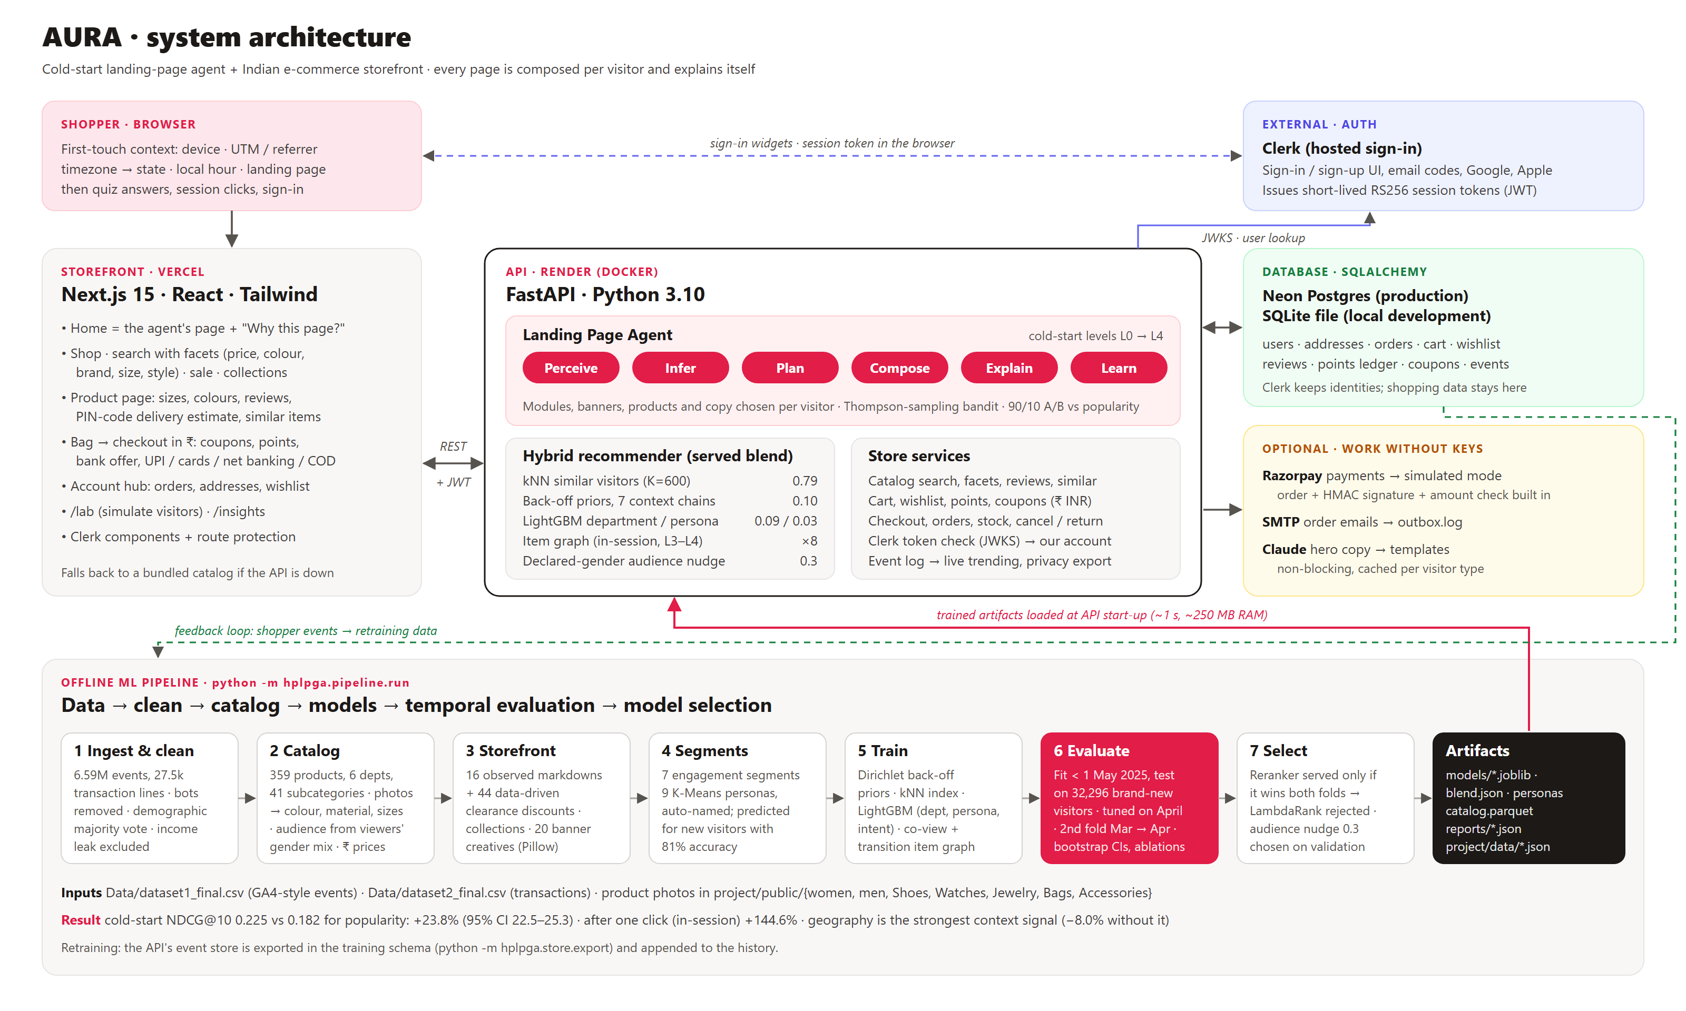
4 · DATA ARCHITECTURE / ML PIPELINE
Architecture & evaluation: decided on held-out months
Temporal protocol
Fit on data < 1 May 2025 → test on 32,296 visitors first seen 1 May – 8 Jun (no history); truth = everything they viewed, carted, bought
Weights tuned on April; second fold (Mar → Apr) confirms +19.8%
NDCG, HitRate, Recall, coverage @10 with bootstrap CIs, ablations, sensitivity
What the evidence rejected (and we report it)
LambdaRank reranker: won Mar→Apr (0.245 vs 0.241) but lost May–Jun (0.216 vs 0.225) → not served; its top feature, the raw state, doesn't transfer
Hard gender filter: women's NDCG 0.240 → 0.136 → served as a soft 0.3 nudge (−1% on validation) + hero & 'For her / For him' row
Department from context ≈ baseline (54%) → switch to behaviour at the first click
Stack
Online learning
Warm-up
Python · pandas/pyarrow · scikit-learn · LightGBM · FastAPI · SQLAlchemy (SQLite / Neon Postgres) · Next.js 15 · Clerk · Docker · 30 pytest tests
Persisted impression/click log · 90/10 A/B vs popularity control · Thompson-sampling bandit over module order
One viewed item → NDCG 0.449, HitRate 0.79 (+144.6% vs popularity)
AURA · Hyper-Personalized Landing Page Generator Agent · NetElixir AIgnition 2.0 · K. Rohit & C. Namish · 4/5

Slide 5
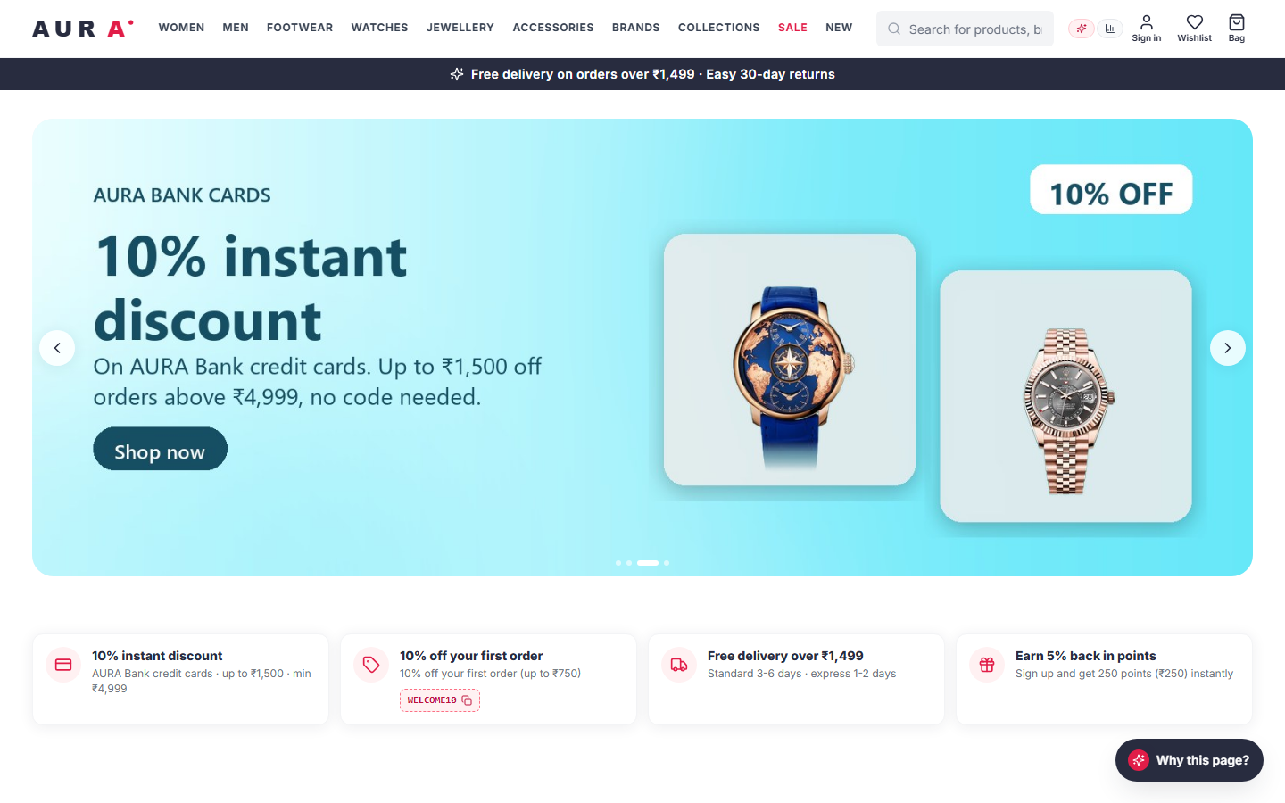
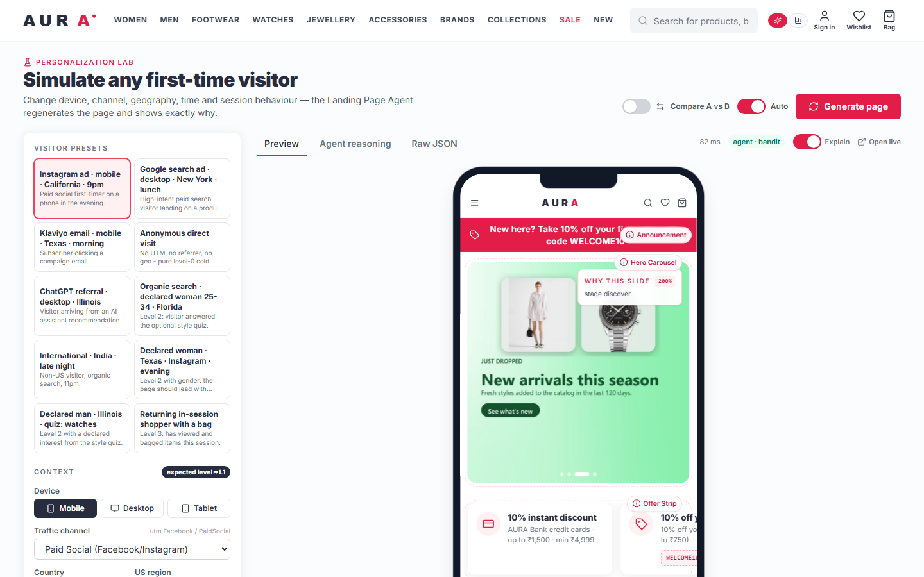
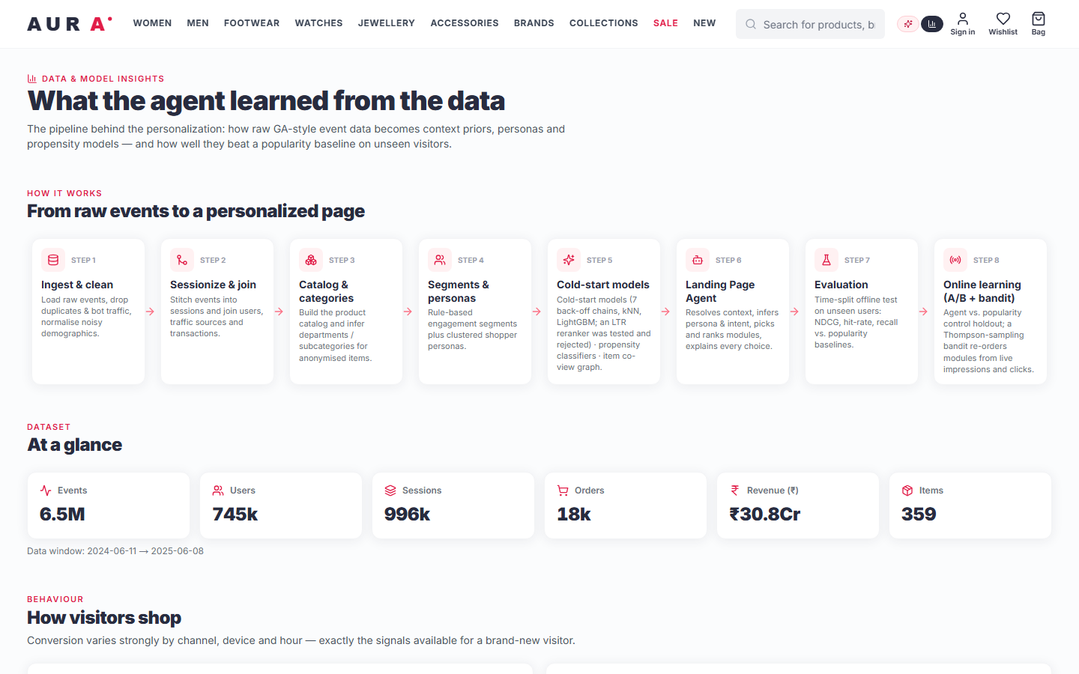
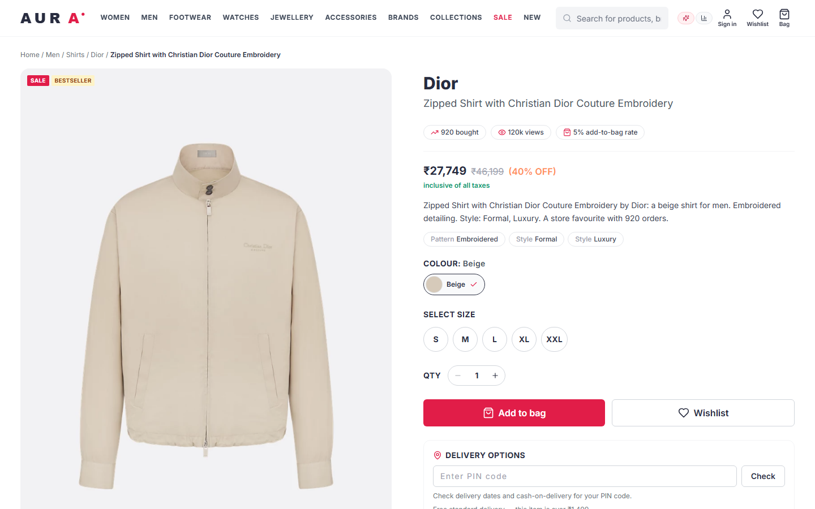
5 · UI DEMONSTRATION
A deployable store whose home page explains itself
Personalization Lab: presets, A/B compare, gender & location check
Insights: pipeline, evaluation, ablations, live experiment
Try it
/ ?utm_source=Facebook&utm_medium=PaidSocial&region=California
/lab · /insights · /sign-up (Clerk) → /welcome → order → back to / (Level 4)
Deploy: Vercel + Render + Neon (docs/DEPLOY.md)
Generated home page: agent-selected creative, ₹ offer strip, "Why this page?" drawer; every module chosen for this visitor
Product page: sizes, ₹ price, real social proof, PIN-code delivery
AURA · Hyper-Personalized Landing Page Generator Agent · NetElixir AIgnition 2.0 · K. Rohit & C. Namish · 5/5

