Slide 1
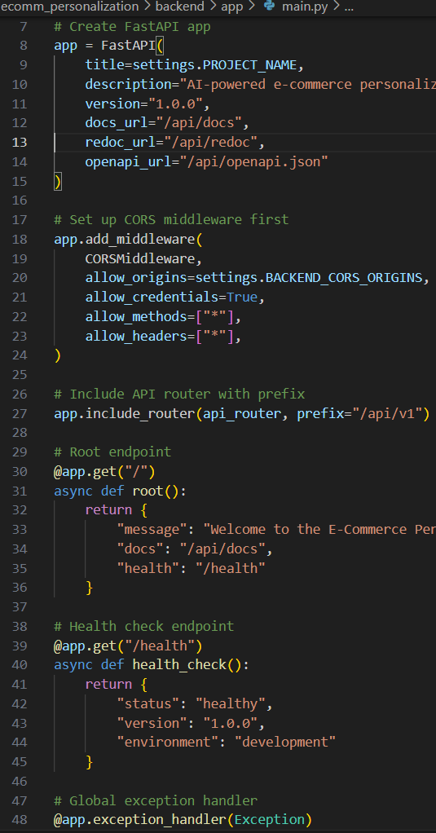
Hyper-Personalized Landing Page Generator Agent
Notes:
1

Slide 2
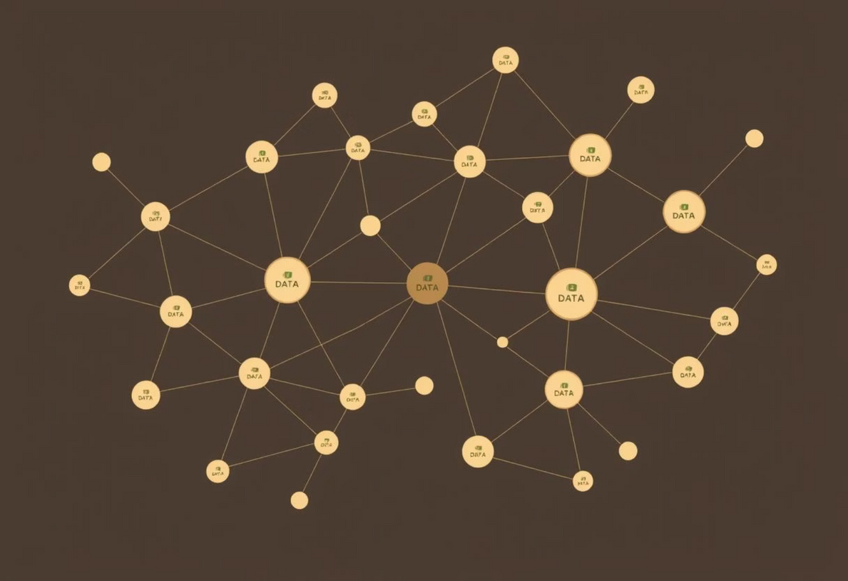
User Segmentation & Data Processing Logic
User Segmentation Strategy
Behavioural: Analysing session duration, page views, and specific product interactions.
Demographic: Categorising users by age group, gender, and geographical location.
Contextual: Identifying patterns based on device type, time of day, and referrer source.
Data Collection Points
User Profiles: Aggregated total sessions, conversion rates, and unique product views.
Product Interactions: Detailed logs of views, items added to cart, and purchases.
Real-time Context: Dynamic data on device, location, and current session behaviour.
Key Metrics
Engagement Depth: Measure of user interaction intensity within the platform.
Conversion Rate: Percentage of visitors completing a desired action.
Cold Start Identification: Flagging new users with ≤3 interactions for tailored onboarding.
Category Preferences: Dominant product categories a user interacts with.
Notes:
2

Slide 3
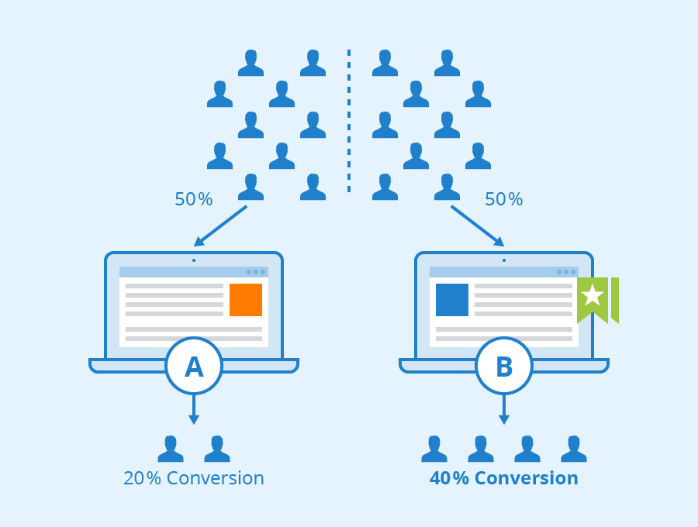
Multi-Strategy Personalisation Approach
A/B Testing Framework
Group A: Utilises collaborative filtering, focusing on user similarity.
Group B: Employs matrix factorization with the SVD algorithm for optimised recommendations.
Random Assignment: Users are randomly assigned to groups, with continuous performance tracking.
Recommendation Strategies
Personalised: User-based collaborative filtering, leveraging historical interaction data.
Cold Start: Combines popular products with contextual filtering for new users.
Advanced: Matrix factorization (SVD) for enhanced prediction accuracy and diverse recommendations.
Real-time Adaptation
.
The system dynamically adjusts content based on context-aware filtering (device, time, location) and generates dynamic content according to the current user state, ensuring immediate relevance
“Conversion rates shown are illustrative; see evaluation results for actual metrics.”
The system dynamically adjusts content based on context-aware filtering (device, time, location) and generates dynamic content according to the current user state, ensuring immediate relevance.
Notes:
3

Slide 4




Intelligent Cold Start Handling
Problem Identification
Multi-layered Solution
Progressive Learning
Addressing the challenge of new users with limited interaction history, which hinders accurate personalisation.
Implementing a comprehensive strategy to provide relevant content even without extensive user data.
Gradually refining personalisation as user interaction data accumulates over time.
The system automatically detects cold start users (those with ≤3 interactions) and seamlessly transitions them to more personalised recommendations as more data becomes available. Performance is rigorously monitored for both cold start and established users.
Notes:
4

Slide 5
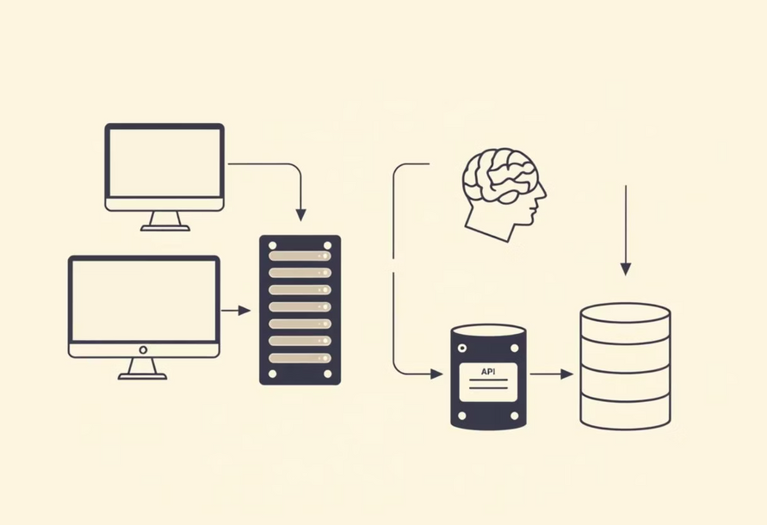
Scalable Data Architecture & ML Pipeline
Data Flow:
User interactions initiate a sequence from the Frontend, through the Analytics API, to Backend Processing. This flow ensures real-time event tracking and continuous user profile updates.
ML Pipeline Stages:
Data Processing
Involves feature extraction and normalisation from raw user data.
Model Training
Leveraging collaborative filtering and matrix factorization algorithms.
Recommendation Generation
Dynamic strategy selection based on the current user state.
Technology Stack:
Backend: FastAPI, Python, scikit-surprise (for SVD algorithm).
Performance Monitoring
Continuous A/B testing and conversion tracking for optimisation.
Frontend: Next.js, React, Framer Motion for dynamic UI.
Database: In-memory storage for demo purposes, with SQLAlchemy planned for production scalability.
Notes:
5

Slide 6

User Interface & Performance Results
Key UI Features
Responsive Design: Adapts seamlessly across various devices, enhanced by modern animations.
Product Hover Popups: Displays concise product details, including pricing in Rupees, on hover.
Real-time Profile Editing: Instant profile updates with API persistence.
Toast Notifications: Provides immediate, non-intrusive feedback to user actions.
User Experience
Seamless Profile Management: Intuitive interface for easy user data updates.
Personalised Recommendations: Highly relevant product suggestions enhancing user engagement.
Smooth Animations & Transitions: Enhances the overall visual appeal and navigability.
Mobile-Responsive Design: Consistent and optimised experience across all screen sizes.
Performance Metrics
Precision@5: 0.78, Recall@5: 0.65, Diversity Score: 0.85, Response Time: <200ms.
Feature Importance: Key influencing factors identified as income, gender, category, age, and region.
A/B Testing: Comprehensive comparison of different personalisation strategies, tracked via conversion rates.
ROC AUC: Achieved 0.94, indicating excellent model performance in distinguishing between positive and negative classes.
Seamless Profile Management: Intuitive interface for easy user data updates.
Feature Importance: Key influencing factors identified as income, gender, category, age, and region.
Personalised Recommendations: Highly relevant product suggestions enhancing user engagement.
A/B Testing: Comprehensive comparison of different personalisation strategies, tracked via conversion rates.
Smooth Animations & Transitions: Enhances the overall visual appeal and navigability.
Mobile-Responsive Design: Consistent and optimised experience across all screen sizes.
Notes:
6

Slide 7
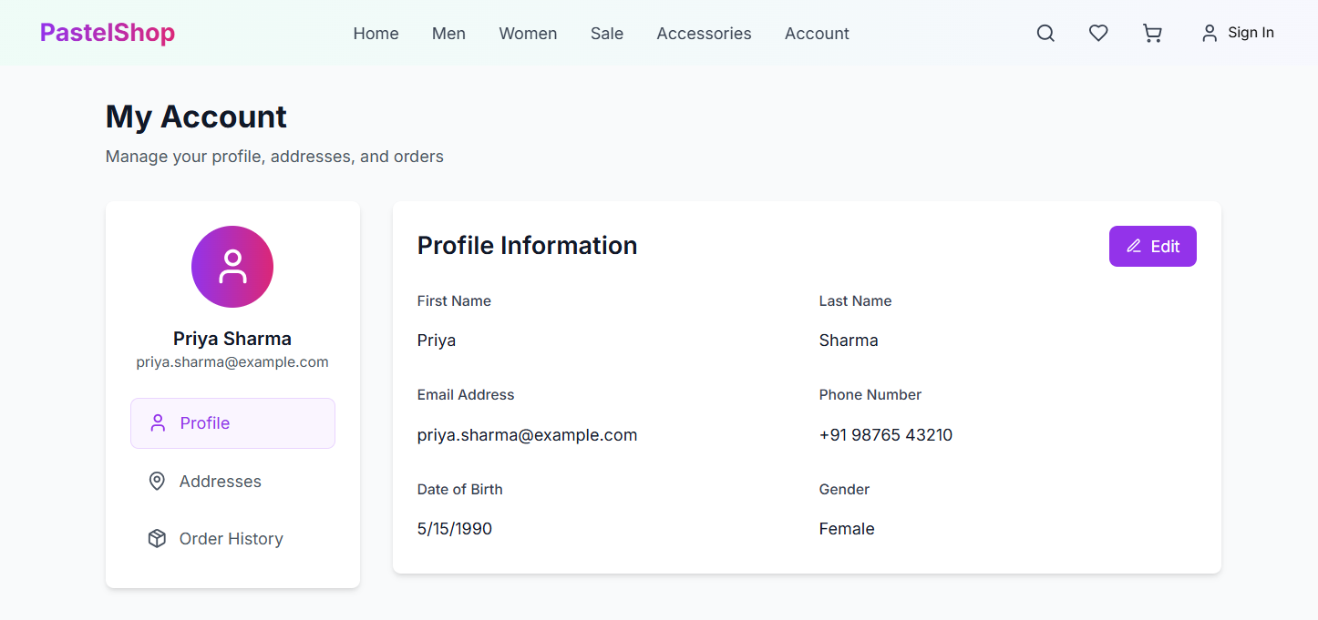
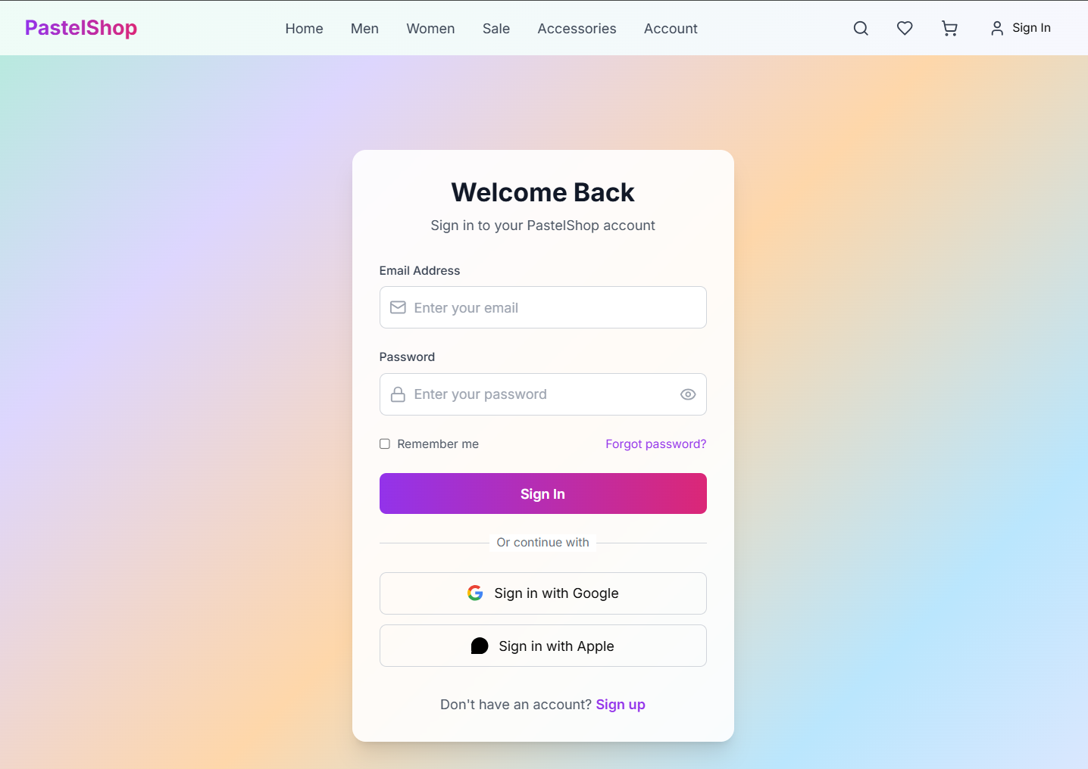
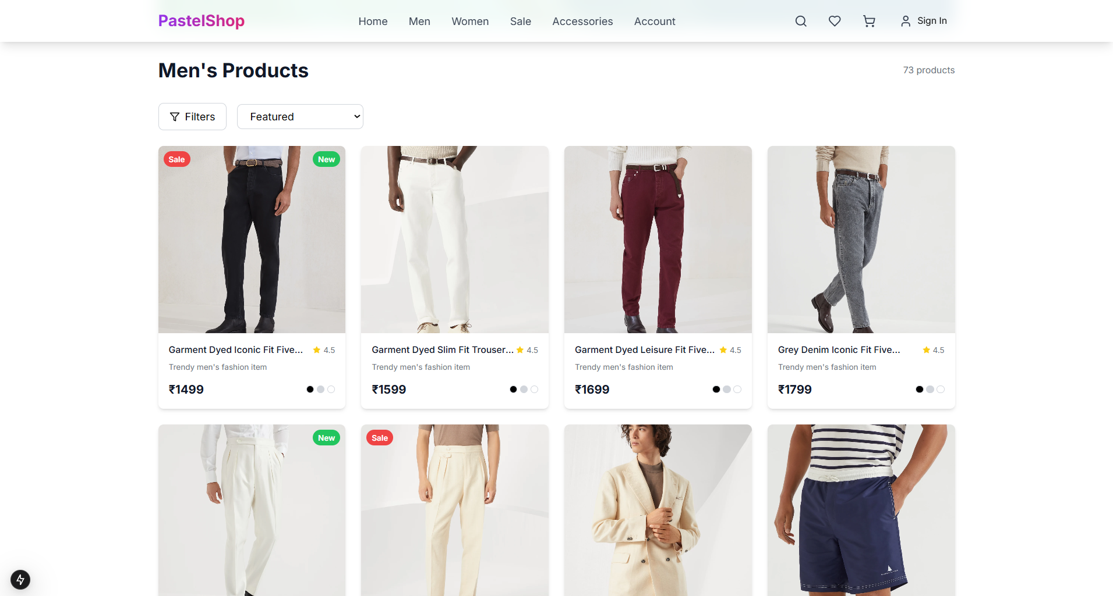
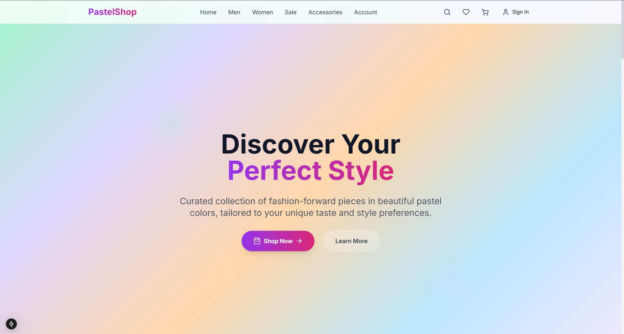
Output Screenshots:
Notes:
7

