Slide 1
CUSTOMER SHOPPING BEHAVIOR
The data behind the next growth move
Notes:
This readout connects customer behavior to the next growth move, using the available transaction, product, promotion, subscription, and shipping signals.

Slide 2
Customer shopping behavior: the data behind the next growth move
THE STARTING POINT
A loyal customer base is already doing the hard work
The question is how to convert existing loyalty into higher-value behavior.
3,900
3,116
701
purchases across four categories and 50 locations
customers classified as loyal
returning customers, alongside 83 new
02
Notes:
The base is already active: 3,900 purchases across four categories and 50 locations, with 3,116 customers classified as loyal. The growth question is conversion, not acquisition alone.

Slide 3
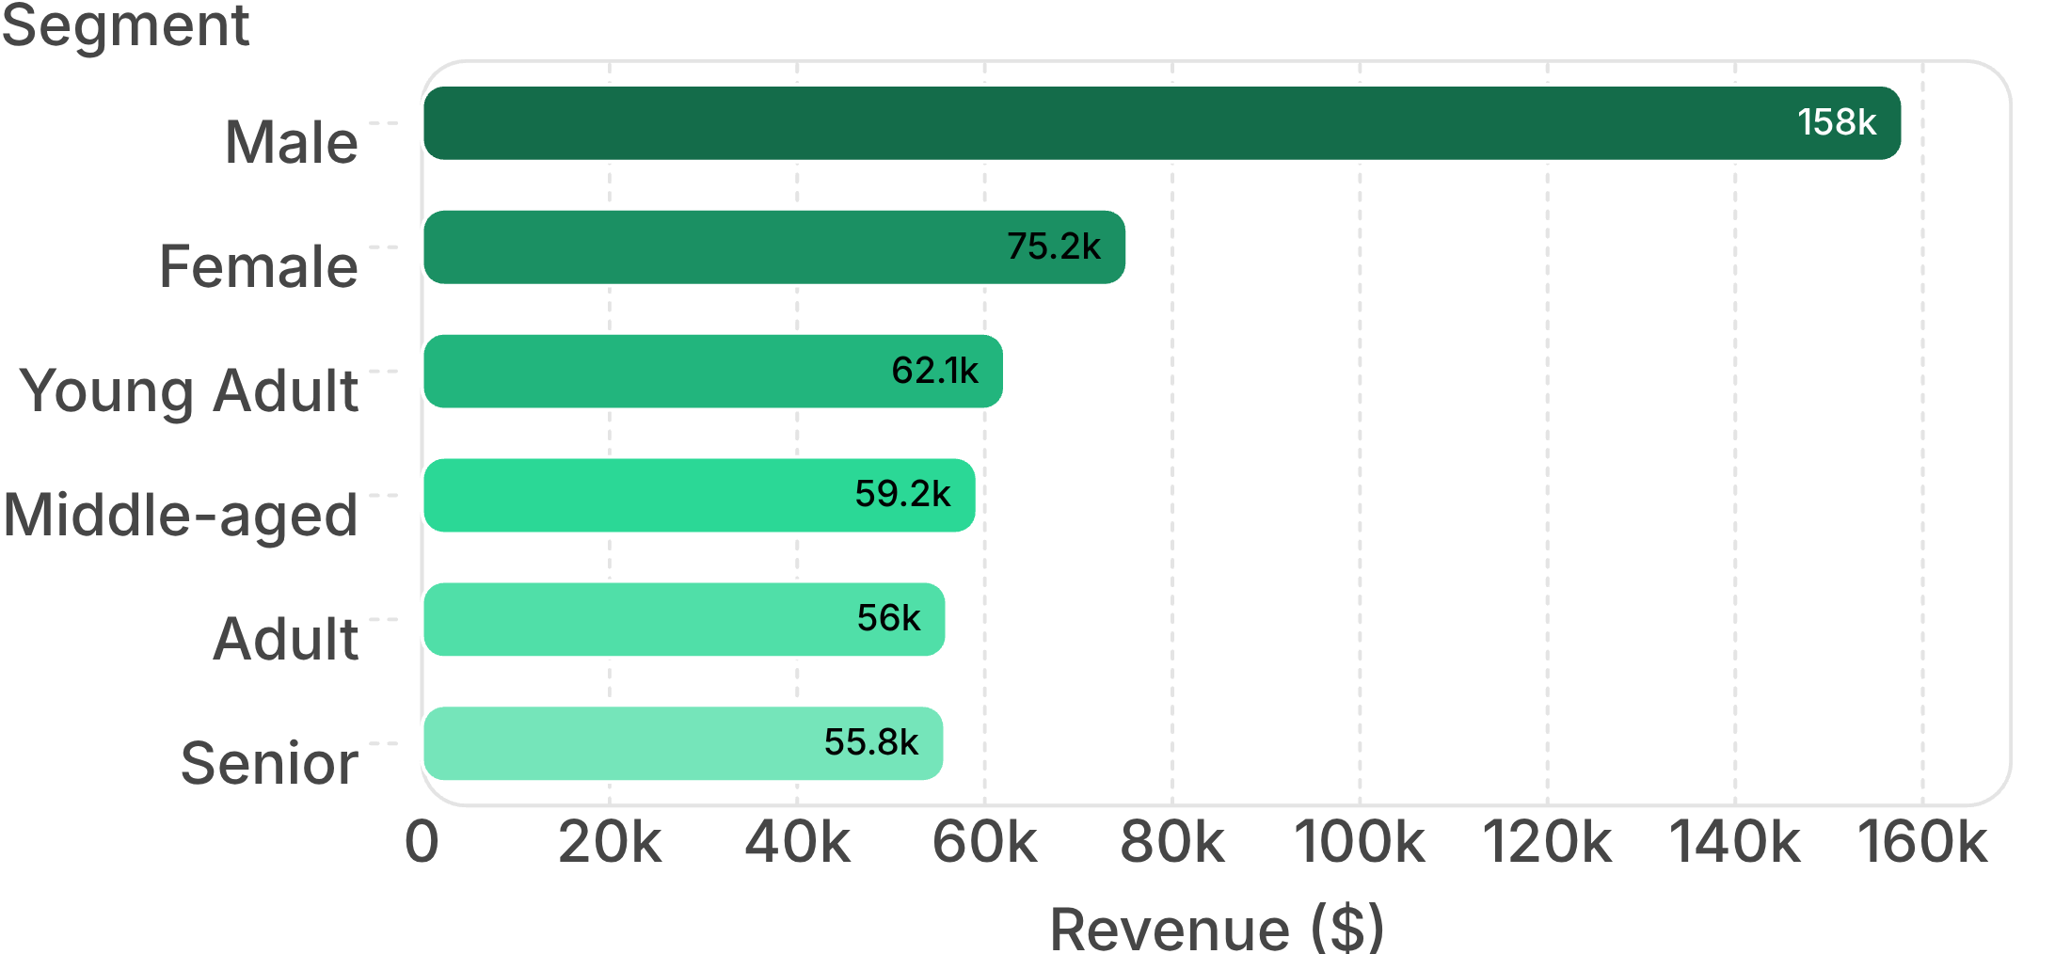
Customer shopping behavior: the data behind the next growth move
DEMAND POOLS
Revenue is concentrated in a few clear demand pools
READ THE CONCENTRATION
Male customers: $157,890; female customers: $75,191.
Young adults lead age-group revenue at $62,143; middle-aged customers: $59,197.
Clothing is the largest category by both revenue and sales volume in the dashboard.
Revenue by customer gender and age group
03
Notes:
The dashboard shows clear concentration by gender and age group. Clothing is the largest category by both revenue and sales volume, while male customers and young adults lead the observed revenue pools.

Slide 4
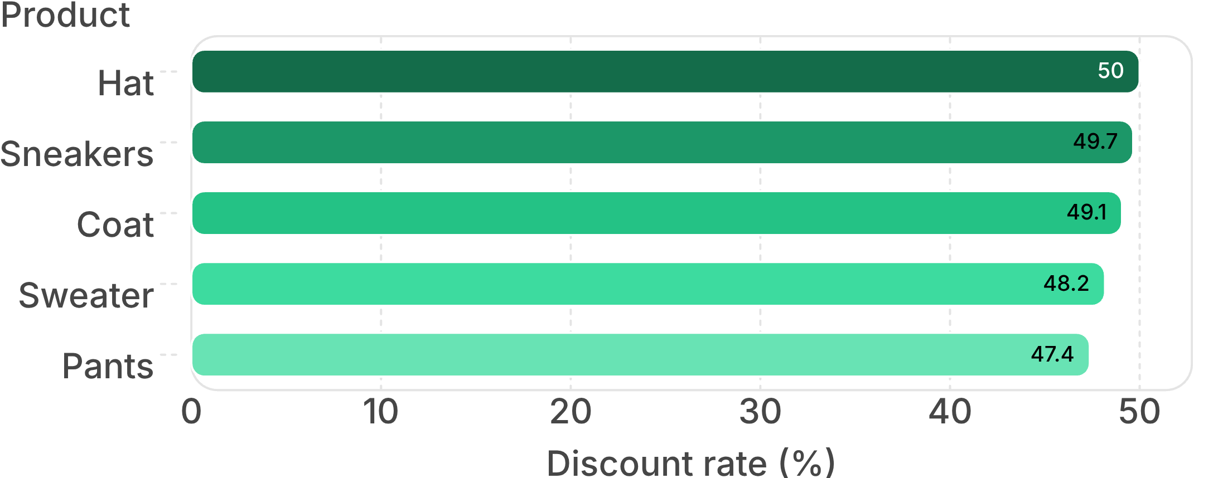
Customer shopping behavior: the data behind the next growth move
PROMOTION DEPENDENCE
Discounts attract high-value orders, but dependence is uneven
839
customers used discounts while spending above the average purchase amount
Distinguish profitable promotion from discount dependency.
Discount rate for the most promotion-dependent products: hat, sneakers, coat, sweater, and pants, from 47% to 50%.
04
Notes:
Discounts are associated with high-value orders for 839 customers, but exposure is uneven by product. The merchandising implication is to separate profitable promotion from discount dependency.

Slide 5
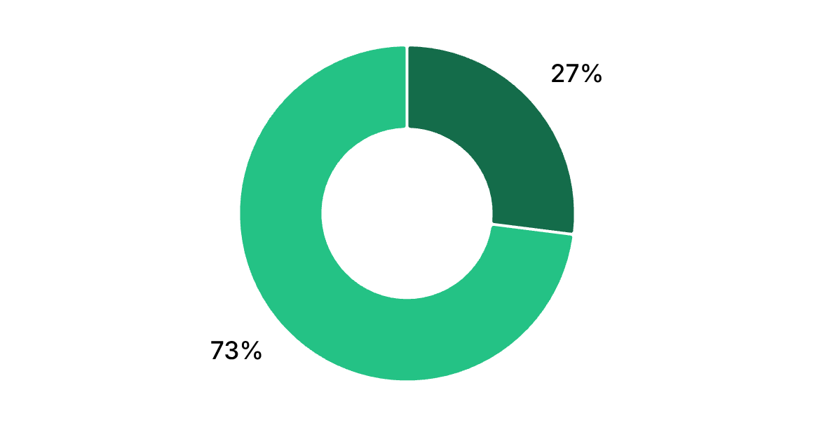
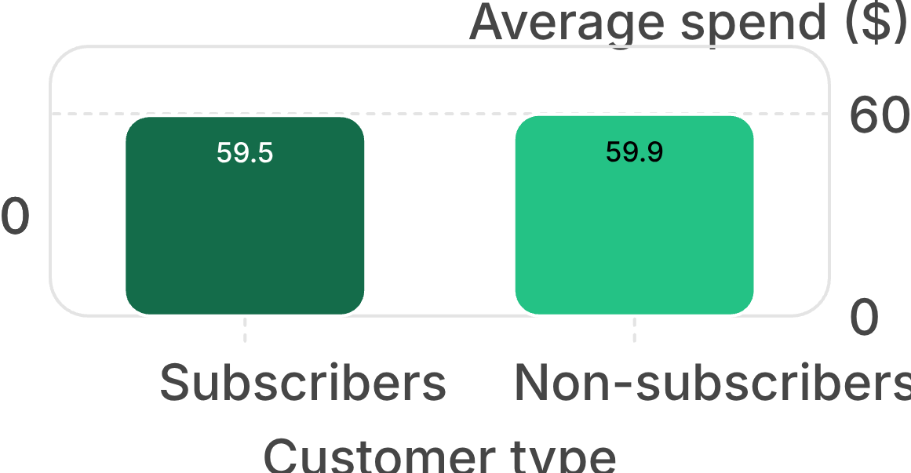
Customer shopping behavior: the data behind the next growth move
SUBSCRIPTION SIGNAL
Subscriptions have reach, but not a spend advantage yet
Customer reach
Average spend
Subscribers: 27%; non-subscribers: 73%. Average spend: $59.49 for subscribers versus $59.87 for non-subscribers. Repeat buyers: 2,518 non-subscribers versus 958 subscribers.
05
Notes:
Subscriptions have meaningful reach, but the spend comparison is nearly flat: $59.49 for subscribers versus $59.87 for non-subscribers. Repeat buyers are also more often non-subscribers.

Slide 6
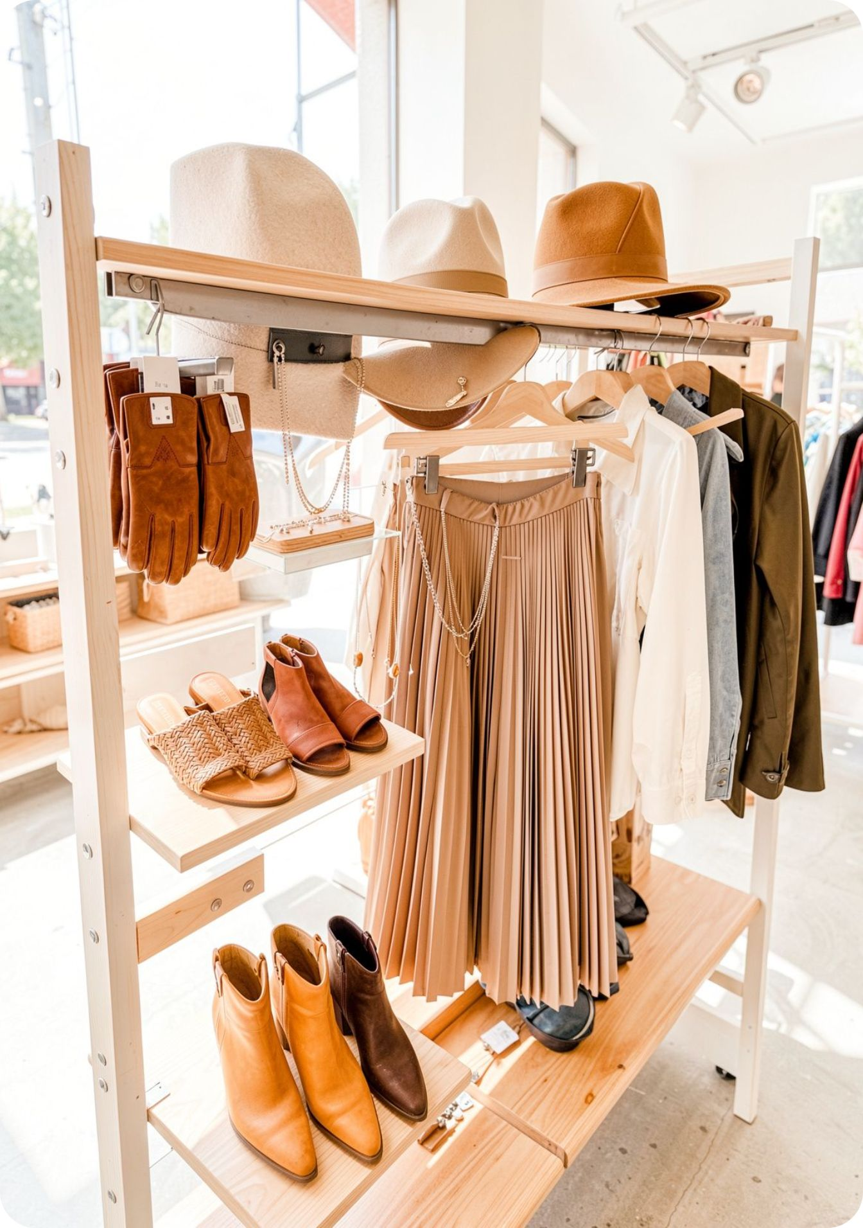
Customer shopping behavior: the data behind the next growth move
MERCHANDISING SIGNALS
Product signals are strong enough to guide merchandising
Signal | Evidence
Top-rated products | Gloves 3.86 · Sandals 3.84 · Boots 3.82 · Hat 3.80 · Skirt 3.78
Best-selling examples | Jewelry · Blouse · Sandals · Jacket
Shipping value | Express shipping $60.48 · Standard shipping $58.46
Use ratings, sales examples, and shipping value as merchandising inputs.
06
Notes:
The product signals are actionable without requiring a new model: ratings identify strong candidates, best-selling examples show category demand, and express shipping has the higher average spend.

Slide 7
Customer shopping behavior: the data behind the next growth move
REPEATABLE METHOD
The analytics workflow is reusable, not one-off
01
02
03
Clean
Standardize
Monitor
Clean transactional data and impute missing review ratings by category median.
Standardize fields and engineer age and purchase-frequency features.
Use SQL for business questions and Power BI for interactive monitoring.
A shared workflow turns future questions into comparable evidence.
07
Notes:
The workflow has three reusable layers: clean the source data, standardize and engineer the analytical fields, then use SQL and Power BI for questions and ongoing monitoring.

Slide 8

Customer shopping behavior: the data behind the next growth move
FROM EVIDENCE TO ACTION
Three actions follow directly from the evidence
Redesign subscription value around exclusive benefits, not just access.
Use loyalty rewards to move returning customers into the loyal segment.
Review discount policy and target high-revenue age groups, top-rated products, and express-shipping users.
08
Notes:
The evidence points to three moves: redesign subscription value around exclusive benefits, use loyalty rewards to move returning customers into the loyal segment, and review promotion and merchandising against the strongest revenue, product, and shipping signals.

