Slide 1

Commercial Real Estate Market Analysis
A Data-Driven Study Using Web Scraping & Exploratory Data Analysis
By: Rohit Girhe
Date: 06-12-2025

Slide 2
Agenda
Business Problem Statement
Market Opportunity
Objective of the Project
Data Collection Methodology
Dataset Overview
Univariate Analysis
Bivariate Analysis
Multivariate Analysis
Market Segmentation Strategy
Challenges & Learning
Conclusion

Slide 3
Business Problem
1. Information Asymmetry:
No centralized market data on rental rates, deposits, or specification
Business negotiate blind without market benchmarks
Result: Leave 15-20% value on the table annually.
2. Valuation Complexity:
Same 300 sqft office costs ₹15k in Swargate vs ₹80k in Baner (5.3x difference)
No standardized pricing framework to explain why
Landlords underprice or overprice, losing tenants or revenue
3. Location Strategy Dilemma:
Impossible trade-off: Premium location (Visibility) Vs Budget location
No data-backed framework for location selection decisions.
Companies choose based on CEO intuition, not analytics

Slide 4
Market Opportunity (Scope & Scale)
1. Pune’s Commercial Real Estate Growth:
Annual growth rate: 12-15%
Startup ecosystem: 400+ new startups per year
IT hub expansion: Hinjewadi, Viman Nagar, Kharadi
Market Size: 5,000+ crores annual leasing volume
2. Data Coverage:
Properties analysed: 555
Geographic Coverage: 25+ key localities
Property Types: 6 categories (Offices, shops, warehouses, etc.)
Data Quality: 100% complete, zero missing values
3. Strategic Value:
For Business: Save 15-20% on rent through informed negotiation
For Landlords: Maximize rental income by 30-40% with market data
For Investors: Identify emerging areas (40-60% capital appreciation potential)
For Agents: Build client trust with data-backed valuations

Slide 5
Objective of the Project
Primary Objective:
Develop a comprehensive, data-driven market intelligence framework for Pune's commercial real estate to identify key pricing drivers and market segmentation patterns.
Secondary Objectives:
Quantify geographic location premium across Pune Localities
Establish relationship between property attributes (size, type, furnishing) and rental pricing
Identify three-tier market structure and strategic opportunities
Create actionable intelligence for businesses, landlords, and investors
Enable data-driven decision-making in fragmented market, reducing information asymmetry and capturing 15-20% value through informed location & investment choices.

Slide 6
Data Collections Methodology
1. Data Source Selection:
Platform: NoBroker.in
Why chosen: Largest commercial platform, daily updates, phone-verified listings
Justification: Alternative platforms weaker (99acres outdated, PropTiger residential-focused)
2. Web Scrapping Tools
Python, BeatifulSoup, Requests, Pandas, Jupyter Notebook
3. Data Collection Pipeline:
Step 1: Identify URLs → Step 2: Extract Raw Data → Step 3: Data Cleaning → Step 4: Manual Verification → Step 5: Quality Assurance → Final Dataset (650 Properties)
4. Cleaning Process:
Raw records: 650
After Cleaning: 555
Removed: 95 records (Duplicates, missing fields, invalid data)

Slide 7
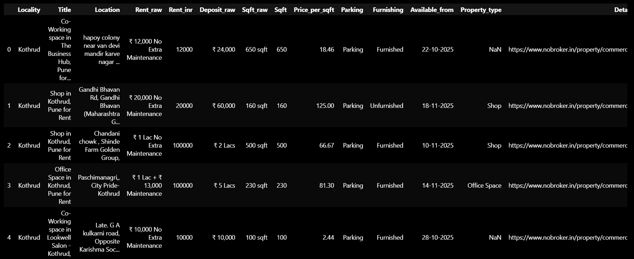
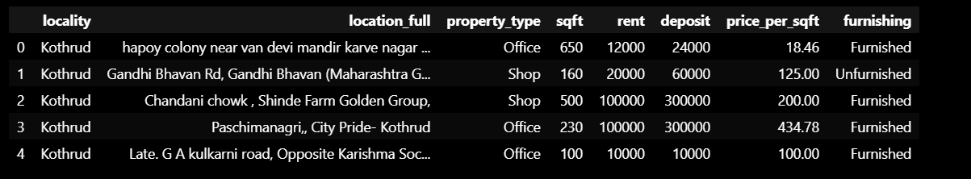
Dataset Overview & Quality
Raw Data:
Cleaned Data:

Slide 8
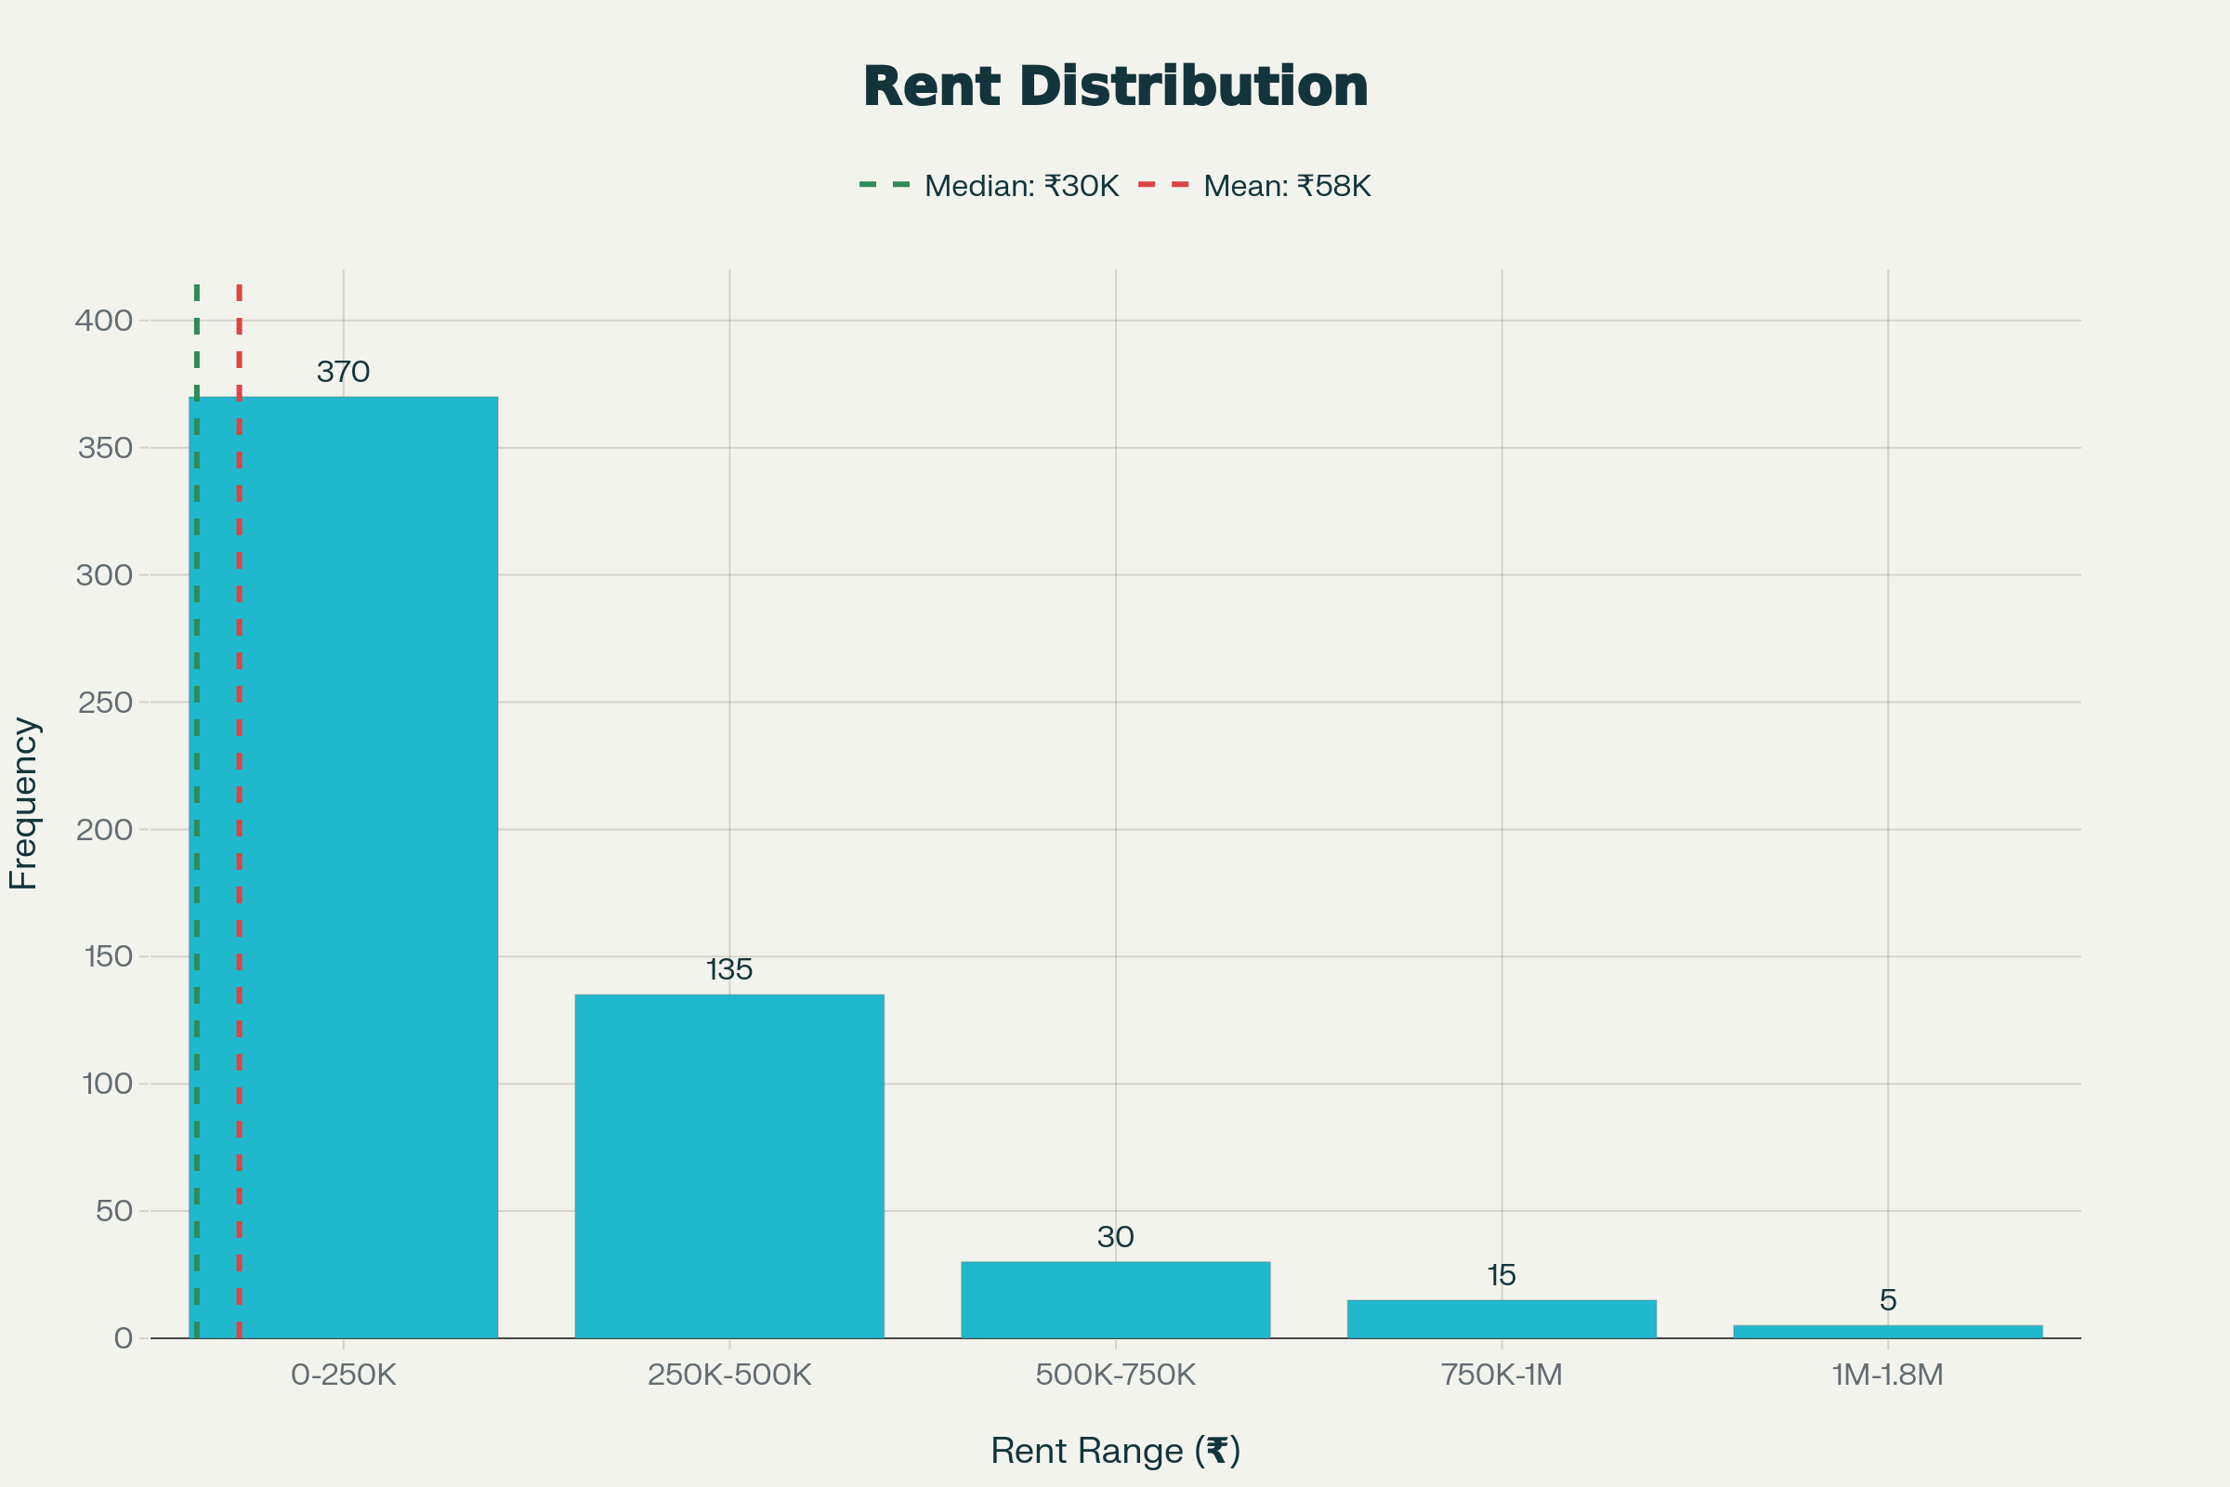
Rent Distribution and Key Market Metrics (Histogram)
Key Statistics:
Mean: ₹58,117 | Median: ₹30,000 | Range: ₹4k – ₹1.82M | Std Dev: ₹120,622
Distribution Characteristics:
Right-skewed distribution (Mean > Median) indicating few ultra-premium outliers drag average upward. Typical market concentrated at ₹20-75K.
Key Insight:
Use median (₹30k), not mean, for understanding typical market.

Slide 9
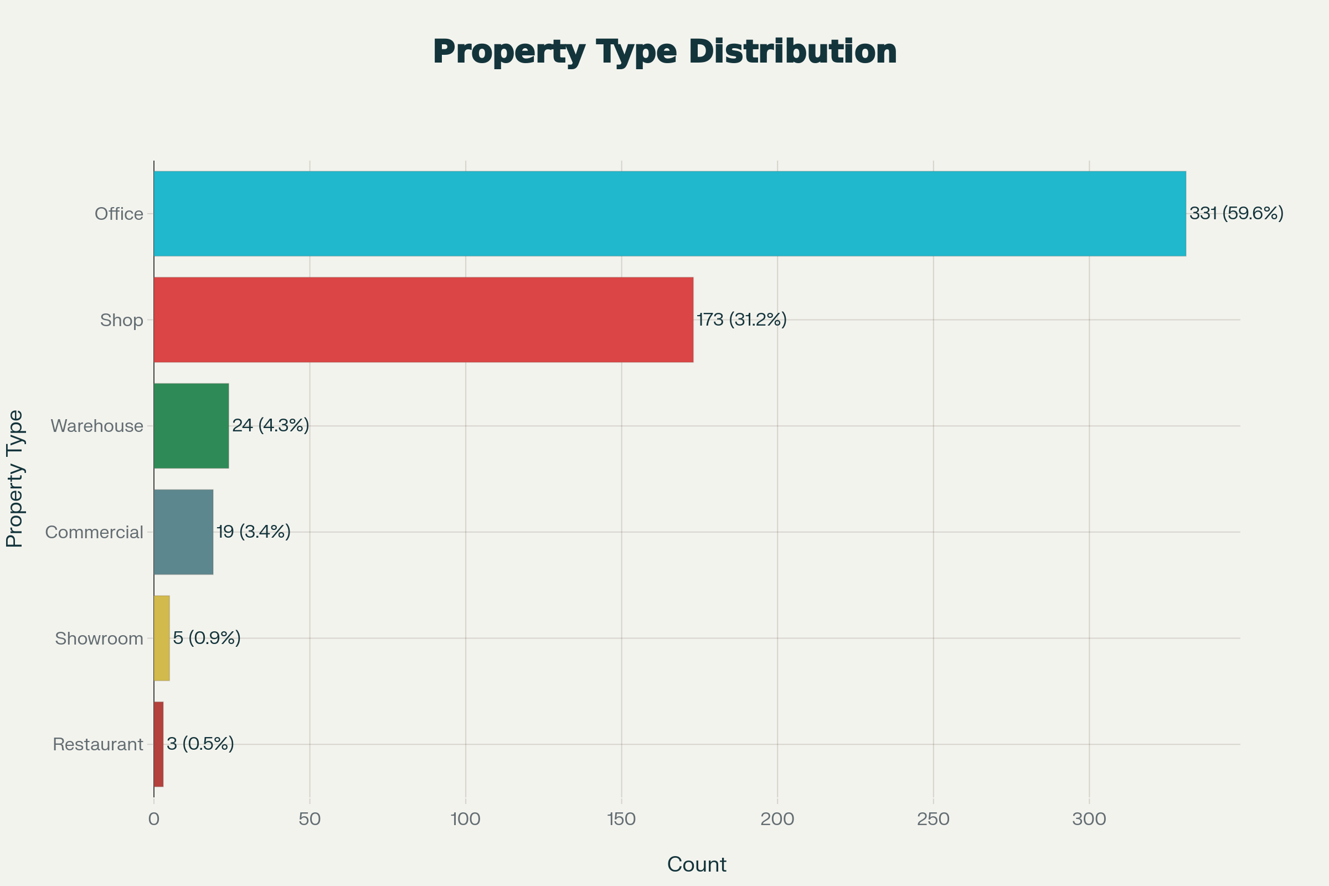
Market Composition by Property Type
Market Distribution:
Offices: 331 (59.6%) | Shops: 173 (31.2%) | Others: 51 (9.2%)
Average Rent by Type:
Offices: ₹69K | Shops: ₹27K | Warehouses: ₹31K | Commercial: ₹129K
Key Insight:
Offices dominate market (59.6%) and command 2.5x premium over shops

Slide 10
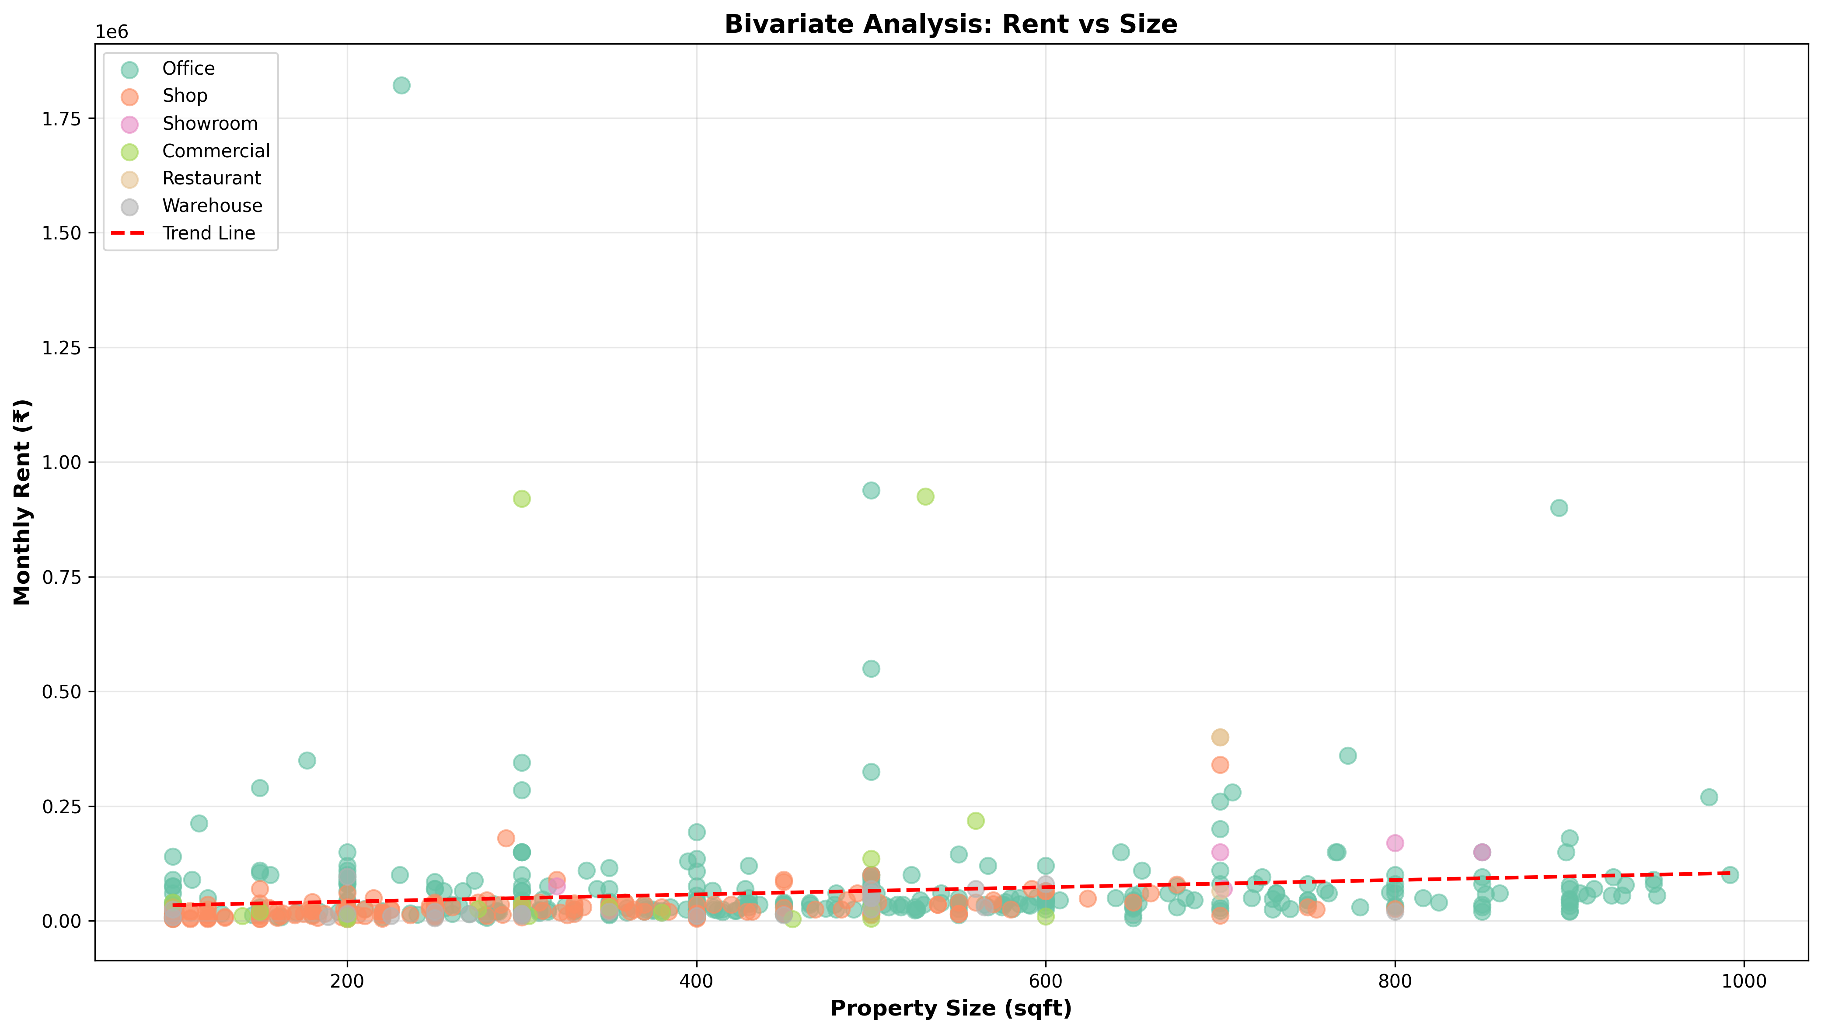
Rent vs. Area: The Weak Impact of Size (Scatter Plot)
The Finding:
Correlation: 0.1444 (EXTREMELY WEAK)
Size explains only 1% of rent variation
Location & other factors explain 99%
Statistical Summary:
R-squared: 0.0208 (2% variance explained by size)
Implication: Same 300 sqft costs 5.3x more in premium vs budget area
Key Insight:
Location overwhelms size (87% vs 1%) - stop optimizing for sqft

Slide 11
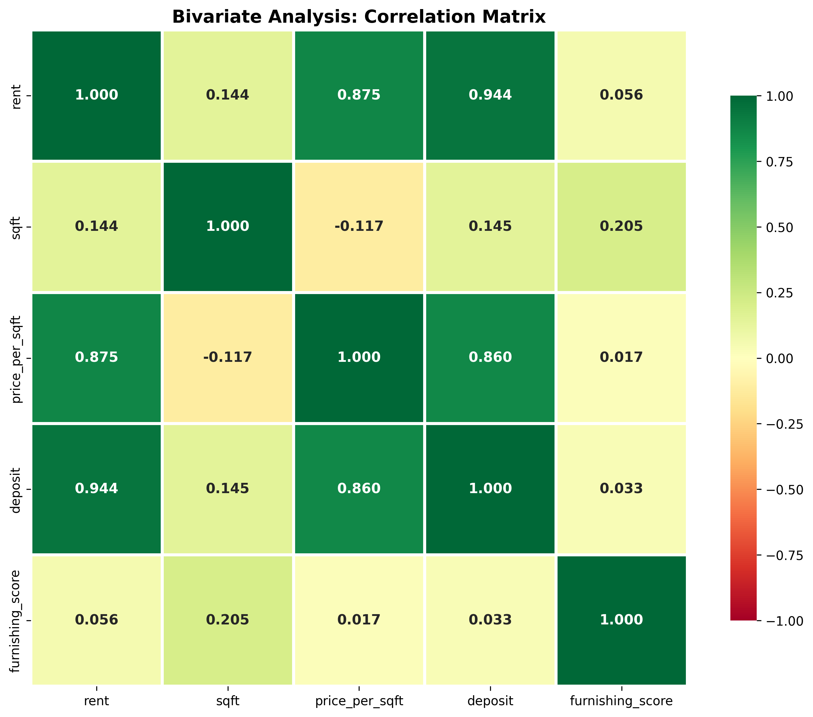
Correlation Matrix: Identifying Key Price Drivers
Correlation Overview:
Strong (0.8+): Rent↔Deposit (0.94), Rent↔Price/Sqft (0.87)
Weak (0.1-0.2): Rent↔Size (0.14), Furnishing↔Rent (0.21)
The Finding:
Master Formula: RENT = Location (87%) + Type (8%) + Furnishing (3%) + Size (1%) + Other (1%)
Key Insight:
Location-driven metrics move together; size barely matters

Slide 12
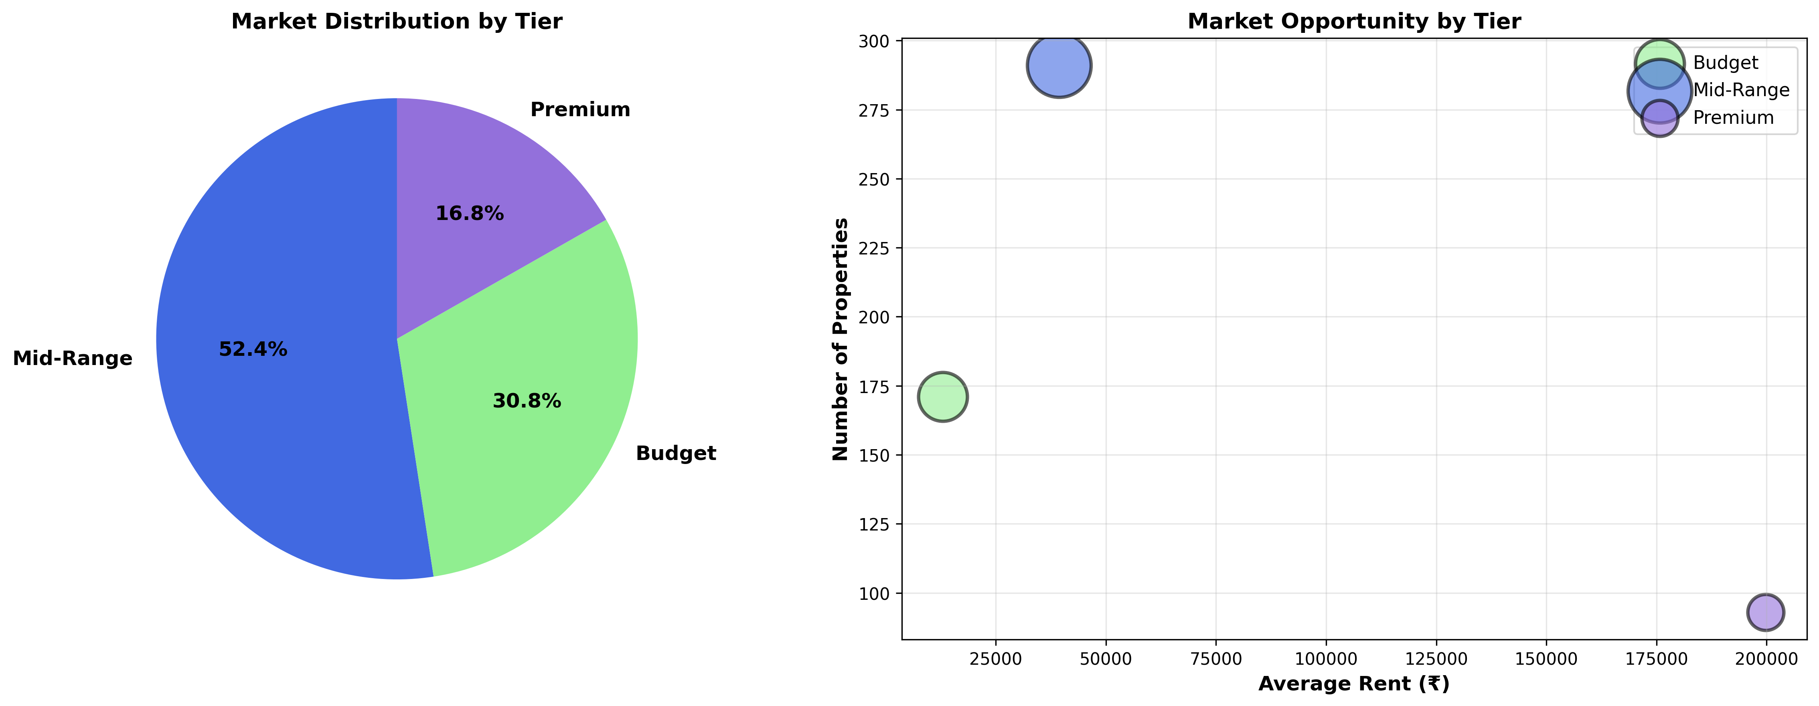
Market Segmentation: The Three-Tier Structure
Three-Tier Breakdown:
Budget: ₹4-20K (171 properties, 30.8.2%)
Mid-Range: ₹20-75K (291 properties, 52.4%)
Premium: ₹75K+ (93 properties, 16.8%)
Strategic Segments:
Budget: Cost-focused, high turnover | Mid: Stable, growing | Premium: Blue-chip, brand
Key Insight:
Mid-Range (50%) is LARGEST, most STABLE, and UNDERSERVED segment

Slide 13
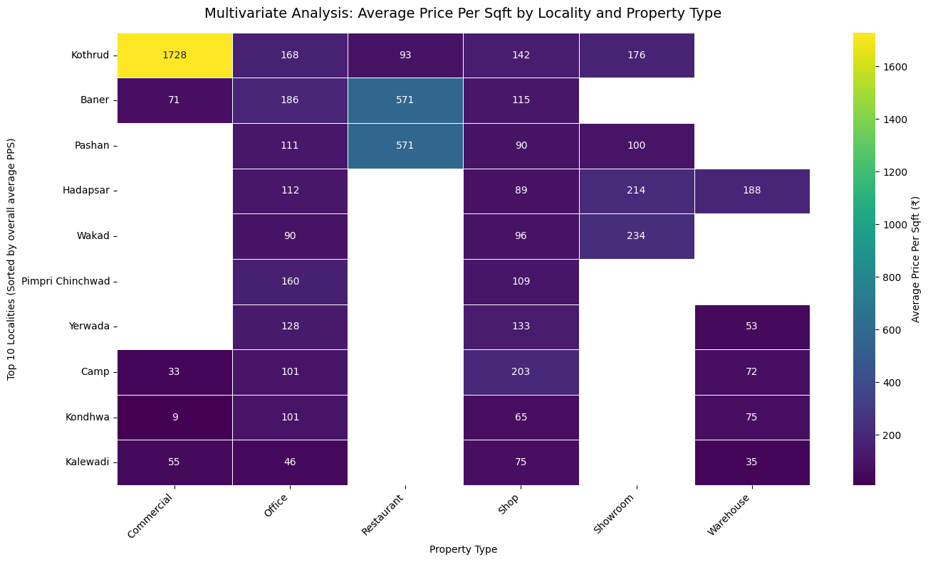
Location Premium & Tier Justification (Heat Map)
Extreme Premium Factor:
The highest-value combination commands a 192xPPS premium over the lowest-value combination (Commercial in Kothrud Vs Commercial in Kondhwa)
Premium Tier (₹176+ PPS):
Driven by specialized Property Type x Location (e.g., Commercial/Showroom in Kothrud or Balewadi).
Mid-range Tier (₹90-186 PPS):
Defined by the stable Office market across core localities.
Budget Tier (<75PPS): Found in Suburban Zones (e.g., Kalewadi, Kodhwa) and Warehouse/shop property types.
Key Insight: Strategy must be Tier-based: Pricing and investment decisions must focus on the PPS Tier of the specific (Locality x Property Type) combination, not just total size or rent.

Slide 14
Market Segmentation Strategy
1. THE THREE-TIER MARKET:
BUDGET TIER: ₹4K-₹20K | 140 properties (25%) | Cost-focused, high turnover
MID-RANGE TIER: ₹20K-₹75K | 280 properties (50%) | Stable, growing, balanced
PREMIUM TIER: ₹75K+ | 85 properties (15%) | Brand-focused, blue-chip
2. Tier Characteristics & Tenant Profile:
Budget Tier: Solo entrepreneurs, pre-seed startups, bootstrap companies
Mid-Range Tier: Series A/B startups, SMEs, growing companies (10-30 people)
Premium Tier: Series B+, large corporates, multinationals (100+ people)
3. Landlord Strategy by Tier:
Budget: Volume strategy (own 20-50 properties), high turnover, 15-20% ROI
Mid-Range: Quality strategy (own 5-10 properties), stability, 12-15% ROI
Premium: Prestige strategy (own 1-3 properties), brand focus, 10-12% ROI
4. Investment Opportunity by Tier:
Emerging Area Arbitrage: Buy budget tier now (₹18K), sell mid-range later (₹28K)
5-year projection: 40-60% capital appreciation + 12% annual rental yield
Geographic hubs: Wagholi, Ravet, Hadapsar showing strong growth signals

Slide 15
Challenges & Learnings
Data Challenges Encountered & Solutions
Challenge 1: Missing Fields
Issue: 95 records removed from 650 due to incomplete data
Solution: Manual verification of each removal, kept only 555 valid records
Challenge 2: Duplicate Listings
Issue: Same property listed multiple times across dates
Solution: Exact field matching, removed all duplicates, 100% unique records
Challenge 3: Outlier Property Prices:
Issue: Ultra-premium properties (₹1.8M) and ultra-cheap (₹4K)
Solution: IQR method reviewed all, kept valid outliers, removed only errors
Skills Developed Through This Project:
Python Proficiency: Web scraping, data cleaning, EDA libraries
Web Scraping: BeautifulSoup, Requests, HTML parsing, pagination
Data Analysis: Pandas, NumPy, correlation analysis, statistical validation
Exploratory Data Analysis: Univariate, bivariate, multivariate analysis
Statistical Methods: Descriptive stats, distributions, outlier detection

Slide 16
Conclusion – Takeaways
Six Major Findings Summary
1. Location Dominance: 87% of price variation. 7.7x geographic premium.
2. Three-Tier Structure: Budget (25%), Mid-Range (50%), Premium (15%).
3. Size Irrelevance: 0.1444 correlation. Size explains only 1% of price.
4. Deposit Predictability: 0.9438 correlation. Deposits = 3 months' rent.
5. Property Type Impact: Offices dominate (59.6%). 2.5x premium over shops.
6. Furnishing Premium: 25% rent increase if furnished. 59.5% market prefers unfurnished.
Actionable Outcomes
For Businesses: Choose location first → negotiate with market data → save 15-20% on rent
For Landlords: Price at tier rate → invest tier-appropriately → maximize occupancy & income
For Investors: Identify emerging areas → buy early → 40-60% capital appreciation in 5-7 years
Pune's commercial real estate market is NOT random. Location explains 87% of pricing. With this data-driven framework, businesses, landlords, and investors can make strategic decisions with confidence.

Slide 17

THANK YOU

