Slide 1
Telecom Customer Churn Prediction Using Machine Learning
Global Consumer Intelligence (GCI) Final Assignment
Submitted by
Rohit KUMAR Meena
B.Tech Mechanical Engineering
Indian Institute of Technology Indore
India

Slide 2
Business Problem
Business Problem
Telecommunication companies face significant financial losses due to customer churn. Identifying customers who are likely to leave enables the company to take proactive actions, improve customer satisfaction, and increase long-term revenue.
• Predict customer churn
• Reduce revenue loss
• Support retention campaigns

Slide 3
Dataset Overview
• Dataset Source
• Company A Telecom Customer Dataset
• Two linked tables: Client.csv and Record.csv
• Dataset Summary
• Total Customers: 17,518
• Total Features: 100
• Target Variable: Churn
  0 = Customer Stays
  1 = Customer Churns
• Data Preparation
• Merged both datasets using the customer ID.
• Handled missing values.
• Prepared the data for machine learning analysis.
•
•

Slide 4
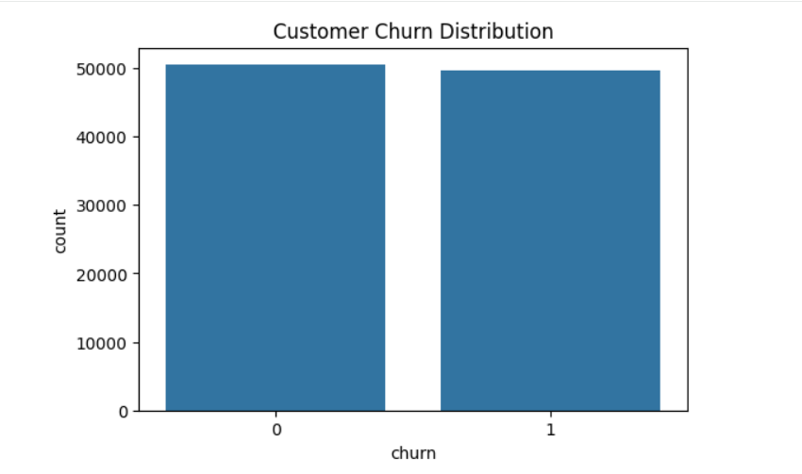
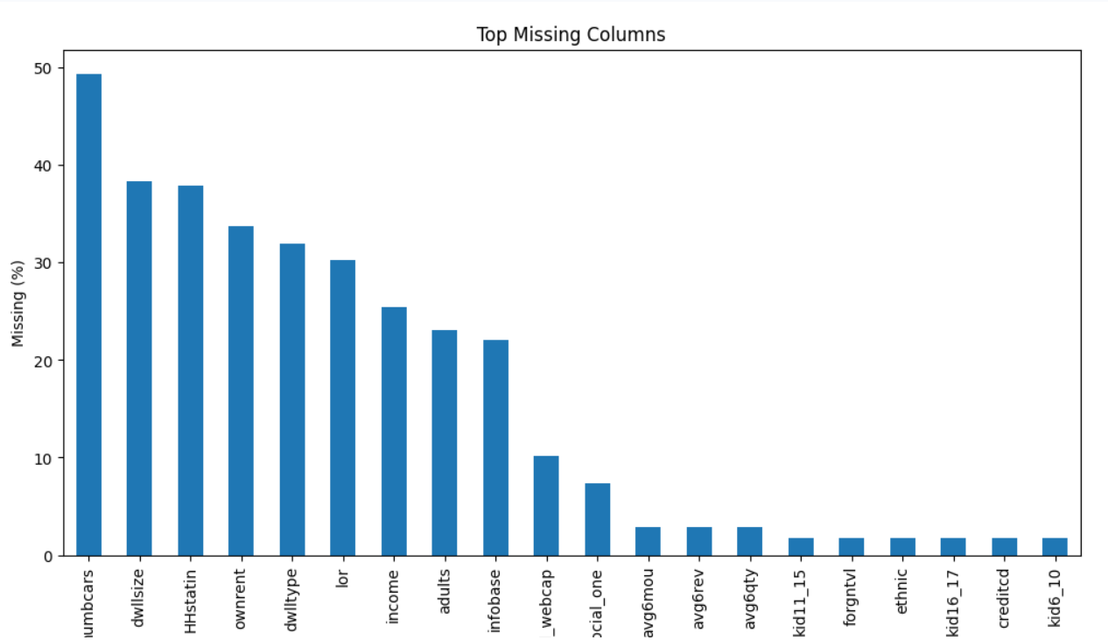
Exploratory Data Analysis
Insert your EDA graphs here:
- Missing Values
- Churn Distribution
Insert Churn Distribution Graph Here
Insert Missing Values Graph Here
Observation: Replace this text with the observations provided in the chat after inserting the graph.

Slide 5
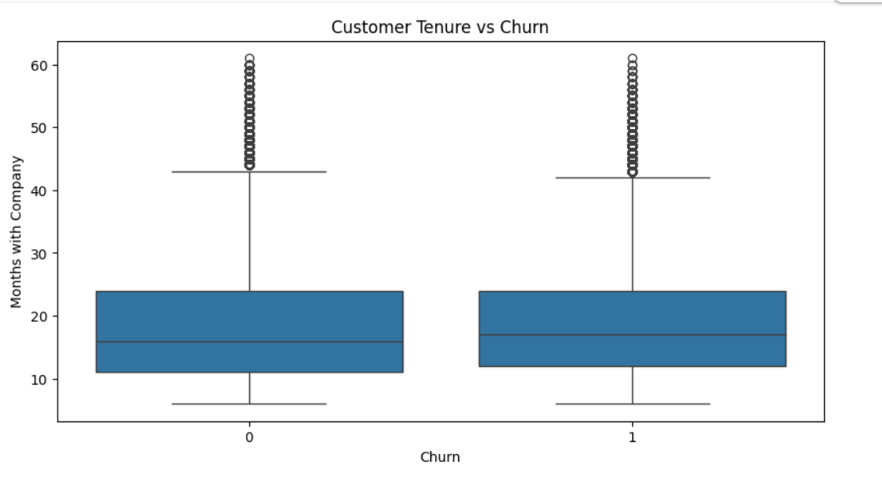
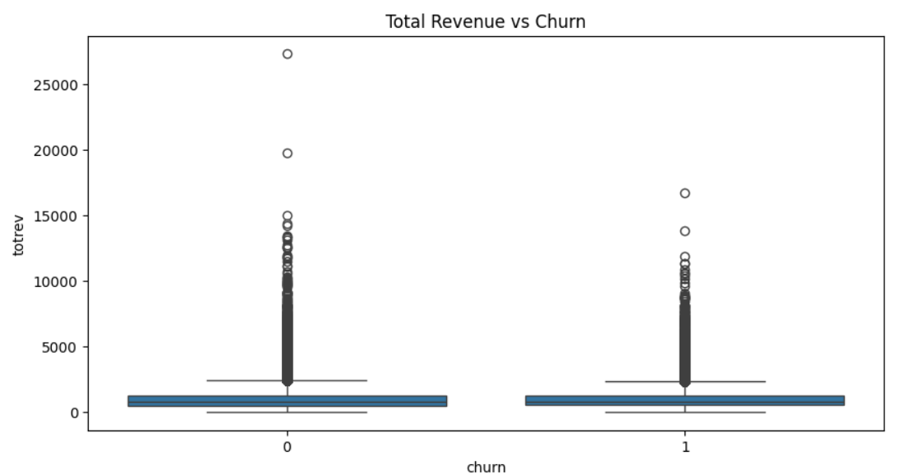
Customer Behavior Analysis
Insert Tenure vs Churn Here
Insert graphs:
- Tenure vs Churn
- Revenue vs Churn
- Avg Monthly Minutes
- Total Minutes
Insert Revenue vs Churn Here
Observation: Replace this text with the observations provided in the chat after inserting the graph.

Slide 6
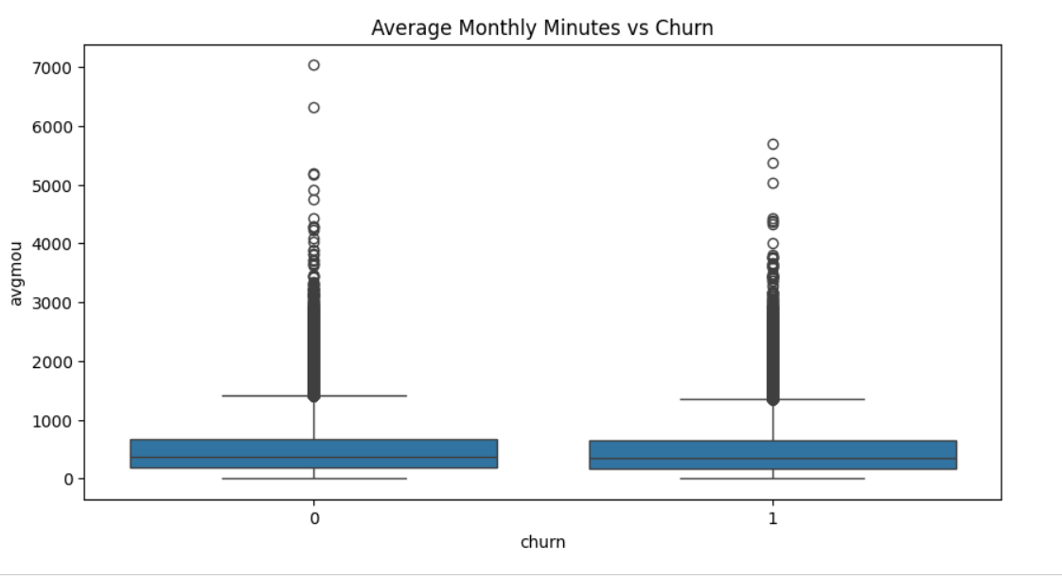
Machine Learning Workflow
Insert Average Monthly Minutes Here
Data → Cleaning → Encoding → Scaling → Train/Test → Models
Models: Logistic Regression, Decision Tree, Random Forest
Insert Total Minutes Used Here
Observation: Replace this text with the observations provided in the chat after inserting the graph.

Slide 7
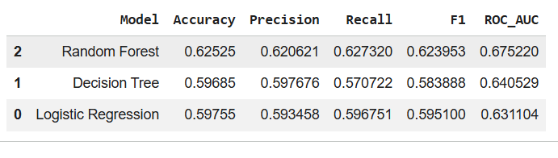
Model Performance
Random Forest performed best.
Accuracy: 62.53%
ROC-AUC: 0.675

Slide 8
Business Recommendations
• Identify high-risk customers
• Personalized offers
• Loyalty rewards
• Better support
• Increase retention

Slide 9
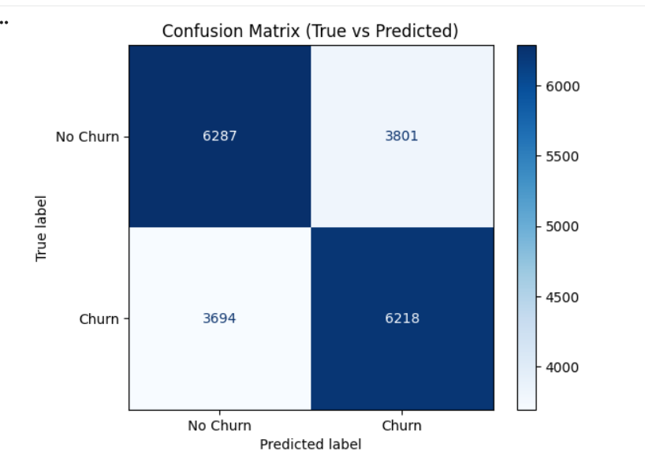
Confusion Matrix
Insert Confusion Matrix Here
Insert Confusion Matrix Image Here
Explanation:
• Shows True vs Predicted labels.
• Higher diagonal values indicate better classification.
• Supports Random Forest performance.

Slide 10
Conclusion
• Random Forest achieved the best performance.
• Predictive analytics can improve retention.
THANK YOU

