Slide 1

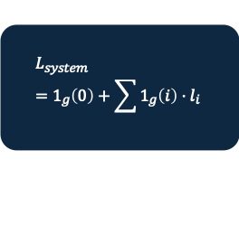




(Frozen)
$π$ (Router)
Stage Costs
System Loss
Input
Shared Encoder
$$m=BCE(f\left(x\right), f(x)$$
$$l_{i}=c_{i}+λ⋅(1−d_{i})$$
$$L_{system}=1_{g}\left(0\right)+\sum{1_{g}\left(i\right)⋅l_{i}}$$
x (claim)
$$π(x, m)$$
f(x)
$$l_{0}=r(AI Wrong)$$
Gumbel Softmax

