Slide 1
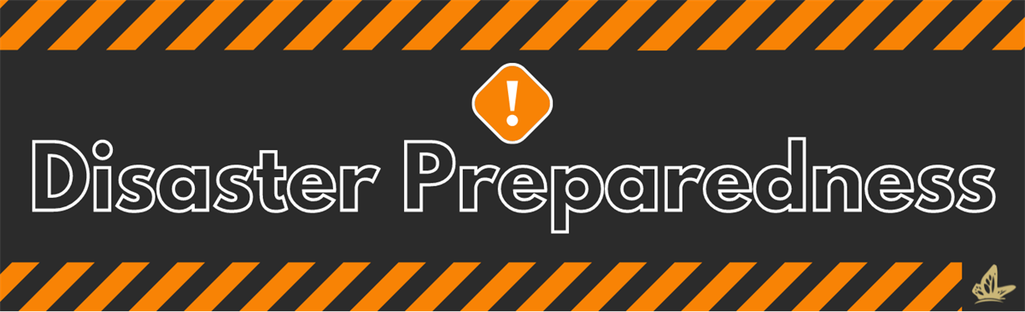
By Failing to prepare, you are preparing to fail
Benjamin Franklin, Founding Father of the United States

Slide 2
what is disaster preparedness?
‘Disaster preparedness’ basically has three main elements:
Forecasting events and issuing warnings.
2. Taking precautionary measures in response to warnings.
3. Improving response by organizing and strengthening capacity to deliver timely and effective rescue, relief and assistance.

Slide 3
The first objective of preparedness is to reduce the disaster impact through appropriate actions and improve the capacity of those who are likely to be affected most (that is, marginalized, poor and handicapped) to get maximum benefit out of relief.
The second is to ensure that ongoing development continues to improve the capacities and the capabilities of the system to strengthen preparedness efforts at community level.
Finally, it guides reconstruction so as to ensure reduction in vulnerability.
The best examples of preparedness activities are the development of local warning and community evacuation plans through community education, evolving local response structures such as Community based Disaster
Management Teams (DMT) and administrative preparedness by way of stockpiling of supplies; developing emergency plans for rescue and relief.

Slide 4
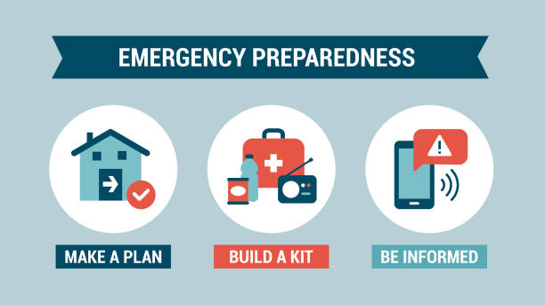
The aim of preparedness is THE REDUCTION OF THE IMPACT OF THE DISASTER
By effectively and efficiently responding to the forecast
The Framework
Is categorized
As follows

Slide 5
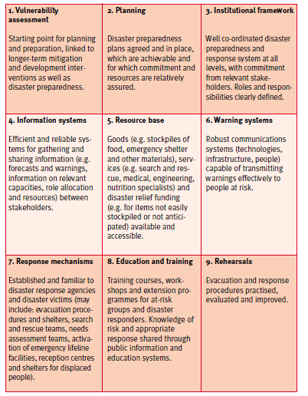

Slide 6
Important Components of Preparedness Plan
Generally community preparedness depends upon following four major components
-Population characteristics (number of children, squatter settlement etc )
-Building and critical infrastructure such as road, drinking water, communication network, health and sanitation
-Physical environment
-Social environment (social groups)
Squatter: a person who is living in an empty building without the owner’s permission

Slide 7
Components of Community Preparedness Plan
1. Physical Safety: i.e. how safe community members are in view of the physical danger from these hazards? The parameters essentially tries to measure how effective structural mitigation measures are e.g. resistance of building structures for earthquakes, availability of safe shelters and its capacity etc.
2. Hazard awareness i.e. awareness level about hazards which have a reasonably higher probability of occurrence
3. Organization preparedness i.e. how far the community is organized to face a disaster
i.e. existence of committee at community level, task forces, volunteers of civil defence and other local volunteers , trained disaster management teams and community disaster management plan etc
4. Infrastructure and services which tries to measure current state of these services and how well restoring critical services as and when disruptions occur

Slide 8

The Three A’s of Disaster Preparedness
Aim, Action and Accountability
to help people to avoid impending disaster threats
to put plans, resources and mechanisms in place
to ensure that those who are affected receive adequate assistance

Slide 9
AIM: It means having a clear goal of what you want to achieve in disaster preparedness.
Example: Reducing loss of life, protecting property, ensuring quick recovery.
ACTION: This involves taking practical steps to prepare for disasters.
Examples: Making emergency plans, Conducting drills, Building safe structures, Keeping emergency kits ready
ACCOUNTABILITY: It means responsibility- everyone (government, organizations, and individuals) must do their role properly.
Ensures: Proper implementation of plans, No negligence, Better coordination

Slide 10
AIM of Preparedness(Provides a Direction)
Developing planning processes to ensure readiness
Formulating disaster plans
Stockpiling resources necessary for
effective response
Developing skills and competencies to ensure
An effective performance of related tasks

Slide 11
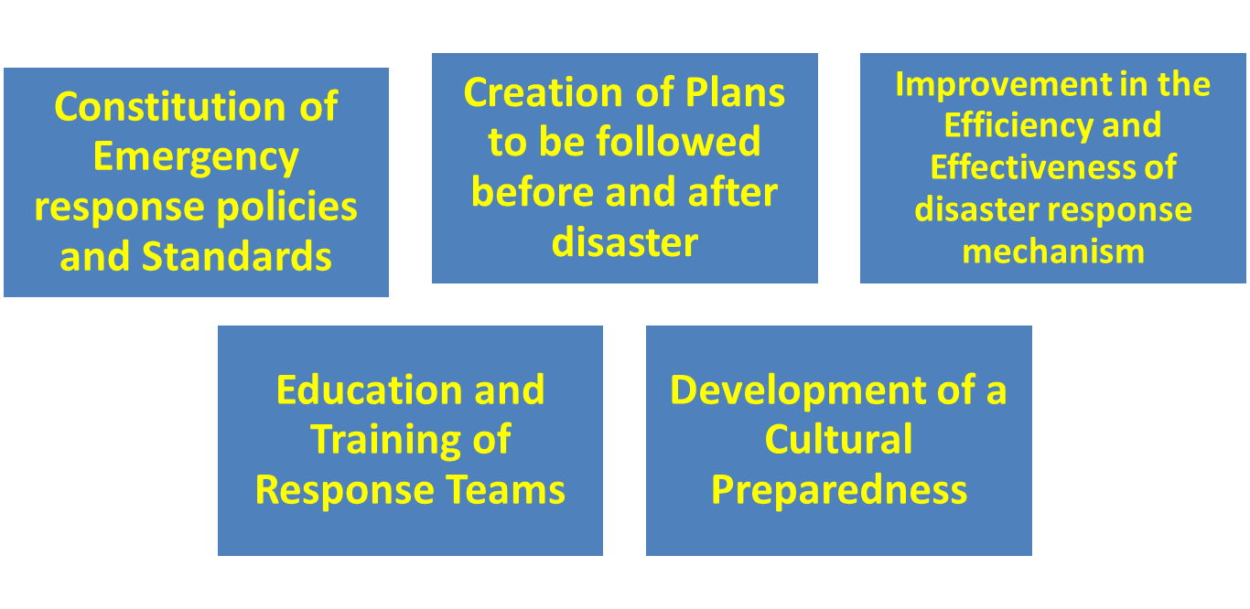
AIM OF PREPAREDNESS IS GENERALLY
Entailing activities aimed at improving response activities
Increasing Coping capabilities
Coping: to deal successfully with a difficult matter or situation

Slide 12
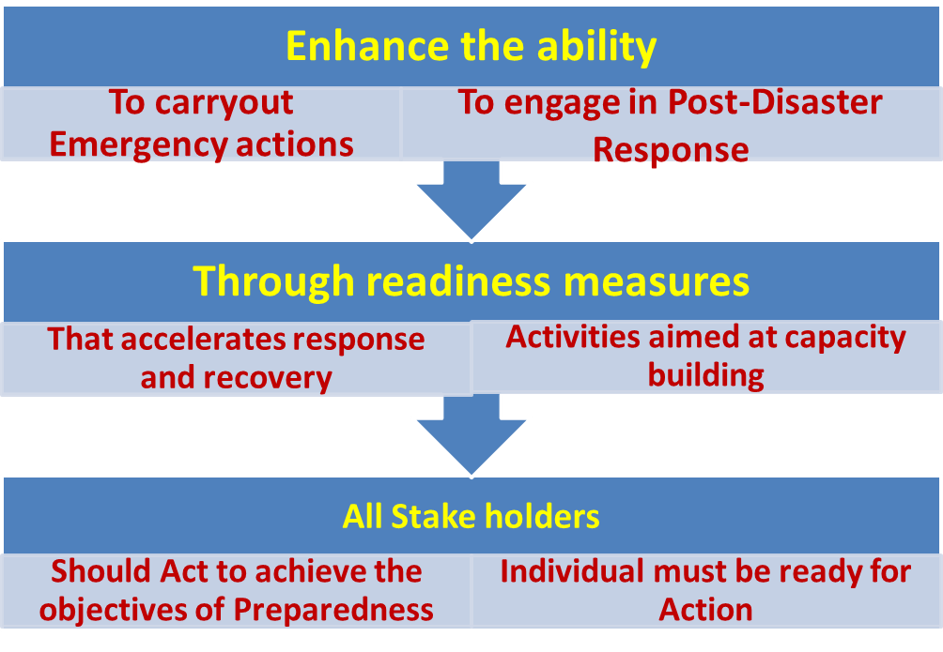
Action of Preparedness
Aim consists of Action premeditated to

Slide 13
Accountability for Preparedness
It details expectations and actions
Ascertains responsibility
It is of immense value as it is the
guiding principle on how people make
Commitments
Measure Progress
Ownership of responsibility

Slide 14
Principles of Disaster Preparedness
PRINCIPLE OF REALISTIC PLANNING
A detailed preparedness plan must be articulated with caution
All important resources needed should be enlisted
An actionable plan must be made
People can be trained and educated to tackle panic-striken victims
2. PRINCIPLE OF CONTINUOUS IMPROVEMENT
Plans must be regularly updated by changing and improving to meet
the changes In environment
Must continuously seek information for refinement and
flexibility of plans

Slide 15
3. PRINCIPLE OF COLLABORATION AND COORDINATION
It needs a coordinated effort from multiple agencies to satisfy the inter-related
Steps for achieving goals
There should be mutual collaboration among diversified stake holders
in framing preparedness plans with commitments.
Creating a strong sense of ownership is required among various parties
To actually implement the plans.
4. PRINCIPLE OF MOTIVATION
As performance is a product of ability and motivation, motivating general
Public is important.
It is essential to know what motivates people and how to motivate them.
Preparedness efforts should be supported relating to social behavior
during the crises

Slide 16
5. PRINCIPLE OF TIME-BOUND IMPLEMENTATION
Sustainable preparedness gives a sense of security
Collaboration with the response team is a must
It has to be both pre- and post-disaster preparedness measures.
6. PRINCIPLE OF ALL-DISASTER INCLUSIVENESS
Preparedness efforts should take into account all hazards irrespective of
Probability of damage
“Hazard-specific” planning, training and resource allocation should be
Undertaken
Impact of urbanization and development: Rapid growth of cities increases risks: Crowded population, environmental changes
Preparedness should be wide and flexible

Slide 17
ORGANISATIONAL STRUCTURE FOR DISASTER PREPAREDNESS
Roles and responsibilities:
Arrange, coordinate and implement the plans, thus, minimizes impact of disaster to a great extent.
Prepare national, state and local agencies.
Organisational structure:
The committee should contain members of the government and representatives from local communities, military forces, medical, media and non-governmental organisations.
Generate public awareness, facilitating training and providing technical and financial support

Slide 18
Disaster Preparedness Division/Unit
There are 5 distinct units in a Disaster Preparedness Division
1. Emergency operations and preparedness unit:
divided into 2 wings, each headed by 2 Deputy Directors.
i) 1st wing: should take an account of preparedness during normal times
ii) 2nd wing: should be crucial time wing, respond in the event of emergency situations. Rescue and recovery is to ensure coordination among various agencies
The two wings are further divided into regional centres, which are headed by regional coordinators. The regional centres are further divided into zonal centres, head by zonal heads

Slide 19
2.Logistical Unit: Headed by Additional Director, coordinate with Railways, Military and Aviation Departments
It is responsible for setting up rescue camps and ensuring a continuous supply of basic food items, medicines, utensils, and temporary shelters.
3. Communications Unit: Headed by Additional Director, supported by a Public Information Officer.
This unit is responsible for disseminating information to the public through news media. It arranges press conferences and press briefings and promotes preparedness policies.

Slide 20
4. Training and Development Unit:
Headed by Additional Director: responsible for providing training and development activities in areas of public education and awareness on disasters.
The team organizes workshops and lectures on aspects of disaster preparedness.
5. Plan Development, Implementations and Monitoring Unit:
The duty of this unit is the development, execution and monitoring of preparedness plans.

Slide 21
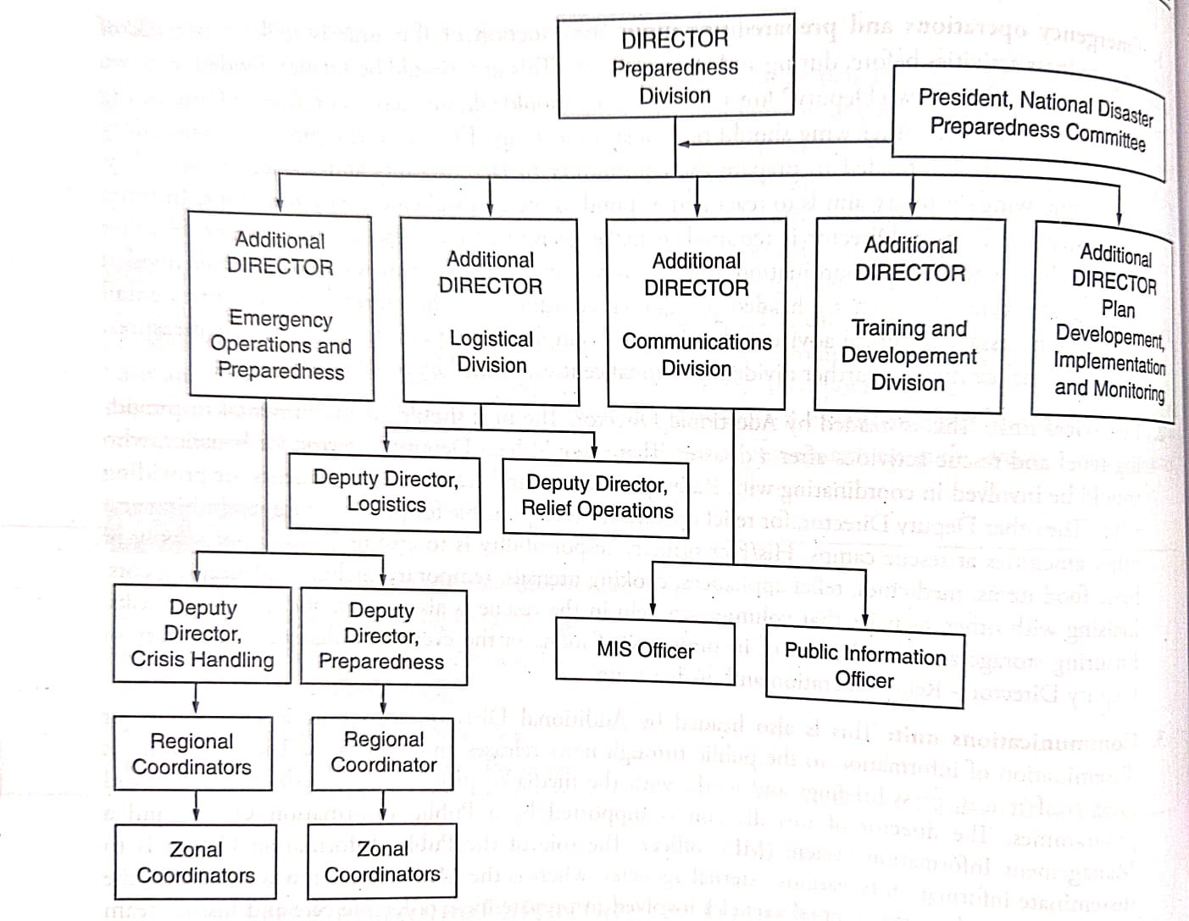

Slide 22
ESSENTIAL SERVICES PREPAREDNESS AND LOGISTICAL READINESS
It is the task of both the logistical division as well as the emergency operations and preparedness division to effectively manage disasters and reducing the quantum of losses
Logistical readiness should be implemented to control the flow of goods and services between the point of origin and the point of utilization.
Stock should be sufficient to meet the needs of the affected community.
The transportation, stock collection and piling, inventorying, managing supplies, all are covered under the scope of logistics management.

Slide 23
Preparedness teams have to be trained and equipped to operate under hazardous, difficult, vague and grave conditions. Trained to carry supplies under demanding conditions.
A fleet of emergency vehicles and trucks should be maintained and should be strategically located.
Warehouses should be created and make shift distribution centres for
i) medical and healthcare services
ii) To provide clean drinking water.
iii)An emergency supply of electricity and telecommunications.
For this, the local administration may need the help of military or specialists.

Slide 24
CONTIGENCY PLANNING
Plan show us the direction and help us use the resources in the best possible way.
Sometime strict compliance with the plans may prove to be disastrous in itself. In time of drought, flood and tsunami, well-made plans may fail because of the sudden turn of events.
Contingency planning entails making a plan B to deal with situational changes.
All the problems arising out of all possible situations need to be addressed, there is no need of any other plan.
Second, they feel that if, any problem arises, it will be addressed as and when it props up.

Slide 25
The aim of the plan should be to ensure a minimum level of functionality of all the resources, and the focus should be on providing prompt service in the event of a disaster.
Issues relating to airport clearance and logistical coordination for providing solutions to problems have to be addressed.
The plan should provide the role and responsibility of each agency at every stage both human and material should be clearly stated.
The method for updating people about the changes in the plan should be clearly mentioned.
Copies of the plans should be made accessible to the community.

Slide 26
The judgement of experts about the limits and extremities of situations is important. The judgement is mostly based on a review of past disasters that may have affected the area.
Contingency planning has three stages:
(a) Readiness- includes training people, arranging resources
(b) Standby- alert phase, teams are ready to act immediately
(c) Activation- Action phase, rescue, relief and emergency operations begin
The plan should first have a detailed account of all the possible scenarios and then should list all the constraints, both human and material.
With limited human capacity to respond and limited means available, a realistic plan should be made.
All the members of the team should be communicated about the roles and responsibilities.

Slide 27
Importance of building team and community relations for environmental and emergency managers.
Team comprises: different communities, groups, gender, environmentalists and government authority.
The whole team need to work together in one direction, more lives and property could be saved.
The teams consist of experts who are dedicated to their work and committed to the job they are entitled to do.
Working individuals is not fruitful to save lives.
Also, it provides a sense of direction to use limited resources wisely and judiciously.
Team building is one of the strategic steps of preparedness that enables an effective response in crisis situations.
The team is to support and help the community members to defend themselves from future disasters.
The team members gain the requisite skills in rescue and relief operations.

Slide 28
The team- building involving four stages, namely forming, storming, norming and performing.
The forming stage: the team defines the problem, decides the goals and commits to tackle the problem by making strategies.
During this stage, the leader should stress the importance of attitude and behavior of team members, the efforts should be to create a positive relationship among the team members.
The storming stage: the members discuss and try to build skills in assessing the situation. The team members realize that the task is more difficult than they imagined.

Slide 29
The norming stage:
(i)The members accept their team, their roles in the team rules and procedures.
ii) They accept the team members with their weaknesses and strengths.
iii) They understand the urgency and need of the preparedness team and start helping each other.
iv) They try to resolve differences and conflicts and develop a close attachment to the team.
The last stage is that of performing:
where each member of the team tries to meet the objective of the team by giving his or her best.
The aim is to provide all help to people who are caught in the disaster.

Slide 30
By building a team, emergency managers are able to delegate responsibility effectively.
It generates higher levels of trust and support.
Team building leads to the creation of a transparent work culture where the policies and procedures are simple and easy to follow.
Many a time, it is seen that the preparedness exercise does not yield good results as the plan does not meet the needs of the stakeholders.
Good community relations are a guide for better action.

Slide 31
People caught in disastrous situations go through many emotional phases.
Acute state: where individuals try to save their own life and that of their near and dear ones.
Reaction stage: where individuals involve in search and rescue work and help in providing medical care to those injured.
Recovery phase: where disaster management teams swing into action to take control.
Reorientation phase: The reorientation phase is a stage after a disaster when survivors begin to understand and accept the reality of what has happened.

