Slide 1

Disaster Management:
Earthquakes
IDM Subject Code : CHM 2042

Slide 2
Earthquake
An earthquake is the shaking of the surface of the Earth resulting from a sudden release of energy in the Earth's lithosphere that creates seismic waves.
It is one of the worst natural hazards which often turn into disaster causing widespread destruction and loss to human life.
The effect of earthquake vary often with the magnitude and intensity.
Earthquake occur every now and then all round the world, except in some places where earthquake occur rarely.
The devastation of cities and towns is one of the effects of earthquake

Slide 3
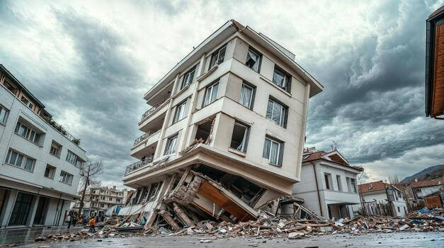
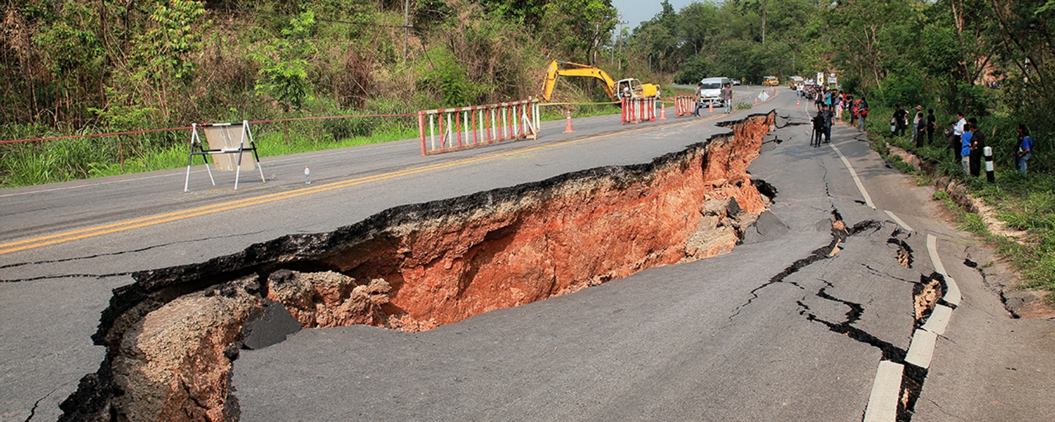
The seismic activity of an area refers to the frequency, type and size of earthquakes experienced over a period of time.

Slide 4
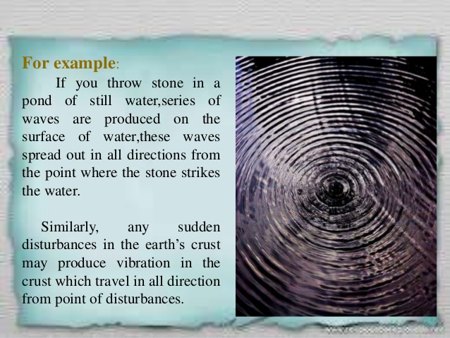

Slide 5
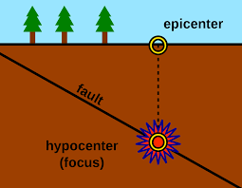
Term related to Earthquake:
Focus ( Hypocenter):
Focus is the point on the fault where rupture occurs and the location from which seismic waves are released.
Epicenter:
Epicenter is the point on the earth surface that is directly above the focus . The point where an earthquake or underground explosion originates.
Fault: A fault is a weak line in the Earth where rocks break and slide, causing an earthquake.

Slide 6
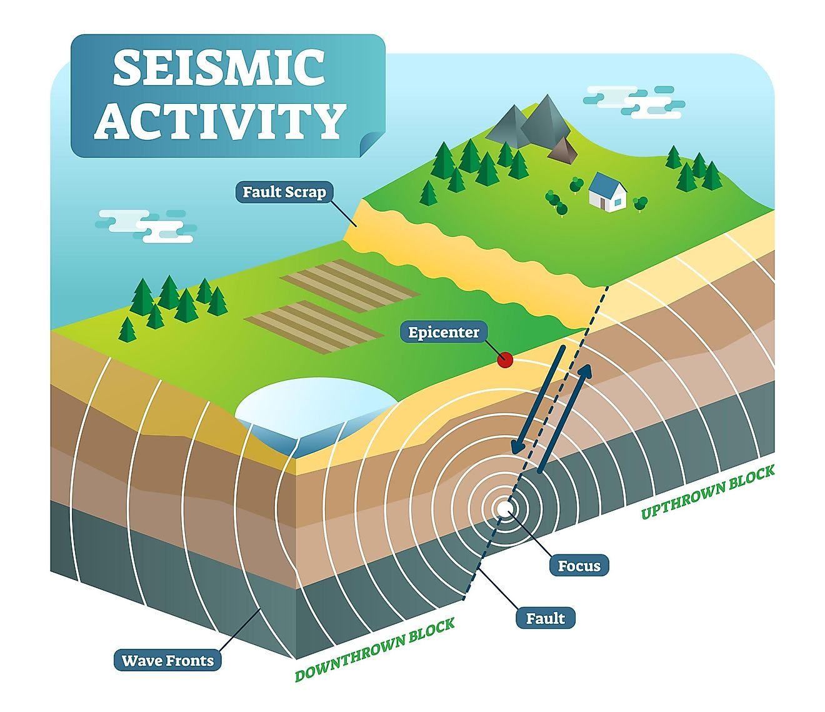
Fault Line :
The definition of a fault line is a break or fracture in the ground that occurs when the Earth's tectonic plates move or shift and are areas where earthquakes are likely to occur.
Fault Plane:
The fault plane is the planar (flat) surface along which there is slip during an earthquake.
Fault Scrap:
A fault scrap is the topographic expression of faulting attributed to the displacement of the land surface by movement along faults.

Slide 7
How Earthquake Occurs?
The Primary cause of an earthquake is faults on the crust of the earth.
A fault is a break or fracture between two blocks of rocks in response to stress.
This movement may occur rapidly in the form of an earthquake or may occur slowly in the form of creep.
Earth scientist use the angle of the fault with respect to the surface ( known as the dip) and the direction of slip along the fault to classify faults.

Slide 8
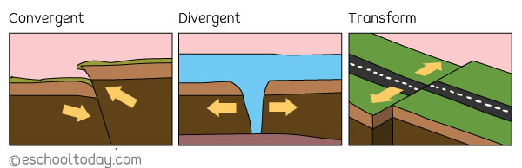
Movement in narrow zones along plate boundaries causes most earthquakes.
Most seismic activity occurs at three types of plate boundaries—divergent, convergent, and transform.
As the plates move past each other, they sometimes get caught and pressure builds up.
When the plates finally give and slip due to the increased pressure, energy is released as seismic waves, causing the ground to shake. This is an earthquake.

Slide 9
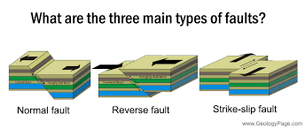
Classification of Faults
Normal Faults:
A geologic fault in which the hanging wall has moved downward relative to the footwall. Normal faults occur where two blocks of rock are pulled apart, as by tension.
Reverse Faults:
Reverse faults are exactly the opposite of normal faults. If the hanging wall rises relative to the footwall, you have a reverse fault. Reverse faults occur in areas undergoing compression.
Strike –slip Faults:
Strike-slip fault, in geology, a fracture in the rocks of Earth's crust in which the rock masses slip past one another parallel to the strike

Slide 10
Causes of Earthquake
Types of Earthquakes
Mainly, there are four types of earthquakes namely tectonic, volcanic, collapse and explosion.
Tectonic Plate Movement: When plates collide, separate, or slide past each other, stress builds up. When the stress becomes too much, it suddenly releases earthquake.
Volcanic earthquake: Movement of magma (molten rock) inside the Earth creates pressure. This pressure can crack rocks and cause small to moderate earthquakes.
Faulting (Sudden Slip of Rocks): The Earth’s crust has cracks called faults. Rocks on either side of a fault get stuck due to friction. When they suddenly slip, energy is released, causing earthquake.
Collapse of Underground Structures: Occurs due to collapse of mines, caves.
Human Activities (Man-made Causes): Mining activities, Filling large dams (reservoir-induced seismicity), Underground nuclear tests

Slide 11
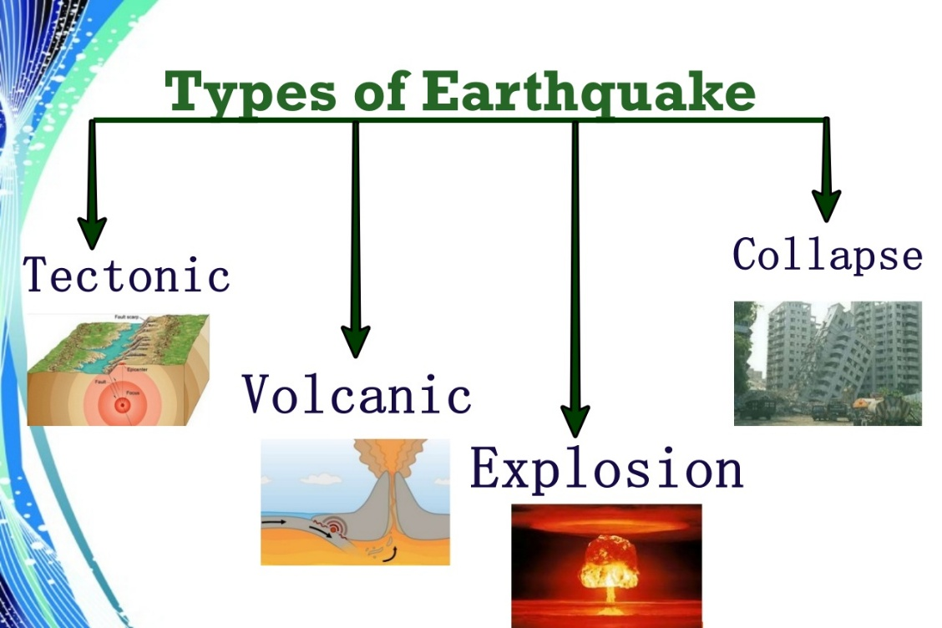

Slide 12
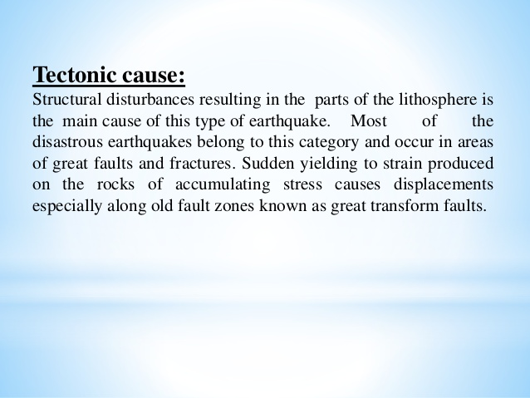

Slide 13
Tectonic earthquake:
This occurs when due to geological forces on rocks and the adjoining plate’s cause’s physical and chemical change and results in the breaking of the Earth's crust.
Volcanic earthquake:
Results from tectonic forces and occurs in conjunction with volcanic activity.
Collapse earthquake:
are generally small earthquakes that occur in underground caverns and mines caused by the seismic waves which are produced from the explosion of rock on the surface.
Explosion earthquake:
Occur due to the detonation of a nuclear or chemical device.

Slide 14
Types of Seismic waves
The two main types of waves are
Body waves
Surface waves
Body waves can travel through the earth's inner layers, but surface waves can only move along the surface of the planet like ripples on water. Earthquakes radiate seismic energy as both body and surface waves.

Slide 15
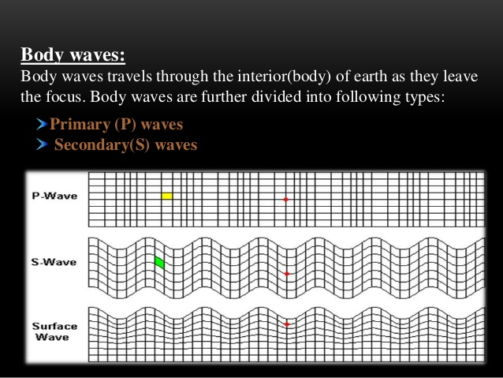

Slide 16
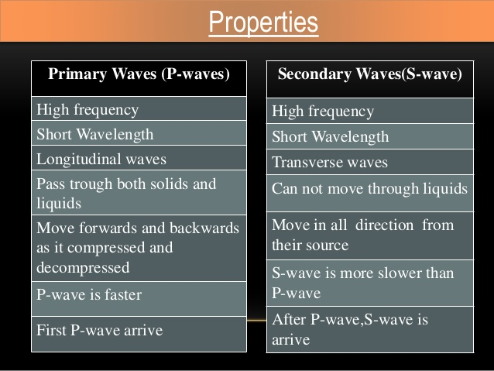

Slide 17
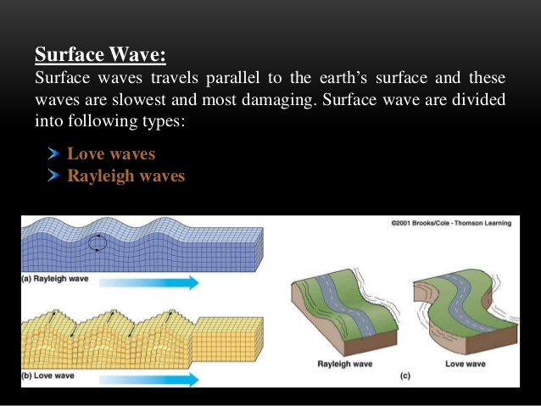

Slide 18
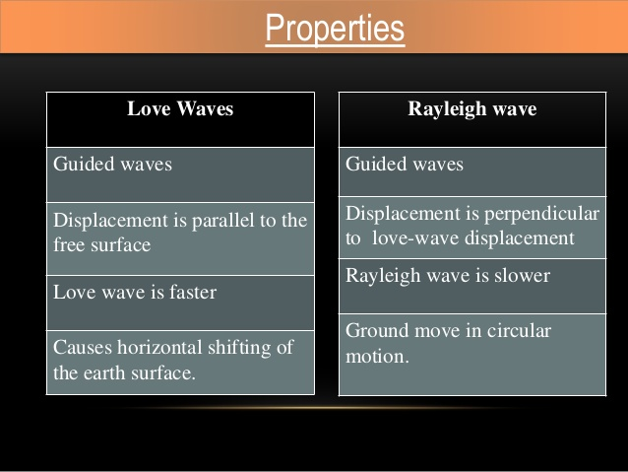

Slide 19
Strength of Earthquake
The intensity and strength of an earthquake is measured on Richter scale , the scale invented by Charles Richter California, USA in 1935, which categorises earthquake on the basis of energy release.
The logarithm to base ten of the maximum seismic wave amplitude recorded on a standard Seismograph at a distance of 100 kilometers from the earthquake epicenter.
Seismograph is the scientific study of earthquakes and the propagation of elastic waves through the Earth.

Slide 20
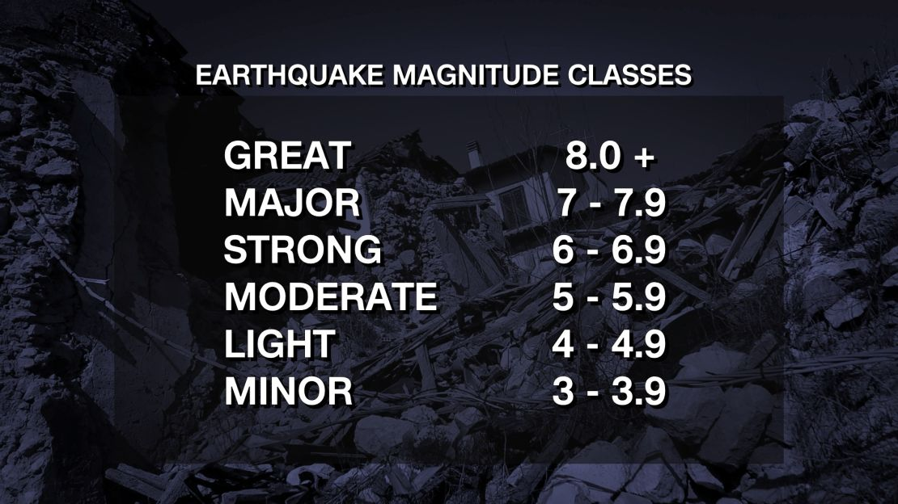

Slide 21
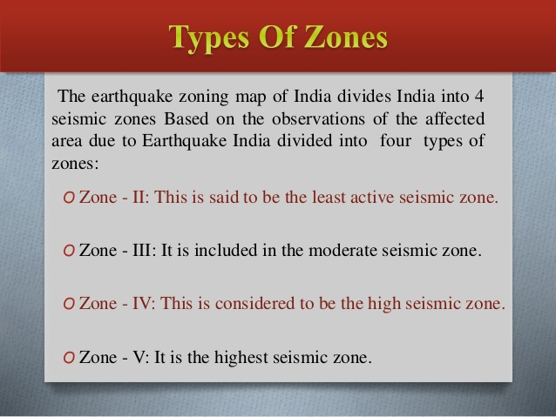

Slide 22
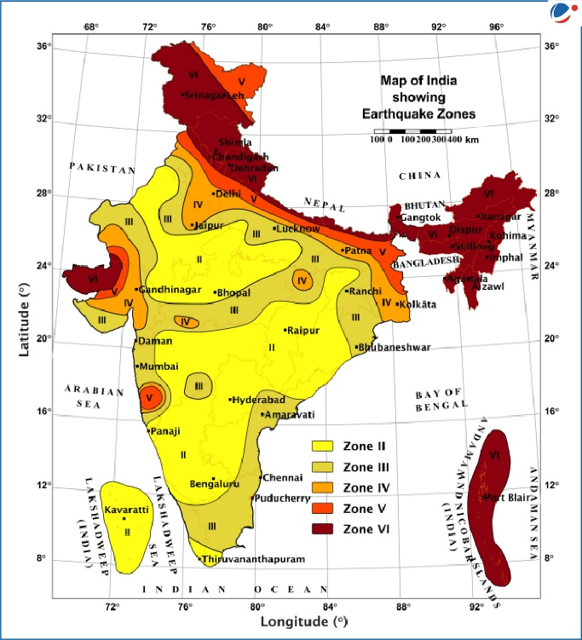

Slide 23
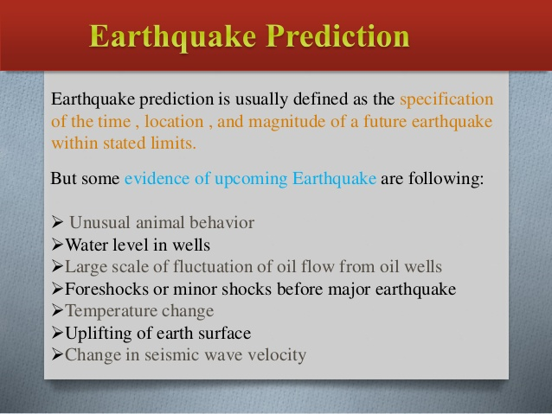

Slide 24
Effect of Earthquake
Ground shaking: Caused by Seismic Waves traveling through the Earth.
Ground rupture: Occurs when the Earth’s surface breaks along a fault line.
Landslides: Shaking makes unstable slopes collapse.
Tsunamis: Caused by underwater earthquakes. Sudden movement of the sea floor displaces water.
Liquefaction: Soil behaves like a liquid instead of solid. Buildings sink or tilt
Fire: caused by broken pipelines, electrical short circuits

Slide 25
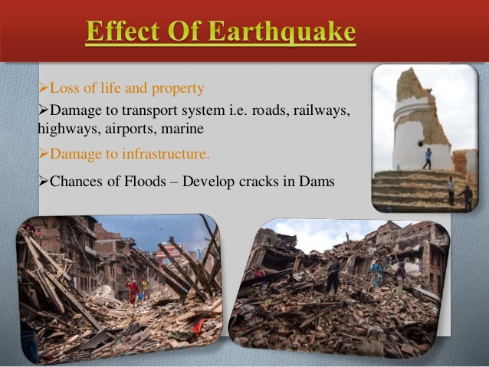

Slide 26
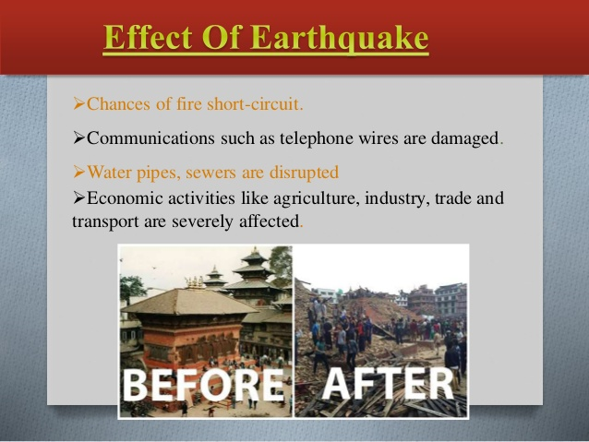

Slide 27
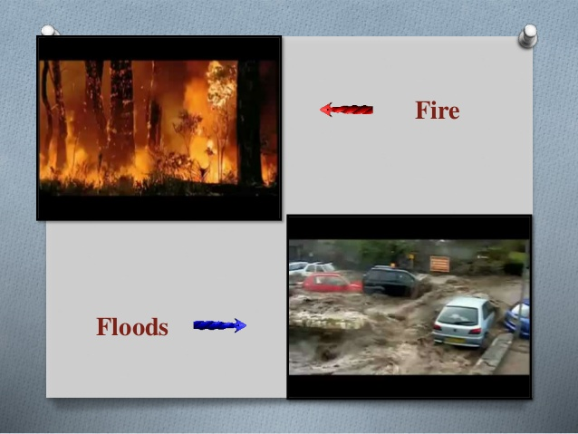

Slide 28
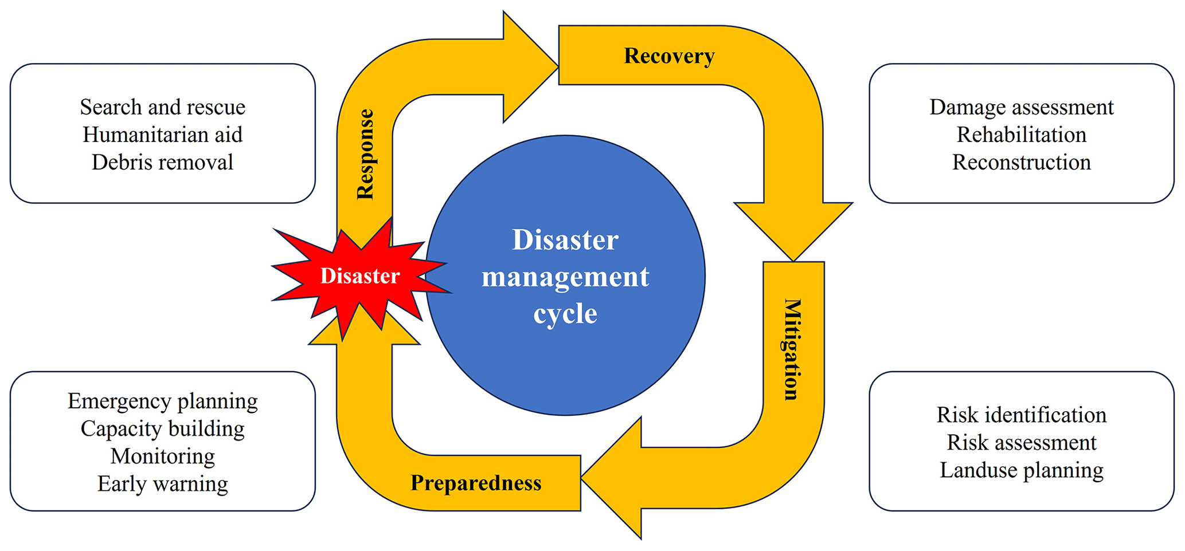
Disaster Management Cycle (Earthquake)

Slide 29
Earthquake Preparedness
Secure furniture so that it can not fall over and fall down.
Plan safety measures to avoid injuries.
Confirm the strength of your house and walls.
Always be ready to extinguish fires.
Prepare emergency supplies in advance.
Take steps for fire prevention and early detection.
Discuss emergency planning with your family.
Know potential hazards in your area.
Train yourself for emergency

Slide 30
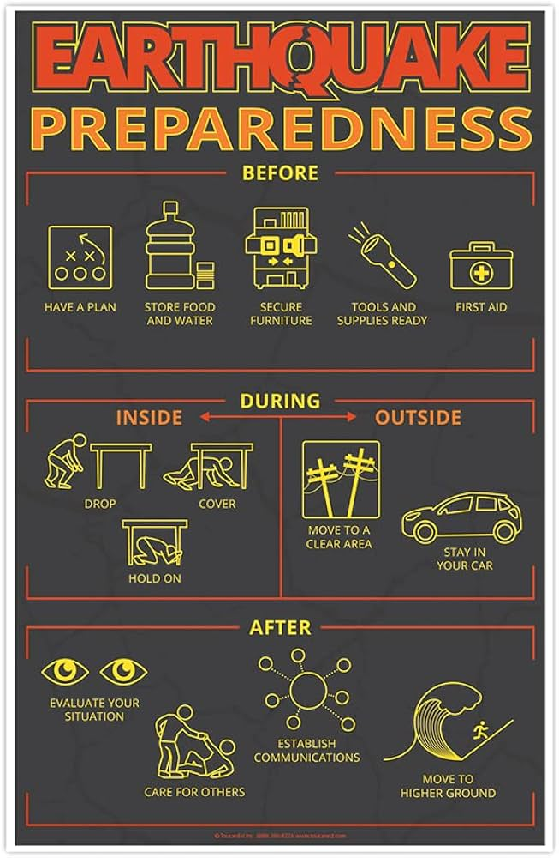

Slide 31
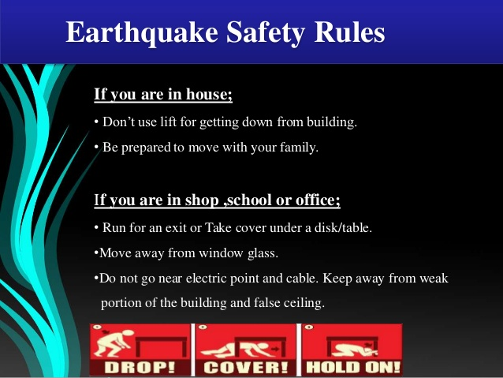
Response during Earthquake:

Slide 32
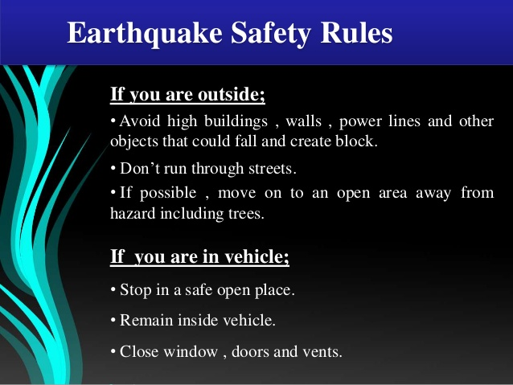
Response during Earthquake

Slide 33
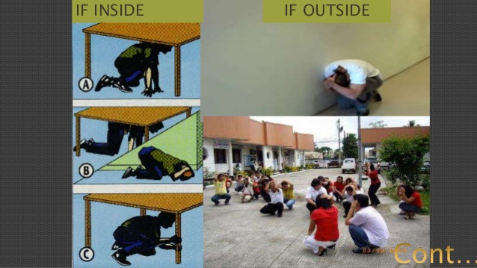

Slide 34
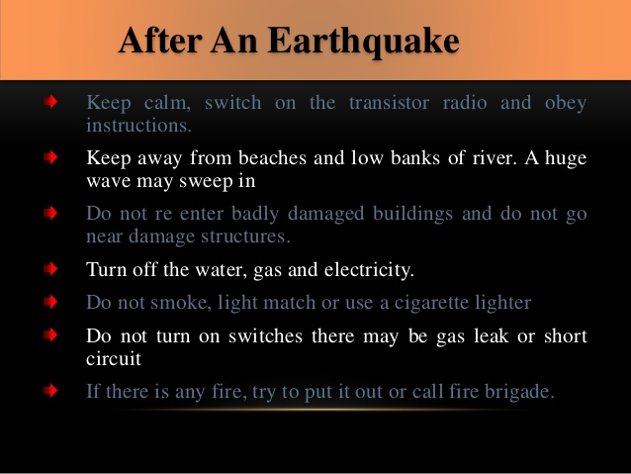
Response After Earthquake

Slide 35
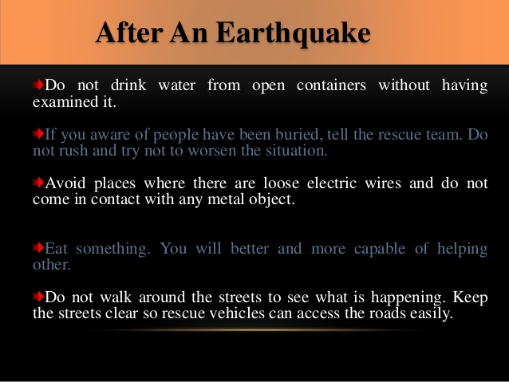
Response After Earthquake

Slide 36
Recovery action after Earthquake
Restore daily life
Reconnecting with others,
Repairing damage,
Rebuilding community.
Renovation work
Removal of Debris
Rescue People
In the days and weeks that follow a big earthquake, your family, friends and neighbors can come together to start the process of recovery.

Slide 37
Mitigation measures for earthquake:
Mitigation measures include:
Hazard mapping.
Adoption and enforcement of land use and zoning practices.
Implementing and enforcing building codes.
The mitigation strategy is made up of three main required components:
mitigation goals, mitigation actions,
action plan for implementation.
These provide the framework to identify, prioritize and implement actions to reduce risk to hazards.

Slide 38
Mitigation measures for earthquake:
Create a Flexible Foundation. One way to resist ground forces is to “lift” the building's foundation above the earth.
Counter Forces with Damping.
Shield Buildings from Vibrations.
Reinforce the Building's Structure.
The most common (and effective) mitigation measures are the enforcement of seismic codes,
land-use zoning, and engineering works to strengthen existing structures and stabilize hitherto unstable ground.
Some measures are applicable to new development while others to existing development.

Slide 39
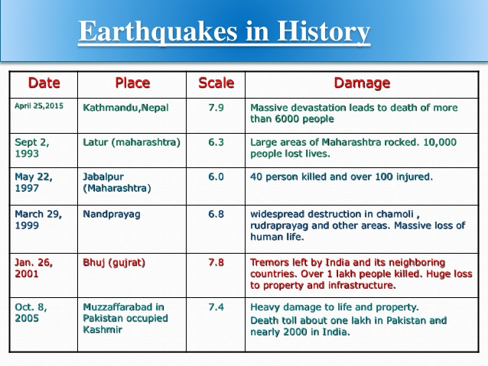

Slide 40
Thank you

