Slide 1

Babel Fish Earbuds
By
Presented by:- Rohit Mene

Slide 2
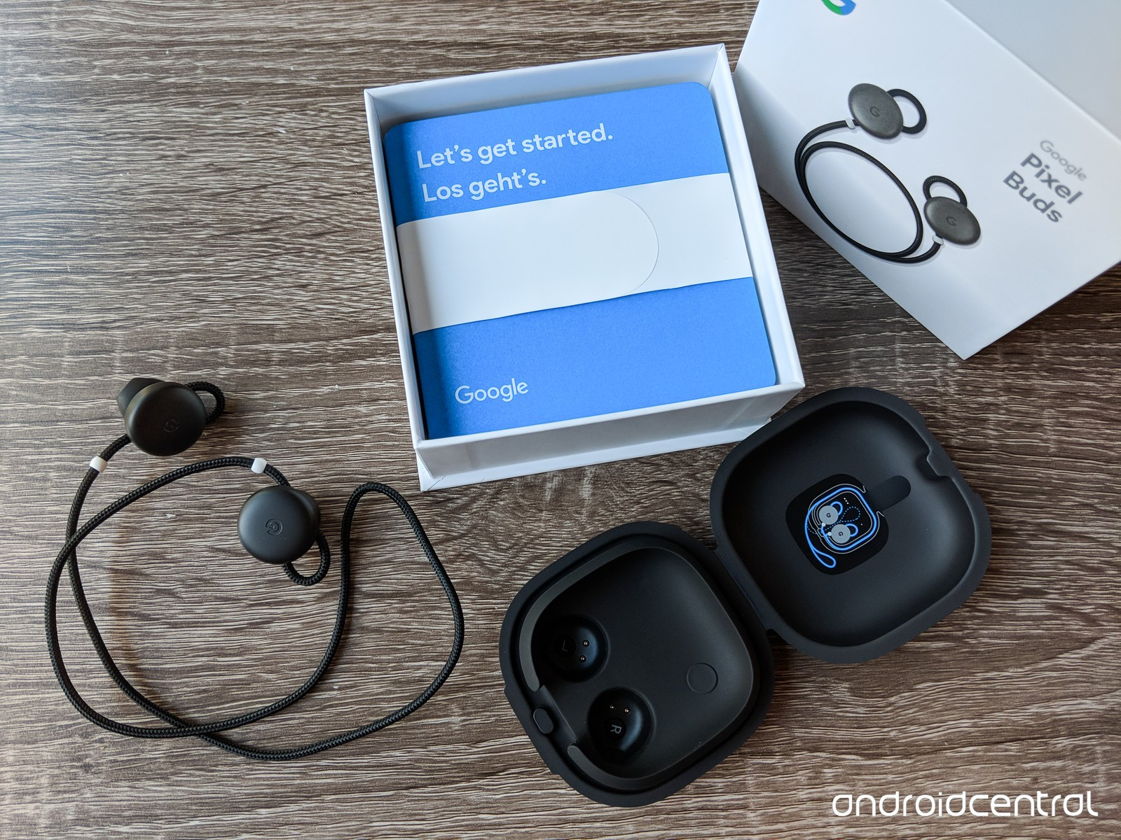
Introduction
In this global environment, communication barrier has always been a major issue since it takes a hell lot of time to understand a language other than your native language and getting a third translator for every other language may cost you a fortune. This device lets you hurdle the barriers by giving you a real-time translation and lets you to reach the global boundaries. A person might be facing problems in cross-country trades due to communication incompatibility but that won’t be a problem anymore.

Slide 3
Need of Babelfish Earbuds
Remove communication barriers
1
Real time translation
2
Interact with global audience
3
Increase portability and Compatibility
4
Increase utility and capability to work
5

Slide 4
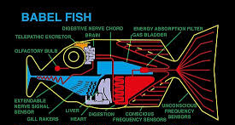
The Hitchhiker’s Guide to the Galaxy

Slide 5
What technology do these buds use?
Google Translate
05
Near real time Translation
01
04
Artificial Intelligence
Google Assistant
02
03
Machine learning

Slide 6
Working of pixel buds
the first person wearing earbud speaks in his language (English is the default language) and the app on the phone translates the language and plays it on the phone.
The same process goes vice-versa where the person holding the phone speaks in his language for example Swedish, the app again translates the conversation and response is played through the earbuds.
One person wears the earbud and the other holds a phone in his hand

Slide 7
Is it different from Google translate?
Provides you real-time translation after automatically figuring out which language the person is speaking.
The speech recognition through app was introduced way earlier but the external noise makes it difficult for an app to understand the words precisely.
Babel-fish cancels the noise and translates even typical phrases and words with a large support of over 40 languages. It is fast enough to hold the conversation.

Slide 8
Challenges
Babel-fish earbuds are criticized for its subpar design and it may not fit into your ears comfortably.
1
Setting up this device with a phone can be a bit difficult.
2
3
Some elements need data connection, costing must be optimized while roaming in some other country.
4
It requires high speed processing at data centers, since the process includes understanding of natural language and then converting it into text and then reverting with a speech output.
5
Difference in accents and verbal pitch could confuse the software.

Slide 9
Thank You

