Slide 1
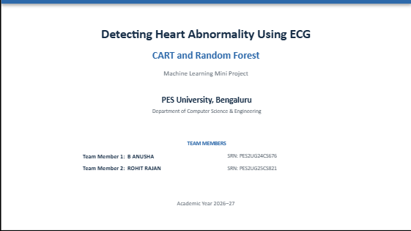
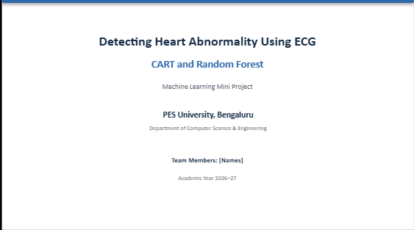
Detecting Heart Abnormality Using ECG
CART and Random Forest
Machine Learning Mini Project
PROJECT FOCUS
Reproduction of the reference CART workflow + Random Forest extension
Team Members: B ANUSHA SRN | PES University | CSE

Slide 2
Problem Statement, Motivation & Objectives
02
PROBLEM STATEMENT
WHY THIS PROJECT?
Build a machine-learning pipeline that uses ECG/arrhythmia data to classify cardiac-condition categories.
The reference study uses CART for ECG-based classification. We reproduce that approach and extend it with an ensemble model for comparison.
OBJECTIVES
• Use the UCI Arrhythmia dataset used by the reference study.
• Inspect the data and handle missing values represented by '?'.
• Remove Feature 14 because of its high missing-value proportion.
• Train and evaluate the reference CART model.
• Implement Random Forest as an additional model.
• Compare model performance and compare CART with the reference result.

Slide 3
Reference Paper & Dataset
03
REFERENCE PAPER
REFERENCE APPROACH
Detecting Heart Abnormality using ECG with CART
ECG / Arrhythmia data → preprocessing → CART classification → performance evaluation
UCI ARRHYTHMIA DATASET
PATIENT RECORDS
ORIGINAL ATTRIBUTES
FINAL FEATURES
TEST SAMPLES
452
279
278
136
• Multiclass classification problem.
• Missing values are represented by '?'.
• The same UCI Arrhythmia dataset was used for our implementation.
• Reference paper reports approximately 80% CART accuracy.

Slide 4
Data Preparation & Preprocessing
04
PIPELINE
1
Load & inspect
2
Convert ? → NaN
3
Remove Feature 14
4
Median imputation
5
Stratified split
452 × 279
Missing values
279 → 278
No missing values
70 : 30
FINAL SPLIT
TRAINING
TESTING
RANDOM STATE
STRATIFIED
316 samples
136 samples
42
Yes
WHY MEDIAN IMPUTATION?
It retains patient records while providing numerical values required by the models. After imputation, the processed feature matrix contains no remaining missing values.

Slide 5
CART — Reference Model Implementation
05
MODEL
WHAT WE DID
WHY CART?
DecisionTreeClassifier
criterion = Gini
random_state = 42
• Trained CART on the preprocessed training set.
• Generated test predictions.
• Evaluated accuracy, precision, recall and F1-score.
• Generated a confusion matrix.
• Performed 10-fold cross-validation.
CART is the main classification model in the reference paper, so reproducing it is the core reproduction component of the project.
CART TEST PERFORMANCE
ACCURACY
PRECISION
RECALL
F1-SCORE
69.12%
67.46%
69.12%
67.80%
10-fold CV: 64.79% ± 7.18%

Slide 6
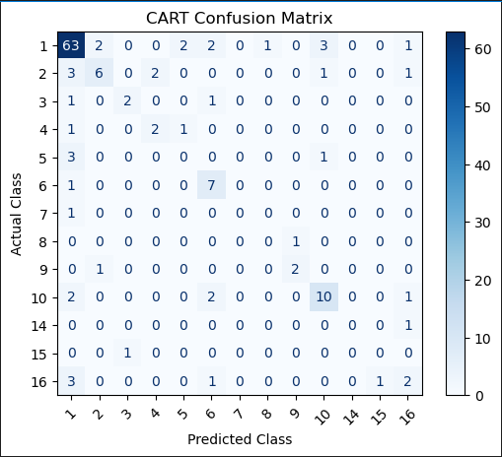
CART Evaluation & Model Behaviour
06
INSERT FIGURE
CONFUSION MATRIX
Shows how CART predictions are distributed across actual and predicted classes.
cart_confusion_matrix.png
HOW TO READ IT
• Diagonal cells = correct predictions.
• Off-diagonal cells = misclassifications.
• Helps identify which classes are confused.
OPTIONAL
If needed, place the decision-tree visualization below this section or keep it for the report.

Slide 7
Random Forest — Project Extension
07
WHY ADD ANOTHER MODEL?
RANDOM FOREST SETUP
The reference work focuses on CART. We extended the project with Random Forest so a single tree can be compared with an ensemble of trees.
n_estimators = 100
random_state = 42
Same preprocessed dataset
Same 70:30 stratified split
Same evaluation metrics
MODEL IDEA
Tree 1
Tree 2
Tree 3
Tree 4
Tree 5
→ Combined ensemble prediction
KEY IDEA
Multiple trees are combined to obtain a more robust ensemble prediction than relying on one decision tree.

Slide 8
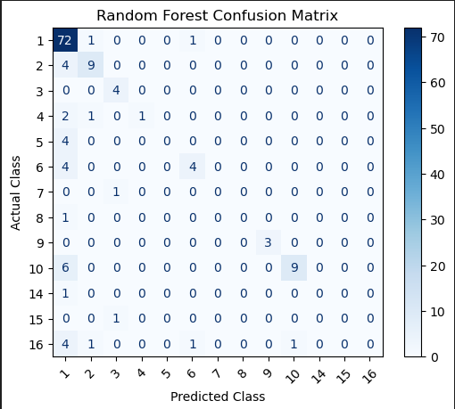
Random Forest Results & Evaluation
08
RANDOM FOREST TEST PERFORMANCE
INSERT FIGURE
random_forest_confusion_matrix.png
ACCURACY
PRECISION
75.00%
68.10%
RECALL
F1-SCORE
75.00%
69.47%
OBSERVATION
Random Forest achieved higher test accuracy, recall and F1-score than CART under the same experimental setup.

Slide 9
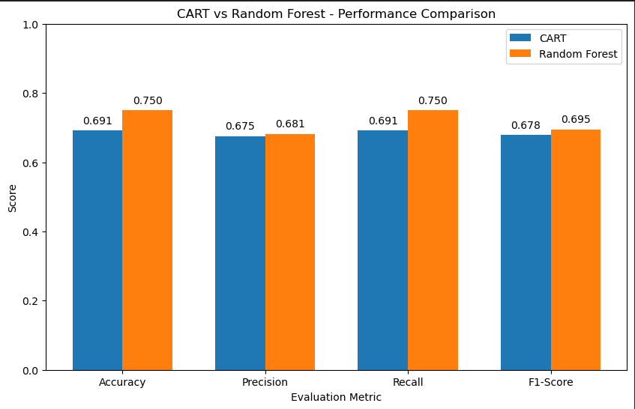
CART vs Random Forest — Comparison
09
RESULT TABLE
INSERT FIGURE
performance_comparison.png
Metric
CART
Random Forest
Accuracy
69.12%
75.00%
Precision
67.46%
68.10%
Recall
69.12%
75.00%
F1-score
67.80%
69.47%
KEY RESULT
Random Forest improved test accuracy by 5.88 percentage points: 75.00% vs 69.12%.

Slide 10
Reference Result vs Our CART Reproduction
10
REFERENCE PAPER
OUR CART
GAP
≈ 80%
69.12%
≈ 10.88 pp
WHY CAN RESULTS DIFFER?
REPRODUCTION PRINCIPLE
• Reference implementation uses R rpart.
• Our implementation uses Python DecisionTreeClassifier with Gini criterion.
• Complexity/pruning settings may differ.
• Train/test split and preprocessing details may differ.
• Random seed and software/library versions can affect results.
We report the actual experimental result (69.12%) transparently. We do not alter the result just to match the reference paper.
WHAT WAS REPRODUCED
Same dataset • Main preprocessing idea • CART classification • Evaluation workflow

Slide 11
Overall Workflow, Conclusion & Future Scope
11
COMPLETE PROJECT WORKFLOW
UCI
Dataset
Preprocess
& Impute
70:30
Split
CART
Random
Forest
Compare
Results
KEY CONCLUSIONS
• CART reproduction achieved 69.12% test accuracy.
• Random Forest achieved 75.00% test accuracy.
• Random Forest improved accuracy by 5.88 percentage points.
• Reference paper reports approximately 80% CART accuracy.
FUTURE SCOPE
Hyperparameter tuning • Feature selection • Class-imbalance handling • Additional ML models • Larger ECG datasets
FINAL TAKEAWAY
The project reproduces the reference CART workflow and extends it with Random Forest for comparative evaluation.

Slide 12
THANK YOU
PROJECT HIGHLIGHT
CART: 69.12% | Random Forest: 75.00%
Questions?

