Slide 1
Domino’s Competition- Final
Group Name: Team 2
Aditi Ramadurgakar
Akshay Kothari
Jagruthi Budda
Meenakshi Nayak
Rohit Sarkar

Slide 2
OVERVIEW - LAST PRESENTATION
Objective - Coupon Ordering Likelihood
Descriptive statistics on the customer order pattern
Rank wise analysis based on average discount
Inferences from rank wise analysis merged with demographics

Slide 3
INTRODUCTION
PART I
Implement RFM model
Clustering on RFM attributes
Decision tree to derive demographic characteristics of clusters
Relevant coupons for each clusters
Association rule mining on coupons

Slide 4
INTRODUCTION contd.
PART II
Logistic Model on mail response data
Recommendations

Slide 5
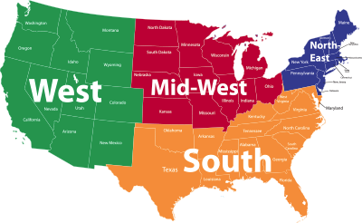
SAMPLING
Stratified sampling, a type of Probability Sampling was done on the transactional data (Oct 2015 to Sep 2016).
Divided the data into 4 groups/strata based on region:

Slide 6

RFM MODELING
Recency, Frequency and Monetary values determined for the customers from the final sample
Customers are sorted and then scored based on RFM values
0 → lowest and 4 → highest
Customers with score ‘444’ are the most recent, frequent and high valued customers

Slide 7
CLUSTERING

Slide 8
CLUSTER DESCRIPTION
Hoppers
First Timers
Irregulars
Recency: Very Low
Frequency: Very Low
Monetary: Very Low
Recency: High
Frequency: Low
Monetary: Low
Recency: Low
Frequency: Low
Monetary: Low
Potential
Best
Valuable
Recency: High
Frequency: High
Monetary: Low
Recency: Very High
Frequency:Very High
Monetary: Very High
Recency: High
Frequency: High
Monetary: High

Slide 9
DAY WISE ANALYSIS

Slide 10
DEMOGRAPHIC PROFILING
Decision Tree algorithm - to define the demographic features of clusters
Combined the demographics classified dataset
with the clusters defined from RFM.
Six clusters are defined with different demographic characteristics.

Slide 11
DEMOGRAPHIC ANALYSIS contd.
Hoppers → Income less than 200k, Commuters
First Timers → Young population who are not Hispanic
Irregulars → American seniors, Married, Financially comfortable
Potential → Middle Income (65k-200k)
Best → Married with no children
Valuable → Predominantly African American, working class, teenagers aged below 18 years

Slide 12
COUPON CATEGORIZATION
Combo
Large
50% Off
Free Side Item
Free Delivery
Carry Out
Drink Offer
Free Pizza
Mix 2 or More or Medium
LG or Large or 14’’
50% OFF
2 lir or 2L
Free and Delivery
CARRY OUT
Free or Pizza
Free Side Item

Slide 13
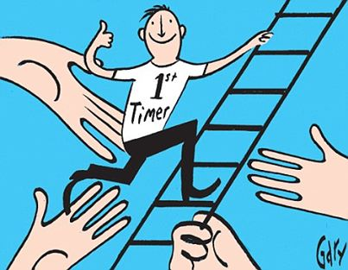


COUPON CATEGORIZATION contd.
First Timers
Carry Out Coupons
Large with Chicken
Combo
Potential
Large Special
Drink Offers
Combo
Valuable
Free Coupons
50% Off Coupons

Slide 14
HIGH FREQUENCY COUPONS
First Timers | Combo with medium pizza, pasta, sandwich
 | Large pizza with chicken
 | Weekday carry out large pizza
Potential | Combo with medium pizza, pasta, sandwich
 | Large Special Pizza
 | Medium pizza with large drinks
Valuable | Medium pan pizza
 | 50% off pizza-online
 | Free medium pizza

Slide 15
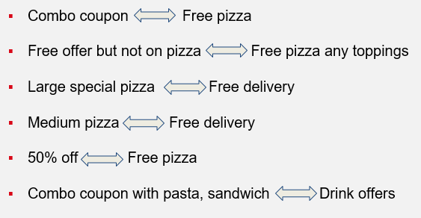
ASSOCIATION RULES

Slide 16
INCREMENTAL EFFECT DUE TO MAILED COUPONS
Control Group: Customers who were mailed but did not use coupon
Treatment Group: Customers who were mailed and used coupon
33%
5%

Slide 17
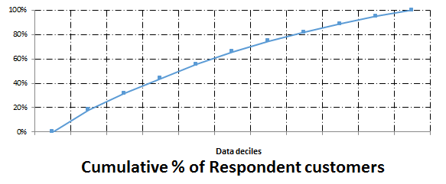
LOGISTIC REGRESSION
 |  | Predicted
 |  | Non Respondent | Respondent
Actual | Non Respondent | 48.38% | 36.34%
 | Respondent | 5.96% | 9.32%
As the data is biased as it is containing 84% of non respondent , the model is able to correctly predicting 57% of the customers.
Lift Model
From the logistic model, we are able to capture 40% of respondent customers in the first four deciles.

Slide 18
LOGISTIC REGRESSION RESULTS
Customer using Large, Med3topping and freedrink coupons are about 20 times more likely to respond than the customers who are not using coupons.
Customers ordering on Monday and Thursday are 10% less likely to respond than Customers ordering on Tuesday.
Customers ordering on Sunday are 10% more likely to respond than Customers ordering on Tuesday.
First timers are 14% more likely to respond the mail than Valuable customers.
Customers having dinner and lunch meal are 8% more likely to respond than the late night dinner customers.

Slide 19
RECOMMENDATIONS
First Timers
(Young Population who are not Hispanic)
Sunday +
Dinner meal, Lunch Meal
Carry out coupons, large with chicken, combo
+
Free Pizza
Potential
(Middle Income(65K-200K))
large special, drink offers, combo
+
free delivery and free pizza
Valuable
(African American,Working Class and Teenagers)
free coupons, 50% off
+
free pizza

Slide 20
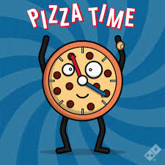
Thank you!
Any Questions?

