Slide 1


Design and Implementation of an
Emotion-Aware
Voice Assistant
Speak or type. Get a text and voice reply.
Rohit Meena (24U021015) · Vishal Chaudhary (24U021019)
Supervisor: Dr. Amit Kumar Nandanwar
IIIT Bhopal

Slide 2
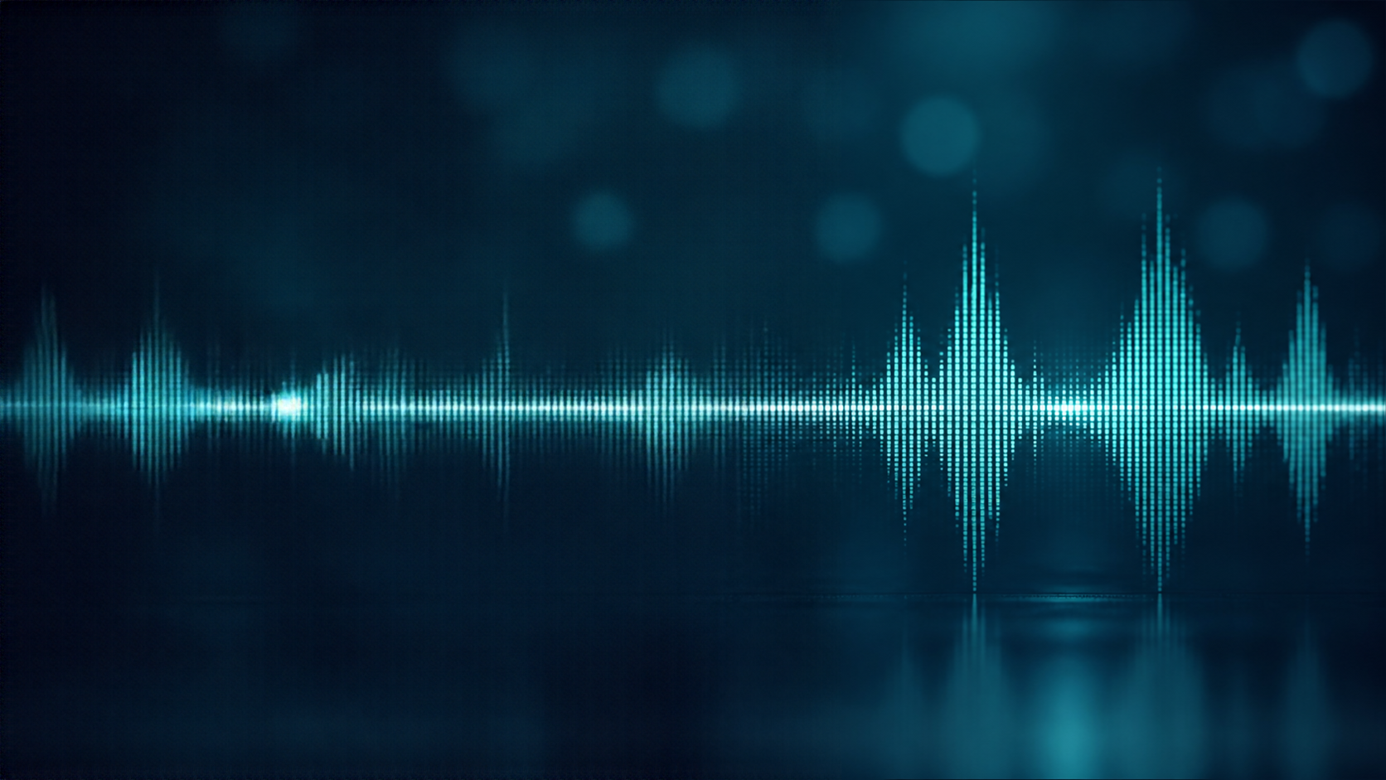


Literature Review / Background
SOVA-Bench [1] evaluates speech assistants. Representative systems include Mini-Omni, LLaMA-Omni and Moshi [2]–[4].
Related speech benchmarks and models are covered by references [5]–[17].
Evaluation datasets and Whisper are cited in [18]–[25]; the framework and provider APIs are [26]–[30]. This project integrates existing tools and does not fine-tune a base model.

Slide 3






















Problem Statement
Speech Recognition
Emotion
Handling
Provider Failure
Fallback and continuity
  Many voice assistants miss emotional cues and can be hard to interrupt while they are speaking.
Response
Generation
  Replies may sound neutral or mismatched.
User Speech
or Text
User Barge-In
Interrupt and recover
  Emotion cues may be missed or misread.
  Interrupting playback may not cancel the full turn.
Audio
Playback

Slide 4
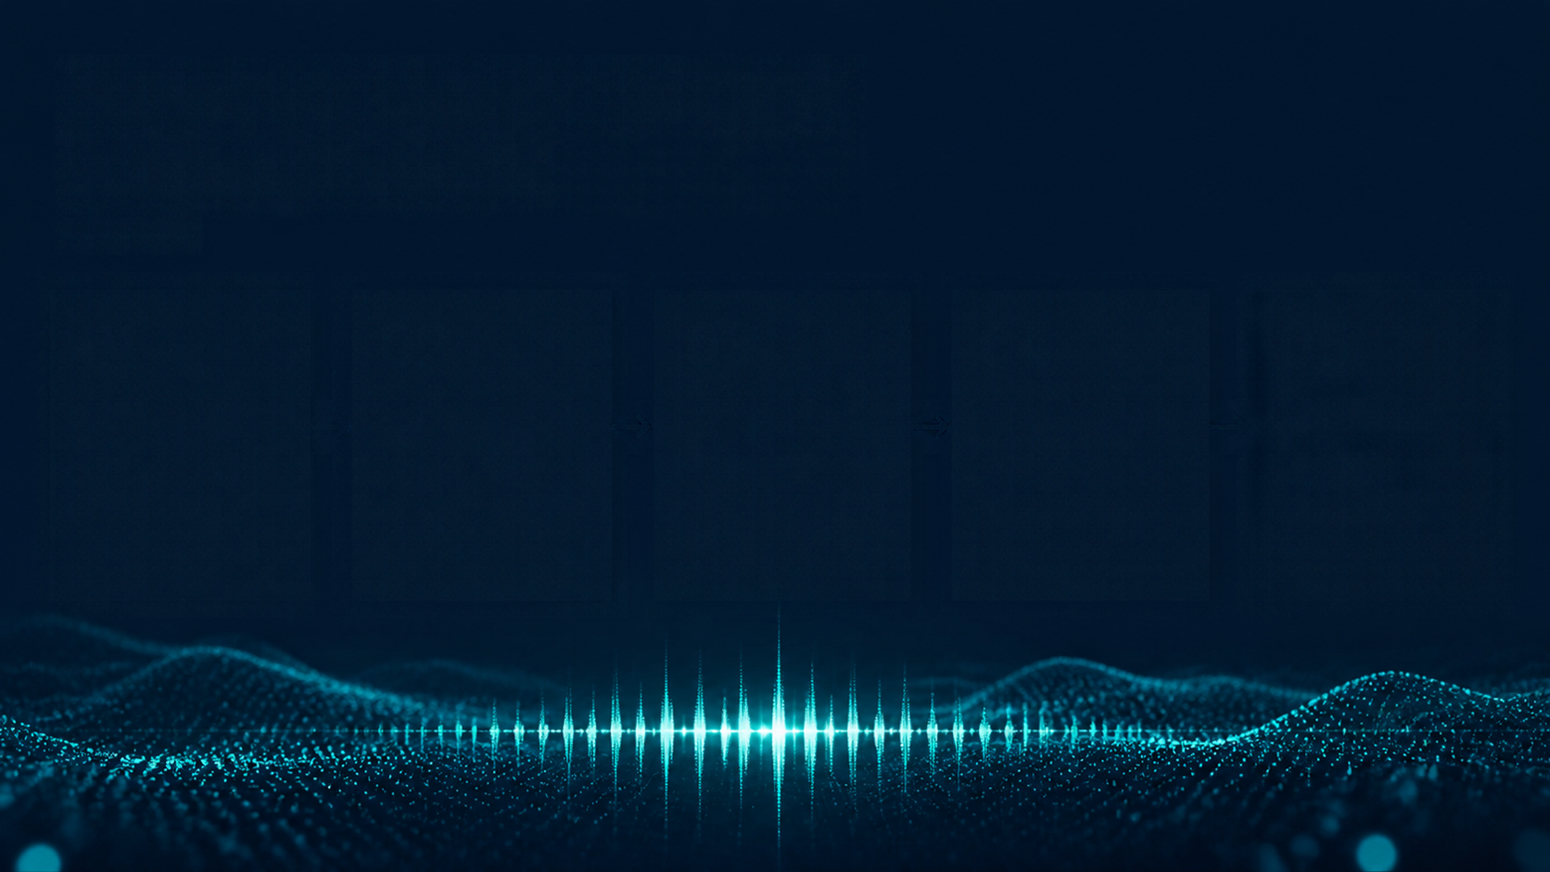










How the Assistant Works
01
02
03
04
05
Input
Speech to text
Emotion cue
Response Generation
Speech Output
Type or speak
Whisper converts speech to text [25], [27]
GPT-OSS writes a reply
ElevenLabs synthesizes speech [28]
Text rules; optional pretrained speech model [5], [13]

Slide 5
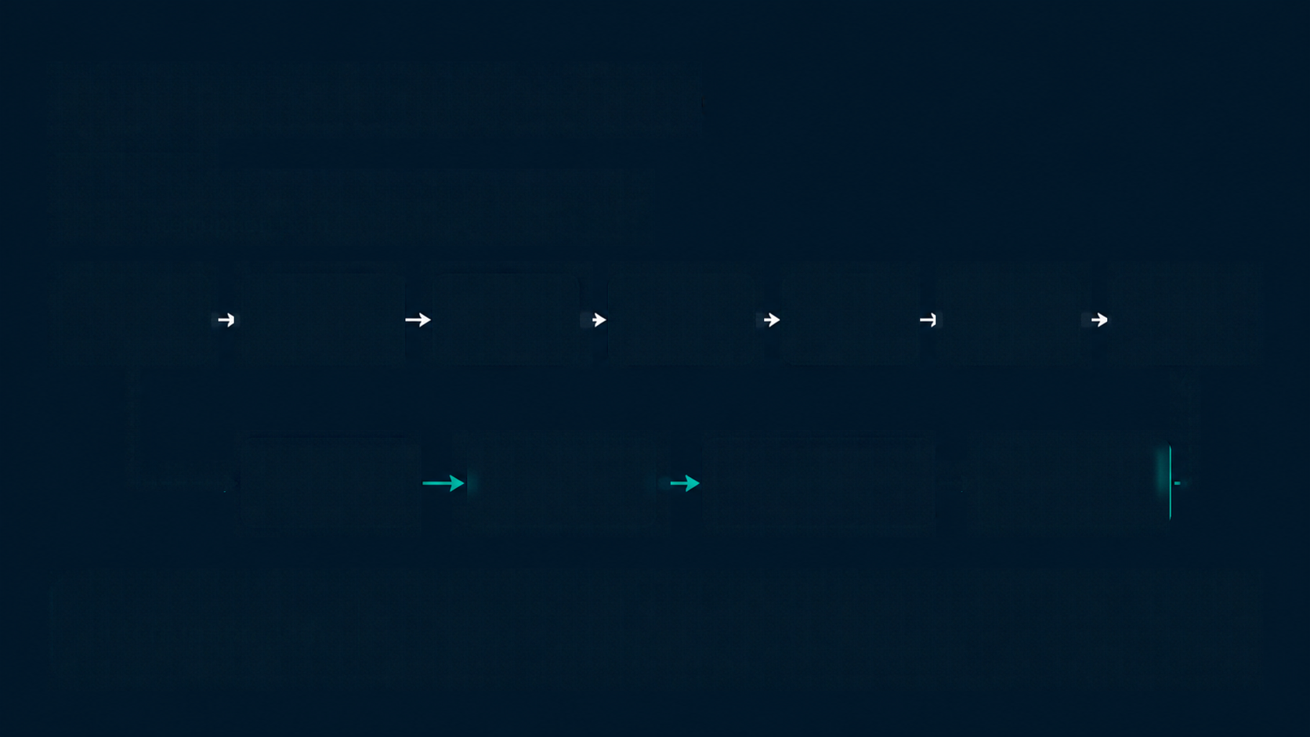
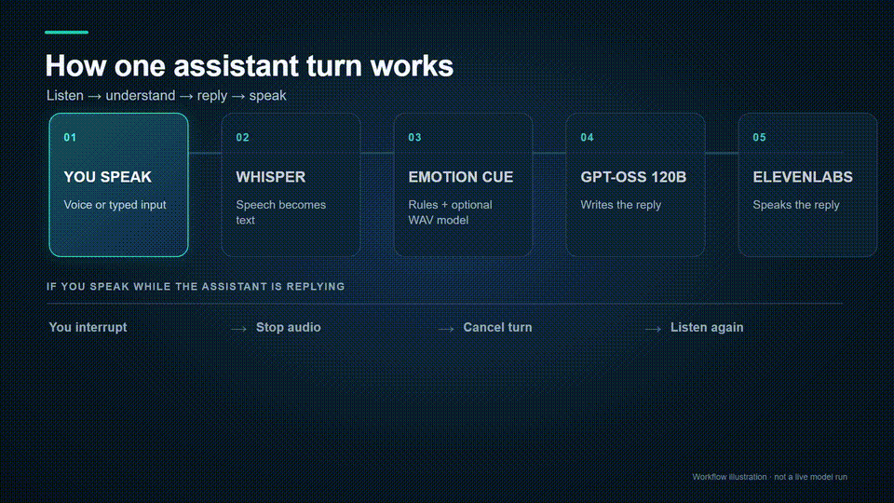
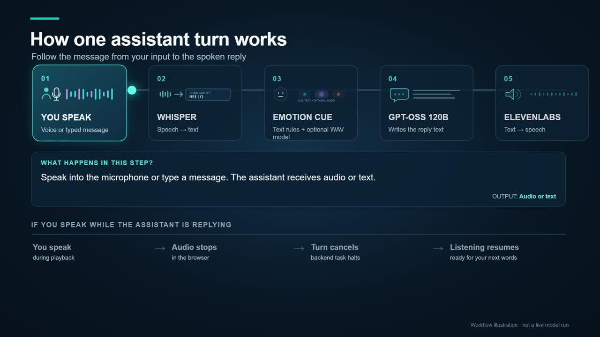
















System Architecture
Turn-based cascade from user input to response, with a separate interruption path.
Browser
FastAPI
STT
Emotion
signal
LLM
TTS
Playback
(to browser)
Browser VAD
(interruption)
Stop playback
(immediate)
Backend cancellation
(halt response)
Resume listening
(continue STT)
Interruption path
Detects candidate user speech during playback, stops local audio, requests backend cancellation, then returns the interface to listening.

Slide 6














Implementation
FastAPI
User speech
FastAPI session and turn endpoints [26]
Flexible STT
Speech
to text
Groq
Optional pretrained SUPERB/Wav2Vec2 model [5], [13]; transcript-rule fallback
Whisper large-v3-turbo [25], Groq STT [27]
Language
understanding
Groq
GPT-OSS 120B
Response
generation
ElevenLabs TTS [28]
No model fine-tuning
TTS
the system uses pretrained
components end to end
Text to speech
output
Browser audio playback uses Web Audio API [29]; barge-in speech detection uses SpeechRecognition [30].

Slide 7

Results, Comparison, and Analysis
EVALUATION DATASET
SAMPLE SIZE (N)
METRIC
RESULT
DENOMINATOR / NOTES
LibriSpeech [21]
1,000
corpus WER
3.55%
656/18,466 words
1,000/1,000 requests
TriviaQA [22]
55
token F1
exact-match proxy
35.58%
0%
all answered
LibriSQA [20]
55
all-case
among 52 valid options
74.55%
78.85%
all answered
55
token F1
exact-match proxy
25.54%
0%
Spoken SQuAD [18]
all answered
Alpaca [24]
55
ROUGE-L F1
token F1
20.93%
26.66%
total evaluated cases 1,220
Lexical proxies differ from paper metrics; emotion accuracy/audio quality/age/gender not measured.
Scope caveat

Slide 8


Conclusion and Future Work
Integrated, working demo with provider-driven turn pipeline and visible transcript, emotion source, response and interruption path.
Measure emotion recognition accuracy on labelled held-out audio.
Evaluate speech quality and repeated barge-in reliability.
Next: expand samples and align with the
full benchmark protocol.

Slide 9


References [1–15]
BENCHMARKS AND SPEECH SYSTEMS
[1] Hou et al., SOVA-Bench, Interspeech (2025).
[2] Xie & Wu, Mini-Omni, arXiv:2408.16725 (2024).
[3] Fang et al., LLaMA-Omni, arXiv:2409.06666 (2024).
[4] Défossez et al., Moshi, arXiv:2410.00037 (2024).
[5] Huang et al., Dynamic-SUPERB, ICASSP (2024).
[6] Huang et al., Dynamic-SUPERB Phase-2, arXiv:2411.05361 (2024).
[7] Wang et al., AudioBench, arXiv:2406.16020 (2024).
[8] Yang et al., AIR-Bench, arXiv:2402.07729 (2024).
SPEECH MODELS AND GENERATION
[9] Chen et al., VoiceBench, arXiv:2410.17196 (2024).
[10] Tang et al., SALMONN, ICLR (2024).
[11] Zhang et al., SpeechGPT, Findings of EMNLP (2023).
[12] Chu et al., Qwen2-Audio, arXiv:2407.10759 (2024).
[13] Hsu et al., HuBERT, IEEE/ACM TASLP (2021).
[14] Kong et al., HiFi-GAN, NeurIPS (2020).
[15] Wang et al., Freeze-Omni, arXiv:2411.00774 (2024).
GITHUB REPOSITORY
github.com/Rohit-Seera/Emotion-Aware-VoiceAssistant

Slide 10
References [16–30]
SYSTEMS, DATASETS AND EVALUATION [16–23]
[16] Xie & Wu, Mini-Omni2, arXiv:2410.11190 (2024).
[17] Hurst et al., GPT-4o System Card, arXiv:2410.21276 (2024).
[18] Lee et al., Spoken SQuAD, Interspeech (2018).
[19] Busso et al., IEMOCAP, Language Resources & Evaluation (2008).
[20] Zhao et al., LibriSQA, IEEE Trans. Artificial Intelligence (2024).
[21] Panayotov et al., LibriSpeech, ICASSP (2015).
[22] Joshi et al., TriviaQA, ACL (2017).
[23] Ardila et al., Common Voice, LREC (2020).
ASR AND IMPLEMENTATION APIS [24–30]
[24] Taori et al., Stanford Alpaca dataset (2023).
[25] Radford et al., Robust Speech Recognition, ICML (2023).
[26] FastAPI, Tutorial / User Guide.
[27] Groq, Speech-to-Text documentation.
[28] ElevenLabs, Streaming Text-to-Speech documentation.
[29] Mozilla, Web Audio API AnalyserNode.
[30] Mozilla, Web Speech API SpeechRecognition.
GITHUB REPOSITORY
github.com/Rohit-Seera/Emotion-Aware-VoiceAssistant

