Slide 1


SMART INDIA HACKATHON 2025
Problem Statement ID – 25002
Problem Statement Title- Smart Tourist Safety Monitoring & Incident Response System Using A.I., Geo-Fencing, and Blockchain-based Digital ID
Theme- Travel & Tourism
PS Category- Software/Hardware
Team ID-
Team Name (Registered on portal) – Algorithm Avengers

Slide 2
Smart Tourist Safety & Monitoring System
Algorithm Avengers
Proposed Solution
Detailed Explanation
Blockchain-based Digital Tourist ID (Token) issued at entry points (airport, railway, toll, hotel) after Aadhaar/Passport verification
Tourist App: OTP login, geo-fencing alerts, panic button, anomaly detection (phone switch-off, unusual route, inactivity)
Police Dashboard: real-time alerts, panic requests, tourist live/last location, digital ID access
Centralized Database: syncs all data between app ↔ police dashboard, ensuring secure & reliable storage
How It Addresses the Problem
Prevents entry into restricted / high-risk areas (geo-fencing alerts)
Enables rapid emergency response (panic button, anomaly detection)
Builds tourist trust & confidence with secure, verified system
Reduces manual dependency with automated, AI-driven alerts
Innovation & Uniqueness
Tamper-proof Blockchain Token ID (valid across states, not just local)
AI anomaly detection beyond SOS button (proactive safety monitoring)
Bi-directional alerts → both tourist & police notified instantly
Integrated ecosystem linking app, centralized DB, and police dashboard
Future Aspects
Federated blockchain nodes for cross-state scalability
Priority scoring system to filter false alarms & misuse
Predictive AI models for risk & crime forecasting
IoT integration (wearables for vitals & location tracking)
Multilingual & accessible alerts (text + voice in 10+ Indian languages)
Tourist education messages explaining risks & safe practices

Slide 3
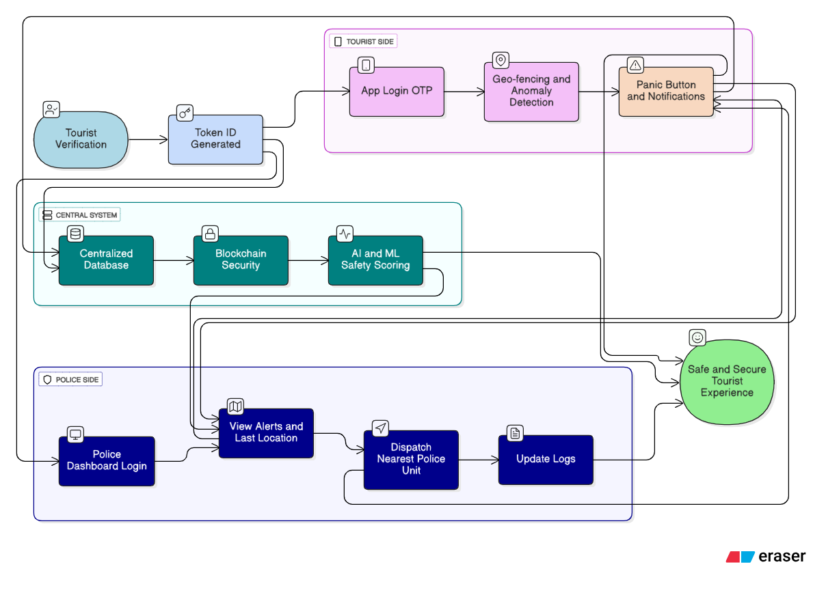
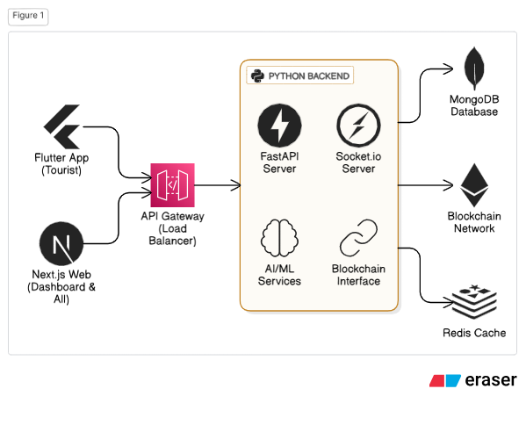
TECHNICAL APPROACH
Algorithm Avengers

Slide 4
FEASIBILITY AND VIABILITY
Algorithm Avengers
Analysis of the feasibility of the idea
Potential challenges and risks
Strategies for overcoming these challenges

Slide 5
IMPACT AND BENEFITS
Algorithm Avengers
Potential impact on the target audience
Benefits of the solution (social, economic, environmental, etc.)

Slide 6
RESEARCH AND REFERENCES
Algorithm Avengers
Details / Links of the reference and research work

Slide 7
IMPORTANT INSTRUCTIONS
Please ensure below pointers are met while submitting the Idea PPT:
Kindly keep the maximum slides limit up to six (6). ( Including the title slide)
Try to avoid paragraphs and post your idea in points /diagrams / Infographics /pictures
Keep your explanation precise and easy to understand
Idea should be unique and novel.
You can only use provided template for making the PPT without changing the idea details pointers (mentioned in previous slides).
You need to save the file in PDF and upload the same on portal. No PPT, Word Doc or any other format will be supported.
Note - You can delete this slide (Important Pointers) when you upload the details of your idea on SIH portal.

