Slide 1


SMART INDIA HACKATHON 2025
Problem Statement ID – 25002
Problem Statement Title- Smart Tourist Safety Monitoring & Incident Response System Using A.I., Geo-Fencing, and Blockchain-based Digital ID
Theme- Travel & Tourism
PS Category- Software/Hardware
Team ID-
Team Name (Registered on portal) – Algorithm Avengers

Slide 2
Smart Tourist Safety & Monitoring System
Algorithm Avengers
Proposed Solution
Detailed Explanation
Blockchain-based Digital Tourist ID (Token) issued at entry points (airport, railway, toll, hotel) after Aadhaar/Passport verification
Tourist App: OTP login, geo-fencing alerts, panic button, anomaly detection (phone switch-off, unusual route, inactivity)
Police Dashboard: real-time alerts, panic requests, tourist live/last location, digital ID access
Centralized Database: syncs all data between app ↔ police dashboard, ensuring secure & reliable storage
How It Addresses the Problem
Prevents entry into restricted / high-risk areas (geo-fencing alerts)
Enables rapid emergency response (panic button, anomaly detection)
Builds tourist trust & confidence with secure, verified system
Reduces manual dependency with automated, AI-driven alerts
Innovation & Uniqueness
Tamper-proof Blockchain Token ID (valid across states, not just local)
AI anomaly detection beyond SOS button (proactive safety monitoring)
Bi-directional alerts → both tourist & police notified instantly
Integrated ecosystem linking app, centralized DB, and police dashboard
Future Aspects
Federated blockchain nodes for cross-state scalability
Priority scoring system to filter false alarms & misuse
Predictive AI models for risk & crime forecasting
IoT integration (wearables for vitals & location tracking)
Multilingual & accessible alerts (text + voice in 10+ Indian languages)
Tourist education messages explaining risks & safe practices

Slide 3
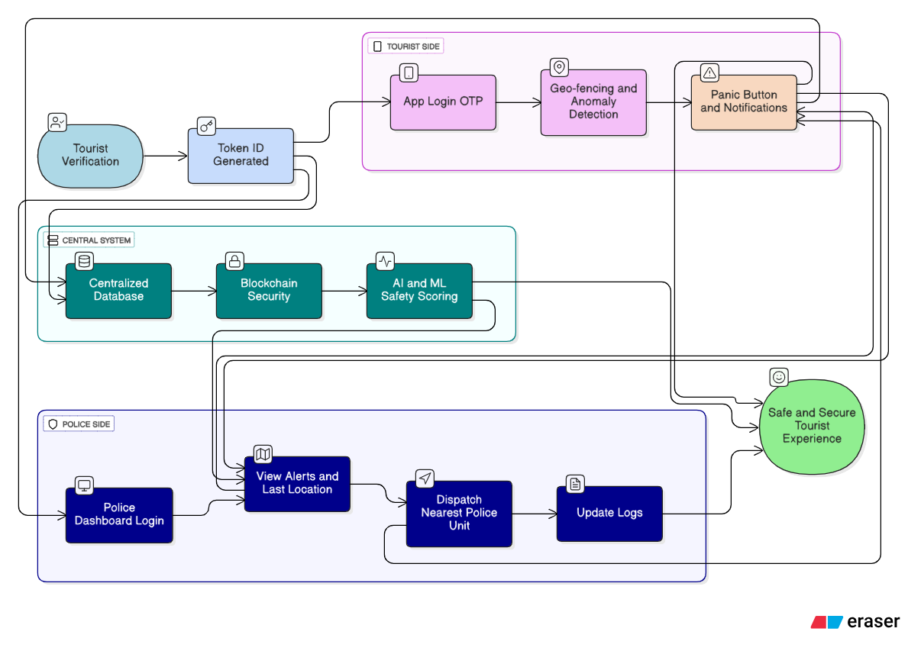
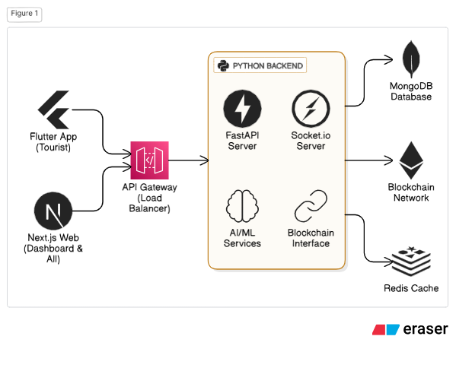
TECHNICAL APPROACH
Algorithm Avengers

Slide 4
FEASIBILITY AND VIABILITY
Algorithm Avengers
Feasibility of the Idea
Technically achievable using Flutter, Next.js, FastAPI, AI/ML, and Blockchain.
Integrates with existing Aadhaar/Passport verification process.
Real-time alerts and dashboards can be built with available infrastructure.
Potential Challenges & Risks
High volume of alerts → panic button misuse & false alarms.
Data privacy concerns → Aadhaar/Passport + location storage.
Tourist adoption issues → lack of awareness or trust.
Connectivity gaps in remote/border areas.
Scalability → states may resist centralized DB sharing.
Strategies to Overcome
Priority-based alert scoring → AI filters real threats vs false alarms.
End-to-end encryption + Blockchain → ensures data security & tamper-proof records.
Tourist education → multilingual, clear alerts with explanations.
IoT/offline support → cached GPS or smart bands in no-network areas.
Federated blockchain model → each state controls its own data node.

Slide 5
IMPACT AND BENEFITS
Algorithm Avengers
Potential Impact on Target Audience :
Tourists → Safer travel experience with real-time alerts & SOS support.
Police & Authorities → Faster incident response, efficient resource allocation.
Tourism Departments → Improved monitoring of tourist clusters & high-risk zones.
Benefits of the Solution :
Social → Increases trust in law enforcement, improves tourist confidence, ensures inclusivity with multilingual support.
Economic → Boosts tourism revenue by improving India’s global safety image, reduces losses from frauds & crimes.
Operational → Automates incident reporting (E-FIR), reduces manual effort, enables data-driven decision making.
Environmental (Indirect) → Encourages safe eco-tourism with monitoring in forests, caves, and remote zones.

Slide 6
RESEARCH AND REFERENCES
Algorithm Avengers
Datasets
Crime in India – Kaggle Dataset https://www.kaggle.com/datasets/rajanand/crime-in-india
Microsoft Geolife GPS Trajectory Dataset https://www.kaggle.com/datasets/arashnic/microsoft-geolife-gps-trajectory-dataset
Safetipin Open Data – Women Safety Scores https://safetipin.com/open-data/
AnLoCOV: An anonymised longitudinal GPS dataset (Pre & Post-COVID mobility patterns) https://doi.org/10.1016/j.dib.2022.108776
Related Research / Articles
“AI for Crime Prediction and Anomaly Detection” – IEEE Xplore.
“Blockchain in Digital Identity Management” – Springer.
“Tourist Safety and Risk Perception in India” – Journal of Tourism Studies.

Slide 7
IMPORTANT INSTRUCTIONS
Please ensure below pointers are met while submitting the Idea PPT:
Kindly keep the maximum slides limit up to six (6). ( Including the title slide)
Try to avoid paragraphs and post your idea in points /diagrams / Infographics /pictures
Keep your explanation precise and easy to understand
Idea should be unique and novel.
You can only use provided template for making the PPT without changing the idea details pointers (mentioned in previous slides).
You need to save the file in PDF and upload the same on portal. No PPT, Word Doc or any other format will be supported.
Note - You can delete this slide (Important Pointers) when you upload the details of your idea on SIH portal.

