Slide 1


SMART INDIA HACKATHON 2025
Problem Statement ID – 25002
Problem Statement Title- Smart Tourist Safety Monitoring & Incident Response System Using A.I., Geo-Fencing, and Blockchain-based Digital ID
Theme- Travel & Tourism
PS Category- Software/Hardware
Team ID-
Team Name (Registered on portal) – Algorithm Avengers
[DemoLink : https://github.com/Rohit-Solanki-6105/doc-sih-25002 ]

Slide 2
Smart Tourist Safety & Monitoring System
Algorithm Avengers
Proposed Solution
Detailed Explanation
Blockchain-based Digital Tourist ID (Token) issued at entry points (airport, railway, toll, hotel) after Aadhaar/Passport verification
Tourist App: OTP login, geo-fencing alerts, panic button, anomaly detection (phone switch-off, unusual route, inactivity)
Police Dashboard: real-time alerts, panic requests, tourist live/last location, digital ID access
Centralized Database: syncs all data between app ↔ police dashboard, ensuring secure & reliable storage
How It Addresses the Problem
Prevents entry into restricted / high-risk areas (geo-fencing alerts)
Enables rapid emergency response (panic button, anomaly detection)
Builds tourist trust & confidence with secure, verified system
Reduces manual dependency with automated, AI-driven alerts
Innovation & Uniqueness
Tamper-proof Blockchain Token ID (valid across states, not just local)
AI anomaly detection beyond SOS button (proactive safety monitoring)
Bi-directional alerts → both tourist & police notified instantly
Integrated ecosystem linking app, centralized DB, and police dashboard
Future Aspects
Federated blockchain nodes for cross-state scalability
Priority scoring system to filter false alarms & misuse
Predictive AI models for risk & crime forecasting
IoT integration (wearables for vitals & location tracking)
Multilingual & accessible alerts (text + voice in 10+ Indian languages)
Tourist education messages explaining risks & safe practices

Slide 3
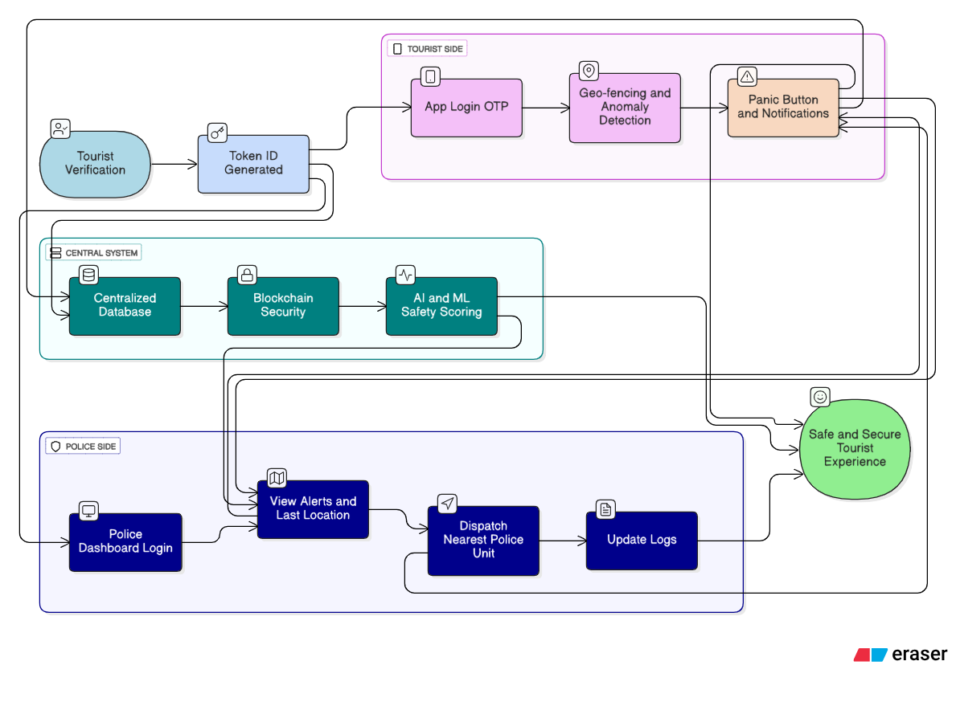
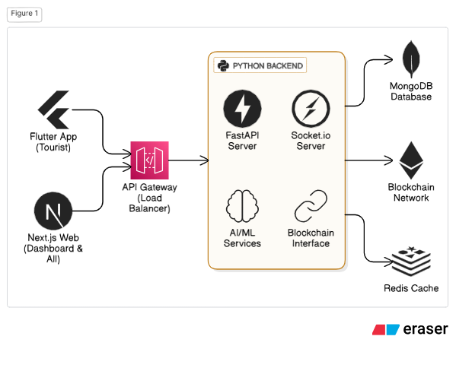
TECHNICAL APPROACH
Algorithm Avengers

Slide 4
FEASIBILITY AND VIABILITY
Algorithm Avengers
Feasibility of the Idea
Technically achievable using Flutter, Next.js, FastAPI, AI/ML, and Blockchain.
Integrates with existing Aadhaar/Passport verification process.
Real-time alerts and dashboards can be built with available infrastructure.
Potential Challenges & Risks
High volume of alerts → panic button misuse & false alarms.
Data privacy concerns → Aadhaar/Passport + location storage.
Tourist adoption issues → lack of awareness or trust.
Connectivity gaps in remote/border areas.
Scalability → states may resist centralized DB sharing.
Strategies to Overcome
Priority-based alert scoring → AI filters real threats vs false alarms.
End-to-end encryption + Blockchain → ensures data security & tamper-proof records.
Tourist education → multilingual, clear alerts with explanations.
IoT/offline support → cached GPS or smart bands in no-network areas.
Federated blockchain model → each state controls its own data node.

Slide 5
IMPACT AND BENEFITS
Algorithm Avengers
Potential Impact on Target Audience :
Tourists → Safer travel experience with real-time alerts & SOS support.
Police & Authorities → Faster incident response, efficient resource allocation.
Tourism Departments → Improved monitoring of tourist clusters & high-risk zones.
Benefits of the Solution :
Social → Increases trust in law enforcement, improves tourist confidence, ensures inclusivity with multilingual support.
Economic → Boosts tourism revenue by improving India’s global safety image, reduces losses from frauds & crimes.
Operational → Automates incident reporting (E-FIR), reduces manual effort, enables data-driven decision making.
Environmental (Indirect) → Encourages safe eco-tourism with monitoring in forests, caves, and remote zones.

Slide 6
RESEARCH AND REFERENCES
Algorithm Avengers
Datasets
Crime in India – Kaggle Dataset https://www.kaggle.com/datasets/rajanand/crime-in-india
Microsoft Geolife GPS Trajectory Dataset https://www.kaggle.com/datasets/arashnic/microsoft-geolife-gps-trajectory-dataset
Safetipin Open Data – Women Safety Scores https://safetipin.com/open-data/
AnLoCOV: An anonymised longitudinal GPS dataset (Pre & Post-COVID mobility patterns) https://doi.org/10.1016/j.dib.2022.108776
Related Research / Articles
“AI for Crime Prediction and Anomaly Detection” – IEEE Xplore.
“Blockchain in Digital Identity Management” – Springer.
“Tourist Safety and Risk Perception in India” – Journal of Tourism Studies.
Github Link : https://github.com/Rohit-Solanki-6105/doc-sih-25002

