Slide 1


BIRLA VISHVAKARMA MAHAVIDYALAYA
(Engineering College) (An Autonomous Institution)
Community investment Platform
Course Code: 4EL33
Presented by:
Rohit Tekchandani 19EL013
Panchal Meet 19EL086

Slide 2
CONTENTS
1
Introduction
2
4
Literature Review
Features
3
5
Working Diagram
Progress

Slide 3
1
Introduction

Slide 4
Introduction:-
CI (Community investment / corporate social investment / Community social investment) platform can also be called employee volunteer program, workplace volunteer programs, corporate volunteer programs, company volunteer programs, and other iterations.
Usually, a company's bigger corporate social responsibility (CSR), community engagement, or community investment activities are supported by these programmes.
Building such platforms may be done for specific business purposes, such as enhancing employee participation in the community or enhancing brand reputation.

Slide 5
Continue…
Through the employer's leadership, the platform will enable the business to "plan and oversee effort that strives to inspire and enable employees to effectively address community needs."

Slide 6
2
Literature Review

Slide 7
Literature Reviewed:-
10.1109/ISECon.2019.8881998F. Alassery, “A Smart Classroom of Wireless Sensor Networks for Students Time Attendance System,” 2019 IEEE Integrated STEM Education Conference (ISEC). IEEE, Mar. 2019. doi: 10.1109/isecon.2019.8881998.
Aamir Nizam Ansari, A. Navada, S. Agarwal, S. Patil, and B. A. Sonkamble, “Automation of attendance system using RFID, biometrics, GSM Modem with .Net framework,” 2011 International Conference on Multimedia Technology. IEEE, Jul. 2011. doi: 10.1109/icmt.2011.6002032.
S. N. Shah and A. Abuzneid, “IoT Based Smart Attendance System (SAS) Using RFID,” 2019 IEEE Long Island Systems, Applications and Technology Conference (LISAT). IEEE, May 2019. doi: 10.1109/lisat.2019.8817339.
A. Qaiser and S. Khan, “Automation of Time and Attendance using RFID Systems,” 2006 International Conference on Emerging Technologies. IEEE, 2006. doi: 10.1109/icet.2006.335928.

Slide 8
Continue…
T. Sharma and S. L. Aarthy, “An automatic attendance monitoring system using RFID and IOT using Cloud,” 2016 Online International Conference on Green Engineering and Technologies (IC-GET). IEEE, Nov. 2016. doi: 10.1109/get.2016.7916851.
W. Muhamad, N. B. Kurniawan, Suhardi, and S. Yazid, “Smart campus features, technologies, and applications: A systematic literature review,” 2017 International Conference on Information Technology Systems and Innovation (ICITSI). IEEE, Oct. 2017. doi: 10.1109/icitsi.2017.8267975.
P. Kovelan, N. Thisenthira, and T. Kartheeswaran, “Automated Attendance Monitoring System Using IoT,” 2019 International Conference on Advancements in Computing (ICAC). IEEE, Dec. 2019. doi: 10.1109/icac49085.2019.9103412.
B. M. Sri Madhu, K. Kanagotagi, and Devansh, “IoT based Automatic Attendance Management System,” 2017 International Conference on Current Trends in Computer, Electrical, Electronics and Communication (CTCEEC). IEEE, Sep. 2017. doi: 10.1109/ctceec.2017.8455099.

Slide 9
Continue…
G. Sittampalam and N. Ratnarajah, “SAMS: An IoT Solution for Attendance Management in Universities,” TENCON 2019 - 2019 IEEE Region 10 Conference (TENCON). IEEE, Oct. 2019. doi: 10.1109/tencon.2019.8929616.

Slide 10
Continue…
Paper Number | Methodology
1 | In this research, they present a wireless sensor network-based time attendance system that includes sensor nodes embedded in smart chairs. They create a smart classroom that has five HX711 amplifiers and twenty 50 kg load sensors. Additionally, the smart classroom has a ZKTeco ZK4500 fingerprint scanner installed so that it can read the daily fingerprints of the five pupils that occupy the five intelligent chairs that have been assigned to them. While a pupil is seated in the chair, the load sensors weigh that person. These weights are transmitted in the form of packets to a master sensor node, which gathers them and transmits them to the system server for use in calculating the lengths of student attendance. Zero weight is given when a student is absent.

Slide 11
Continue…
Paper Number | Methodology
2 | This paper explains how an automated attendance system utilizing RFID, fingerprints, and a GSM modem can be deployed in a college or other academic environment using the “. Net Framework”. With the help of the GPS (Global Positioning System), the student's whereabouts can be found anywhere on campus.
3 | The Python Tkinter Module is used to create the software's front end. The open source cloud API and MySQLite3 are used to create the backend. It includes the MFRC522 RFID Reader and Atmega328P Microcontroller hardware interface.
4 | RFID is a technology that automates identification and data collecting, resulting in faster corporate operations and more precise and timely data entry. In the paper, an unique use of RFID systems to classroom automation was suggested. Experimental results showed that the Windows Service's processing was 100% accurate and timely.

Slide 12
Continue…
Paper Number | Methodology
5 | In this paper, the attendance monitoring system makes use of RFID and IOT. The best aspect is that by using the supplied methods, a lot of work may be completed automatically rather than manually. We store data on the cloud for our backend. We are adapting it so that it can be accessed via IoT from any location.
6 | Students attendance management is presented in this paper by using most of the advanced technologies of the IoT (Internet of Things), such as mobility, wireless network, fingerprint sensor and cloud computing in which Middle layer is implemented using Apache server, PHP (web programming language) and MySQL (relational database). The database is employed to mainly store the attendance data captured by the Fingerprint Scanner. Smart Attendance Management System can manipulate the recorded student attendance by querying the database for automated operation.

Slide 13
Continue…
Paper Number | Methodology
7 | In this paper they are Using face recognition and detection algorithm the faces are detected and the attendance is updated into the student's database. The Raspberry pi use face recognition method for taking attendance automatically and communicates with cloud database.
8 | The signal intensity of each version was assessed in this study. They used ESP8266 v12F Wi-Fi module with a 40m maximum sender-to-receiver distance. In case Wi-fi communication fails, the GSM module is utilized as an alternative communication configuration.
9 | In this paper they uses XAMPP software to create a database and a basic Android Application (App) to allow students to check their attendance directly from their mobile phones. The RFID reader will accept only one card at a time until the other PIR Sensor detects the person.

Slide 14
3
Working Diagram

Slide 15
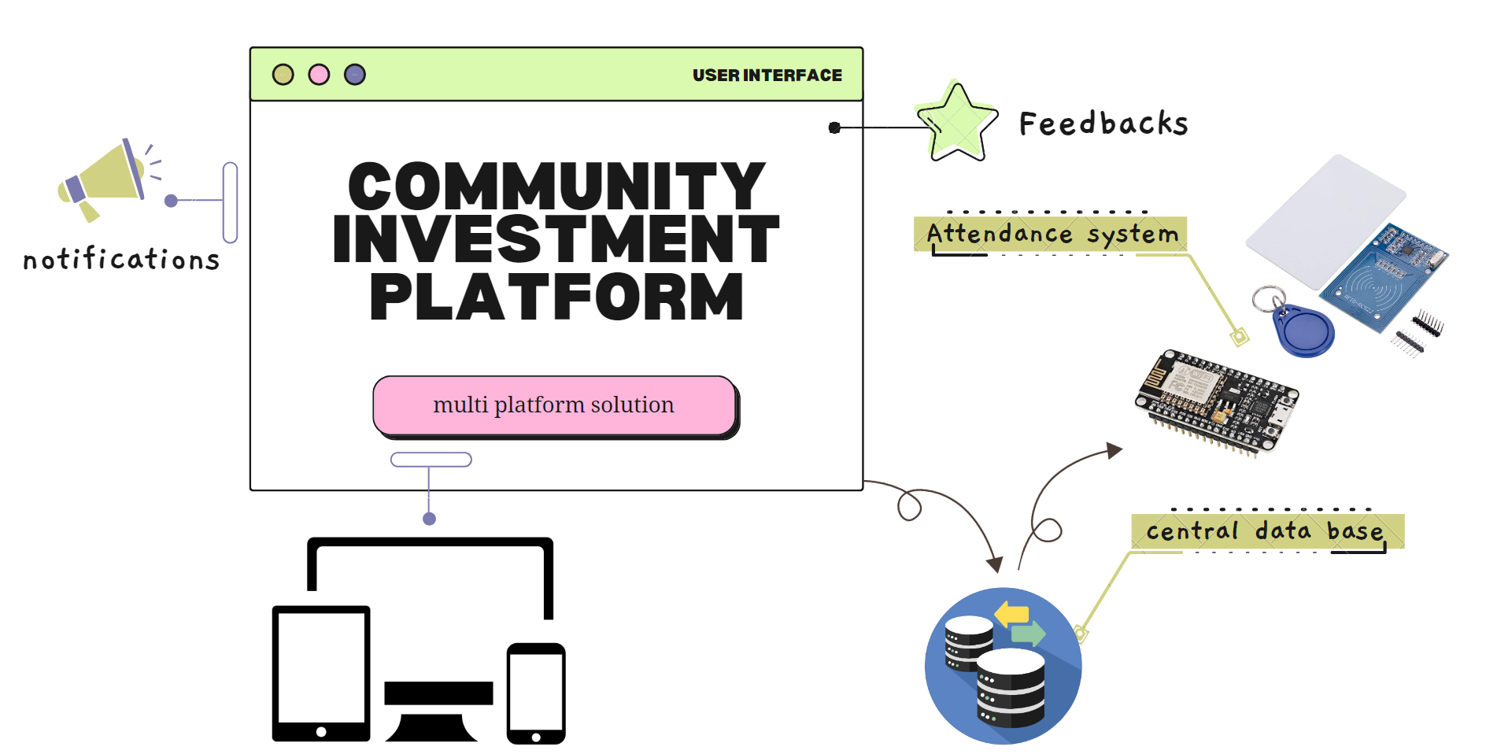
Working Diagram

Slide 16
4
Features

Slide 17
Features
Security and user authentication are provided. Reduces trips to the areas where the bin still have a lot of capacity.
It supports maintaining work-life balance for professionals.
simple and effective user interface.
Organizing, managing, and participating in events is simple.
Depending on the user's talents and location, it prioritizes the activities.
Different activities are carried out by individual organizations using a centrally managed database with backup.
Support is available for all platforms of devices with various screen sizes.

Slide 18
5
Progress

Slide 19
Progress:-
January
learning about web frontend
February
Technology Stack
learning about backend
24th March
completing website
13th April
Integrating with hardware
Back end: ASP.Net Core API | Node JS | ASP.Net MVC | PHP 7
Front end: React JS | Angular 11+ | Vue JS | ASP.Net MVC | PHP 7
Database: SQL Server 2017 | Mongo | Postgres | Mysql
Tools/IDE: Visual Studio 2019 | Visual Studio Code
Source Control Repository: GitHub
ORM (Object relational mapping): Entity Framework | Sequelize
24th April
Debugging and Documentation
Within Timeline
Project implementation

Slide 20
THANK YOU

