Slide 1

PRESENTATION on FACE EXPRESSION DETECTION USING CONVOLUTIONAL NEURAL NETWORK
Under The Guidance Of Asst. Director-IQAC and Asst. Prof. Dr. Neeraj Varshney
Presented by Group-VI
Team Members:-
Rohit Varshney (2284200178)
Munendra Kumar Kushwaha (2284200126)
Abhyudai Srivastava (2284200010)
Dept. of Computer Applications

Slide 2

OUTLINE
Introduction
Problem Definition
Application
Requirements
Project Work
Conclusion

Slide 3
INTRODUCTION
Facial expression is an essential part of communication. For this reason, the issue of human emotions evaluation using a machine is a very interesting topic, which has gained more and more attention in recent years. It is mainly related to the possibility of applying facial expression recognition in many fields such as HCI, video games, virtual reality, and analyzing customer satisfaction etc. Emotion’s determination ( recognition process) is often performed in 3 basic phases: face detection, facial features extraction, and last stage – expression classification

Slide 4
PROBLEM DEFINITON
Face expression detection is the problem of automatically recognizing and categorizing the emotional states of a person based on their facial expressions. It involves analyzing visual data, such as images or videos, and using machine learning algorithms to identify patterns in the facial features and movements that correspond to different emotions, such as happiness, sadness, anger, or surprise. The goal of face expression detection is to provide a more natural and intuitive interface for human-computer interaction, as well as to enable applications in fields such as psychology, human-robot interaction, and marketing research.

Slide 5
APPLICATION
Following are rapidly growing areas where the system can be used:
Cameras or in Cell phone camera applications
For the Advertising
Content creators to sell product e.g. Affectiva company
Q-Sensor- to guise emotion of children
Learner emotion detection
Attitude and Action detection
Marketing and scientific research- Visage sdk
Face analytics and emotion recognition - Eyeris
Film industries

Slide 6
REQUIREMENTS
HARDWARE
SOFTWARE
System with min of 2GB of RAM
Processor I3 or above
Minimum 5 GB memory required
Python versions: 3.7X or higher
Operating systems: Linux, MacOS and Windows7 or above
PyCharm
Jupyter

Slide 7
PROJECT WORK
Tools and Libraries used
OpenCV
Python
Deep Learning
OpenCV is the library
we will be using for
image transformation
functions such as converting
the image to grayscale
Python is an advanced scripting language and is very useful for solving statistical problems involving machine learning algorithms
Deep learning is the
Subset of machine
Learning in artificial
Intelligence that has
Networks capable of
Learning unsupervised
From data that is
Unstructured and
unlabelled
NumPy
Keras
NumPy is a library for python programming
Language. Adding support for large multi-
Dimensional arrays
Keras is an open-source software library that provides a python interface for artificial neural networks

Slide 8
PROJECT WORK
DATASET
With respect the task to recognize expression, a dataset required to train and test the network essentially has the following requirements :
Data should be in the form of images in which most of the computer face is visible.
The faces must be mostly front-facing, i.e. the Y and Z axis rotation of faces must not be too high.
The resolution of images must be sufficiently large.
FERC-2013 Dataset:
The Facial Expression Recognition Challenge was an open-for-all challenge, part of the ICML 2013 conference workshop, which contained an emotion- annotated dataset of cropped images of faces.

Slide 9
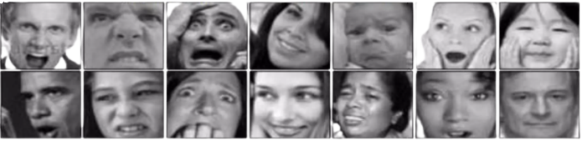
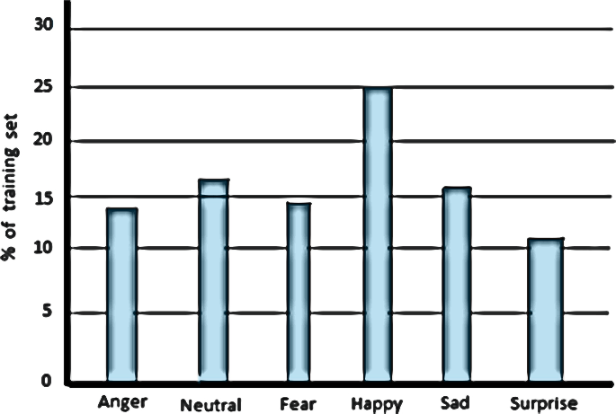
PROJECT WORK
(A)Examples of the dataset (left to right ): Angry, Disgust, Fear, Happy, Sad, Surprise, Neutral
Histogram representing distribution of classes

Slide 10
PROJECT WORK
DATASET TRAINING
INPUT IMAGE
MATRIX GENERATION
CONVOLUTION
FLATTENING
POOLLING
STORING(H5PY)

Slide 11
FLOWCHART
Data Collection
Data Preprocessing
Model Selection
Training and Validation
Evaluation
Final Model
Data Collection
It is the process of gathering and measuring information on variables of interest
Data Preprocessing
Data preprocessing, a component of data preparation, describes any type of processing performed on raw data
Model Selection
Model selection is the process of selecting one final machine learning model
Training and Validation
We do training data for machine analysis itself and we do one more step is a validation of training data, we test the model using cross-validation
Evaluation
Model evaluation is the process of using different evaluation metrics to understand a machine learning model's performance
Final Model
A model that you use to make predictions on new data

Slide 12
ALGORITHM
Step 1: Take a still image of a normal expression pic1 (say) of a human face
Step 2: Converts the color image to grayscale
Step 3: Crop the five facial image region of interest (ROI) (eyes, eye brows and lip) from the image by defining region.
Step 4: Find edges of all image region.
Step 5: Take a still image of a emotional face (angry or happy) pic2 (say) of same person and repeat step 2, 3 and 4
Step 6: Comparing the deviation of edges of the specified region of pic1 with pic2 by finding the Euclidian distances of coordinate of each pixel.
Step 7: Put the Euclidian distances in a array k (say).
Step 8: Find the standard deviation (SD) from the elements of array.
Step 9: Comparing the SD with pre-define threshold and get the emotions.

Slide 13
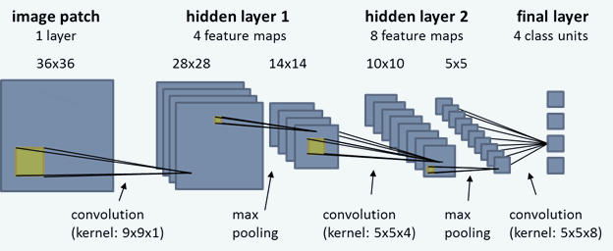
CONVOLUTIONAL NEURAL NETWORK LAYERS

Slide 14
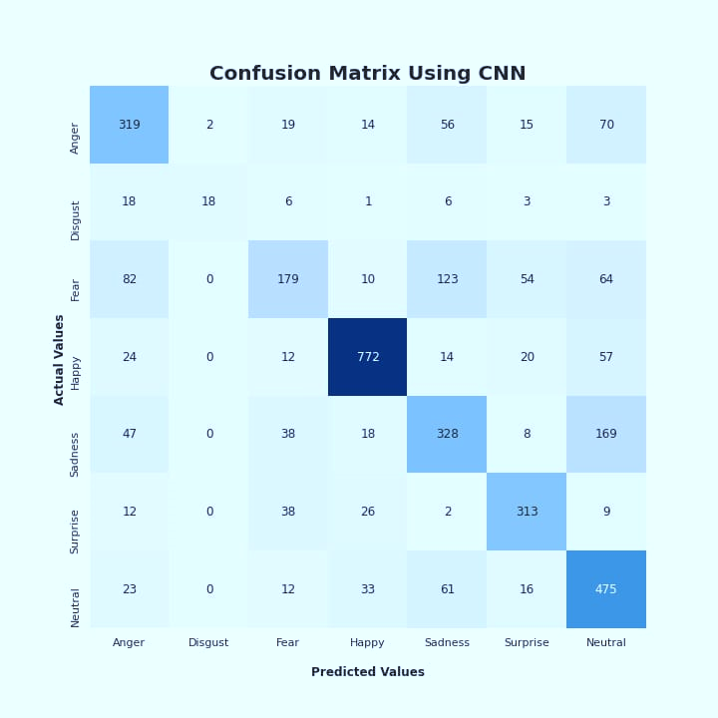
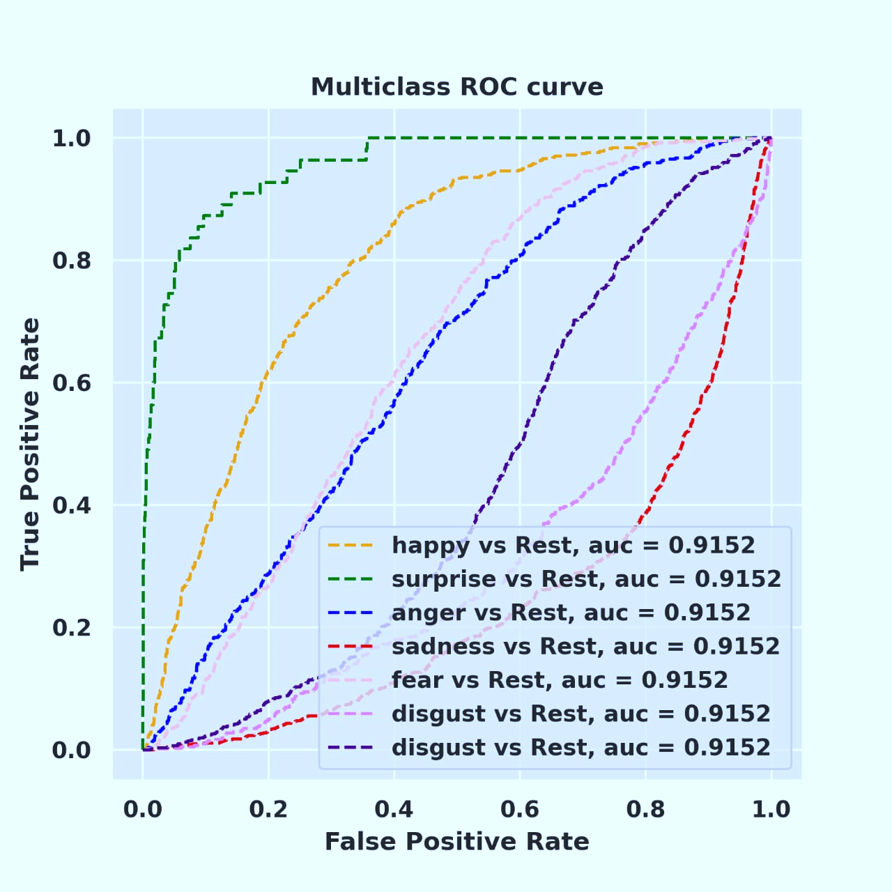
Model Evaluation

Slide 15
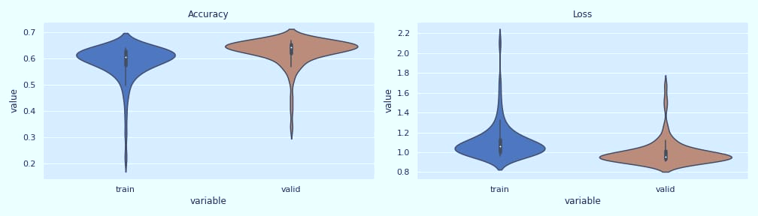
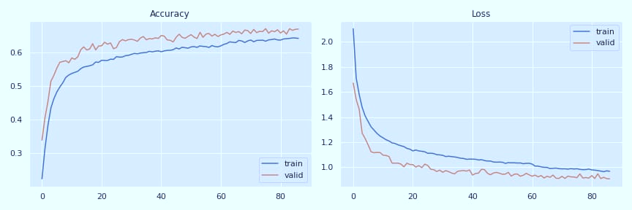
Model Evaluation

Slide 16
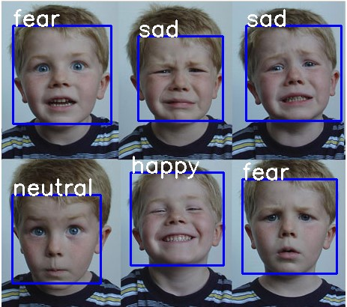
OUTPUT

Slide 17
CONCLUSION
In this project, we studied what are the techniques used which are previously mentioned, what are the real time application for the proposed system which covered in objective and motivation.
We also conclude that face expression recognition technology has the potential to revolutionize various fields and improve our understanding of human emotions and behaviour.
Overall, the future of face expression recognition technology is exciting and we can expect to see many innovative applications and advancements in the coming years.

Slide 18
THANK YOU!

