Slide 1


MLFlow in Databricks
Group 9
Radhika J
Irving C
Rohit M
Alexandra

Slide 2
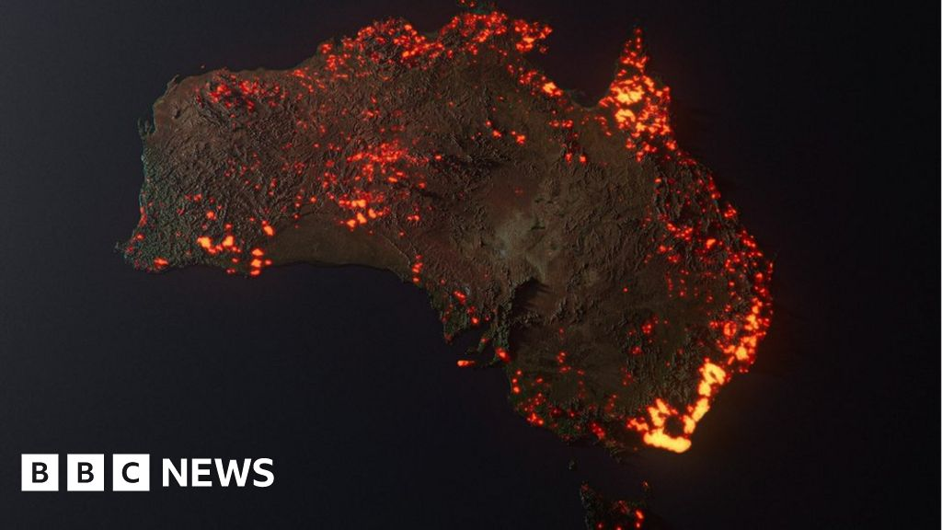
What are we solving?
Predicting Australian Wildfires using Weather Data from NASA
According to RGS, the 2020 wildfire was so devastating that:
28 people have been killed
2,000 homes have been lost
An estimated 1 billion animals have been lost
One-third of the entire koala population has perished
Why?

Slide 3
The Platform
Databricks is a unified analytics platform for building, deploying, sharing, and maintaining enterprise-grade data, analytics, and AI solutions at scale.
Open-source platform for managing the end-to-end machine learning lifecycle.
Tracking
Models
Projects
Registry

Slide 4


The Data
Australian Wildfire Prediction using weather data
Dataset curated by IBM from data generated by NASA
4 Datasets
Weather Data (242781, 8)
Vegetation Index (1330, 7)
Wildfires Data (26406, 10)
Land Class Data (7, 15)

Slide 5
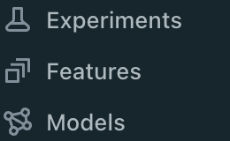


The Architecture
Databricks Workspaces
Data Preparation
EDA
Featurization
AutoML
Model Development
Model Tracking & Benchmarking
Model Registry
Model Inferencing
Databricks File Systems
Unity Catalog
Data Storage and Management

Slide 6

The Team
The ML Engineer
The MLOps Engineer
The Data Analyst
The Data Engineer

