Slide 1

Jenkins
Rohit Shinde

Slide 2

What is Jenkins?
Jenkins is a powerful tool that helps automate parts of the software development process, including building, testing, and deploying code. It integrates with various version control systems (like Git), build tools (like Maven and Gradle), and deployment environments, enabling seamless automation of the entire development pipeline

Slide 3
Why Jenkins is popular?
Continuous Integration (CI): Automatically builds and tests code changes, allowing developers to detect issues early.
Continuous Delivery (CD): Automates the deployment of applications, ensuring faster and more reliable releases.
Extensibility: Jenkins has a vast library of plugins that extend its functionality, integrating with many other tools and services.
Easy Configuration: Configuration through a web interface makes it user-friendly, and Jenkinsfiles (code-based configuration) allow for more complex setups.
Scalability: Can be scaled across multiple nodes to distribute build and test loads, improving performance.
Community Support: Being open-source, Jenkins has a large, active community contributing plugins, improvements, and support.

Slide 4
Why do we need continuous integration
Continuous integration is a development practice in which developers are required to commit changes to source code in a shared repository several times a day. every commit is then build and this allows the teams to detect problem early.
it then bring following benefits to software development:
1. catches issue fast
2. Everyone can see what’s happening
3. Automate the build
4. Continuous integration leads to continuous deployment allowing us to deliver software more rapidly

Slide 5
User managing security
There can be multiple users that can operate Jenkins for the same set of project holding different responsibility.
so it is very important to restrict access of users so they can operate on their responsibility in a contriled manner.
To manage access of users:
1. Click on manage Jenkins from the home page.
2. click on the link configure global security.
3. Under "Access control" you will see an " authorization label”.

Slide 6
What are different plugins in Jenkins?
Jenkins supports plugins which allow Jenkins to be extended to meet specific needs of individual projects.
Maven integration
Maven invoker
Docker Pipeline
Publish over SSH
Deploy to container

Slide 7
What is Jenkins Master?
What is Jenkins?
Jenkins is a tool used to automate parts of software development, like building, testing, and deploying code. It helps teams work faster and catch problems early.
Jenkins Master
Think of the Jenkins master as the boss of the Jenkins setup. It has several important jobs:
User Interface: It gives you a web interface to set up tasks, see results, and manage the system.
Job Scheduling: It decides when and where jobs (tasks) should run.
Job Dispatching: It tells other machines (slaves) to do the actual work.
Monitoring: It keeps an eye on all the jobs running on the slaves.
Result Aggregation: It collects and shows the results of all the jobs.

Slide 8
What is Jenkins Slave?
Jenkins Slaves (Agents)
Slaves are the workers in the Jenkins setup. They are machines that do the heavy lifting, like building and testing your code. Here’s what they do:
Execution Environment: They can run on different operating systems (like Windows, Linux, or macOS) to test your code in different environments.
Workload Distribution: By spreading tasks across multiple slaves, Jenkins can run many jobs at once, speeding up the process.
Scalability: You can add more slaves to handle more work.
Specialization: Slaves can be set up with specific tools and environments for specialized tasks.

Slide 9
How Master and Slaves Work Together
The master and slaves communicate to get the work done:
Job Dispatch: The master sends job details to a slave.
Resource Management: The master makes sure slaves aren’t overloaded with too much work.
Result Reporting: Slaves report back to the master once they finish a job.
Why Use This Setup?
Parallel Execution: Multiple jobs run at the same time, speeding up the whole process.
Load Balancing: Work is spread out, so no single machine gets too busy.
Fault Tolerance: If a slave fails, the master can assign the job to another slave.
Scalability: You can add more slaves to handle more tasks as your needs grow.
Specialization: Different slaves can be set up for different tasks, ensuring the best environment for each job.
Example Workflow
Create a Job: You create a job on the Jenkins master and set it to run on a specific type of slave (like one running Linux).
Trigger the Job: The job starts automatically when you commit code.
Assign the Job: The master assigns the job to an available slave.
Run the Job: The slave builds and tests the code.
Report Results: The slave sends the results back to the master.
Notify Users: The master shows the results in the web interface and can send notifications (like emails).

Slide 10
What is Maven?
Maven is a tool that helps you manage and build Java projects. It takes care of downloading the necessary libraries, compiling your code, running tests, and packaging your project into a file like a JAR or WAR.
Key Things Maven Does
Manages Dependencies: Automatically downloads the libraries your project needs.
Builds Projects: Compiles your code and packages it into a JAR or WAR file.
Runs Tests: Automatically runs tests to make sure your code works.
Standardizes Projects: Provides a standard way to organize your project files.
Uses Plugins: Can be extended with plugins to do more tasks.

Slide 11
How Maven Works?
POM File (pom.xml)
Maven uses a file called pom.xml to know what to do. This file includes:
Project Info: Basic details like project name and version.
Dependencies: Lists of libraries your project needs.
Plugins: Tools that add extra features to Maven.
Build Instructions: Steps on how to build your project
Build Lifecycle
Maven follows a series of steps called the build lifecycle. Some important steps are:
validate: Checks if everything is ready.
compile: Compiles the source code.
test: Runs tests on the compiled code.
package: Packages the code into a JAR or WAR file.
install: Installs the package into your local system for use by other projects.
deploy: Copies the package to a remote server so others can use it.

Slide 12
What is Continuous Deployment?
Continuous Deployment (CD) is a software development practice where code changes are automatically deployed to production environments once they pass all necessary tests. This means that every change that passes the automated testing phase is released to users without any manual intervention.

Slide 13
What is tomcat?
Apache Tomcat is an open-source web server and servlet container. It's widely used to deploy and run Java web applications. Here’s a simple breakdown of what Tomcat is and what it does:
What is Apache Tomcat?
Web Server: Tomcat serves web content, meaning it handles HTTP requests from users and serves web pages and applications.
Servlet Container: It runs Java Servlets and JavaServer Pages (JSPs), which are technologies used for building dynamic web applications

Slide 14
Different Types of Jenkins CI/CD Pipelines
1. Scripted Pipeline
2. Declarative Pipeline

Slide 15
Different Types of Jenkins CI/CD Pipelines
Scripted Pipeline:
A Jenkins Scripted Pipeline is a way to define your continuous integration and continuous delivery (CI/CD) process as code. It uses a domain-specific language (DSL) based on Groovy, which allows for a high degree of flexibility and control over the pipeline’s behavior.
Pros and Cons:
The imbalance between developers’ experience in Groovy and Jenkins creates an impedance mismatch that is not easy to remove.
Although scripted syntax is powerful and expedites the creation of complex pipelines, it concurrently makes the pipeline hard to read and hard to manage.

Slide 16
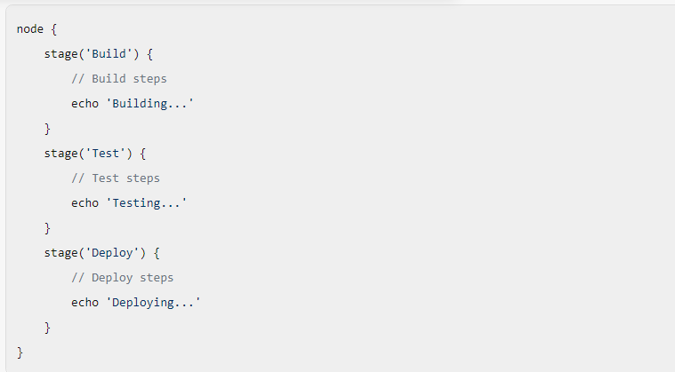
Scripted pipeline

Slide 17
Different Types of Jenkins CI/CD Pipelines
Declarative Pipeline:
A Jenkins Declarative Pipeline is a more recent and simplified way to define your continuous integration and continuous delivery (CI/CD) pipelines in Jenkins. It provides a more structured and user-friendly syntax compared to the traditional scripted pipeline.
Pros and Cons:
Since declarative pipelines don’t make use of Groovy code, the declarative syntax doesn’t access valuable APIs. But, at the end of the day, the declarative syntax is uncomplicated to read and comparatively easier to manage.

Slide 18
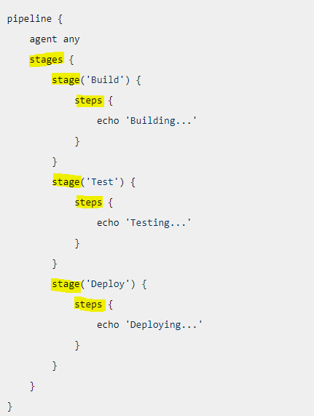
Declarative Pipeline

Slide 19
Practical Demo

Slide 20


