Slide 1

Types of Written Communication
Formal
Informal
Office letters, Business Letters, Circulars, Notice, Pamphlets, Press release, press Report, etc.
Personal letters, Personal Essay.

Slide 2

Name of Organization
Ref: ……………
Date: ………………….
Office Order
---------------------------------------------------------------------------------------------------------------------------------------------------------------------------------------------------------------------------------------------------------------------------------------------------------------------------------------------------------------------------------------
Copies To:
---------------------------------------------------------------------------------
Signed by
Name -----------------
Designation ----------------

Slide 3
Types of Report Writing
Oral and Written Report
Formal Report
Special Report
Informal Report
Informal Letter
Business Report

Slide 4
Prewriting
Drafting
Revising
Editing
Publishing

Slide 5
car
BMW
Scorpio
Tesla
Class
Object

Slide 6
Non-verbal Communication
Kinesics
Artifacts
Oculesics
Vocalises or paralanguage
Haptics
Proxemics

Slide 7
Encapsulation
Methods Variable
class

Slide 8
A
A
B
B
C
D
Single Inheritance
Hierarchical Inheritance
A
B
A
A
B
B
C
C
C
D
Multiple Inheritance
Multilevel Inheritance
Hybrid Inheritance
Types of Inheritance

Slide 9
Man
responsibility()
Employee object
Husband Object
Son object
responsibility(employee)
responsibility(husband)
responsibility(son)
Polymorphism

Slide 10
Access Modifier | Default | Public | Private | Protected
Same Class | ✔ | ✔ | ✔ | ✔
Same Package | ✔ | ✔ | ❌ | ✔
outside package by subclass only | ❌ | ✔ | ❌ | ✔
Outside package by non subclass | ❌ | ✔ | ❌ | ❌

Slide 11
Object1
Car
Object2
String Constant Pool
Heap

Slide 12
demoStr1
courseTpoint
demoStr2
demoStr1
courseTpoint
Stack Area
Heap Area
JVM Memory

Slide 13
Learn Java With courseTpoint
StringTokenizer
Token
Learn
Java
With
courseTpoint

Slide 14
Method name
Parameter List
Return type
public int sum(int a , int b)
{
return (a+b);
}
Access Modifier
body
Method Declaration

Slide 15
public static double calArea(double rad){
………………………………………………..
//code
}
public static double calPeri(double rad){
………………………….
//code
}
Return
calArea(radius);
………………..
calPeri(radius)
………………….
Method call
Method Calling

Slide 16
<HTML>
<HEAD>
<TITLE> A Simple Program </TITLE>
</HEAD>
<BODY>
//Here is the output of my program:
<APPLET CODE="HelloWorld.class" WIDTH=100 HEIGHT=100>
</APPLET>
</BODY>
</HTML>

Slide 17
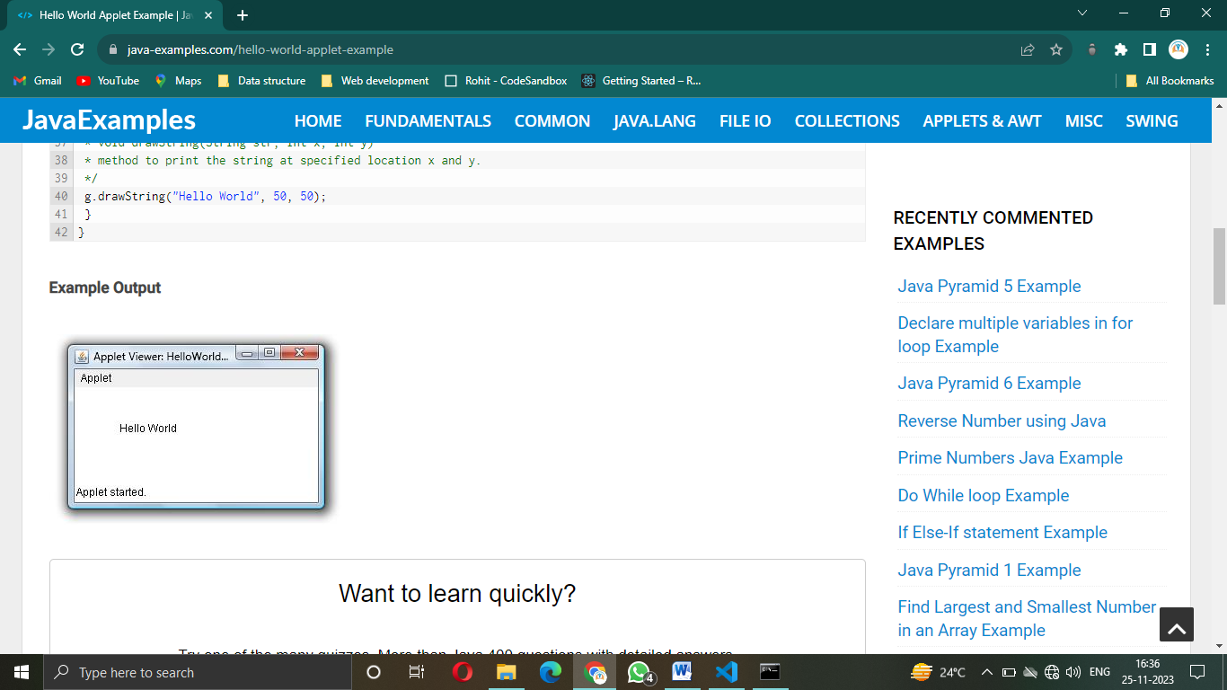
Output:
/*Note: Above code is not working on current version of applet because it is not used new versions in java it work previous version like 1.6. When you can compile in your system did not work and show a Warning*/

Slide 18
Local Applet
Local Computer
Loading local Applet

Slide 19
Internet
Local Computer
(client)
Remote Computer
(server)
Remote Applet
Loading a remote Applet

Slide 20
initialization
Born
stop()
init()
stopped
Idle
Running
start()
paint()
destroy()
Dead
Exit the Browser

