Slide 1

Types of Written Communication
Formal
Informal
Office letters, Business Letters, Circulars, Notice, Pamphlets, Press release, press Report, etc.
Personal letters, Personal Essay.

Slide 2
Stimuli
Attention
Recognition
Overt Environment
Physical
Socio-cultural
Work relation
2. Convert or Internal Environment
a. Sensor
b. self
Sensory and Neural Mechanisms
Mediators and Physical Organisms
Translation
Response Organism Decisions
Satisfaction
Performance
Behavior
Expectation and Performance Evaluation
Action Satisfaction Reaction Retrospection
Overt Physical Action Covert Mental State
Components/Process of Perception

Slide 3


Acoustic Modeling
Speech Enhancement
Feature Extraction
Phonetic unit Recognition
Welcome to courseTpoint…..
(Text)
Speech Recognition Process

Slide 4
Key
Database
Signature Key pair
Signature Key pair
Key container for user 1
Key container for user 2
Contents of Key database

Slide 5
Workstation
Workstation
IBM SNA Architecture
Cluster Controller
Cluster Controller
Comm. Controller
Comm. Controller
Mainframe

Slide 6
Name of Organization
Ref: ……………
Date: ………………….
Office Order
---------------------------------------------------------------------------------------------------------------------------------------------------------------------------------------------------------------------------------------------------------------------------------------------------------------------------------------------------------------------------------------
Copies To:
---------------------------------------------------------------------------------
Signed by
Name -----------------
Designation ----------------

Slide 7
Types of Report Writing
Oral and Written Report
Formal Report
Special Report
Informal Report
Informal Letter
Business Report

Slide 8
Prewriting
Drafting
Revising
Editing
Publishing

Slide 9
car
BMW
Scorpio
Tesla
Class
Object

Slide 10
Non-verbal Communication
Kinesics
Artifacts
Oculesics
Vocalises or paralanguage
Haptics
Proxemics

Slide 11
Encapsulation
Methods Variable
class

Slide 12
A
A
B
B
C
D
Single Inheritance
Hierarchical Inheritance
A
B
A
A
B
B
C
C
C
D
Multiple Inheritance
Multilevel Inheritance
Hybrid Inheritance
Types of Inheritance

Slide 13
Man
responsibility()
Employee object
Husband Object
Son object
responsibility(employee)
responsibility(husband)
responsibility(son)
Polymorphism

Slide 14
Access Modifier | Default | Public | Private | Protected
Same Class | ✔ | ✔ | ✔ | ✔
Same Package | ✔ | ✔ | ❌ | ✔
outside package by subclass only | ❌ | ✔ | ❌ | ✔
Outside package by non subclass | ❌ | ✔ | ❌ | ❌

Slide 15
Object1
Car
Object2
String Constant Pool
Heap

Slide 16
demoStr1
courseTpoint
demoStr2
demoStr1
courseTpoint
Stack Area
Heap Area
JVM Memory

Slide 17
Learn Java With courseTpoint
StringTokenizer
Token
Learn
Java
With
courseTpoint

Slide 18
Method name
Parameter List
Return type
public int sum(int a , int b)
{
return (a+b);
}
Access Modifier
body
Method Declaration

Slide 19
public static double calArea(double rad){
………………………………………………..
//code
}
public static double calPeri(double rad){
………………………….
//code
}
Return
calArea(radius);
………………..
calPeri(radius)
………………….
Method call
Method Calling

Slide 20
<HTML>
<HEAD>
<TITLE> A Simple Program </TITLE>
</HEAD>
<BODY>
//Here is the output of my program:
<APPLET CODE="HelloWorld.class" WIDTH=100 HEIGHT=100>
</APPLET>
</BODY>
</HTML>

Slide 21
Button
Object
Label
Checkbox
Component
Choice
List
Container
Windows
Panel
Applet
Frame
Dialog

Slide 22
Administrative Tool
JNDI Namespace
Bind
CF
D
Inject
Resource
JMS Client
JMS Provider
Logical connection

Slide 23


Slide 24


Client1
MSG
Sends
Queue
Acknowledges
Consume
Client2
MSG
Point-To-Point Messaging

Slide 25

Publishes
Subscribes
Client2
Delivers
Client1
MSG
Topics
MSG
Subscribes
Client3
Delivers
Publish/Subscribe Messaging

Slide 26
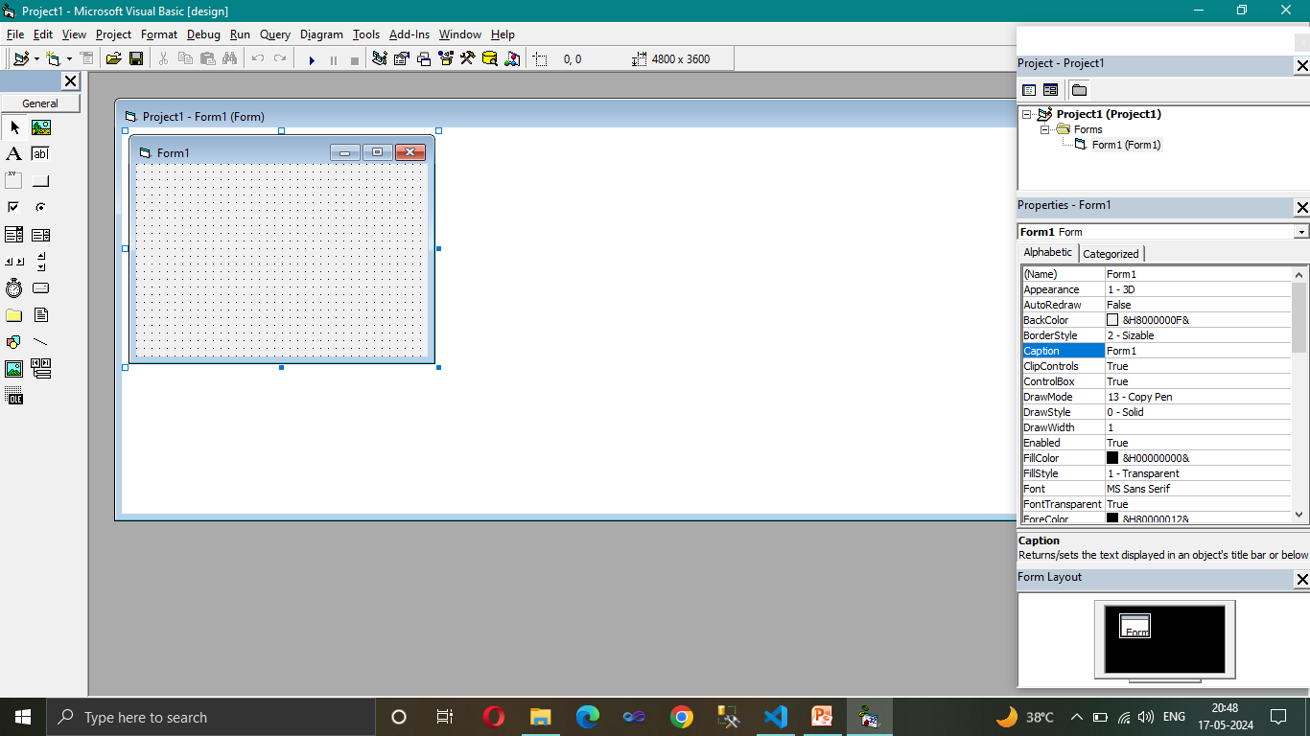
Toolbar
Menu bar
Project Explorer
View code button
View form button
Tool Box
Form designer
Properties window
Form Layout

Slide 27
PEOPLE
STRUCTURE
ENVIRONMENT
TECHNOLOGY
Elements of OB

Slide 28
S.No | Basis of Difference | Autocratic | Custodial | Supportive | Collegial
1. | Basis of Model | Power | Economic sources | Leadership | Partnership
2. | Managerial Orientation | Authority | Money | Support | Teamwork
3. | Employee Orientation | Obedience | Security and benefits | Job Performance | Responsible behavior
4. | Employee Psychological Result | Dependence on boss | Dependence on Organization | Participation | Self-discipline
5. | Employee needs met | Subsistence | Security | Status and recognition | Self-actualization
6. | Performance result | Minimum | Passive cooperation | Awakened drives | Moderate enthusiasm
Models of OB

Slide 29
ID
EGO
SUPER EGO
Psychoanalytical Theory
Social Factor(Family, Religion, Society and more.)
+
Biological Factor(Feeling, thought, Action and more.)
Socio-Psychoanalystical Theory

Slide 30

POVLOV’S DOG
Before Conditioning
Food = Salivation
Unconditioned stimulus = Unconditioned Response
During Conditioning
Food + Bell = Salivation
Unconditioned stimulus = Unconditioned Response
After Conditioning
Bell = Salivation
Conditioned stimulus = Conditioned Response

Slide 31



I Want to Dance

Slide 32
Theories of Motivation
Content (Personal) Theory
Process(Organizational) Theory
Maslow’s hierarchy of need
Adam’s Equity
Alderfer’s ERG Theory
Vroom’s Expectancy
McClelland’s Three need Theory
Goal-setting(Theory X & Y)
Herzberg’s Motivator- hygiene or two factor theory

Slide 33
Level 4
Self Actualisation
Level 3
Self Esteem
Social Need
Level 2
Level 1
Safety Need
Physiological/Basic Need
Level 0
Maslow’s Hierarchy of Needs

Slide 34
Two factor theories
Motivation
More
Less
Satisfaction
Less
Hygiene factor
More
Dissatisfaction
.
Employee dissatisfaction
and unmotivated
Employee not dissatisfied and but unmotivated
Employee satisfied and motivated
Hygiene factor
Motivation factor

Slide 35
Adam’s Equity Theory- Job Motivation
Balance ‘Calibrated ’ and measured against comparable references in the market-place.
Time, effort, ability, Loyalty, hard work.
Pay, bonus, Reputation
OUTPUT
INPUT
INPUT

Slide 36
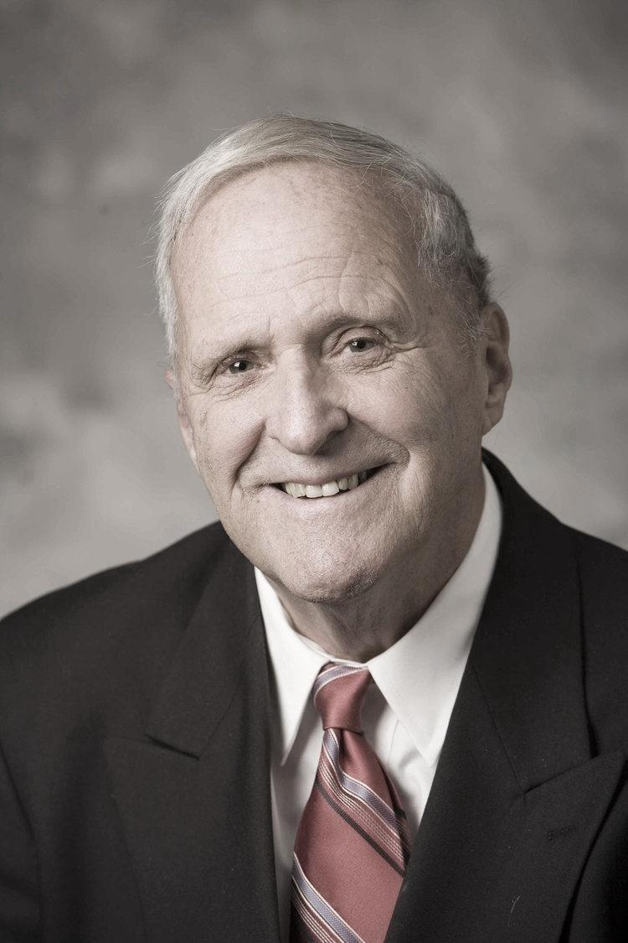
Effort
Expectancy
Performance
Instrumentality
Rewards
Valence
Personal Goals

Slide 37
Tension
Drive
Search Behaviour
Satisfied Need
Unsatisfied Need
Reduction of tension
Process of Motivation

Slide 38
A
B
E
A
C
B
C
D
D
Autocratic Leadership style
Participative Style of Leadership
A
B
C
D
E
Free-rein Style of Leadership

Slide 39
(High)
S3
S2
Low task High Relationship
High task High Relationship
Relationship Behavior
(Supportive)
S4
S1
Low task Low Relationship
High task Low Relationship
(Low)
Task Behavior
(Directive)
(High)

Slide 40
Storming
Storming
Storming
Storming
Forming
During the storming stage, teams discover teamwork is more difficult than they expected.
The forming stage occurs when team members first come together as a team.

Slide 41
Stage 1 | Stage 2 | Stage 3 | Stage 4 | Stage 5
Adjourning
Breaking up the team when the required task is complete.
Performing
Norming
When a team reaches the performing stage it is functioning as a high performance team.
Storming
The Norming stage begins as the team move beyond the storming stage and begins to function as a team.
Forming
During the storming stage, teams discover teamwork is more difficult than they expected.
The forming stage occurs when team members first come together as a team.

Slide 42
Diagnose the problem
Developing Alternatives
Evaluating the Alternatives
Implementation & Monitoring the Decision
Group Decision Making Process

Slide 43
Focus on RESULT
Embrace ACCOUNTABILITY
Achieve
COMMITMENT
Master
CONFLICT
Build TRUST
The Five FUNCTONS

Slide 44
Latent Conflict
Perceived Conflict
Felt Conflict
Manifest Conflict
Conflict Aftermath
Process of Conflict

