Slide 1

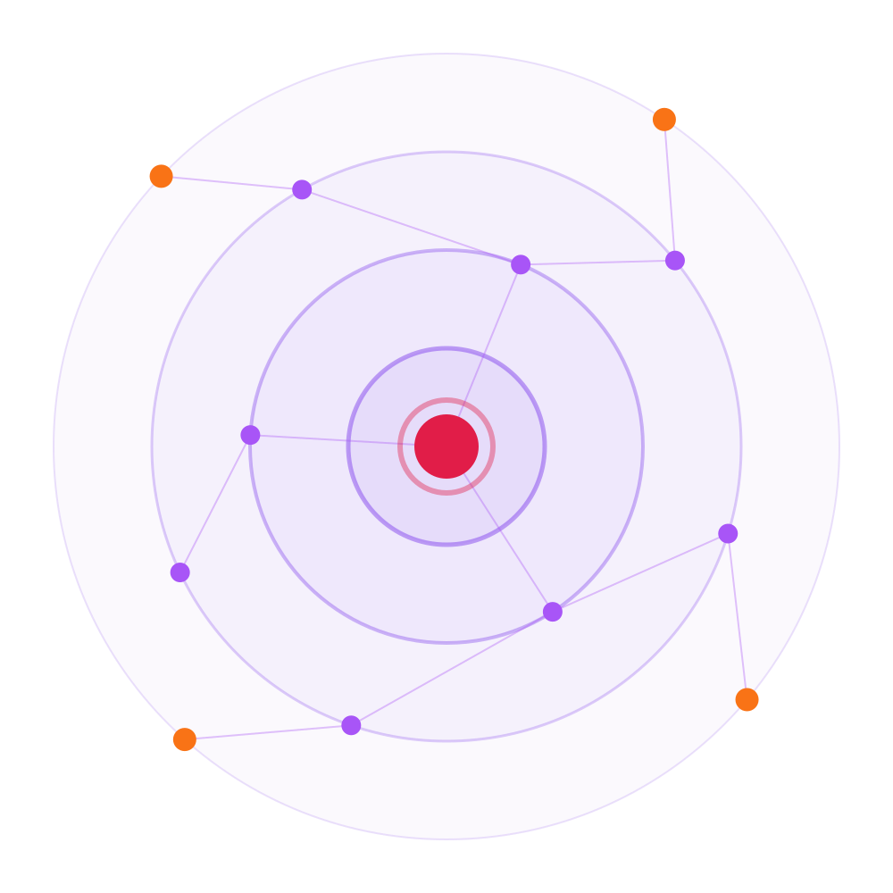
Manipal Hackathon 2026
RippleGuard
See the ripple before it hits production.
Team Name: Spectra
Track: Cybersecurity
Problem Statement: P04 · Open Source Supply Chains: The Ripple Effect
Solution Title: RippleGuard — explainable dependency risk & ripple simulation
Team Members: Rohit Girish Belagali · Thambichetty Shashank · M Harshavardan · Tejasvi M H · Varsha K
9
SDG 9 · Industry, Innovation & Infrastructure

Slide 2



THE DEPENDENCY TREE IS THE ATTACK SURFACE
Problem
454,600
WHY TODAY'S SCANNERS MISS IT
They score packages one at a time.
A CVSS number says how bad a bug is — never how much of your app sits on top of that package.
new malicious open-source packages catalogued in 2025 — up 75% year on year. 99% of them live on npm.
Sonatype · State of the Software Supply Chain 2026
They can't show the path.
$4.91M
267 days
79
Which apps get hit, through which chain, in what order? The graph is never modelled.
average cost of one supply-chain compromise
to identify and contain — the longest of any breach vector
transitive packages pulled in by the average npm install
They hide the reasoning.
IBM 2025
IBM 2025
Zimmermann et al.
An opaque score that blocks a build gets disabled by lunchtime. No reasons, no trust.
Shai-Hulud, Sep 2025: the first self-replicating npm worm spread package to package through the same dependency edges nobody was watching.
TEAM SPECTRA · RIPPLEGUARD · MANIPAL HACKATHON 2026
2 / 6

Slide 3
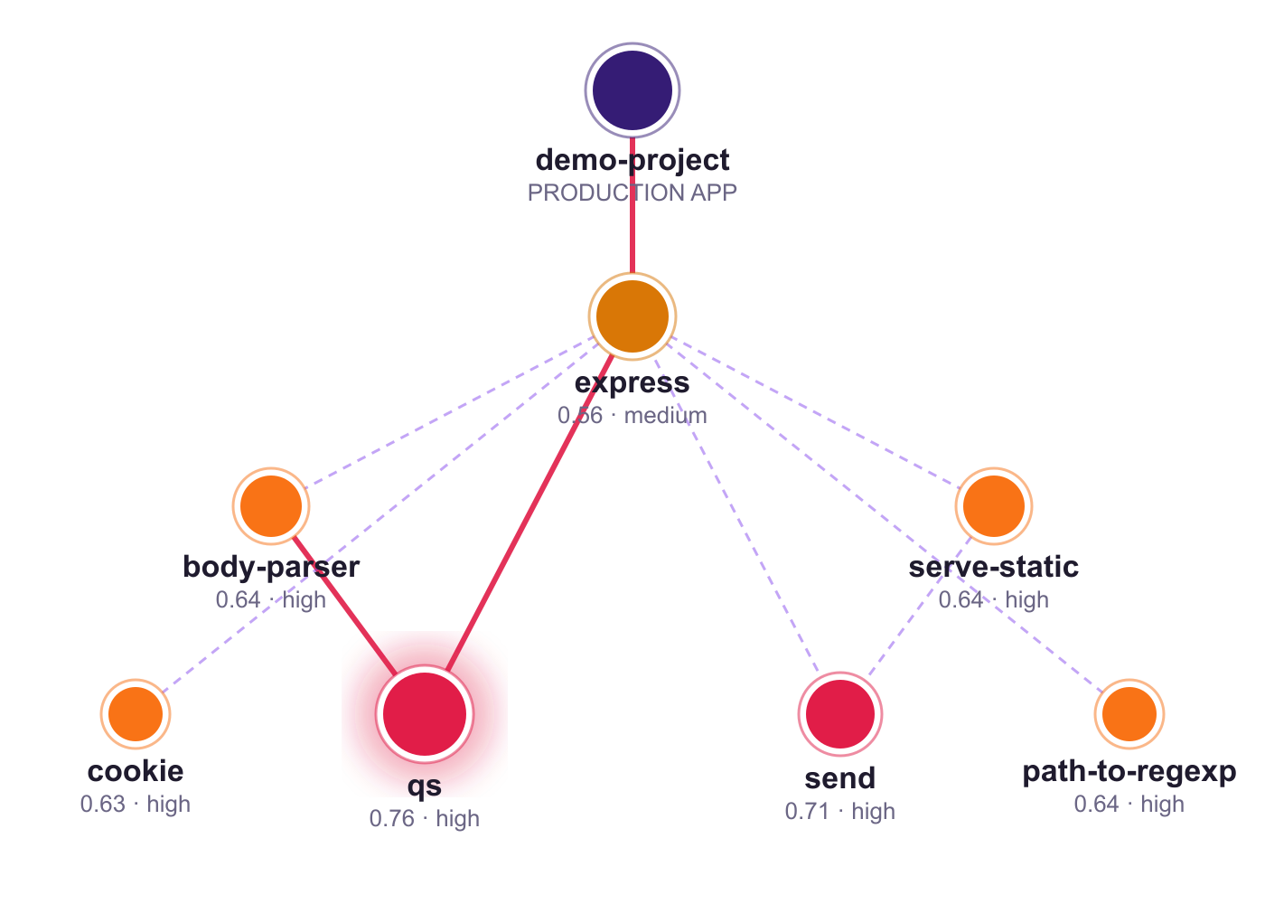




RIPPLEGUARD · MAP, SCORE, SIMULATE, EXPLAIN
Solution
RippleGuard models the ecosystem as a graph, scores every package with reasons, and simulates how a compromise ripples to production.
Map
package-lock.json → full graph with reverse “dependents” edges. Blast radius of any node is one traversal away.
Score
Four explainable factors — exposure, compromise signal, blast radius, evidence confidence — fed by live OSV.dev, EPSS and CVSS 3.1 data.
Simulate
Time-step ripple from any package to the production root. Quarantine a node and get the before/after blast radius instantly.
Explain
Every score ships with plain-English reasons, so developers fix instead of bypass.
fixtures/demo-project · 49 packages · real RippleGuard scores · red = critical path
TEAM SPECTRA · RIPPLEGUARD · MANIPAL HACKATHON 2026
3 / 6

Slide 4
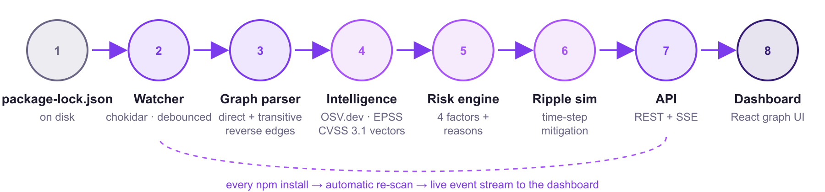
ARCHITECTURE · RISK ENGINE · REAL OUTPUT
Technical Implementation
Exposure
×
Compromise
×
Blast radius
·
Confidence
CVSS × EPSS × reachability
trust + drift × mutability
downstream reach × centrality
penalty on thin evidence
score = 1 − e^(−risk) · stays in 0–1, no hard clamp
WHY THIS SCORE? · qs@6.7.0 · 0.76 HIGH
4 advisories incl. CVE-2026-82417, CVE-2025-15284
3 downstream dependents · transitive · reaches production
Sits at a central topological junction in the graph
Evidence confidence is high (0.95)
TEAM SPECTRA · RIPPLEGUARD · MANIPAL HACKATHON 2026
4 / 6

Slide 5
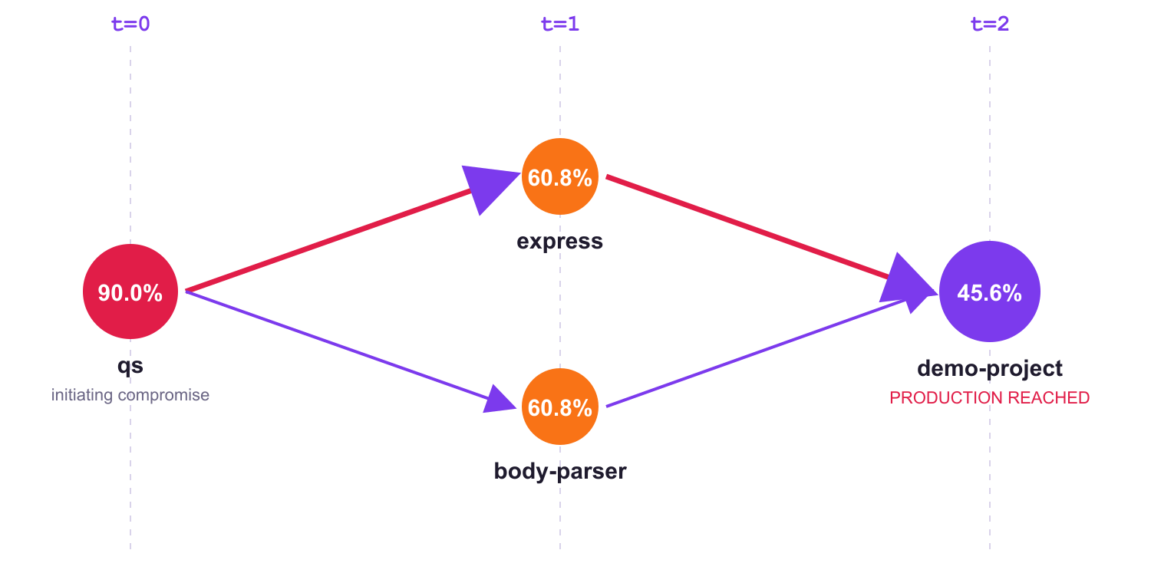
SIMULATION, MITIGATION AND WHAT IS ALREADY BUILT
Feasibility
Built, tested and running end to end — the numbers below are live output from the tool.
−6.3%
−55.1%
Baseline blast radius 60.4% critical path qs → express → demo-project
blocking body-parser: qs still reaches the app via express
blocking express: production app no longer reached
13 / 13
~3.7k
19
0
< 1 s
tests passing
lines of code
REST endpoints + SSE
API keys or paid feeds
scan of 49 packages
TEAM SPECTRA · RIPPLEGUARD · MANIPAL HACKATHON 2026
5 / 6

Slide 6









OPEN-SOURCE CLI TODAY · CI GATE TOMORROW
Business Strategy
Free
CLI + single-project dashboard
SCAN TO SEE IT LIVE
adoption engine · open source core
GitHub repo
Team
per-seat SaaS · scan history · Slack alerts · GitHub Action CI gate
github.com/Rohit-girish-Belagali/Spectra
the wedge into every pipeline
Enterprise
SBOM import · org-wide graph · SSO · on-prem
Live dashboard
where the revenue is
spectra.rohitgb.info
WHO PAYS
Engineering teams shipping JS/TS · DevSecOps & AppSec in mid-to-large enterprises · OSS maintainers protecting their downstream
ROADMAP
Demo video
youtu.be/rq-swil9kwo
Now
+3 mo
+6 mo
+12 mo
npm · live watch · ripple sim
GitHub Action · PyPI · Maven
CycloneDX SBOM · multi-repo
policy engine · on-prem
TEAM SPECTRA · RIPPLEGUARD · MANIPAL HACKATHON 2026
6 / 6

