Slide 1

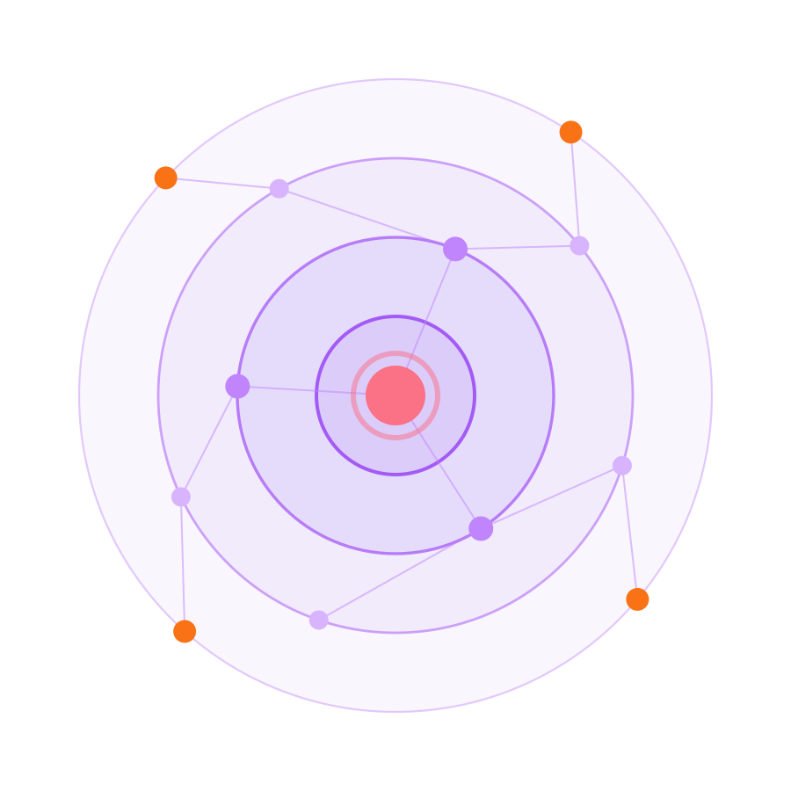

MANIPAL HACKATHON 2026
CYBERSECURITY · PROBLEM STATEMENT P04
RippleGuard
See the ripple before it hits production.
TEAM NAME
Spectra
TRACK
Cybersecurity
PROBLEM STATEMENT
P04 · Open Source Supply Chains: The Ripple Effect
SOLUTION TITLE
RippleGuard — explainable dependency risk & ripple simulation
TEAM MEMBERS
Rohit Girish Belagali · Thambichetty Shashank · M Harshavardan · Tejasvi M H · Varsha K
9
SDG 9 · Industry & Infrastructure

Slide 2
THE PROBLEM
The dependency tree is now the attack surface.
454,600
WHY TODAY'S SCANNERS MISS IT
01
They score packages one at a time.
A CVSS number says how bad a bug is — never how much of your app sits on top of that package.
new malicious open-source packages catalogued in 2025 alone — a 75% jump year on year. 99% of them live on npm.
Sonatype · State of the Software Supply Chain 2026
02
They can't show the path.
Which apps get hit, through which chain, in what order? The graph is never modelled, so the question is never answered.
$4.91M
267 days
79
average cost of one supply-chain compromise
to identify and contain — the longest of any breach vector
transitive packages pulled in by the average npm install
03
They hide the reasoning.
IBM 2025
IBM 2025
Zimmermann et al.
An opaque score that blocks a build gets disabled by lunchtime. No reasons, no trust, no adoption.
Shai-Hulud, Sep 2025: the first self-replicating npm worm — it spread package to package through the same dependency edges nobody was watching.
SPECTRA · 02 / 07

Slide 3
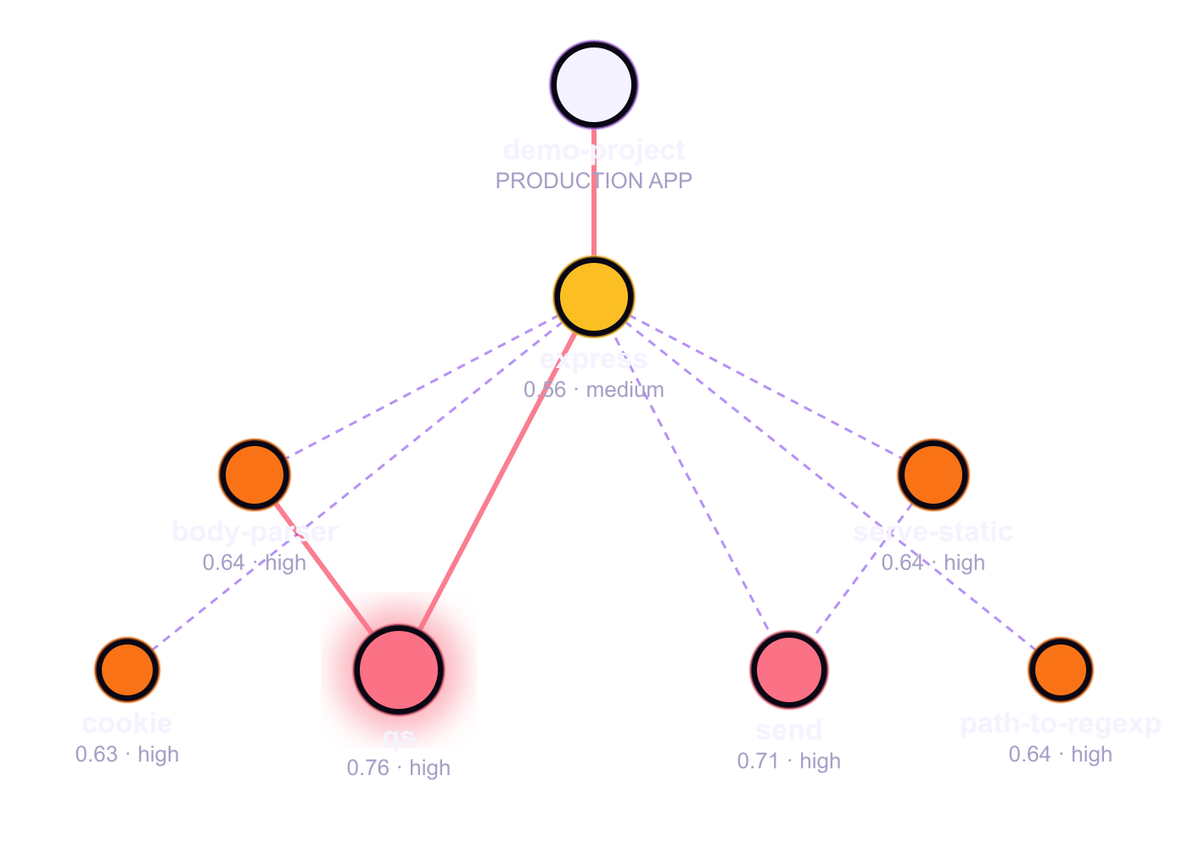
OUR SOLUTION
Model the graph. Then ask “what if?”
01
Map
package-lock.json → full graph with reverse “dependents” edges. Blast radius of any node is one traversal away.
02
Score
Four explainable factors — exposure, compromise signal, blast radius, evidence confidence — fed by live OSV.dev, EPSS and CVSS 3.1 data.
03
Simulate
Time-step ripple from any package to the production root. Quarantine a node and get the before/after blast radius instantly.
04
Explain
Every score ships with plain-English reasons. Developers see why, so they fix instead of bypass.
fixtures/demo-project · 49 packages · real RippleGuard scores · red edges = critical path
SPECTRA · 03 / 07

Slide 4
RISK ENGINE
Every score is a sentence, not just a number.
Exposure
×
Compromise
×
Blast radius
·
Confidence
CVSS × EPSS ×
reachability
trust + drift ×
version mutability
downstream reach ×
centrality
uncertainty penalty
on thin evidence
CONTEXTUAL RISK · demo-project · 7 PKGS · 14 CVEs
WHY THIS SCORE? · qs@6.7.0 · 0.76 HIGH
4 advisories incl. CVE-2026-82417, CVE-2025-15284
Known vulnerability exposure is moderate
Package has 3 downstream dependents in this project
Dependency is transitive
It reaches a production application
Sits at a central topological junction in the dependency graph
Evidence confidence is high (0.95)
verbatim output of node src/index.js --once
SPECTRA · 04 / 07

Slide 5
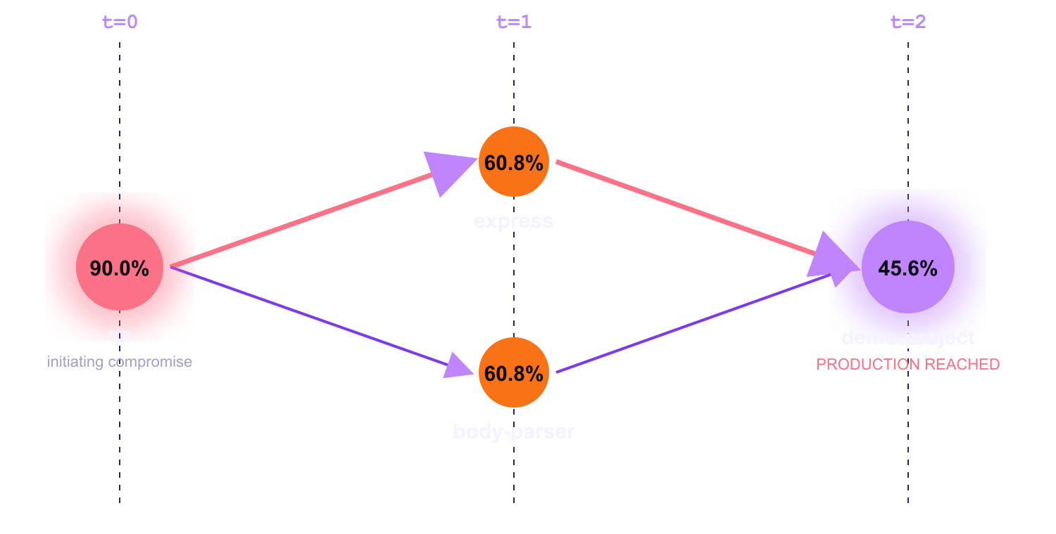
RIPPLE SIMULATION
Simulate the blast. Cut the edge that matters.
BLAST RADIUS AFTER QUARANTINE
Baseline blast radius 60.4% critical path qs → express → demo-project
−6.3%
−55.1%
Two packages, identical CVSS-class findings, one decision: which do you quarantine? RippleGuard ranks mitigations by how much blast radius they remove — not by severity alone.
blocking body-parser —
qs still reaches the app via express
blocking express —
production app no longer reached
SPECTRA · 05 / 07

Slide 6
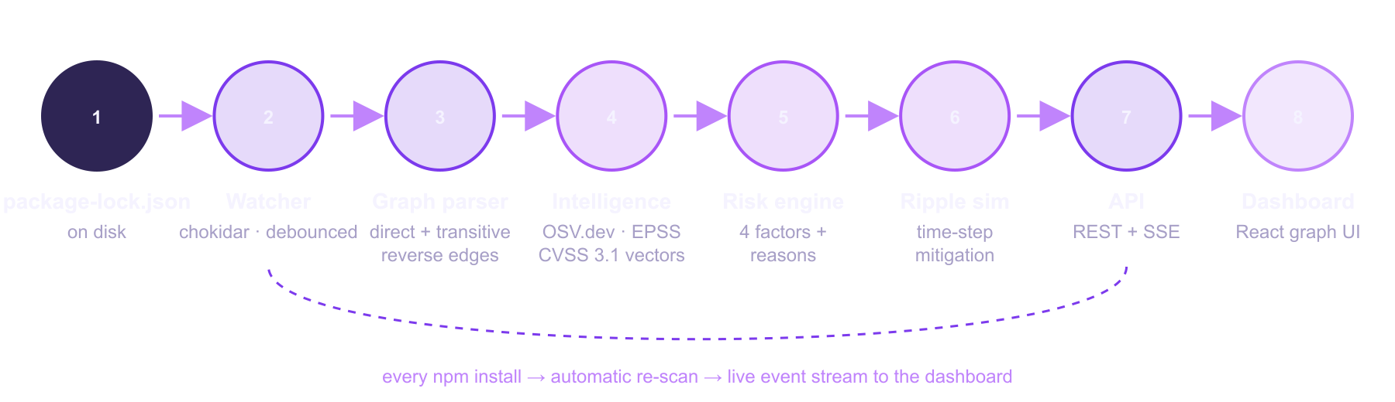
TECHNICAL IMPLEMENTATION & FEASIBILITY
Built, tested, and running end to end.
13 / 13
~3.7k
19
0
< 1 s
tests passing
(engine · simulation · API)
lines of code
Node.js + React
REST endpoints
+ SSE event stream
API keys or paid feeds —
OSV.dev & FIRST EPSS are free
graph + score on
49 packages, lookups cached
One shared scanProject() powers the CLI, the API and the watcher — no divergent scoring logic. Hosted mode accepts an uploaded package-lock.json, so it works where the server has no disk access.
SPECTRA · 06 / 07

Slide 7






BUSINESS STRATEGY · TRY IT NOW
Open-source CLI today. CI gate tomorrow.
Free
CLI + single-project dashboard
SCAN TO SEE IT LIVE
adoption engine · open source core
GitHub repo
Team
per-seat SaaS · scan history · Slack alerts · GitHub Action CI gate
github.com/Rohit-girish-Belagali/Spectra
the wedge into every pipeline
Enterprise
SBOM import · org-wide graph · SSO · on-prem
Live dashboard
where the revenue is
spectra-rippleguard.vercel.app
WHO PAYS
Engineering teams shipping JS/TS · DevSecOps & AppSec in mid-to-large enterprises · OSS maintainers protecting their downstream
ROADMAP
Demo video
youtu.be/REPLACE_ME
Now
+3 mo
+6 mo
+12 mo
npm · live watch · ripple sim
GitHub Action · PyPI · Maven
CycloneDX SBOM · multi-repo
policy engine · on-prem
SPECTRA · 07 / 07

