Slide 1
Lead Scoring Case Study
X Education Use-case
Rohit Yadav, Poorna Dasari & Ashish Sharma

Slide 2
Problem Statement
X Education, an online education company, required assistance in increasing the typical lean conversion rate which currently is only around 30%
In a effort to improve lead conversion rate, X Education seeks a solution to identify and prioritize the leads that are most likely to convert into a paying customer.
Case Study Goals
Develop a logistic regression model to assign lead score from 0 to 100, enabling efficient targeting of potential leads.
A higher score would mean that the lead is hot, i.e. is most likely to convert whereas a lower score would mean that the lead is cold and will mostly not get converted.
Cater model flexibility to address further changes.

Slide 3
Model Building Steps:
Import all required libraries.
Reading the dataset into Data-Frame
Data Cleaning (Null and Outlier handling)
Exploratory Data Analysis
Data Preparation
Train-Test split
Scaling of features
Model Building Using Stats model and RFE.
Model Evaluation for Train set
• Obtaining predicted value on y_train set
• Creating a dataframe with the actual converted flag and predicted probabilities
• Creating a threshold value for the new column "predicted"
• Creating Confusion matrix
A.Accuracy
B.Sensitivity
C.Specificity
D.False positive rate
E.Positive predictive value
F.Negative predictive value
G.Precision
H.Recall
• Plotting the RoC curve
• Determining optimal cut-off point or probability
• Model evaluation after obtaining optimal cut-off point or probability method
• Model Evaluation using Precision-Recall Trade off method
• Comparing the metrics values from Optimal cut-off point method and Precision-Recall Trade off method
Model Evaluation for Test set
• Prediction on Test Dataset
• Test model Evaluation
• Comparision of train set and Test set values
• Adding Lead_Score to test data
Results
Metrics Value
• Hot leads
• Prospect ID of the customers
• Features of the model

Slide 4
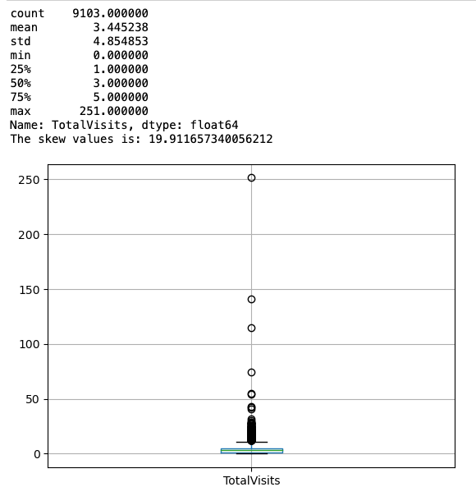
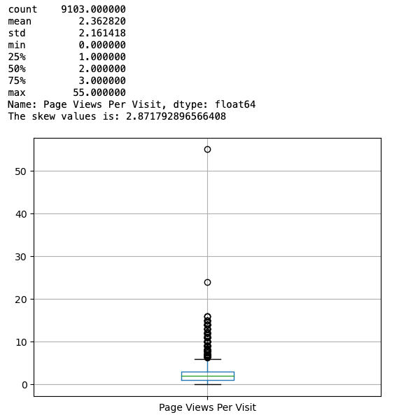
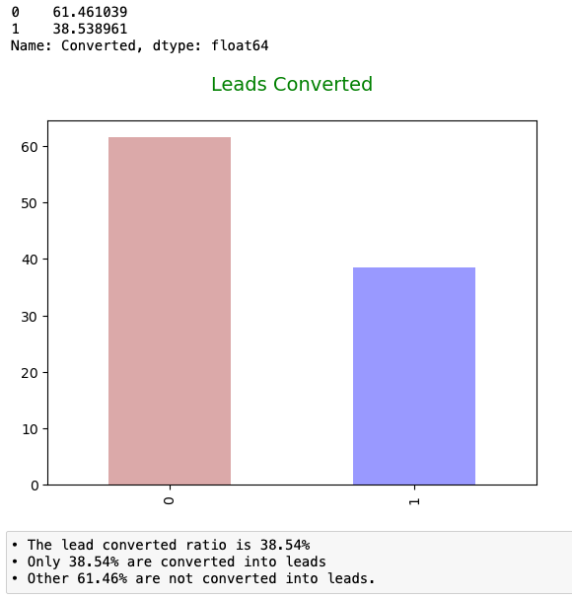
Exploratory Data Analysis
Handling missing values- The process consists of:
Segregation of numerical and categorical column.
Imputation on numerical and categorical column.
Segregation of numerical and categorical columns
The columns which has null values are as follows:
Numerical columns - Page Views Per Visit, TotalVisits
Categorical columns - City, Specialization, Tags, What matters most to you in choosing a course, What is your current occupation,Country, Last Activity, Lead Source
Observations:
Both “TotalVisits”[Figure#1] and “Page Views per Visit” [Figure#2] contains outliers, as evident from box plot; which can be imputed by mean/median.
Categorical column like city, Specialization, Tag etc , can be imputed with mode value.
Current leads Converted ratio [Figure#3].
Figure:1
Figure:2
Figure:3

Slide 5
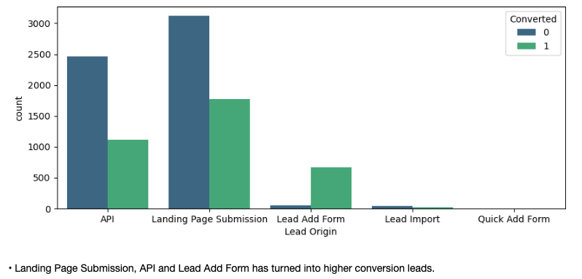
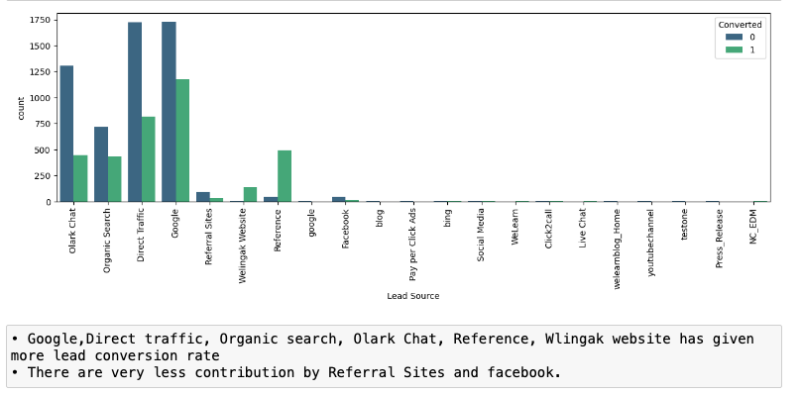
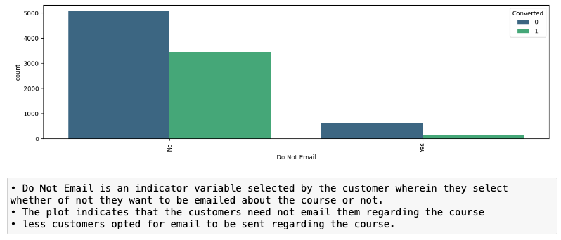
Categorical Columns - Visualization

Slide 6
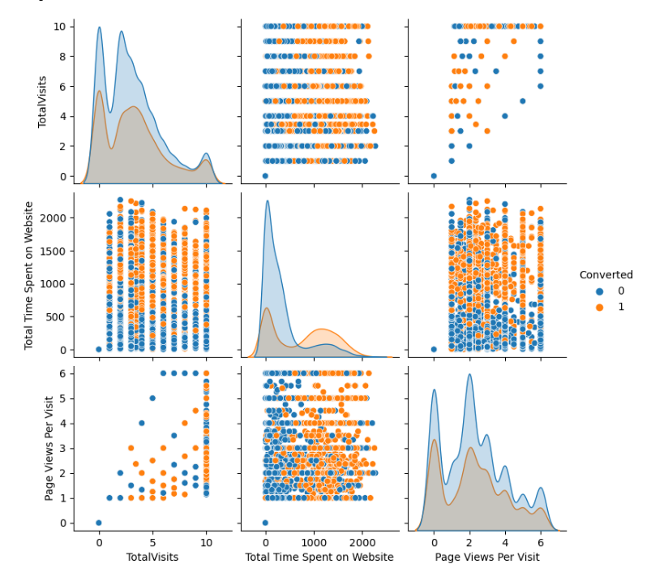
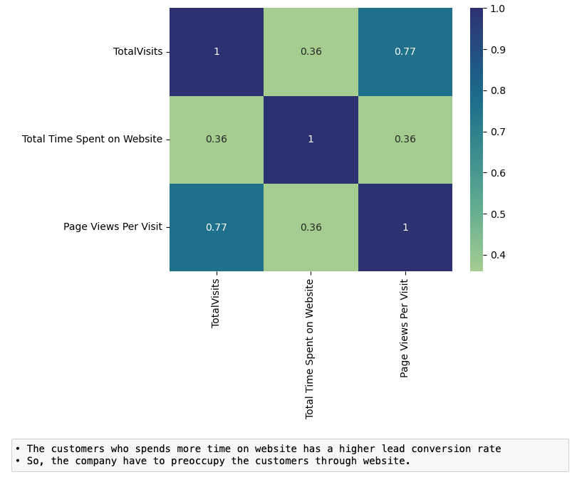
Bivariate Analysis for Numerical Variables - Visualization

Slide 7
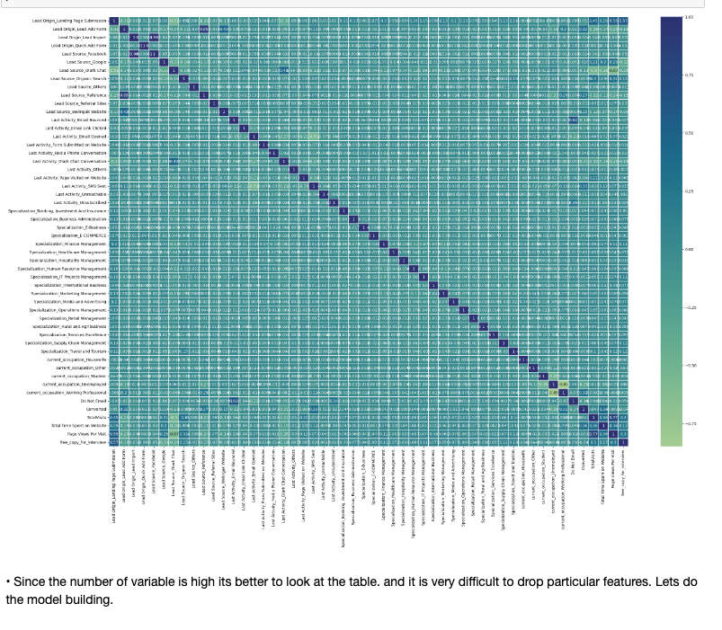
Correlations - Visualization

Slide 8
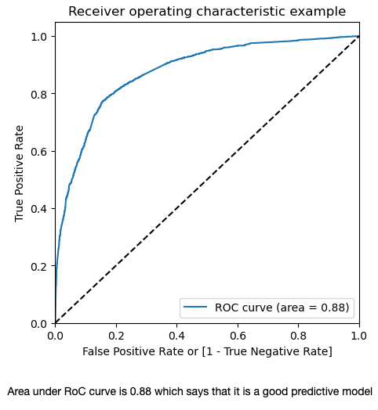
Model Building & Evaluation
Listing out key features using RFE ranking:
'Lead Origin_Lead Add Form', 'Lead Source_Olark Chat',
'Lead Source_Welingak Website', 'Last Activity_Email Opened',
'Last Activity_Had a Phone Conversation', 'Last Activity_Others',
'Last Activity_SMS Sent', 'Last Activity_Unreachable',
'Specialization_Banking, Investment And Insurance',
'Specialization_Finance Management',
'Specialization_IT Projects Management',
'Specialization_Rural and Agribusiness', 'current_occupation_Housewife',
'current_occupation_Working Professional',
'Total Time Spent on Website’
Features Dropped:
‘Lead Origin_Landing Page Submission', 'Lead Origin_Lead Import',
'Lead Origin_Quick Add Form', 'Lead Source_Facebook',
'Lead Source_Google', 'Lead Source_Organic Search',
'Lead Source_Others', 'Lead Source_Reference',
'Lead Source_Referral Sites', 'Last Activity_Email Bounced',
'Last Activity_Email Link Clicked',
'Last Activity_Form Submitted on Website',
'Last Activity_Olark Chat Conversation',
'Last Activity_Page Visited on Website', 'Last Activity_Unsubscribed',
'Specialization_Business Administration', 'Specialization_E-Business',
'Specialization_E-COMMERCE', 'Specialization_Healthcare Management',
'Specialization_Hospitality Management',
'Specialization_Human Resource Management',
'Specialization_International Business',
'Specialization_Marketing Management',
'Specialization_Media and Advertising',
'Specialization_Operations Management',
'Specialization_Retail Management',
'Specialization_Services Excellence',
'Specialization_Supply Chain Management',
'Specialization_Travel and Tourism', 'current_occupation_Other',
'current_occupation_Student', 'current_occupation_Unemployed',
'Do Not Email', 'TotalVisits', 'Page Views Per Visit',
'free_copy_for_interview'
Plotting the ROC Curve:
The ROC Curve value, which stands at 0.88, is close to 1 and the curve approaching the top left corner of the graph indicating a strong predictive model performance.
Sensitivity: 0.6508515815085159
Specificity: 0.8958020989505248
False positive Rate: 0.10419790104947527
Positive Predictive Value: 0.7937685459940653
Negative Predctive Value: 0.8063427800269906
Precision 0.7937685459940653
Recall 0.6508515815085159

Slide 9
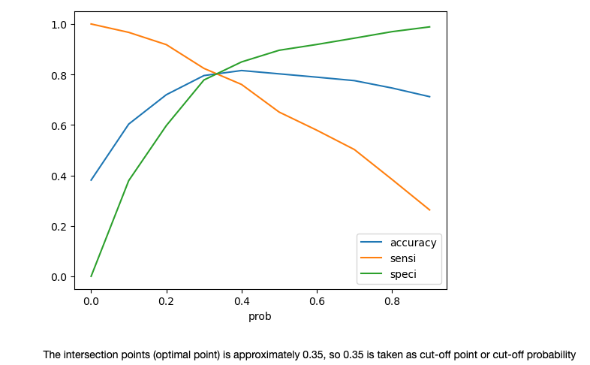
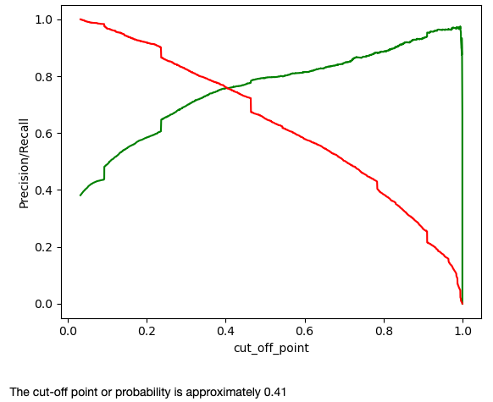
Optimal Cut-off and Model Accuracy
In the plot having accuracy, sensitivity, and specificity plotted for various probabilities, we could see they consider approximately at probability of 0.35, which shall be out optimal cut-off to proceed.
On applying the optimal cut-off; result metrics for train dataset looks like:
Sensitivity: 0.6508515815085159
Specificity: 0.8958020989505248
False positive Rate: 0.10419790104947527
Positive Predictive Value: 0.7937685459940653
Negative Predctive Value: 0.8063427800269906
Precision 0.7937685459940653
Recall 0.6508515815085159
Model evaluation using Precision-Recall Trade off Method.
Comparing the metrics values from Optimal cut-off point method and Precision-Recall Trade off method¶
Metrics based on optimal cut-off point method (0.35):
Accuracy : 80.94
Sensitivity: 79.24
Specificity: 81.98
Precision : 73.05
Recall : 79.24
Metrics based on precision-recall curve (0.41):
Accuracy : 81.49
Sensitivity: 75.39
Specificity: 85.26
Precision : 75.91
Recall : 75.39

Slide 10
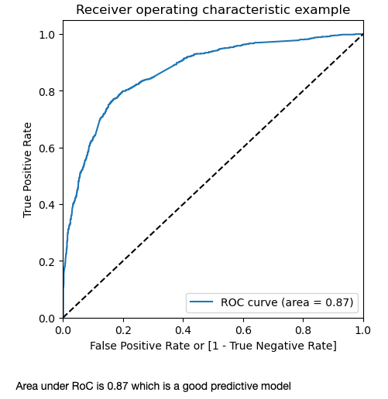
Model Performance
Columns that obtained in the final model:
cols=['Lead Origin_Lead Add Form', 'Lead Source_Olark Chat', 'Lead Source_Welingak Website', 'Last Activity_Email Opened', 'Last Activity_Had a Phone Conversation', 'Last Activity_Others’, 'Last Activity_SMS Sent', 'Last Activity_Unreachable', 'Specialization_Finance Management', 'Specialization_Rural and Agribusiness’, 'current_occupation_Working Professional’,'Total Time Spent on Website’]
Metrics for Train set and test set are:
Metrics Train Set Test Set
Accuracy : 80.94 80.16
Sensitivity : 79.24 78.02
Specificity : 81.98 81.51
Total of 357 customers have Lead score of more than 85% and can be termed as Hot Leads.
Feature of the model listed in Figure#.
Features of the model
Out[179]:
Lead Origin_Lead Add Form 3.583953
Last Activity_Had a Phone Conversation 3.186922
current_occupation_Working Professional 2.838692
Last Activity_SMS Sent 2.139051
Lead Source_Welingak Website 2.008014
Last Activity_Others 1.999648
Lead Source_Olark Chat 1.123125
Last Activity_Unreachable 1.120002
Last Activity_Email Opened 1.110415
Total Time Spent on Website 1.096518
Specialization_Rural and Agribusiness 0.780593
Specialization_Finance Management 0.301746
const -2.437811

Slide 11
Conclusion
• Model accuracy on Train & test Dataset: 80.94 & 80.16 respectively.
High lead conversation rates are possible for "Lead Origin_Lead Add Form".
• The company should focus on the customers who had a last activity of phone conversation
• Working professional has a higher rate of lead conversation rate
• The company should concentrate on sending SMS to customers in order to convert them into leads
• Lead source like "Welingak Website" and "Olark Chat" to be focused
• The company should send email for converting into leads
• The customers who spent time on website have a higher lead conversion rate. The company should know how to convert the customers into leads when they enter into website
• The customers whose specializations are "Rural and Agri business" and "Financial management" are likely to be converted into leads.

