Slide 1




Normalization, Agile Scrum and Views and Store Procedure
By :- Rohit Sabat
Umaid SHAIKH
Amisha Yadav

Slide 2

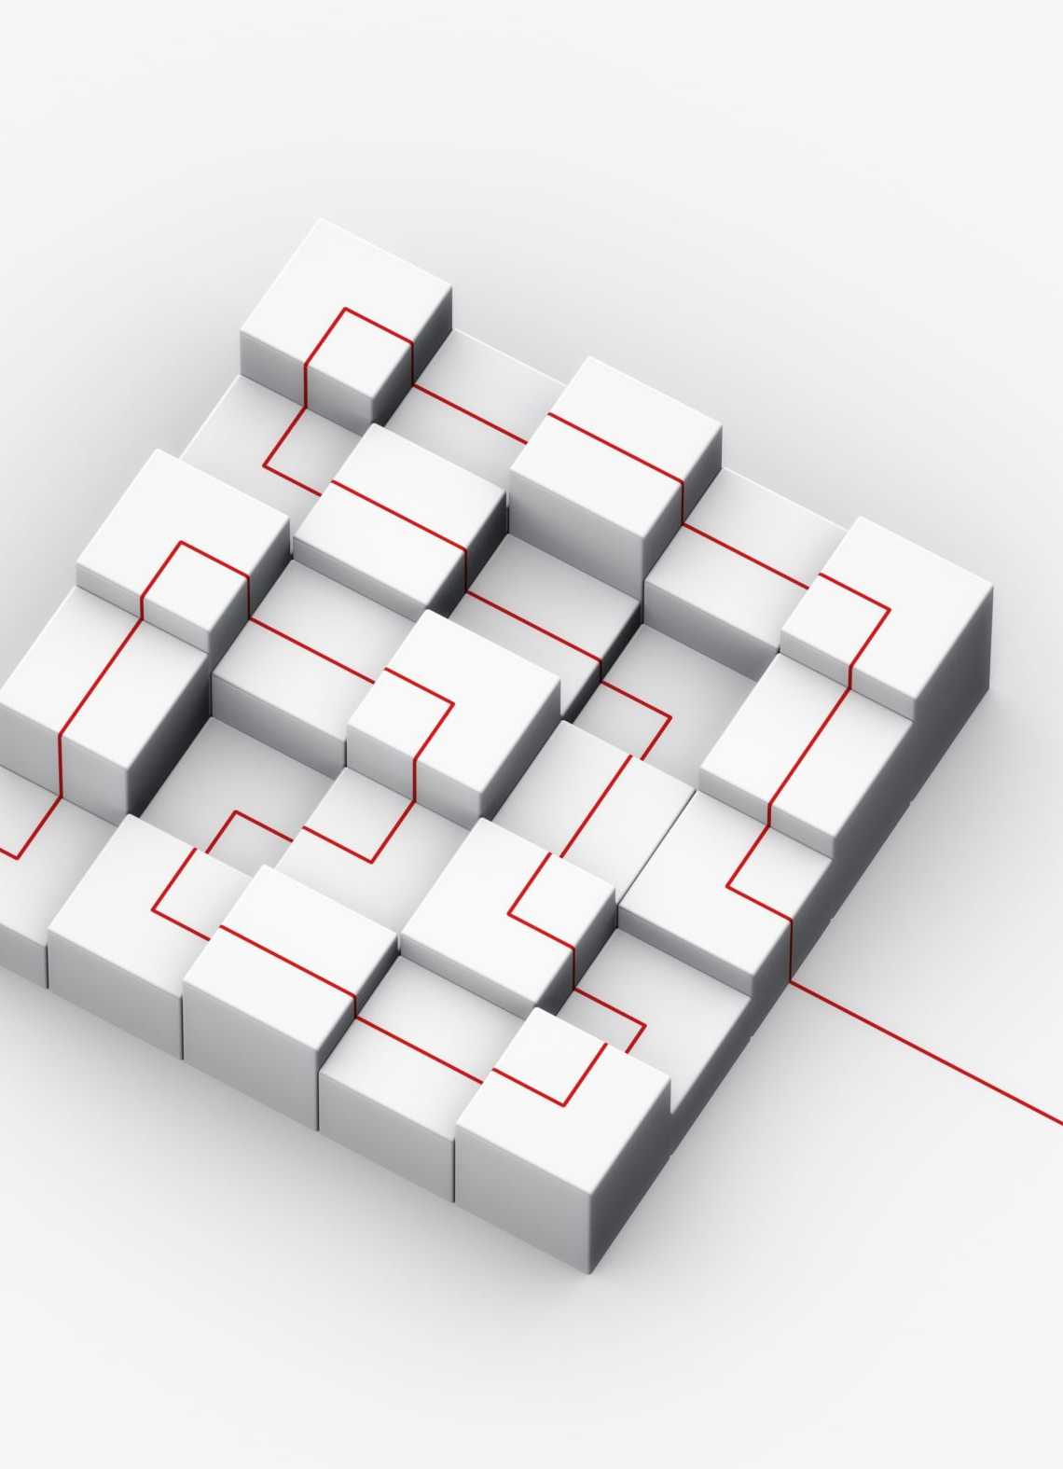
Definition
This is the process which allows you to winnow out redundant data within your database.
This involves restructuring the tables to successively meeting higher forms of Normalization.
A properly normalized database should have the following characteristics
Scalar values in each fields
Absence of redundancy.
Minimal use of null values.
Minimal loss of information.
Notes:
22
10/8/2023

Slide 3
Levels of normalization based on the amount of redundancy in the database.
Various levels of normalization are:
First Normal Form (1NF)
Second Normal Form (2NF)
Third Normal Form (3NF)
Boyce-Codd Normal Form (BCNF)
Fourth Normal Form (4NF)
Fifth Normal Form (5NF)
Domain Key Normal Form (DKNF)
Redundancy
Number of Tables
Complexity
Most databases should be 3NF or BCNF in order to avoid the database anomalies.
Levels of Normalization
Notes:
23
10/8/2023

Slide 4
Levels of Normalization
1NF
2NF
3NF
4NF
Each higher level is a subset of the lower level
5NF
DKNF
Notes:
24
10/8/2023

Slide 5

First Normal Form (1NF)
A relation is in first normal form if, and only if all domains contain Atomic values only.
A table is considered to be in 1NF if all the fields contain only scalar values.
Notes:
25
10/8/2023
Having scalar values also means that all instances of a record type must contain the same number of fields.
A table not in first normal form is called un normalized

Slide 6

Second Normal Form (2NF)
For a table to be in 2NF, there are two requirements
The database is in first normal form
All non-key attributes in the table must be functionally dependent on the entire primary key.
Note: non-key attributes - These are all the other attributes in the table that are not part of the primary key.
Notes:
26
10/8/2023

Slide 7
Third Normal Form (3NF)
.
For a table to be in 3NF, there are two requirements:
The table should be second normal form.
all non key-attributes are non-transitively dependent on the primary key.
Note: A transitive dependency is a situation where two functional dependencies are related in the sense that A B and B C In other words; C is transitively dependent on A.
This form stipulates that there can be no interdependencies among non-key characteristics, and all non-key attributes of a table must be functionally dependent on a candidate key.
Notes:
27
10/8/2023
In the Book Schema Third Normal Form is violated since a non-key field is dependent on another non-key field and is transitively dependent on the primary key.

Slide 8

Fourth Normal Form (4NF)
Fourth normal form eliminates independent many-to-one relationships between columns.
To be in Fourth Normal Form,
a relation must first be in Boyce-Codd Normal Form.
a given relation may not contain more than one multi-valued attribute.
Notes:
29
10/8/2023

Slide 9
Boyce-Codd Normal Form (BCNF)
BCNF does not allow dependencies between attributes that belong to candidate keys.
BCNF is a refinement of the third normal form in which it drops the restriction of a non-key attribute from the 3rd normal form.
Third normal form and BCNF are not same if the following conditions are true:
The table has two or more candidate keys
At least two of the candidate keys are composed of more than one attribute
The keys are not disjoint i.e. The composite candidate keys share same attributes
Boyce-Codd Normal form: A relation is in BCNF if all determinants are candidate keys. Usually, a relation that is in 3NF is in BCNF too.
Notes:
28
10/8/2023
The second and third normal forms assume that all attributes not part of the candidate keys depend on the candidate keys but does not deal with dependencies within the keys. BCNF deals with such dependencies.
Under third normal form all non-key columns must be functionally dependent on a candidate key. Under BCNF, even columns that are part of a candidate key must be dependent on another candidate key, if they have a dependency at all.
For most tables third normal form and BCNF are the same. Third normal form does not cover some specific cases for which BCNF was created. Third normal form and BCNF are not same if the following conditions are true:
The table has two or more candidate keys
At least two of the candidate keys are composed of more than one attribute
The keys are not disjoint i.e. The composite candidate keys share some attributes

Slide 10

Views:-
A view is a virtual table that is based on the result of an SQL query. It does not store any data itself; instead, it provides a way to present data from one or more tables in a structured and easily accessible manner.

Slide 11
Purpose:-
Data Abstraction: Views allow you to abstract complex underlying data structures and present a simplified and tailored view to users. This simplifies data access and manipulation.
Security: Views can be used to control access to sensitive data by restricting the columns or rows that users can see.
Simplifying Queries: Views can encapsulate complex queries or joins, making it easier to retrieve data without writing the same query multiple times.
Data Integrity: Views can enforce business rules or data validation by allowing or disallowing certain data modifications through the view.

Slide 12

Stores Procedures:-
A stored procedure is a precompiled set of SQL statements that are stored in the database and can be executed as a single unit. Stored procedures are typically used to encapsulate business logic and data operations.

Slide 13
Purpose:-
Modularity: Stored procedures allow you to encapsulate frequently used SQL statements or business logic into reusable modules.
Performance: Stored procedures are precompiled and stored in the database, which can lead to improved performance compared to executing individual SQL statements.
Security: By controlling access to stored procedures, you can enhance security by limiting direct access to database tables.
Transaction Management: Stored procedures can participate in database transactions, ensuring data integrity.

Slide 14
Agenda
Introduction
What is Scrum
What is Scrum Framework
Scrum Roles
Scrum Artifacts
Scrum Events
Scrum Matrics
Tools
Conclusion

Slide 15
Introduction
Agile Scrum is a dynamic and adaptable project management framework that has revolutionized the way teams develop products and deliver value to customers.
It originated in the world of software development but has found widespread adoption in various industries due to its effectiveness in managing complex projects.

Slide 16
Principles of Agile Scrum
Iterative and Incremental: Agile Scrum promotes iterative and incremental development. Instead of trying to deliver everything at once, it divides the project into small, manageable pieces called "Sprints."
1
Customer-Centric: The framework places a strong emphasis on customer satisfaction. The customer or product owner plays a central role in setting priorities and ensuring that the team delivers features that provide real value.
2
Transparency: Agile Scrum values transparency at all levels. The progress, issues, and impediments are made visible through artifacts and ceremonies, fostering trust and collaboration.
3
Empowered Teams: Agile Scrum empowers self-organizing teams. Team members have the autonomy to decide how to accomplish their work, leading to greater creativity and ownership.
4
Continuous Improvement: The framework encourages continuous improvement through regular retrospectives, where teams reflect on their work and make adjustments to enhance efficiency and quality.
5

Slide 17
What is Scrum ?
Scrum is an Agile project management framework used for developing products, especially software.
It emphasizes iterative and incremental progress, frequent inspection, and adaptation to deliver high-value products to customers.

Slide 18
What is Scrum Framework ?
The Scrum framework provides a structured approach to Agile project management. It consists of defined roles, artifacts, events, and rules that guide teams in delivering valuable increments of a product.
Key Components:
Scrum Roles: The Product Owner, Scrum Master, and Developers (Development Team) play distinct roles in Scrum, each with specific responsibilities.
Scrum Artifacts: Scrum uses specific artifacts to ensure transparency and clarity. These include the Product Backlog, Sprint Backlog, and Increment.
Scrum Events: Scrum events are time-boxed meetings and ceremonies that facilitate planning, inspection, adaptation, and collaboration.

Slide 19

Scrum Roles
Product Owner: Represents the customer or stakeholders, prioritizes the Product Backlog, and ensures the team delivers value.
Scrum Master: Facilitates the Scrum process, removes impediments, and helps the team improve.
Developers (Development Team): Cross-functional members who do the actual work to deliver the Increment

Slide 20
Scrum Artifacts
Product Backlog: An ordered list of all desired product features, enhancements, bug fixes, and other work items.
Sprint Backlog: A subset of the Product Backlog items selected for a specific Sprint, detailing how they will be implemented.
Increment: The potentially shippable product increment created during the Sprint.

Slide 21
Scrum Events
Sprint: A time-boxed period (usually 2-4 weeks) during which the Development Team creates a potentially shippable product increment.
Sprint Planning: A meeting at the beginning of a Sprint where the team plans what they will deliver in the Sprint.
Daily Scrum: A daily, time-boxed meeting where the team synchronizes their work and identifies impediments.
Sprint Review: A meeting at the end of the Sprint to inspect and adapt the Increment, gather feedback, and plan the next steps.
Sprint Retrospective: A meeting after the Sprint Review where the team reflects on their process and identifies improvements.

Slide 22
Scrum Metrics
Planning Poker: A collaborative estimation technique used to estimate the effort required for Product Backlog items.
Burndown Chart: A visual representation showing the amount of work remaining in a Sprint, helping track progress.
Velocity: A measure of the team's capacity to deliver work in a Sprint based on historical data.

Slide 23
Tools(Jira)
Jira is a widely used project management tool that supports Agile and Scrum methodologies.
It helps teams manage their backlog, plan Sprints, track progress, and collaborate effectively.
It is designed to facilitate Agile project management and software development processes, making it a valuable tool for Scrum teams and other Agile methodologies.

Slide 24
Why Jira for Agile Scrum ?
Visibility: Jira enhances transparency by providing a clear view of project progress, allowing stakeholders to stay informed and make data-driven decisions.
Flexibility: Teams can customize Jira to align with their specific Agile practices and adapt as their processes evolve.
Collaboration: Jira facilitates collaboration among team members, enabling effective communication and coordination, particularly for remote or distributed teams.
Scalability: Jira is suitable for small teams as well as large organizations with complex projects, making it a versatile tool for Agile Scrum implementations.

Slide 25
Conclusion
Agile Scrum promotes collaboration, adaptability, and customer value.
It offers a structured approach to project management for iterative and incremental development.
Successful implementation of Scrum requires understanding and commitment from all team members.

Slide 26
Thank you!

